Slide 1
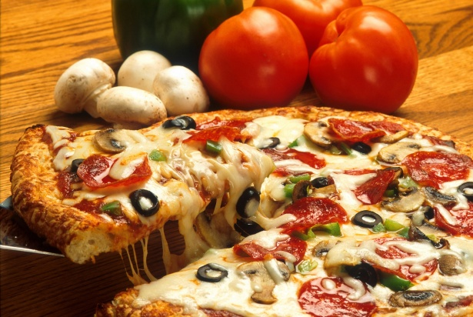
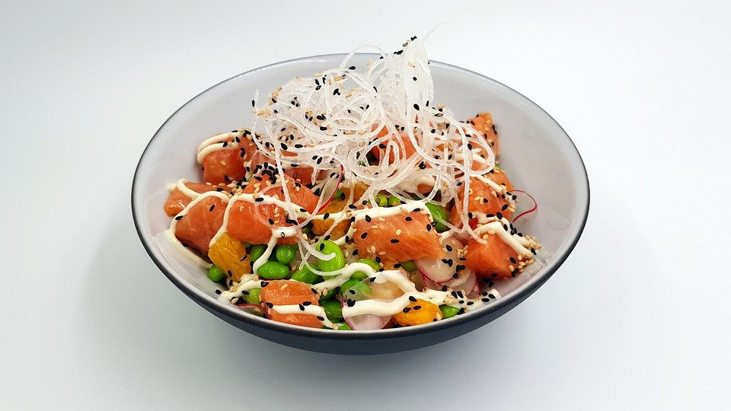
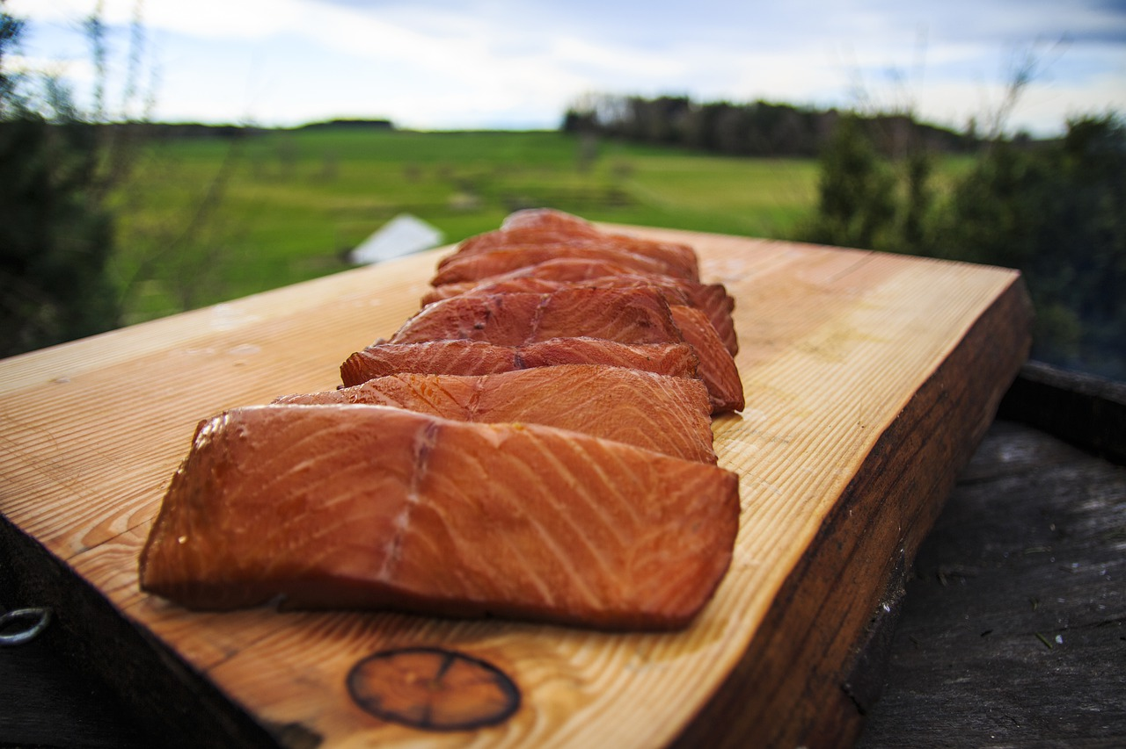
Pre-Arrival English
The Best Restaurants
& Popular Cuisine
Copyright © 2020 International House Pacific Group
Do not share or copy without permission

Slide 2
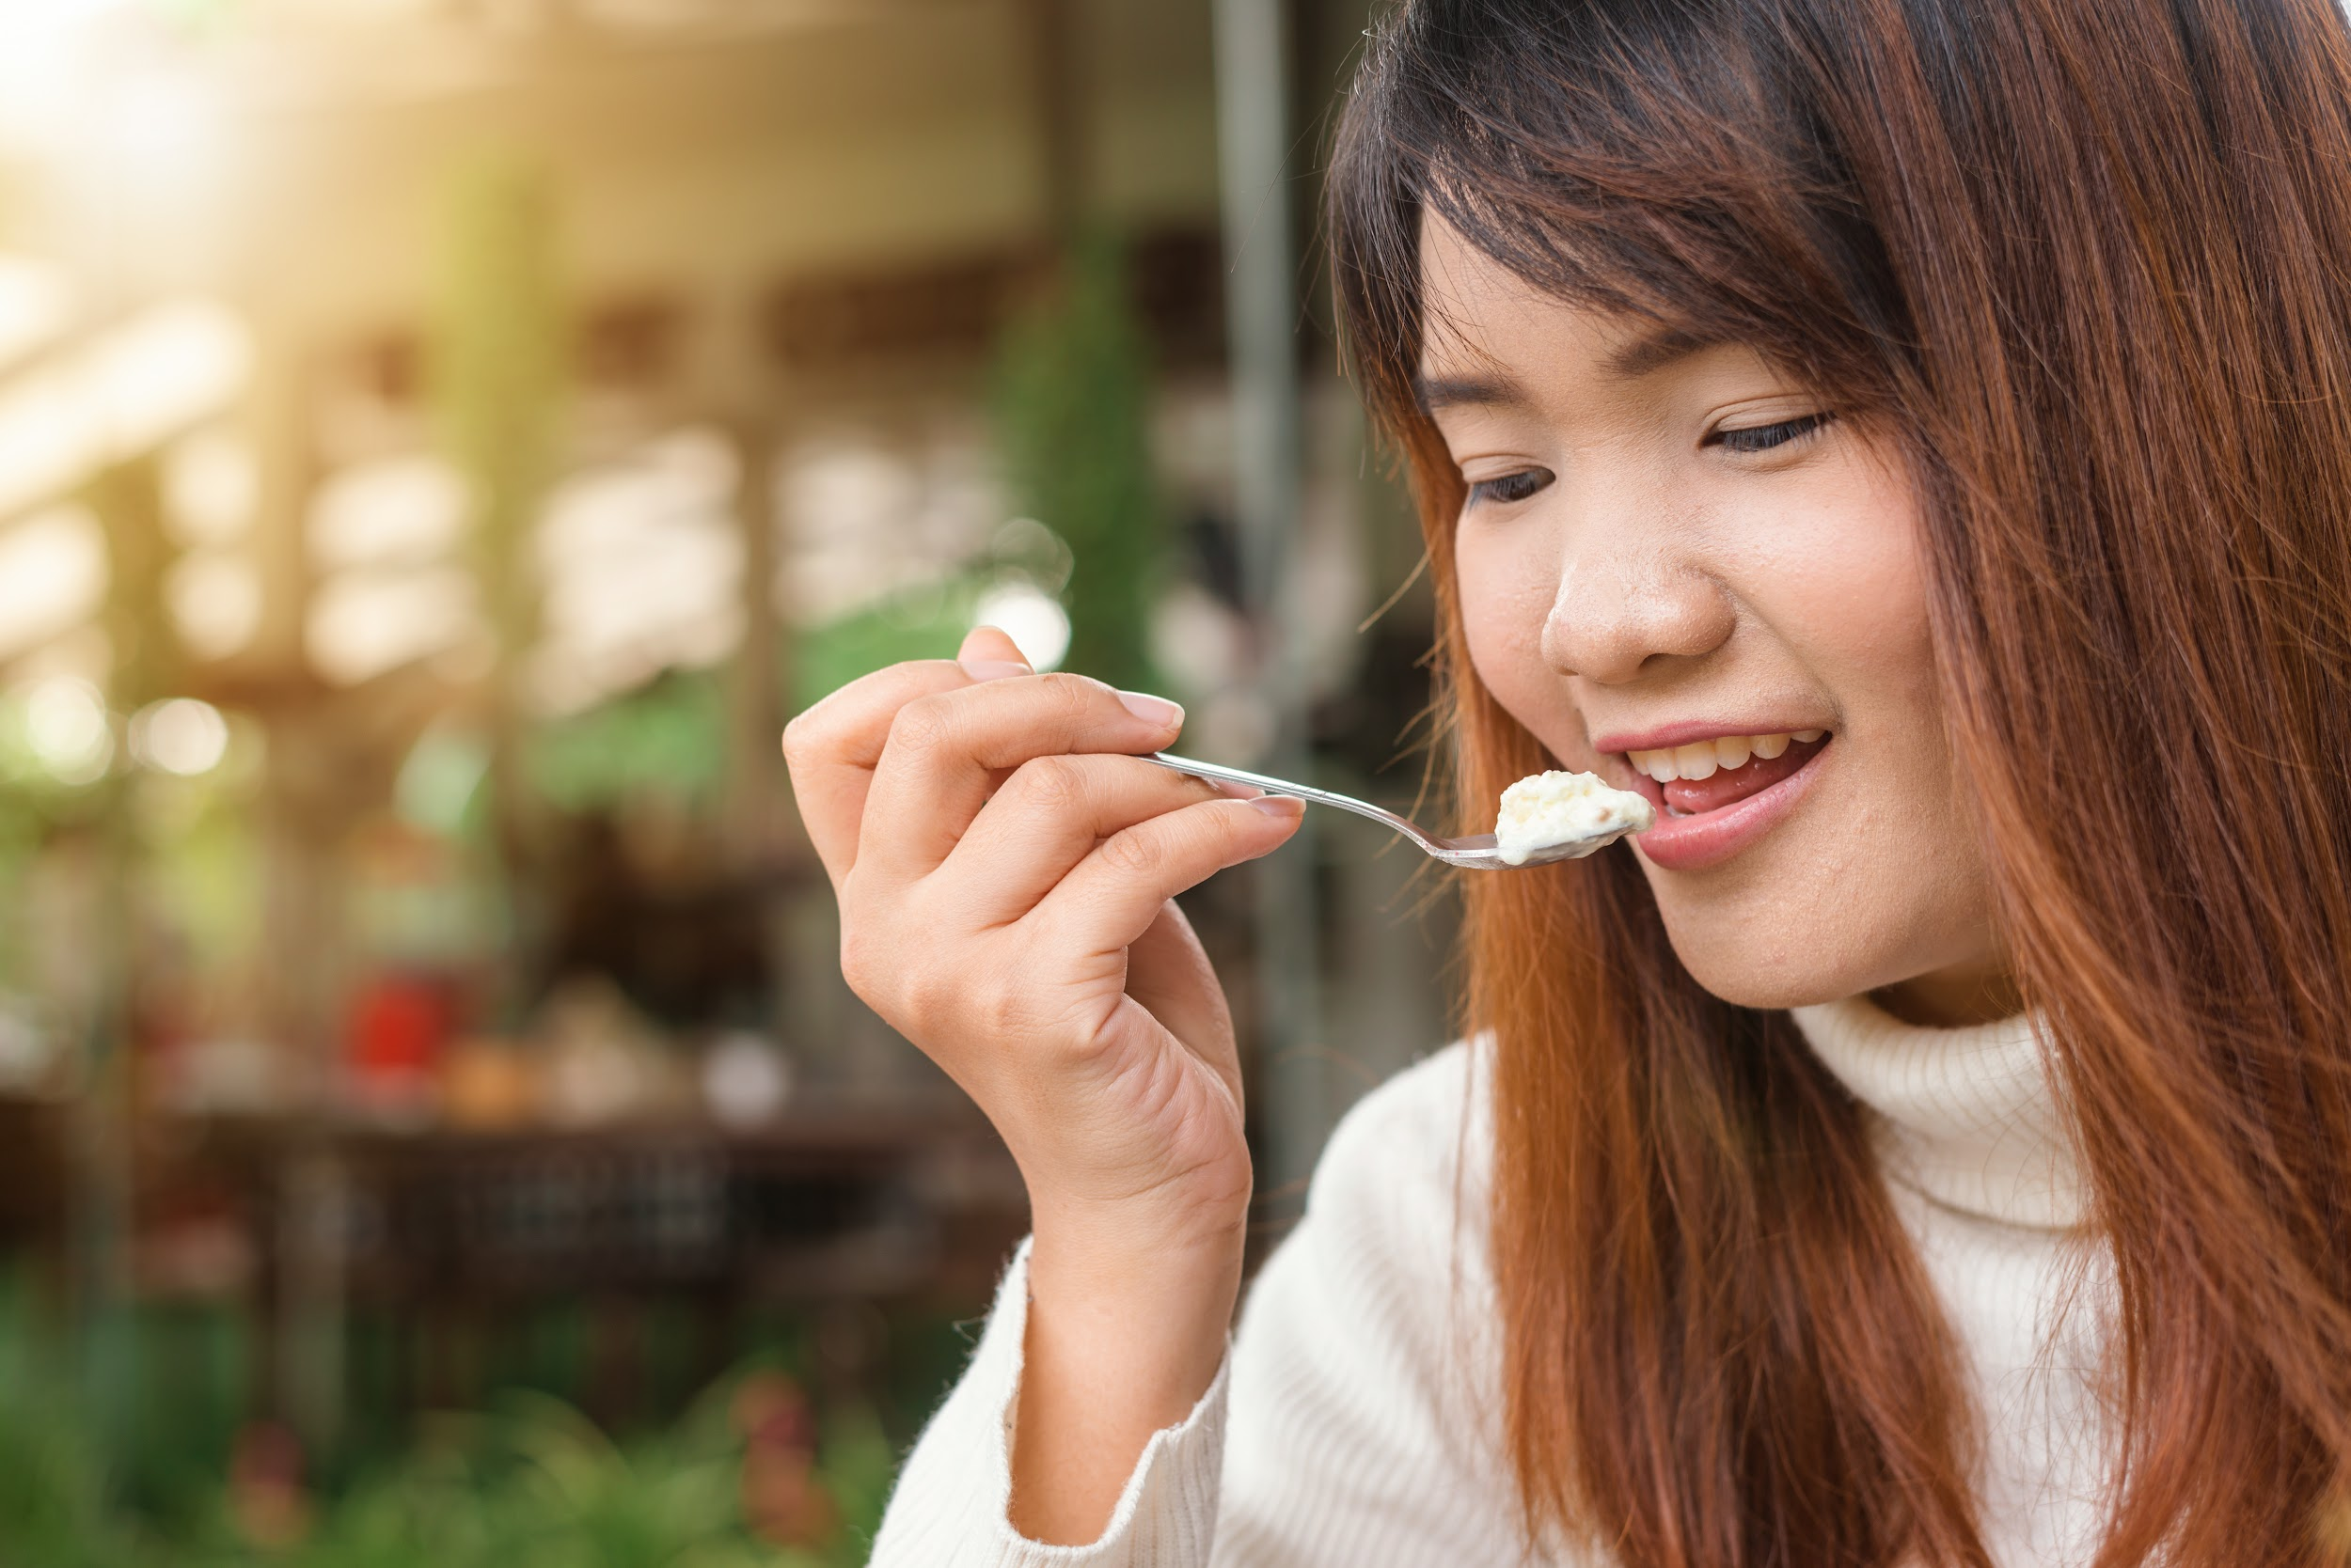
Warm-Up
What is your favorite type of cuisine?
Where are the best restaurants in your city located?
Is there diverse cuisine where you live?

Slide 3
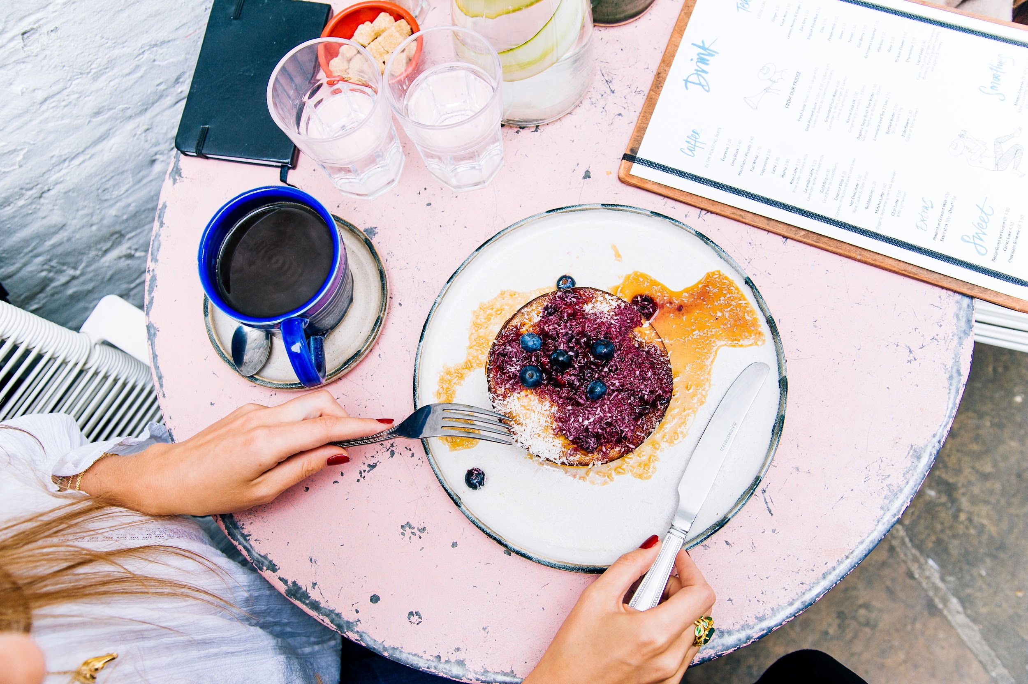
The Best Restaurants
They are usually NOT downtown/in the city center
They are usually not “chain” restaurants
Family-owned restaurants tend to be unique and especially friendly

Slide 4
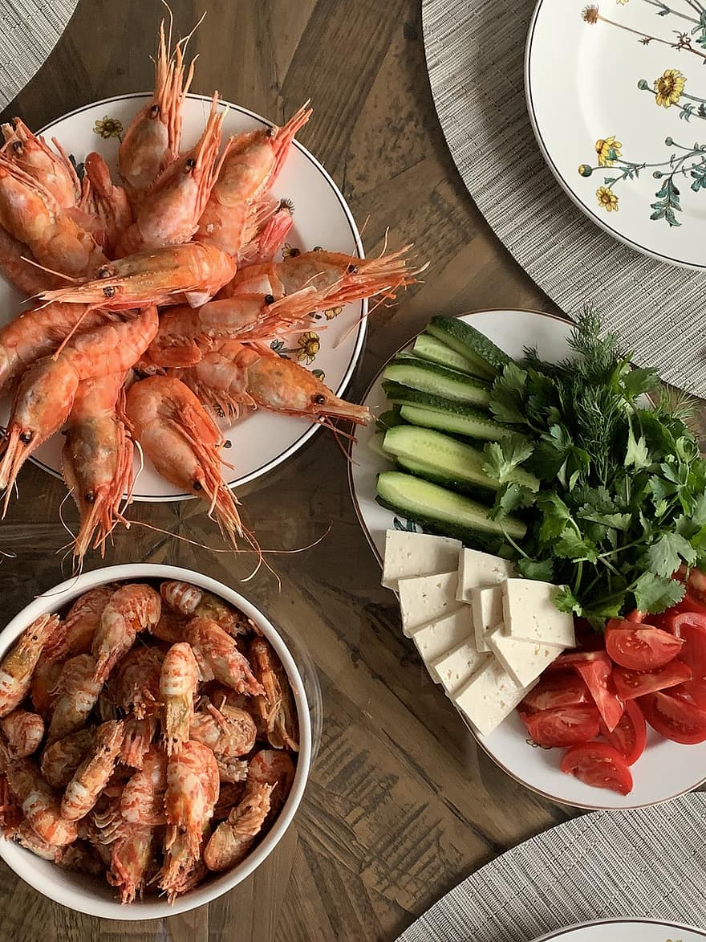
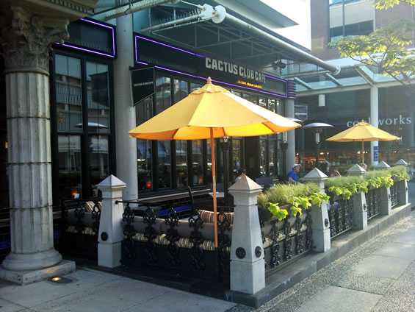
Popular Cuisine
Fusion food
All kinds of seafood
Wood-fired pizza
Asian-inspired dishes
Poke bowls
Fried Chicken
Bento boxes

Slide 5
Types of Cuisines & Food
flavour
spicy
sour
sweet
bitter
plain/bland
dishes
Appetizers (appies)
entrees
sides
salads
soups
fries
desserts
beverages (drinks)
Alcoholic
Cocktails
High balls
Wine/Beer
Non-alcoholic (virgin drinks)
mocktails

Slide 6
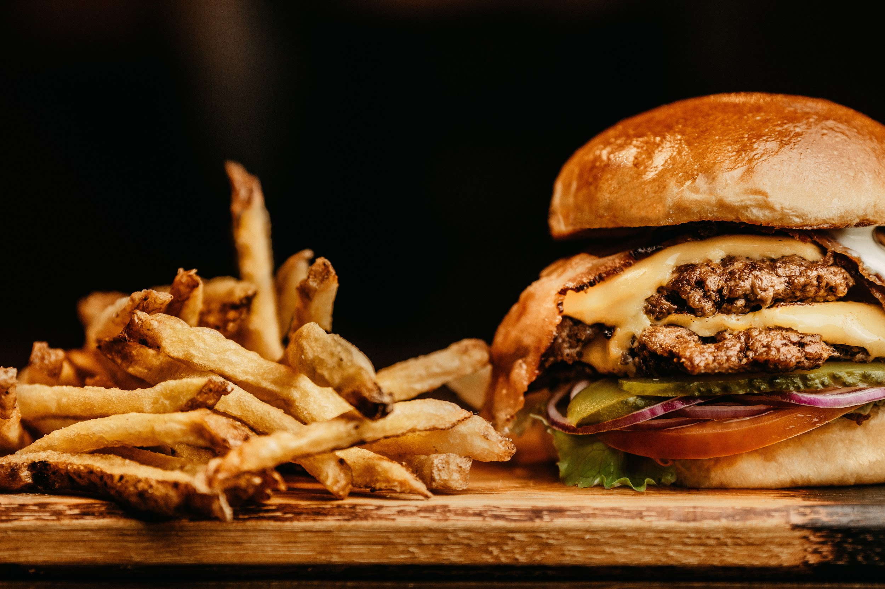
Ordering Food
“May I have (a hamburger) please?”
“What would you like on the side?”
“Are there any allergies or food preferences?”

Slide 7
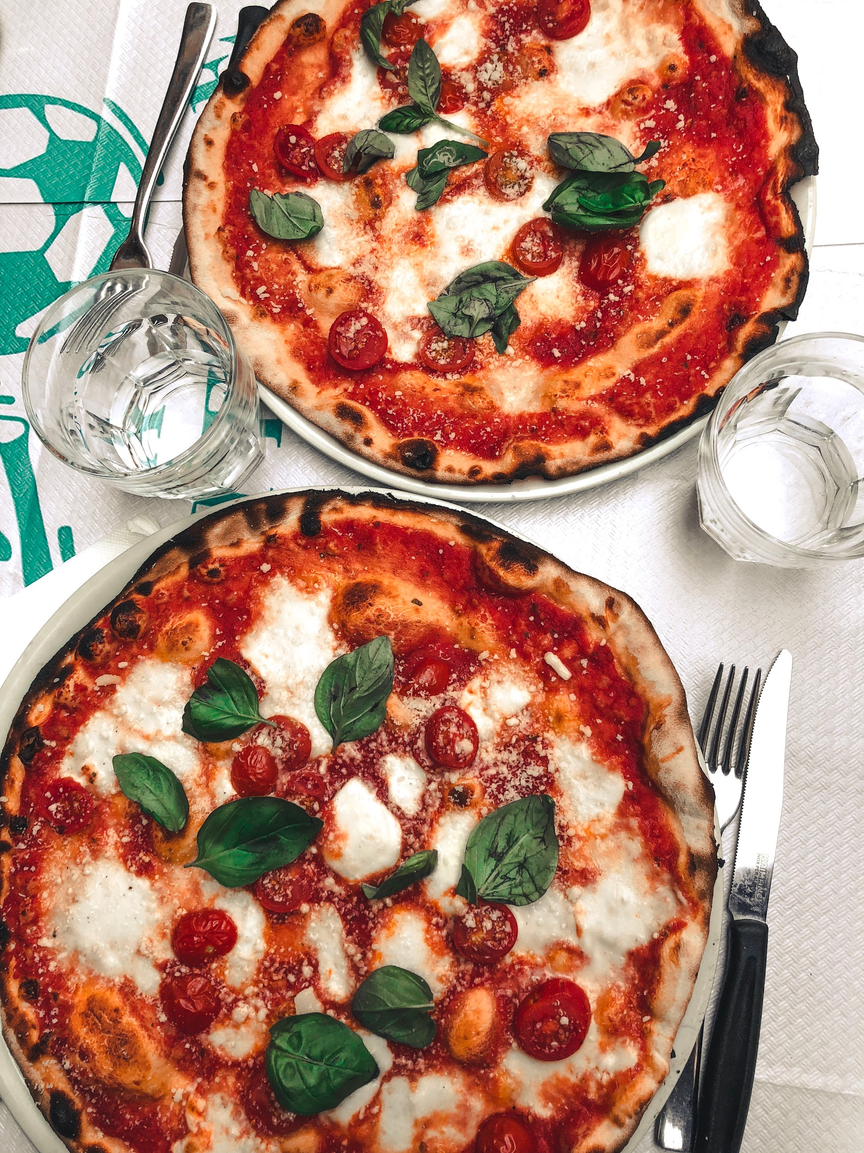
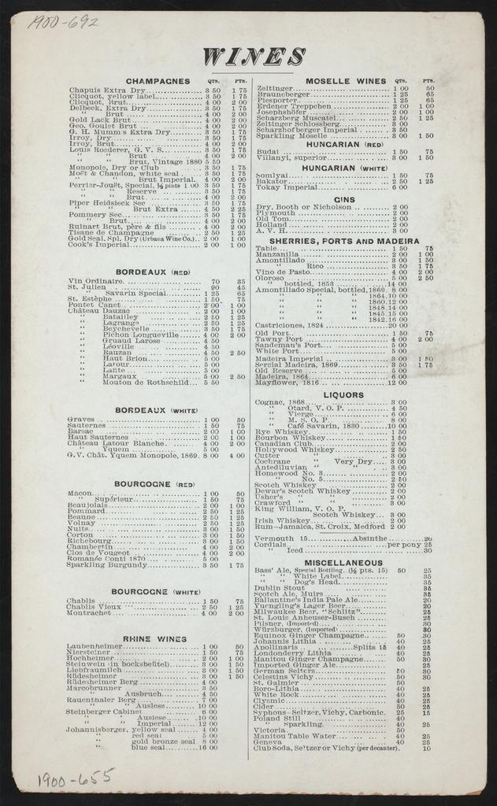
Too many choices
Sometimes, there’s too many menu items (and no pictures).
What should I do?
What can I say?

Slide 8
Ordering Food
“Hmm... I can’t decide. What do you recommend on the menu?”
“I would say chicken pesto pizza or the margherita (mar-gar-ita) pizza tend to be our most popular ones.”
“Ohhh! I think I’ll go for the margherita.”

Slide 9
Wrap-Up
What kind of food do you eat in your country?
What is your favorite types of cuisines?
What are you looking forward to eating in Canada?
Next Class: Making International Friends

