Slide 1
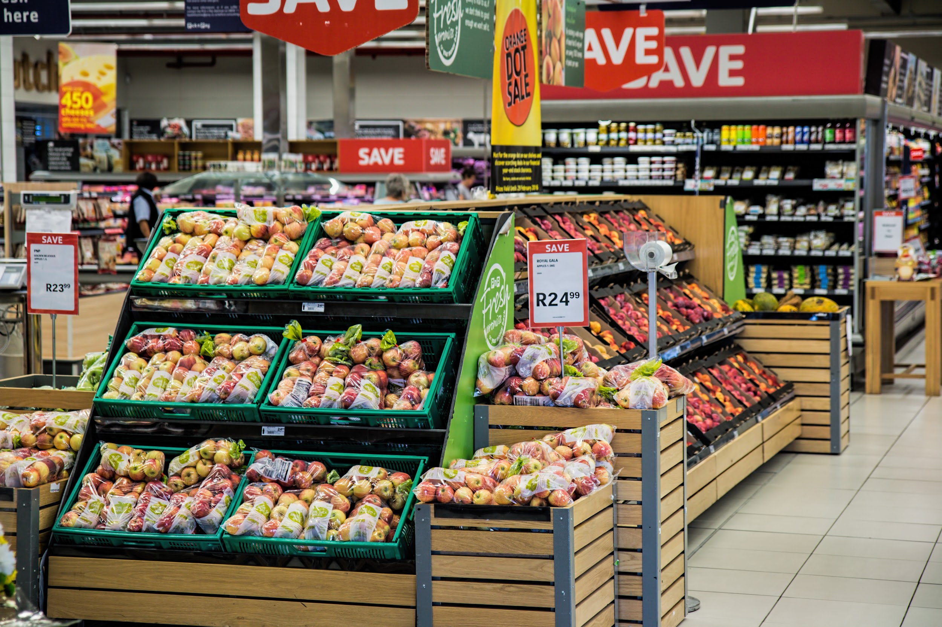
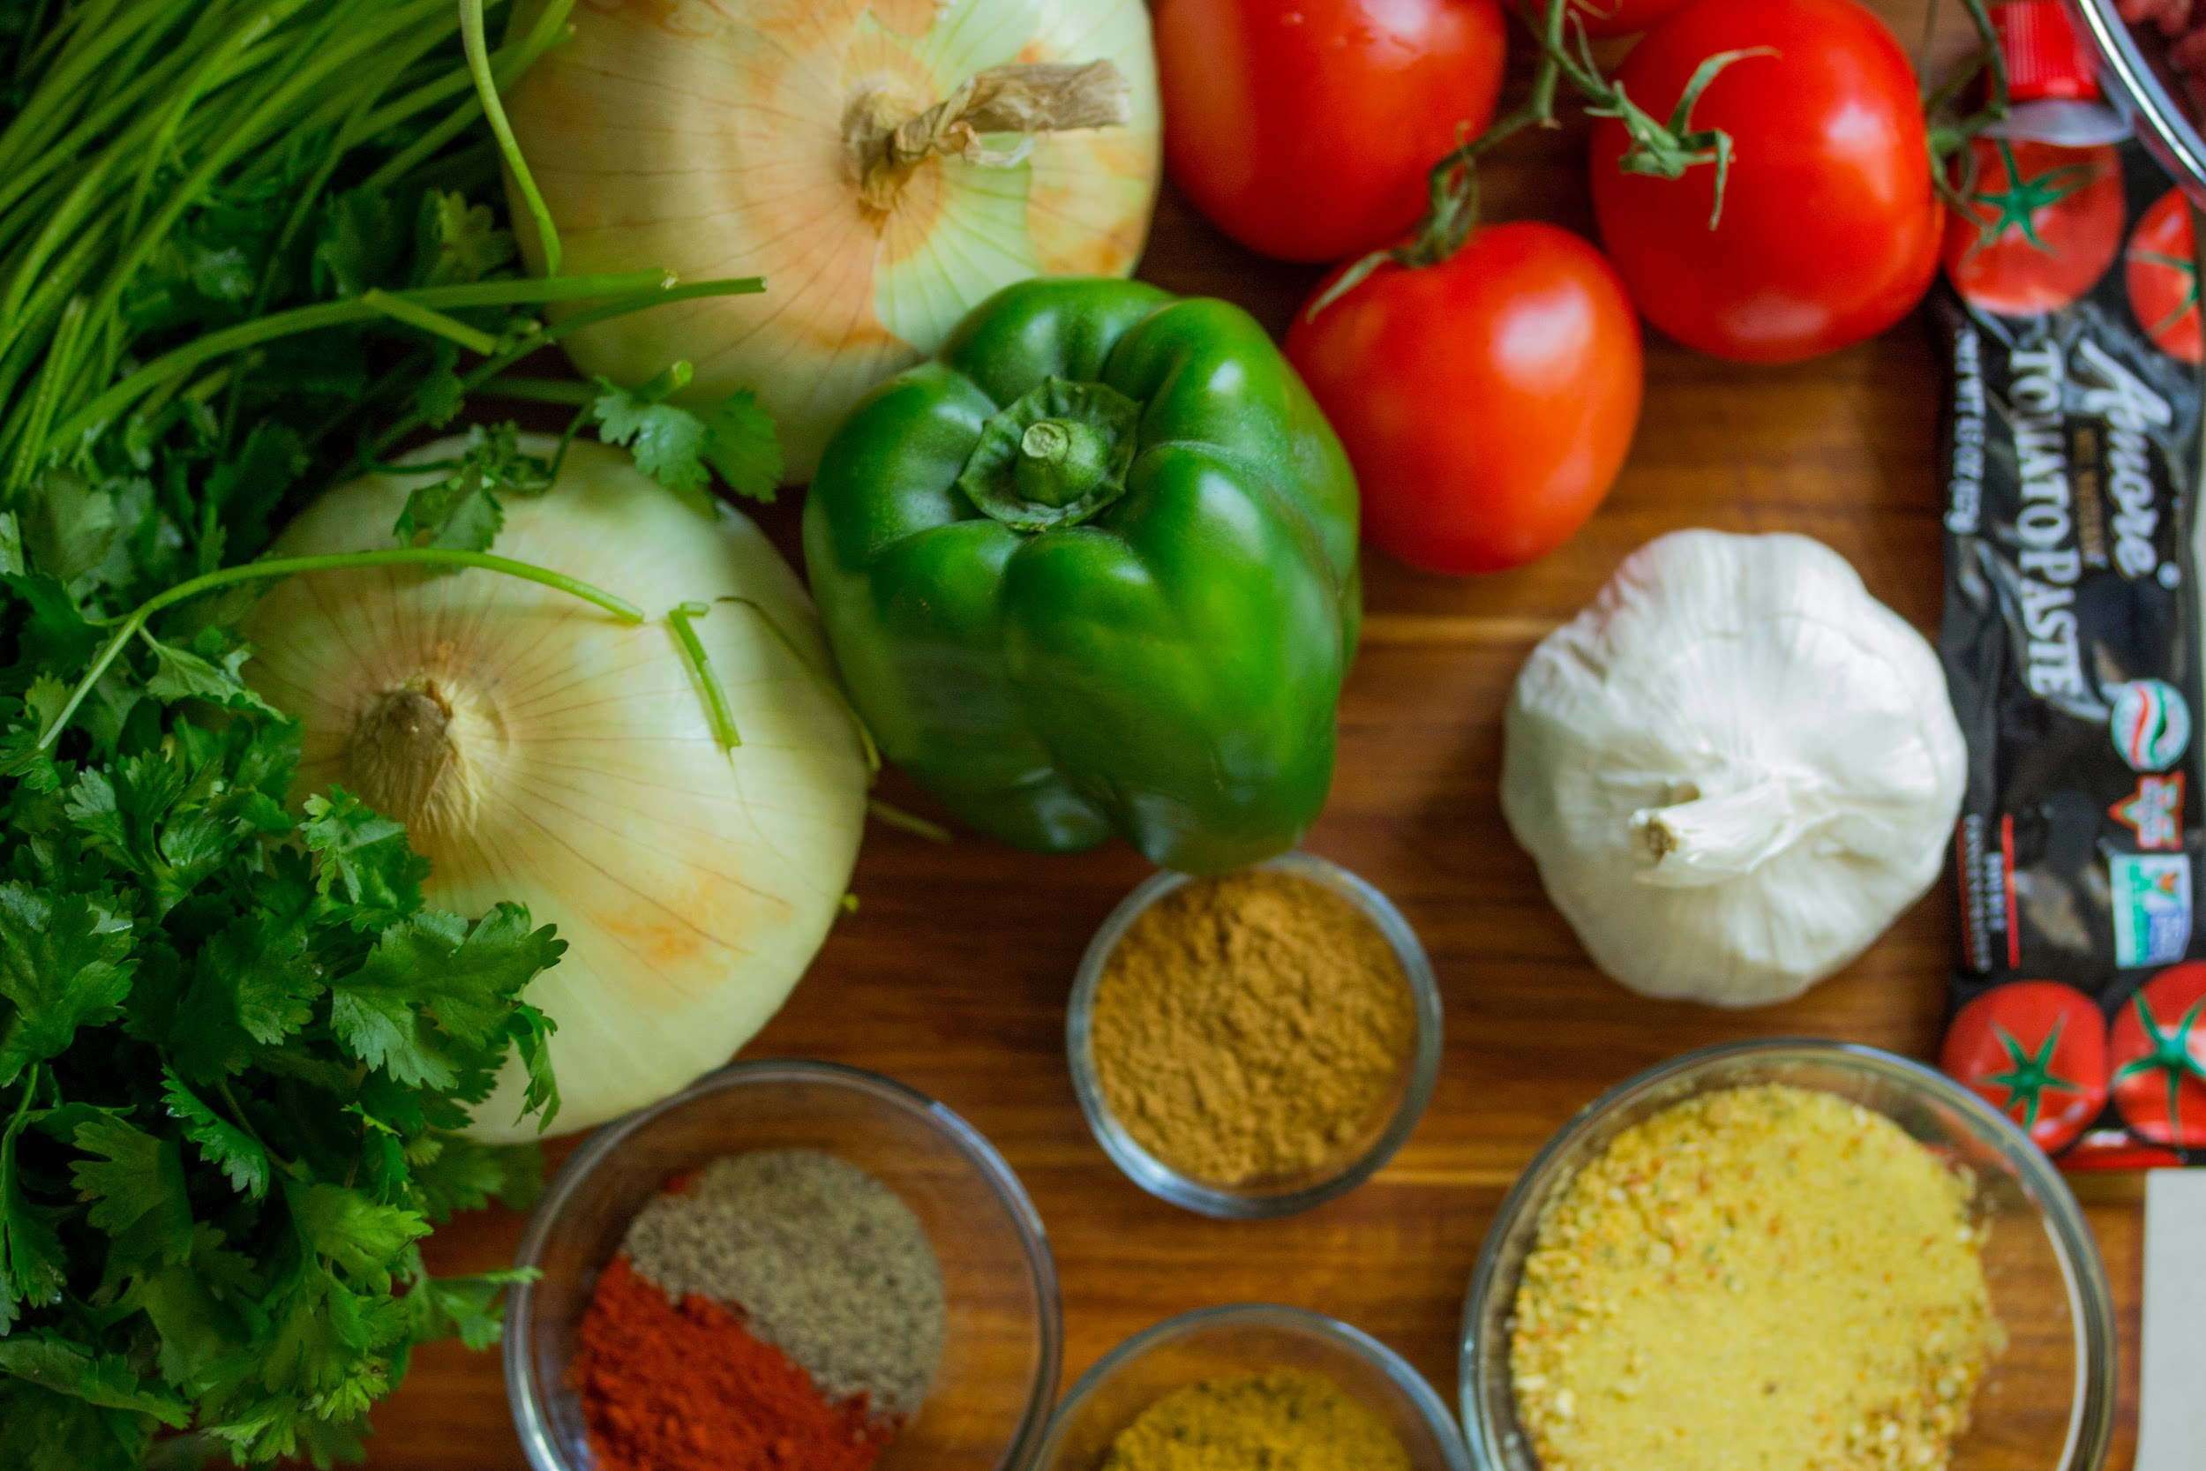
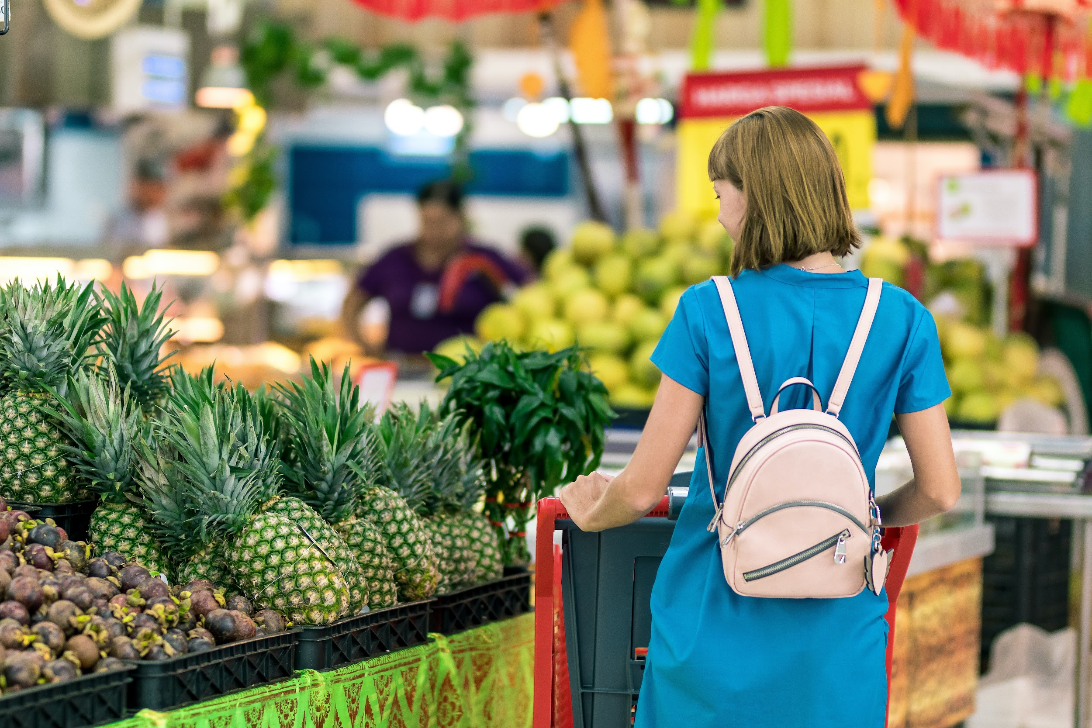
Pre-Arrival English
Grocery Stores and
How to Look for Food
Copyright © 2020 International House Pacific Group
Do not share or copy without permission

Slide 2
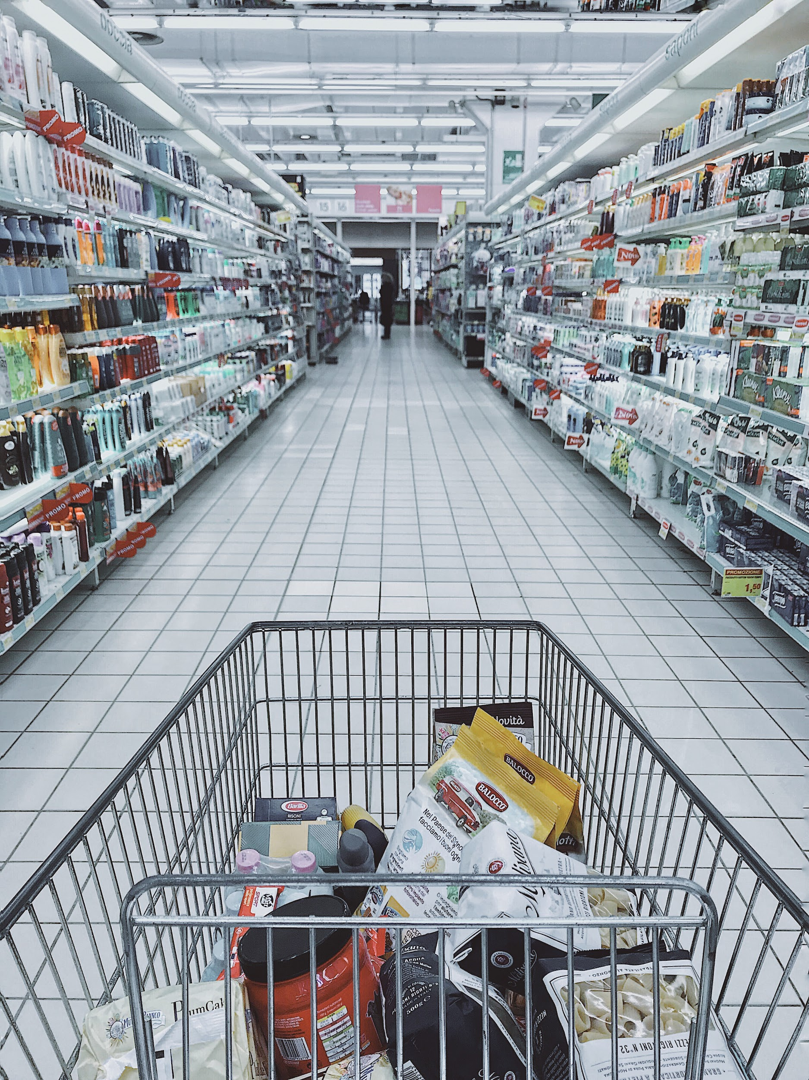
Warm-Up
How often do you or your family go to the grocery store?
What are your favorite foods to get there?
Do you prefer cooking or going to restaurants?

Slide 3
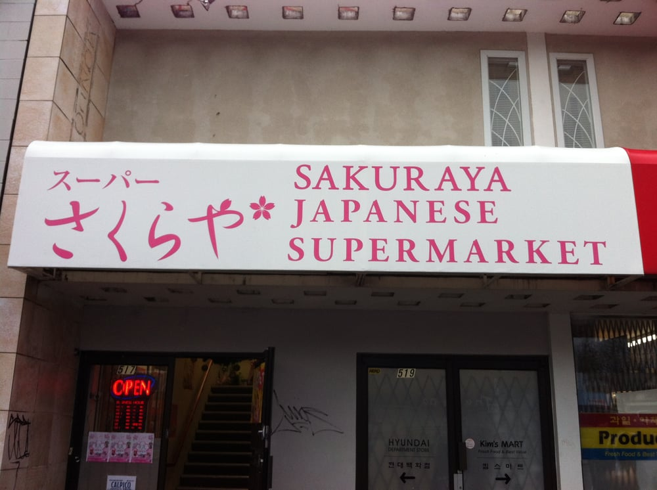
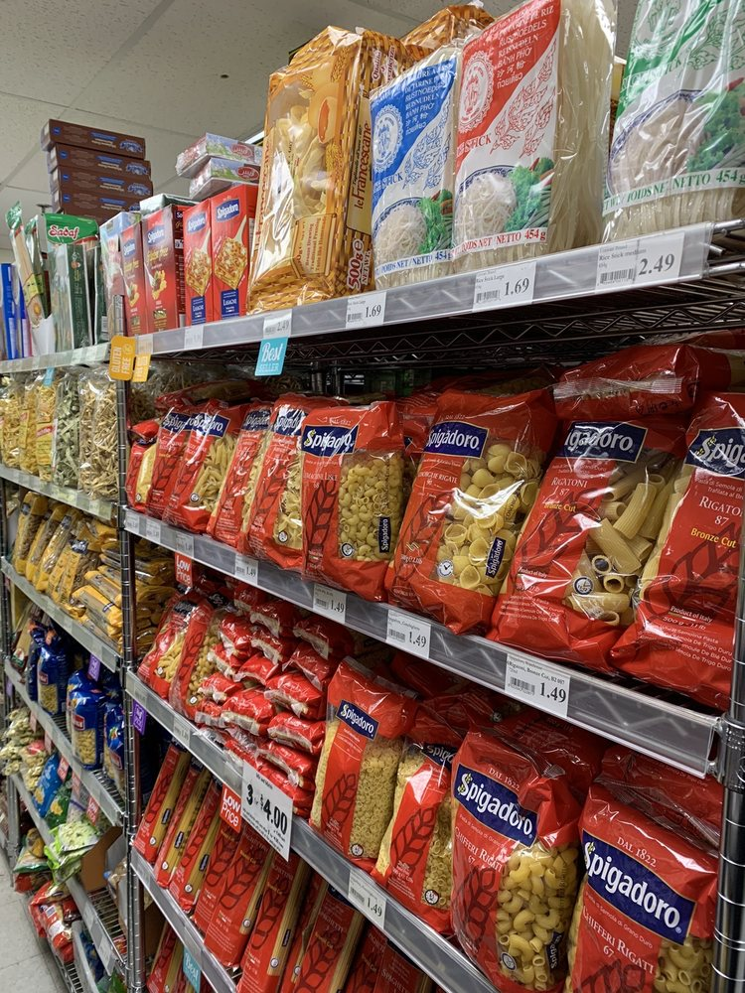
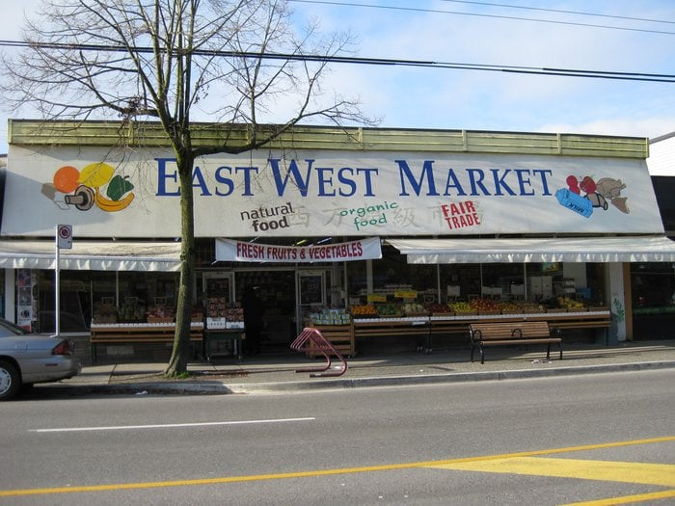
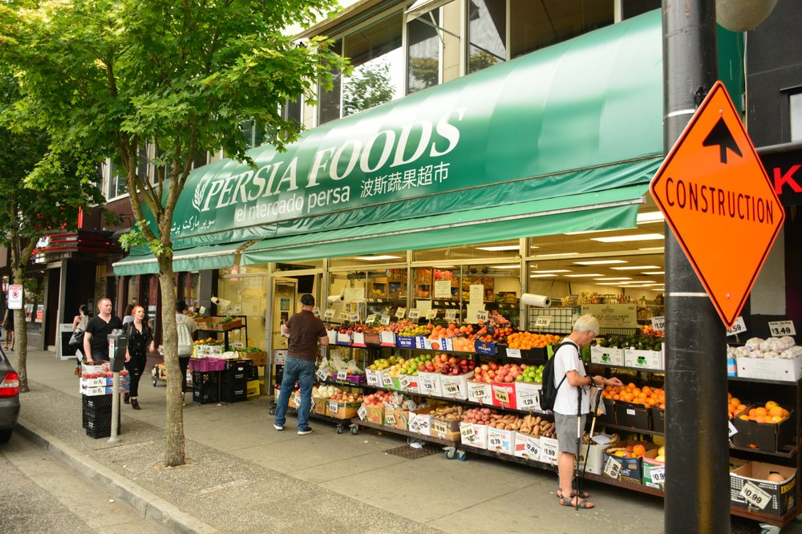
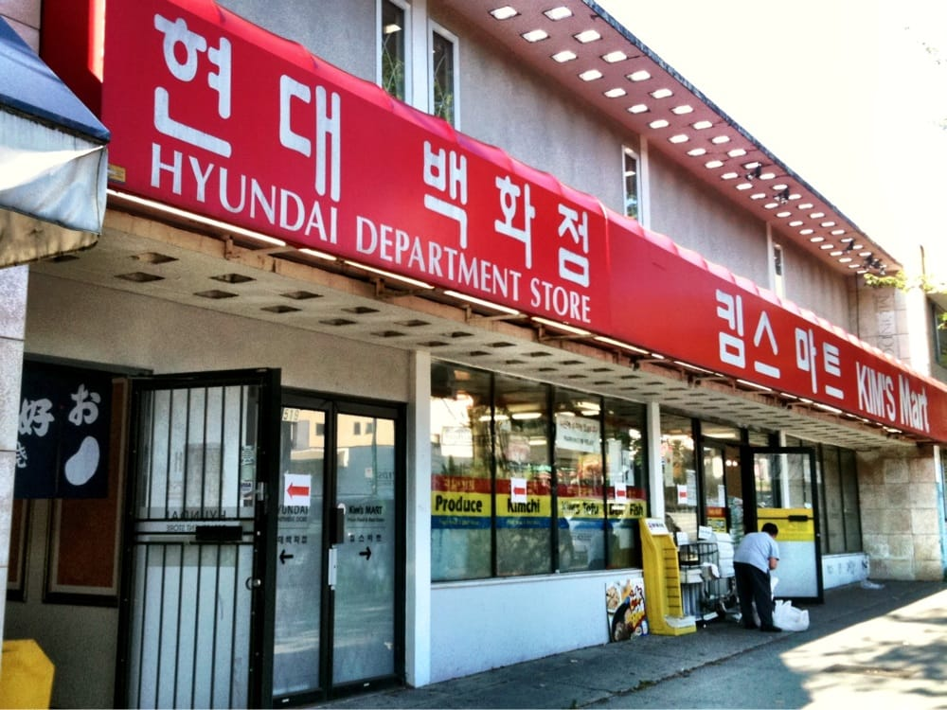
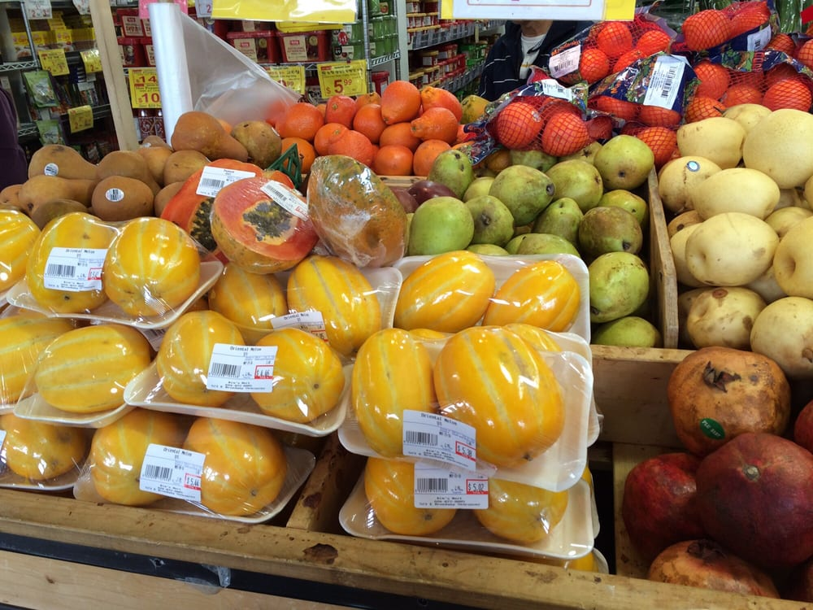
Foreign grocery stores
Sakuraya Japanese Supermarket
(517 East Broadway, Mount Pleasant area, Vancouver, BC)
East West Market
(4169 Main Street near Riley Park, Vancouver, BC)
Persia Foods
(2827 West Broadway, Kitsilano area, Vancouver, BC)
Kim’s Mart
(519 East Broadway, Mount Pleasant area, Vancouver, BC)

Slide 4
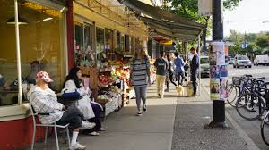
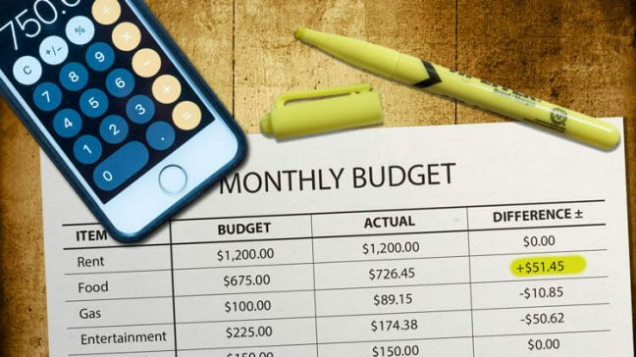
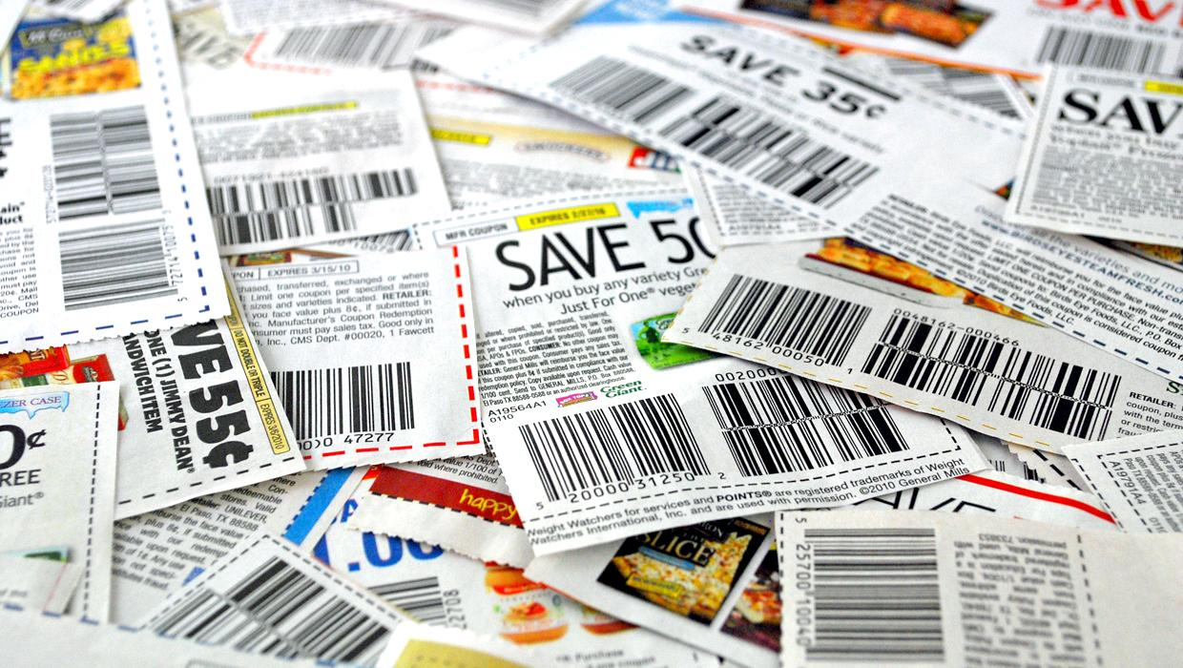
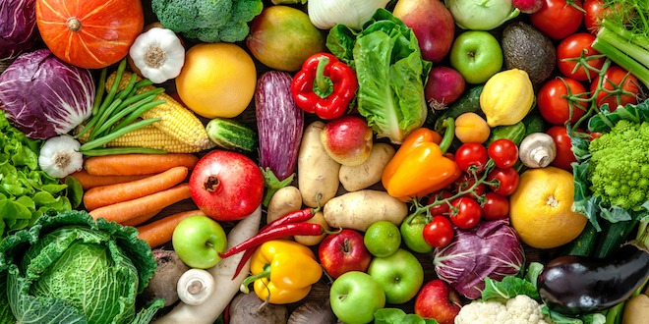
Budgeting in Vancouver
Where to shop for cheap (but good quality) food:
Supermarkets such as Canadian Superstore and TnT Supermarket have loyalty cards and coupons that give you discounts.
For snacks, beverages and even some packaged goods, the Dollarama can provide a cheaper alternative to brand-name items.
Cheap fruits and veggies: shop at the local grocers’ around residential areas (Southeast Victoria Street, Main Street, the Drive, etc.)

Slide 5
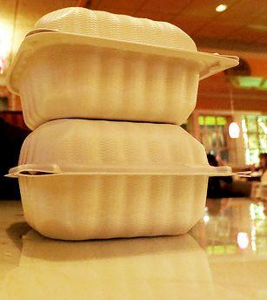
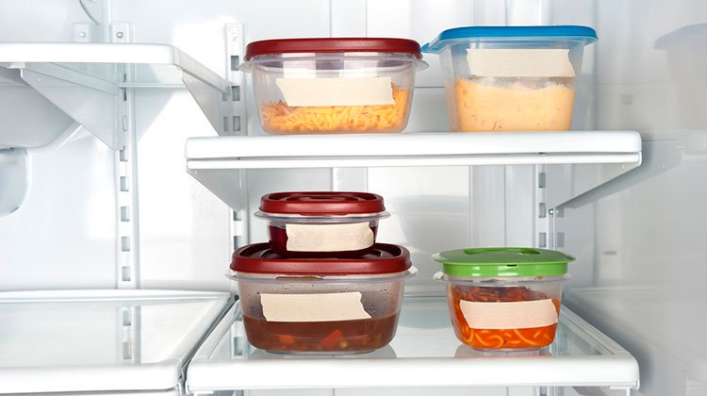
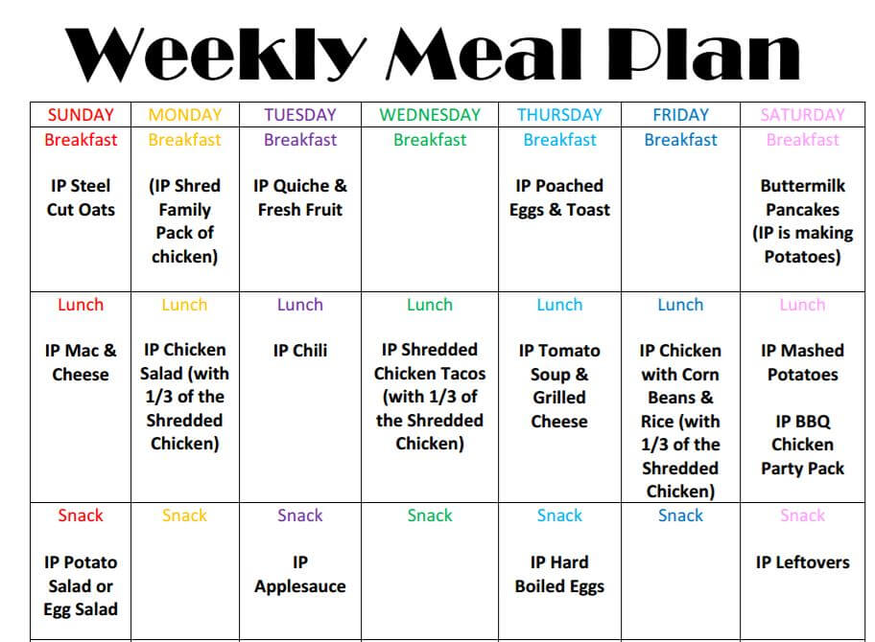
Budgeting in Vancouver
How to make eating at restaurants more cost effective:
Ask the server to give you a box at the end of your meal so you can take the leftovers home. It’s completely normal in Vancouver.
Check the prices and/or portion sizes online or in person before you go (Google the restaurant or find them on sites like Yelp).
Split a dish with a friend or ask for a ‘half-order’.

Slide 6
Wrap-Up
What food will you most miss from home?
Which one are you excited to share with your host family and local friends?
Do you have a “signature dish”?
Next Class: The Best Restaurants & Popular Cuisine

