Slide 1
Pre-Arrival English
Festivals and Activities
In Vancouver
Copyright © 2020 International House Pacific Group
Do not share or copy without permission

Slide 2
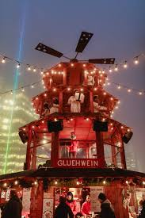
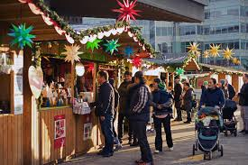
Warm-Up
What festivals or events do you celebrate in your city?
Which one is your favorite?
How do you prepare for this celebration?
Photo courtesy of tourismvancouver.com

Slide 3
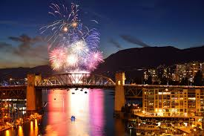
Festivals and Events
Festival of Lights (December-January)
Dine-Out Vancouver (January/February)
Jazz Festival (June)
Playland/PNE (June)
Celebration of Lights (July)
Fright Nights / Halloween (October)
Ice Skating (December)
Photo courtesy of tourismvancouver.com

Slide 4
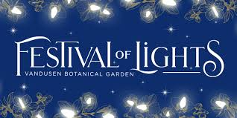
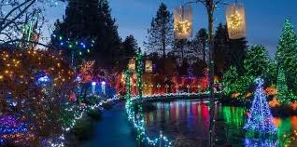
Festival of Lights
at the Van Dusen Botanical Garden from December to the following January
displays feature over 1 million lights spread out over 15 acres of gardens
open from 4:00 pm until 9:30 pm throughout December
Amazing instagramable moments and photography session!
Photo courtesy of tourismvancouver.com

Slide 5
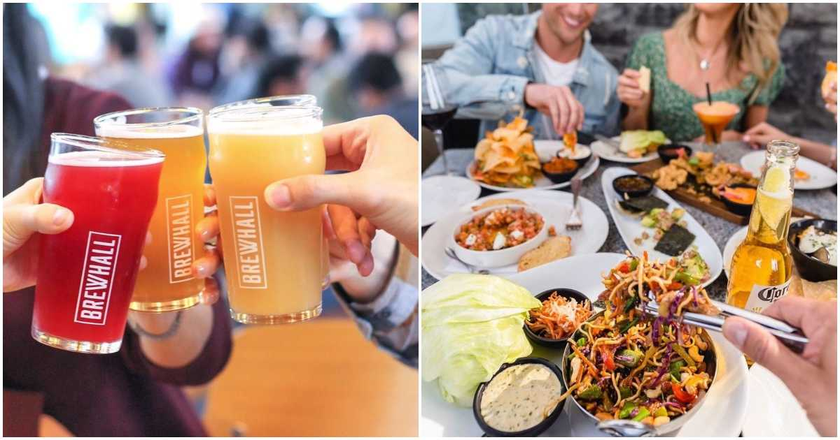
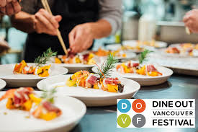
Dine-Out Vancouver
For a few weeks in January and February, the city of Vancouver hosts ‘Dine Out Vancouver’
Select restaurants in every neighborhood participate by creating a specialty menu for a fixed price
Great way to sample the various places and different cuisines all in one city!
Photo courtesy of tourismvancouver.com

Slide 6
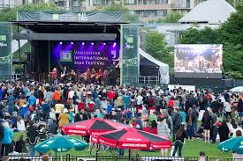
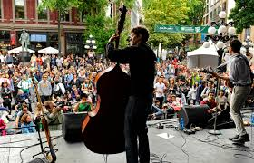
Jazz Festival
Not only are jazz performances at the bars and restaurants of Vancouver, there are also free outdoor concerts
Venues include the Vancouver Art Gallery, Granville Island and David Lam Park
Fun for all ages!
Photo courtesy of tourismvancouver.com

Slide 7
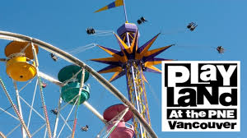
Playland/PNE
Opens June to September
National Amusement Park
Great food and fun rides
Beautiful photo spots
Affordable prices
Family-friendly activities
Photo courtesy of tourismvancouver.com

Slide 8
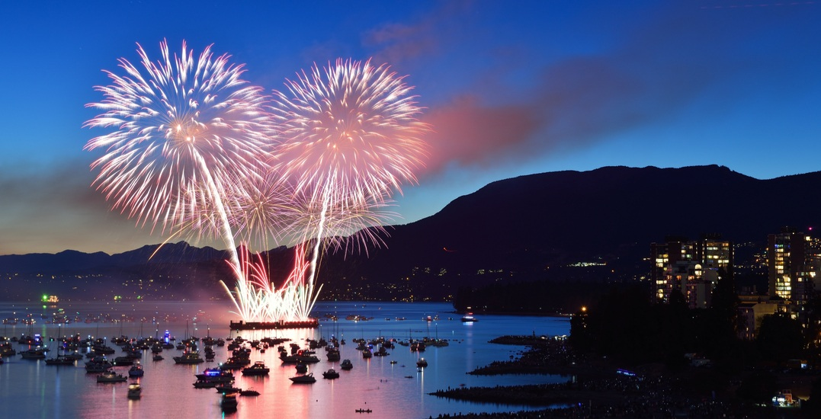
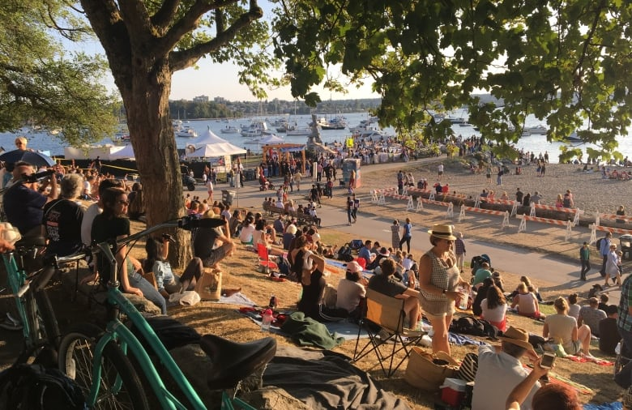
Celebration of Lights
Annual fireworks competition
Three countries each year
Great spots to watch the fireworks
English Bay
Burrard Bridge
Stanley Park
Kitsilano Beach

Slide 9
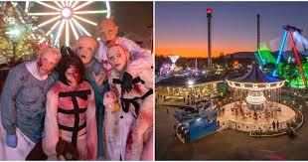
Fright Nights for Halloween
Hosted at the Playland Amusement Park
Get scared by all the spooky ghosts
Wear a costume (optional)
Great way to celebration the Halloween spirit!
Feature is the Haunted House

Slide 10
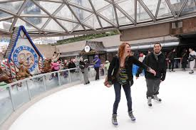
Ice Skating (Robson Square)
Held during the winter season
In the heart of the city
Skating is free!
(skate rentals are $5)
More ice skating at the new outdoor rink on the North Shore at Shipyard Commons

Slide 11
Wrap-Up
What festival do you have in your country that is most similar to these?
Which one seems the most different to you?
Which are you most excited to experience?
Next Class: Grocery Shopping

