Slide 1
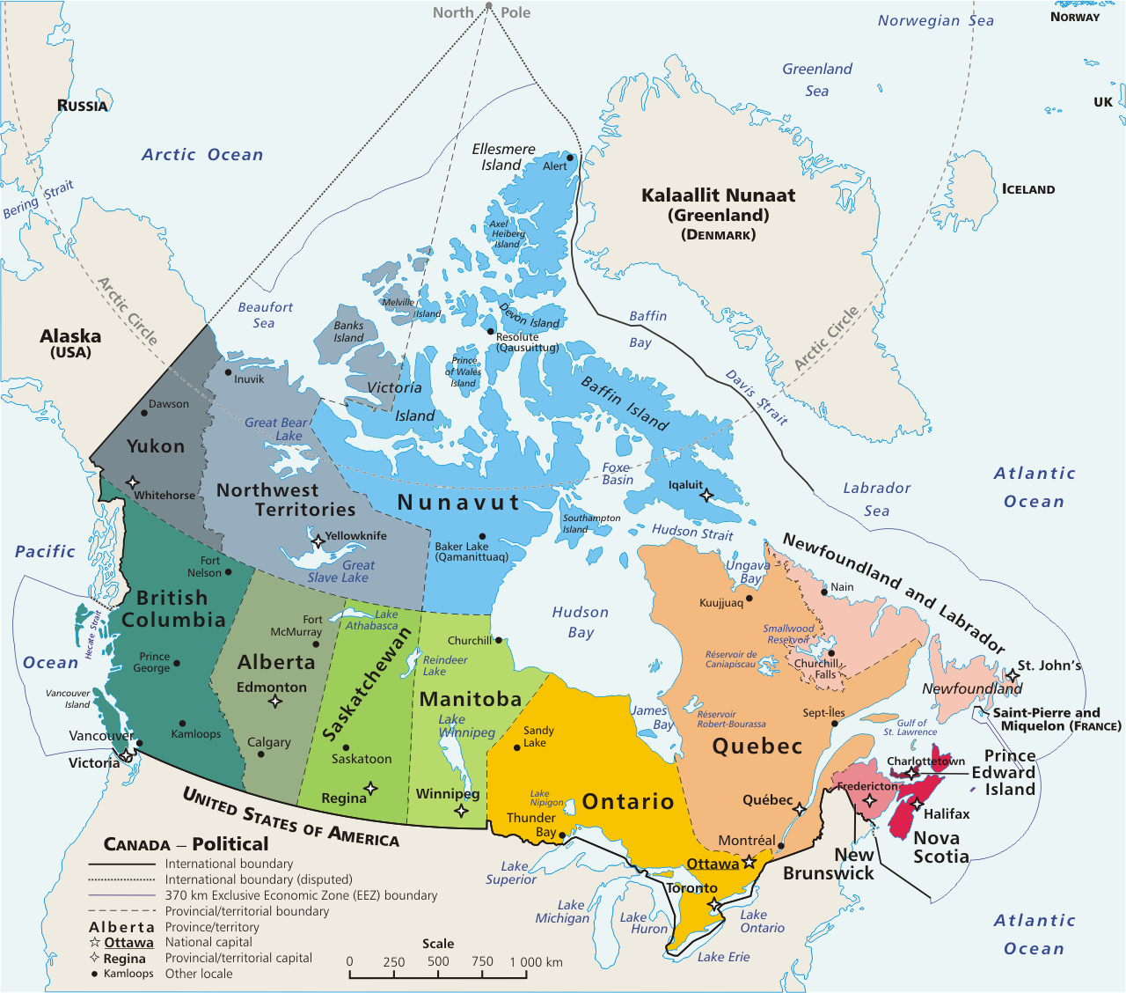
Pre-Arrival English
How to Communicate When You Don't Understand What People Are Saying
Copyright © 2020 International House Pacific Group
Do not share or copy without permission

Slide 2
Warm-Up
When you don’t understand what someone has said, how do you ask for clarification in your country?
For English, do you find it harder to listen or speak? Why?
Is it easier for you to speak English to native speakers or foreigners? Why?

Slide 3
How Canadians Ask for Clarification
Usually very informally in daily situations:
“Huh?”, “What?”, “Sorry?”
In formal settings, you can use:
“Excuse me?”
“Pardon me?”
“Could you please repeat that?”
“I’m sorry, what do you mean?”

Slide 4
Voicing Your Confusion
Most Canadians would prefer to repeat themselves if you don’t understand than to find out later and have to “backtrack” (especially in a formal setting)
Don’t be embarrassed to ask for clarification in the moment. Let’s look at some skillful ways to do it!

Slide 5
Reformulation
One simple and effective way to clarify is to summarize what you think they said back to them:
“So, if I heard you correctly…”
“Let me see if I understand…”
“Do you mean that…”
“What I hear from you is...is that correct?”

Slide 6
Practice
Let’s take turns sharing a routine or process and reformulating it back to the other using the phrases we just learned:
“So, if I heard you correctly…”
“Let me see if I understand…”
“Do you mean that…”
“What I hear from you is...is that correct?”
I’ll go first as an example. Tell me about...
Your daily routine
Your favorite way to travel
How to prepare your favorite meal
What you do for your favorite holiday
Copyright © 2020 International House Pacific Group
Do not share or copy without permission

Slide 7
Roleplays
At the store buying groceries
Enrolling in a new class
Learning a process at work
Hearing directions in a new city
Meeting new friends at a party
Copyright © 2020 International House Pacific Group
Do not share or copy without permission

Slide 8
Wrap-Up
How Canadians will clarify
Voicing your confusion
Reformulation / Useful phrases
Copyright © 2020 International House Pacific Group
Do not share or copy without permission
Next Class: Festivals in Vancouver

