Slide 1
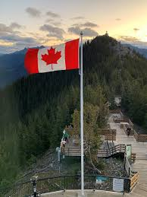
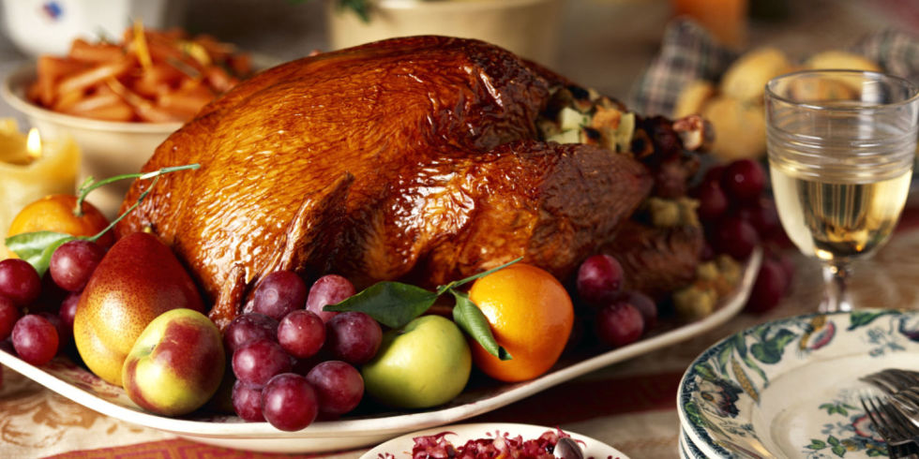
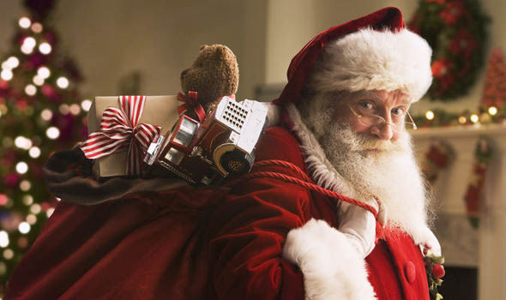
Pre-Arrival English
Canadian Holidays
Copyright © 2020 International House Pacific Group
Do not share or copy without permission

Slide 2
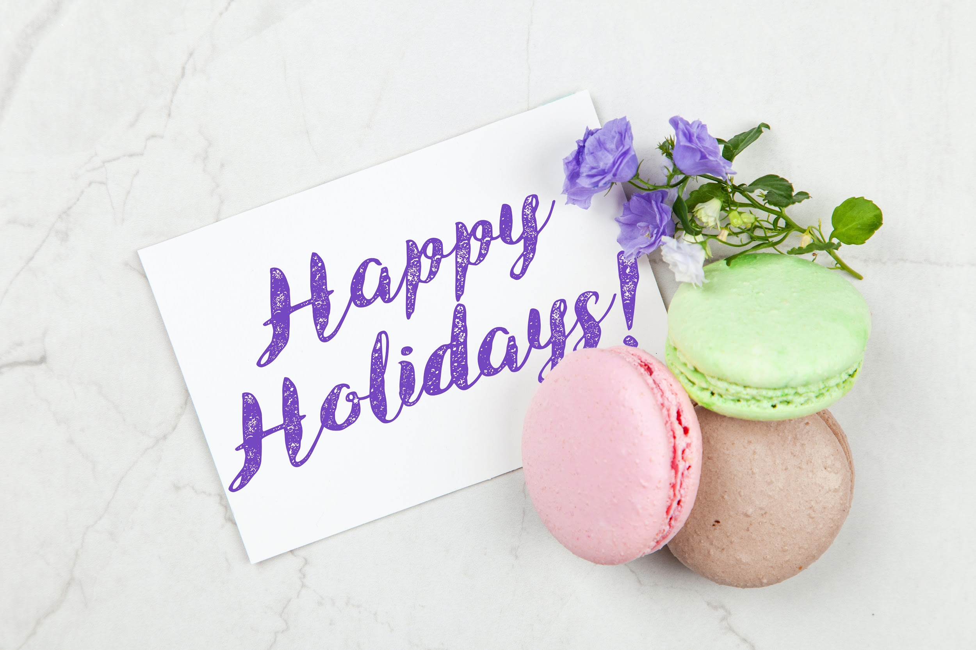
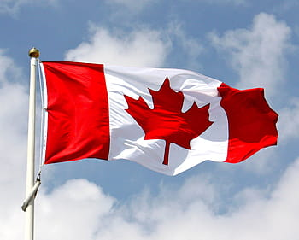
Warm-Up
What are some Canadian holidays you know?
What do people do during those holidays?
What time of year do most holidays happen here?
Which holidays do you also celebrate?
Copyright © 2020 International House Pacific Group
Do not share or copy without permission

Slide 3
Holidays Observed
School & National Holidays:
December 31/January 1: New Year's Eve/Day
February 15: Family Day (provincial holiday)
April 10: Good Friday / April 13: Easter
May 24: Victoria Day (provincial holiday)
July 1: Canada Day
August 3: BC Day (provincial holiday)
September 6: Labour Day
October 11: Thanksgiving Day
November 11: Remembrance Day
December 25: Christmas Day
holidays change depending on the province
Copyright © 2020 International House Pacific Group
Do not share or copy without permission

Slide 4
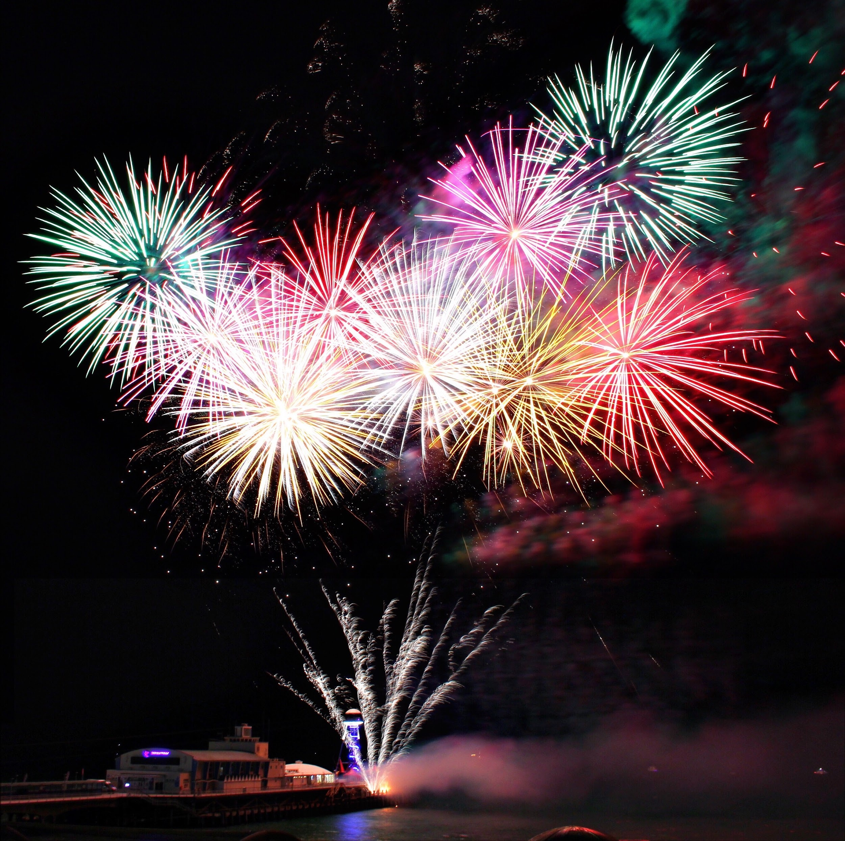
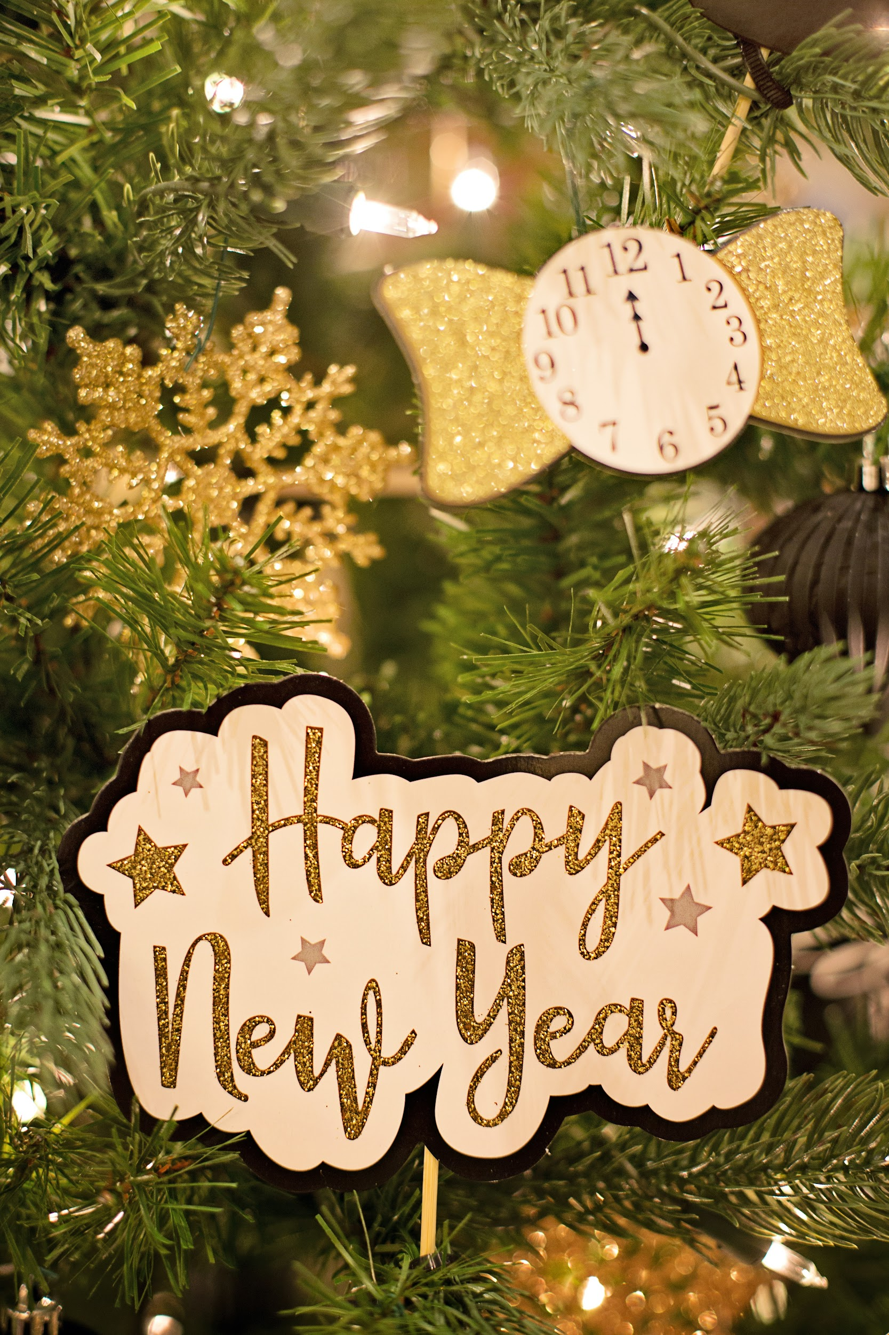
New Year’s Eve/Day
House Parties
Midnight Countdown
Fireworks
Champagne Toast
Sing Auld Lang Syne
New Year’s Resolutions
How do you celebrate this day in your country?
Copyright © 2020 International House Pacific Group
Do not share or copy without permission

Slide 5
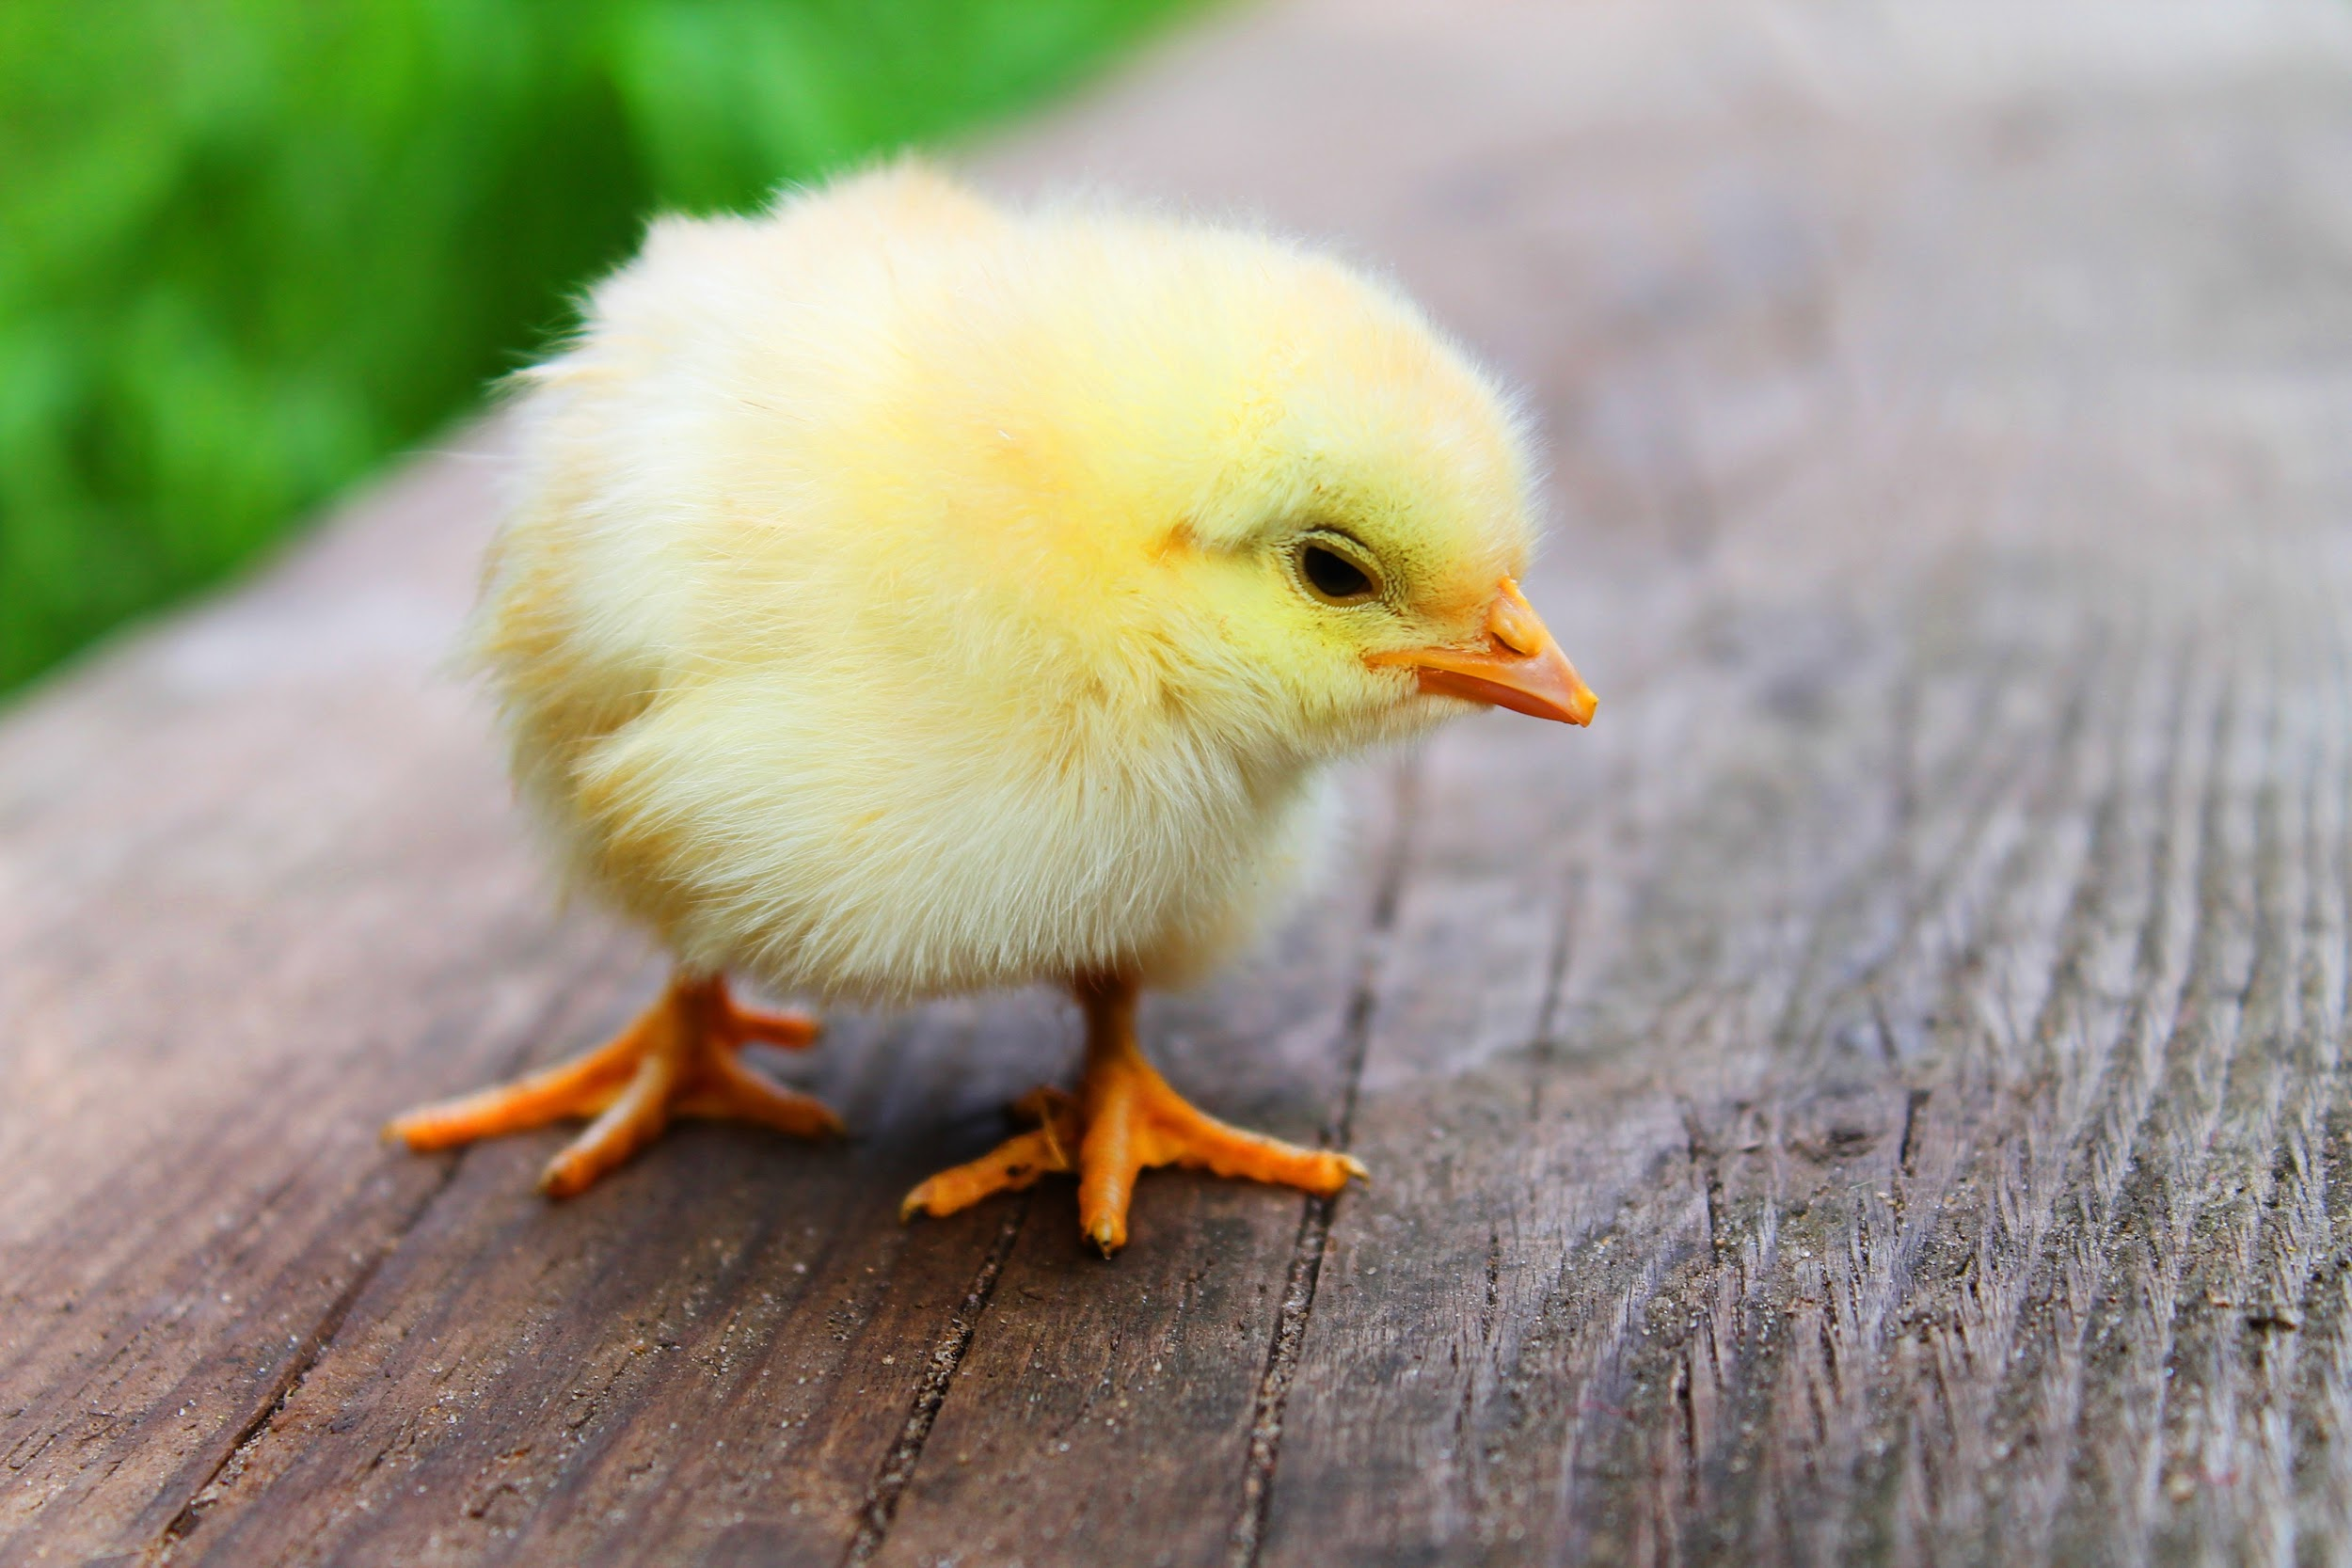
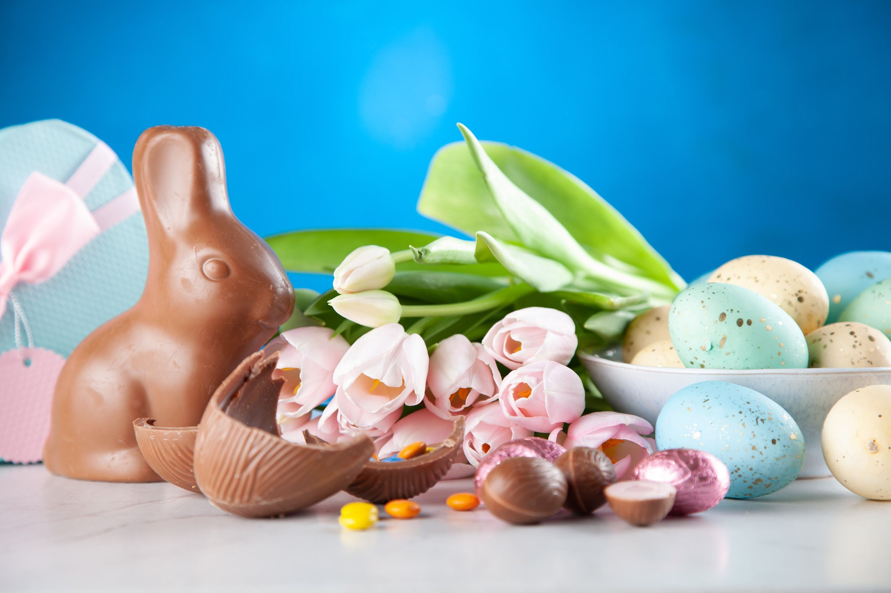
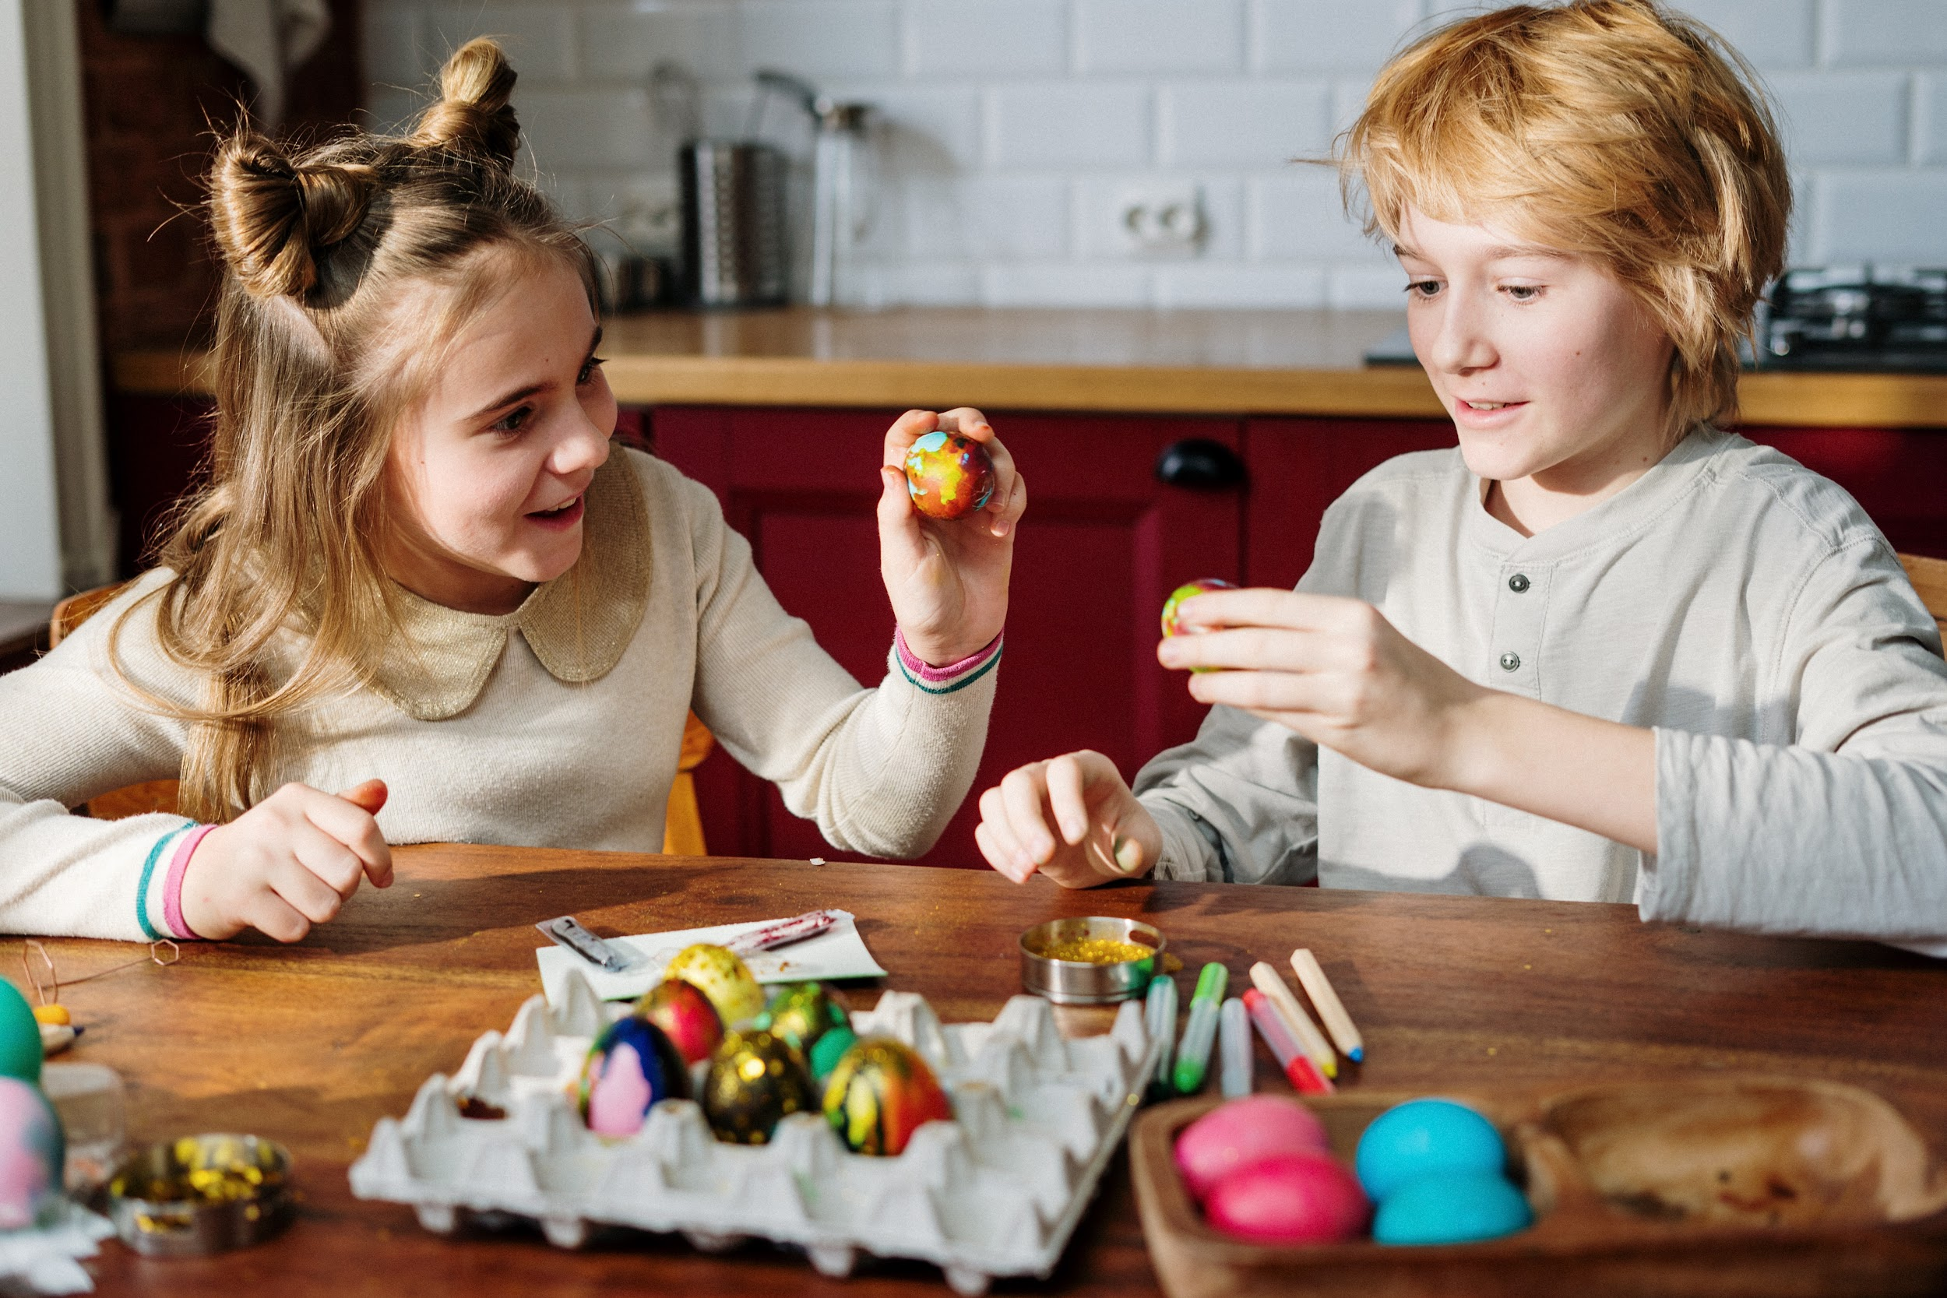
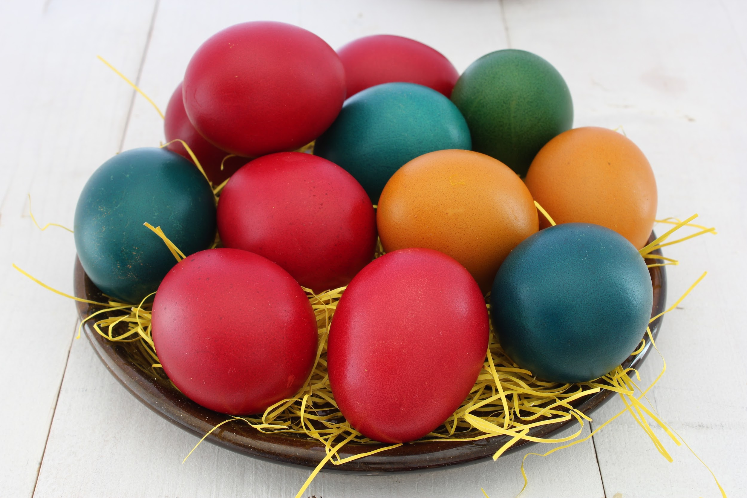
Easter/Good Friday
Originating from Christianity, but now celebrated by many Canadians as a family day of:
Coloring eggs
Going on Easter basket hunts for candy/toys
Going to church
Having a big family dinner together
Do you celebrate this day in your country? If not, what is a holiday like it that you celebrate?
Copyright © 2020 International House Pacific Group
Do not share or copy without permission

Slide 6
Canada Day
What do Canadians do?
Picnics
BBQs
Local festivals
Wear Red and White!
Watch FIREWORKS!
What is a similar holiday in your country?
Copyright © 2020 International House Pacific Group
Do not share or copy without permission

Slide 7
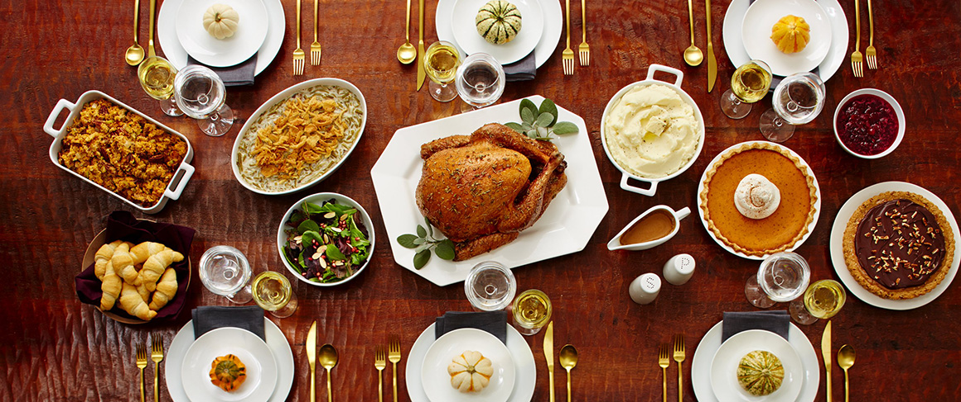
Thanksgiving
What do you know about this holiday?
Video credit: The History Channel
What is a similar holiday in your country?
Notes:
Click on the photo for the video

Slide 8
Main Dish: Turkey
The focus is on giving thanks for the harvest in autumn (October in Canada.)
Copyright © 2020 International House Pacific Group
Do not share or copy without permission

Slide 9
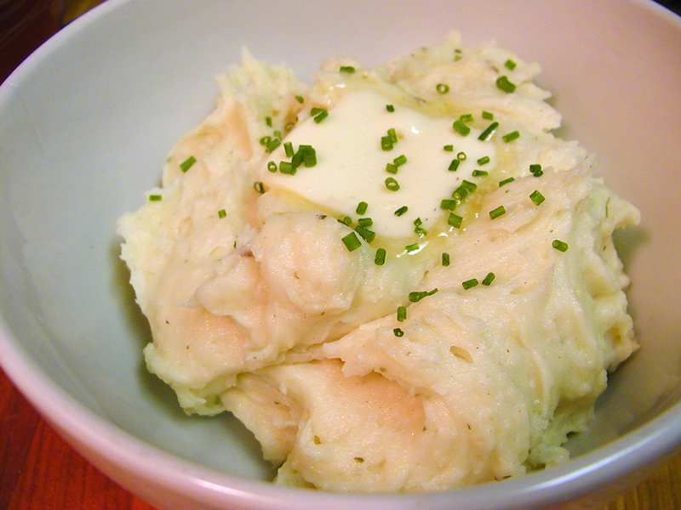
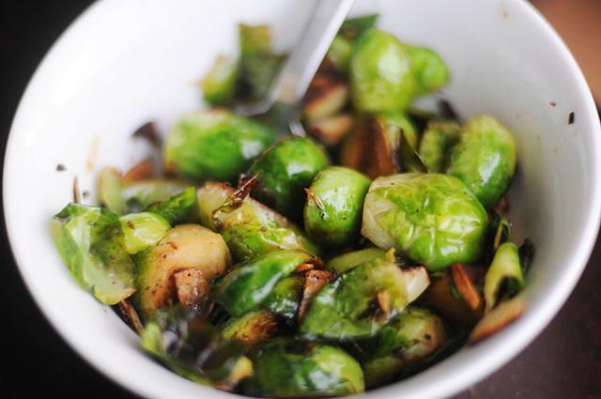
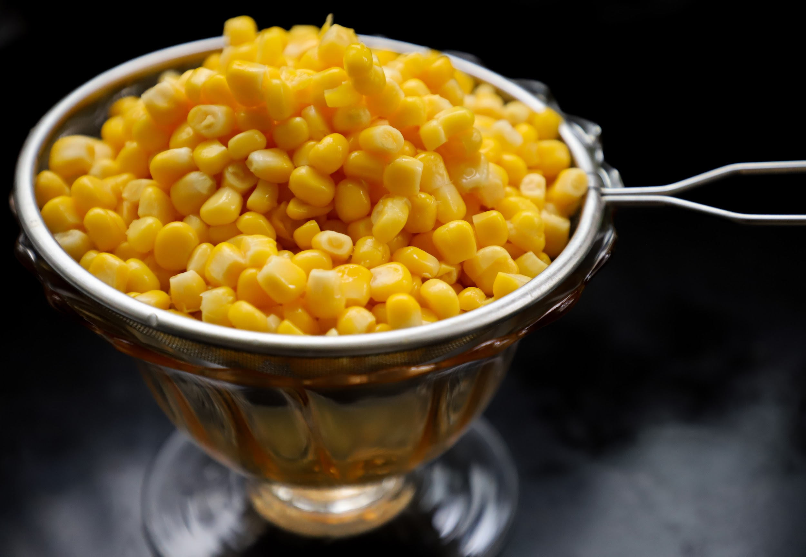
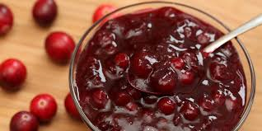
And a side of...

Slide 10
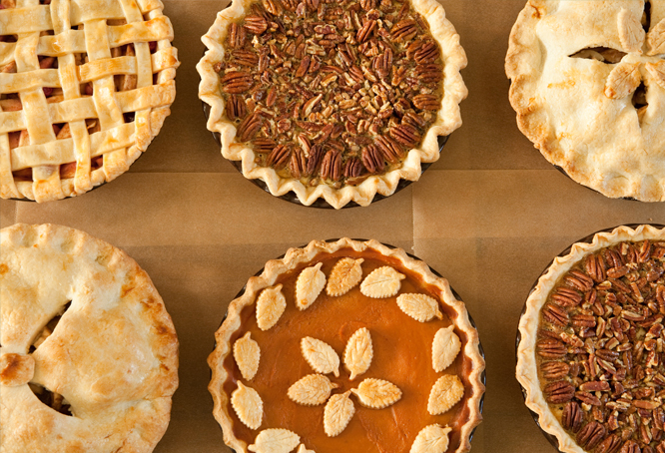
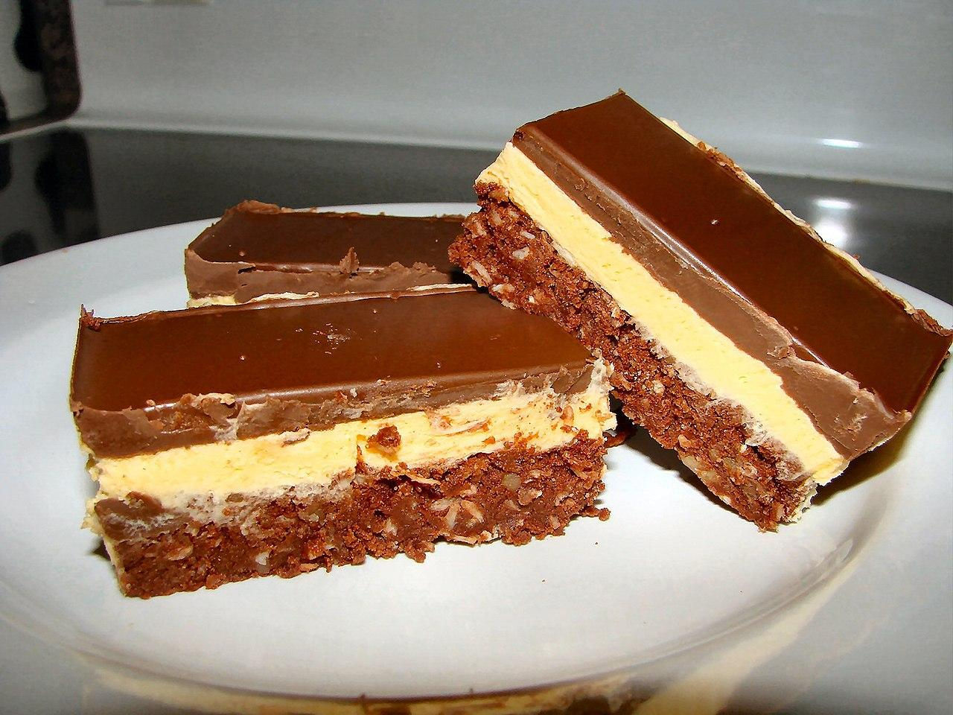
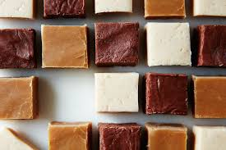
Thanksgiving Pies, nanaimo bars, fudge...

Slide 11
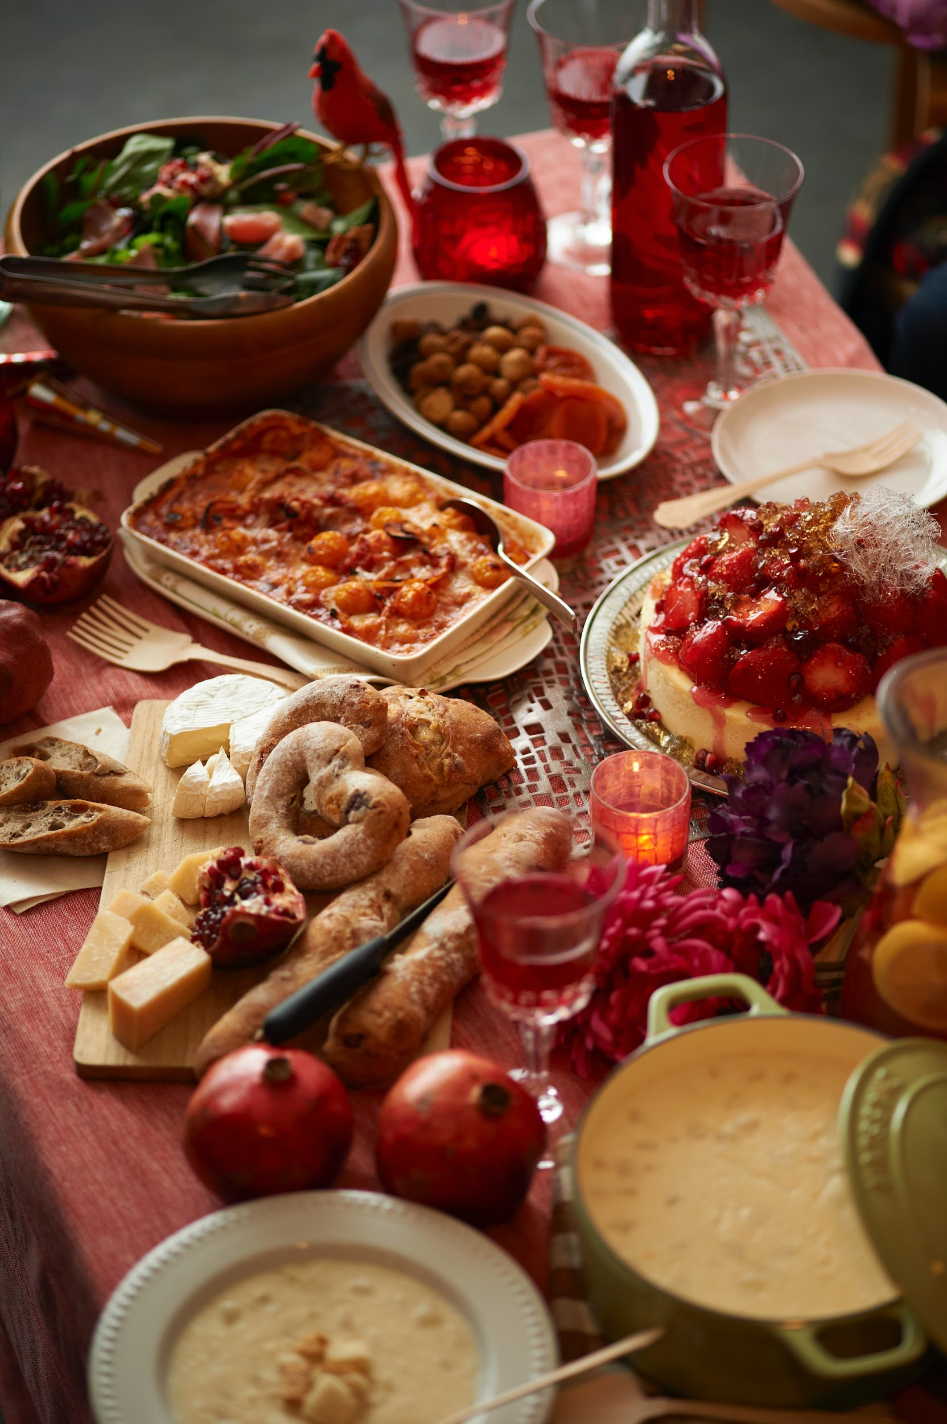
What do families do on Thanksgiving?
...besides eat a ton of food.

Slide 12
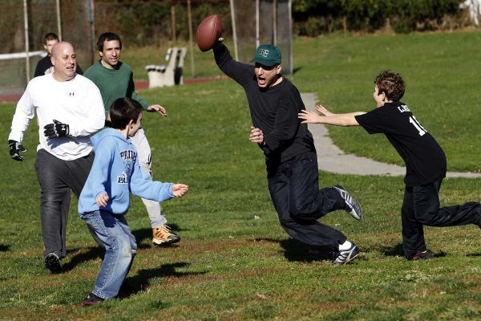
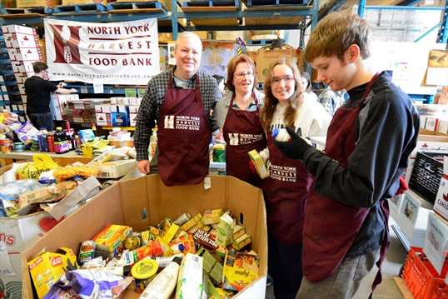
Photo credit: pucksandpuzzlepieces.com
Morning football or other sports...
or volunteering at a food bank.

Slide 13
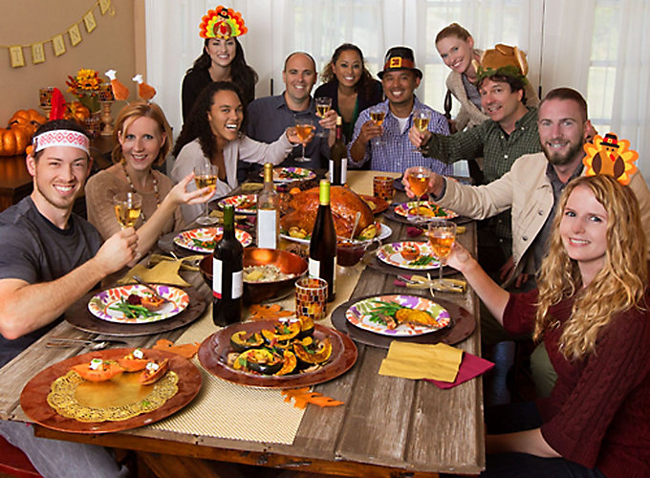
Friendsgiving
Your friends are family too
Especially if you don’t have family in town
...or you do have family in town, but you want ANOTHER Thanksgiving!
Copyright © 2020 International House Pacific Group
Do not share or copy without permission

Slide 14
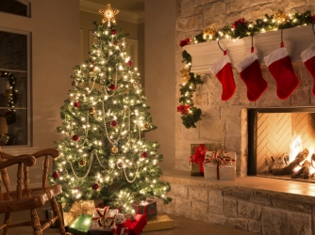
What do you know?
CHRISTMAS
Copyright © 2020 International House Pacific Group
Do not share or copy without permission

Slide 15
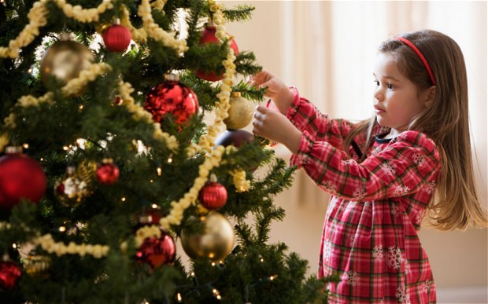
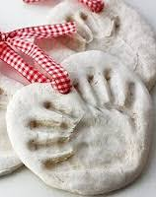
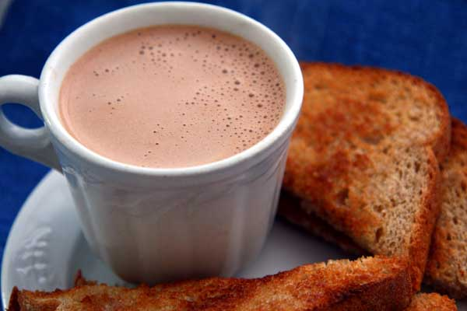
The Christmas Tree is symbolic of many things, such as the spring to come and continuing a full, healthy life. It is very traditional for families to decorate the tree together, often with homemade ornaments and treats.
Copyright © 2020 International House Pacific Group
Do not share or copy without permission

Slide 16
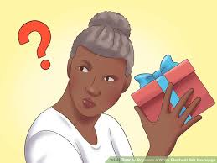
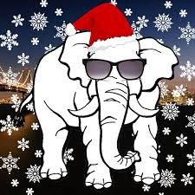
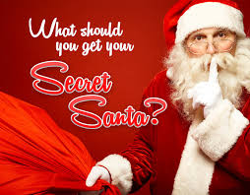
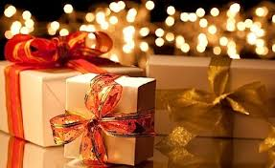
Christmas Gift Exchanges: White Elephant and Secret Santa
Copyright © 2020 International House Pacific Group
Do not share or copy without permission

Slide 17
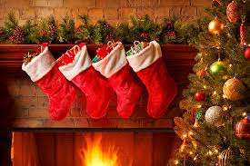
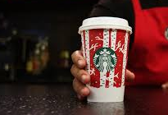
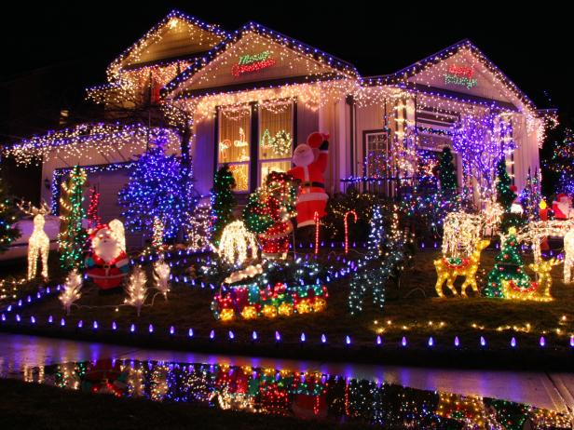
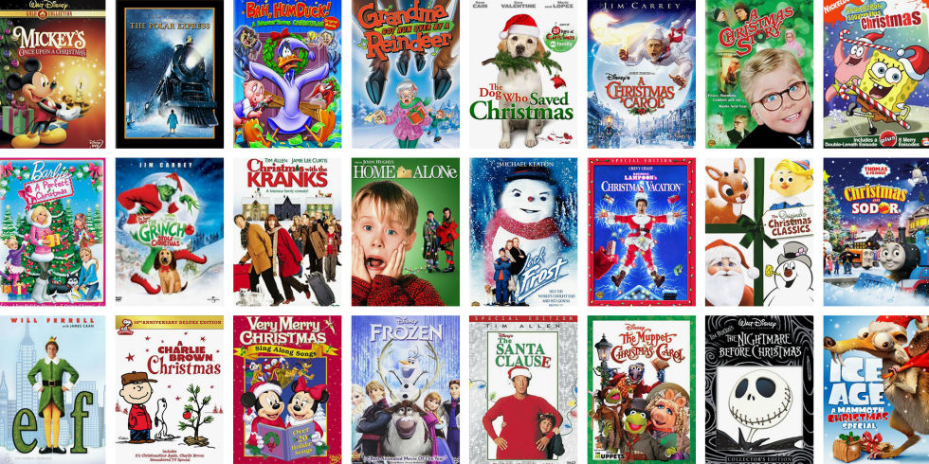
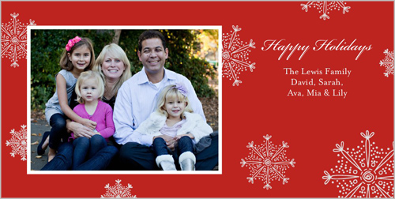
Photo credit: sheamazing.net
Other Christmas traditions...
Copyright © 2020 International House Pacific Group
Do not share or copy without permission

Slide 18
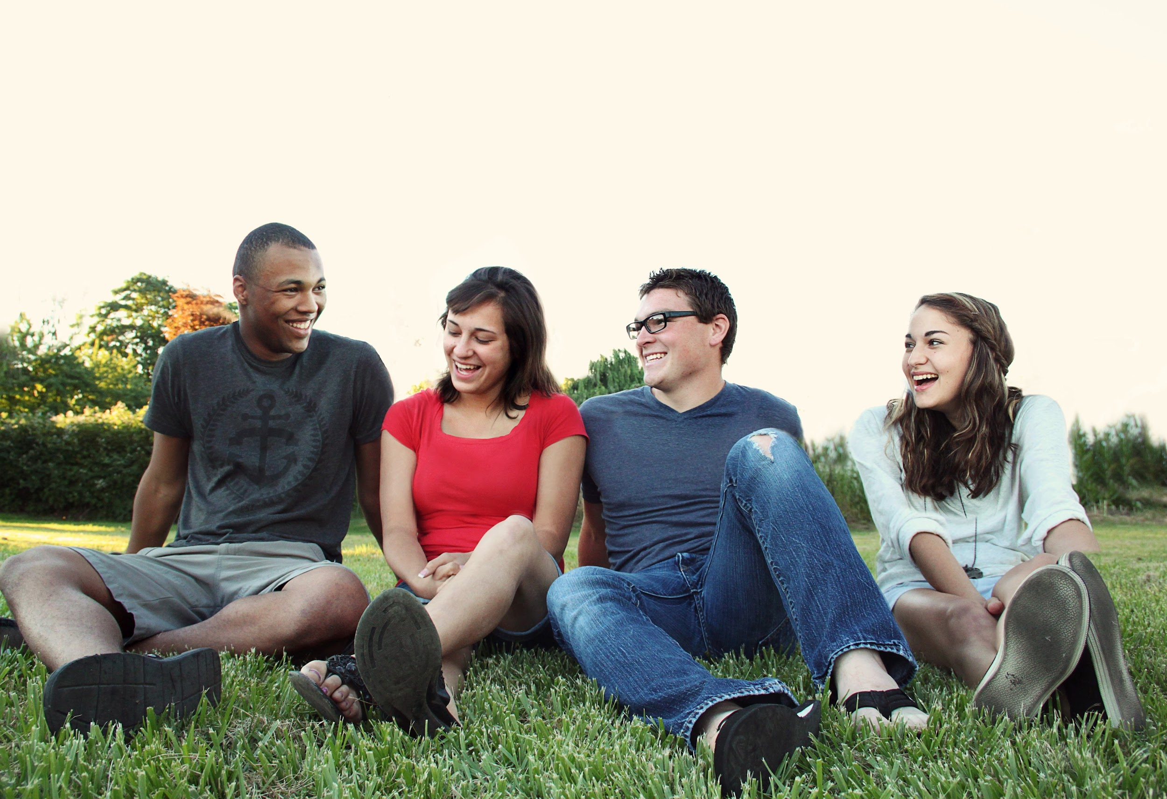
Functional Language
“Happy Holidays!
Happy New Year!
Happy Easter!”
BUT
“Merry Christmas!”
Copyright © 2020 International House Pacific Group
Do not share or copy without permission

Slide 19
Functional Language
“What do you do for (say a holiday)?”
“My family/friends and I (say an activity).”
“What is your favorite holiday?”
“Probably (say a holiday) because (say the reason)! What about you?”
Copyright © 2020 International House Pacific Group
Do not share or copy without permission

Slide 20
Do you have any other questions about Canadian holidays?
Next Class: Neighbourhoods of Vancouver

