Slide 1
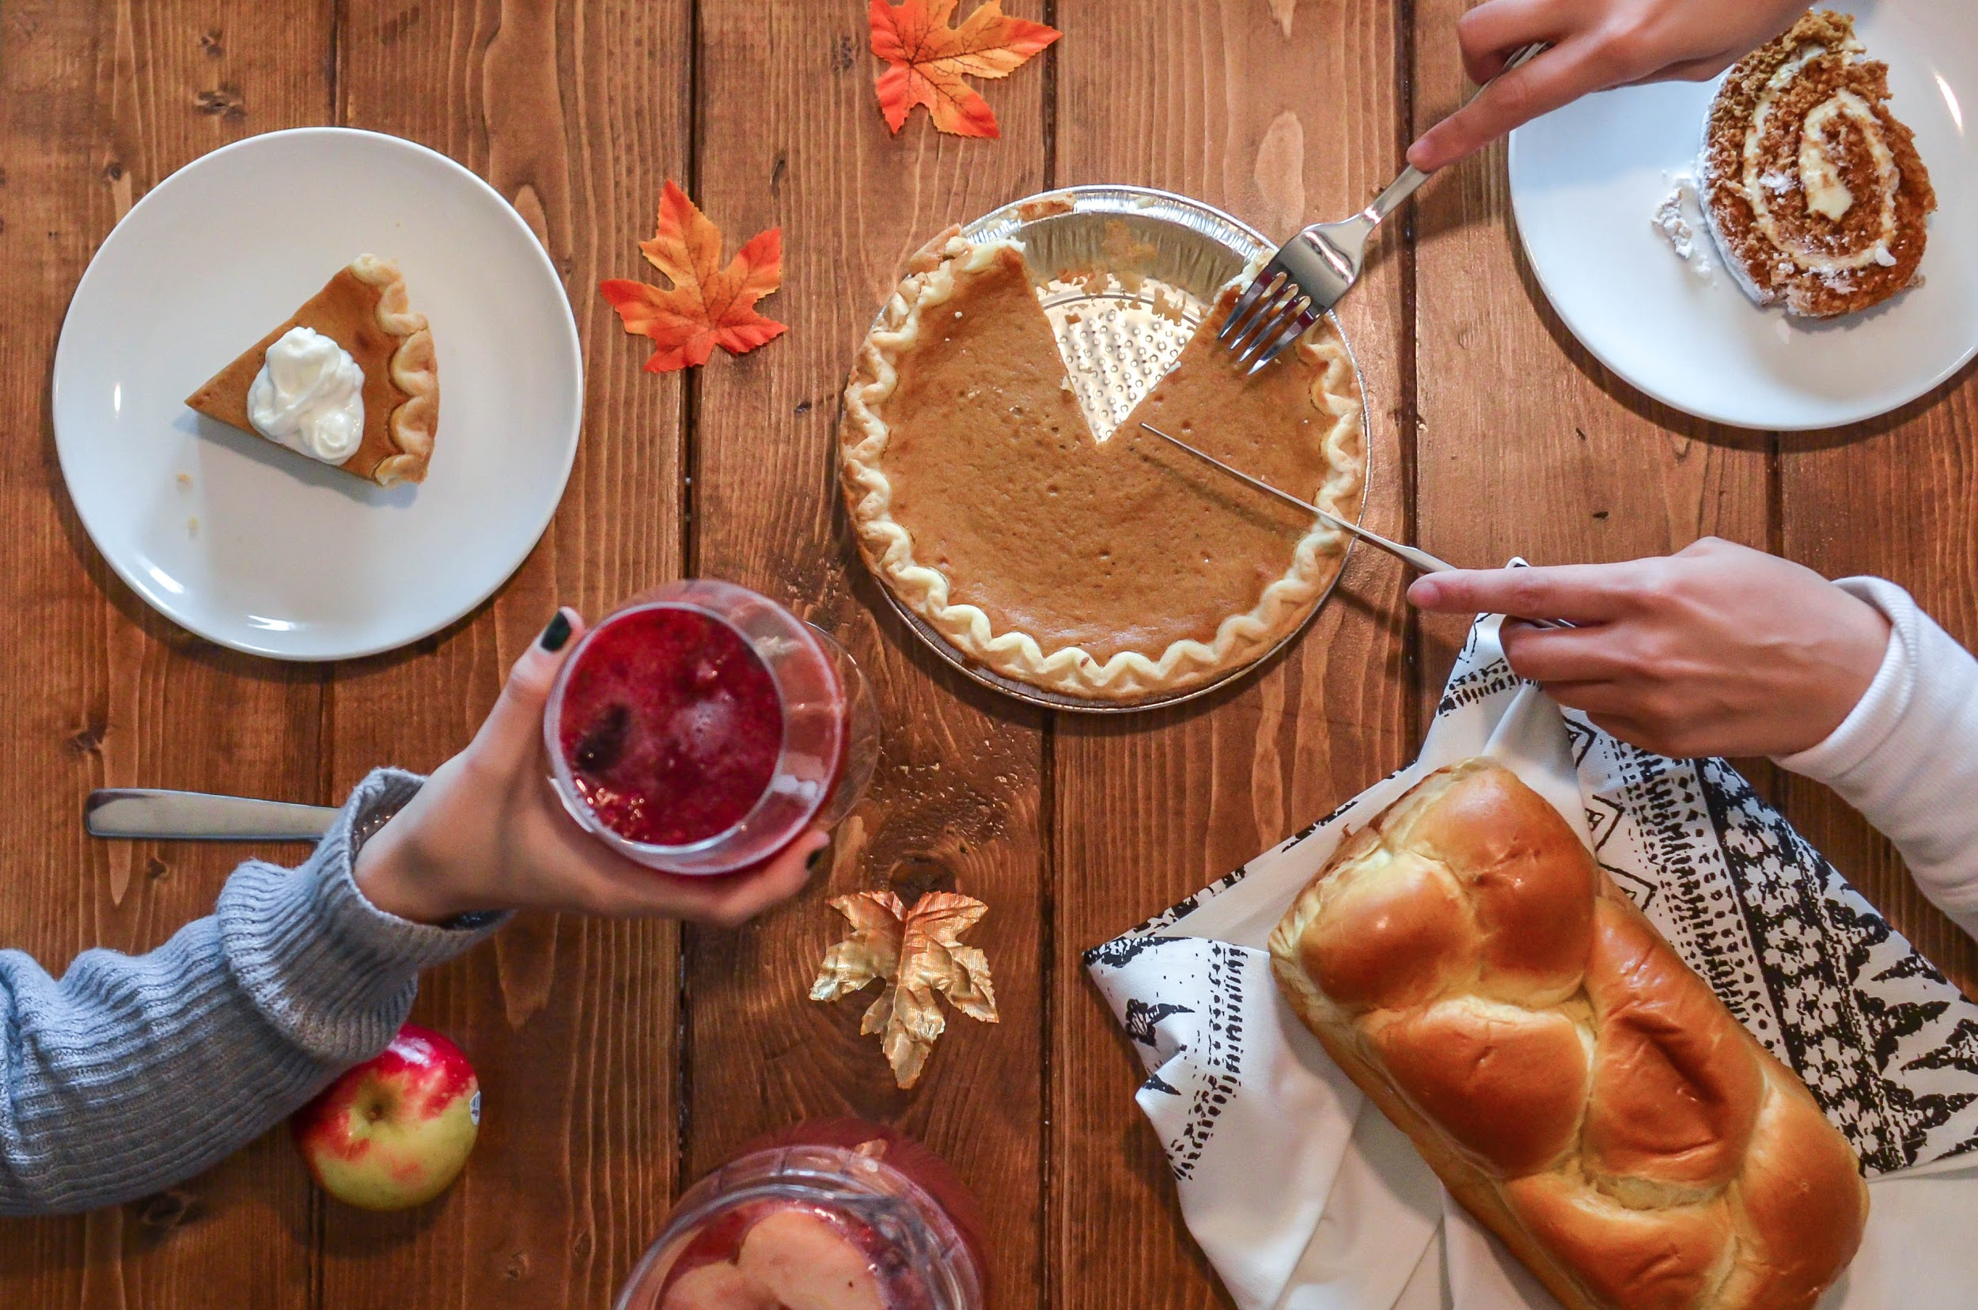
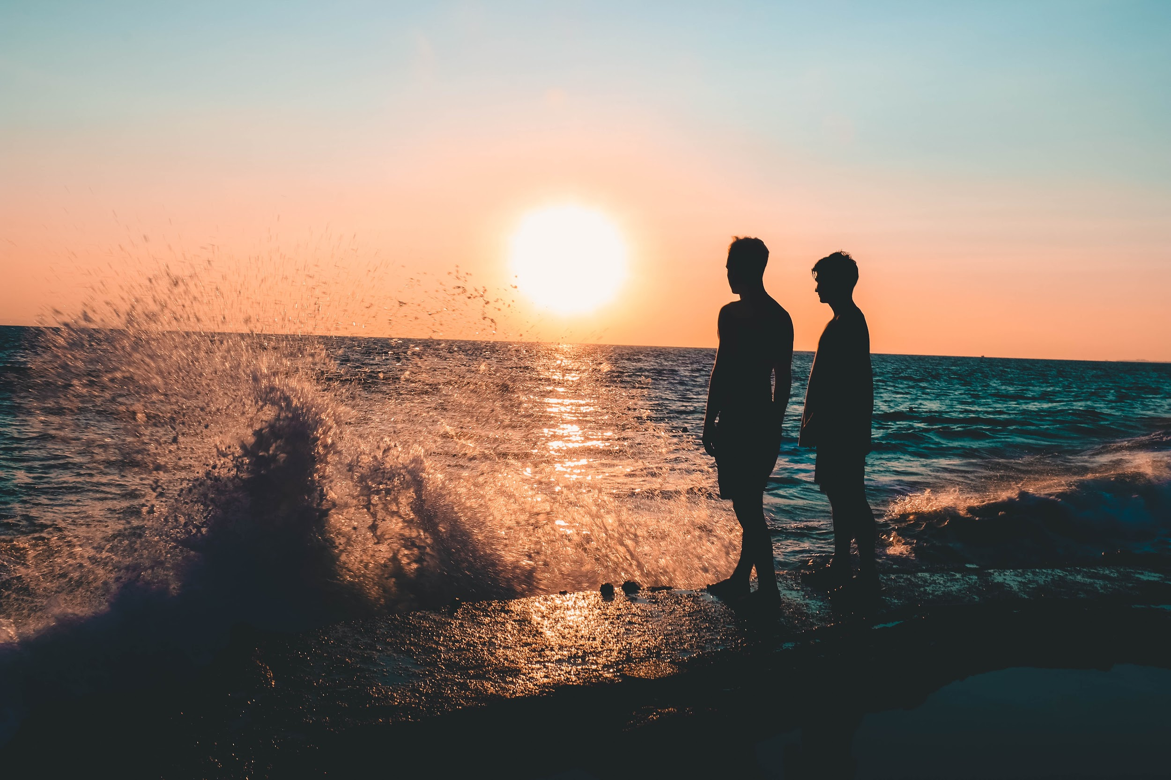
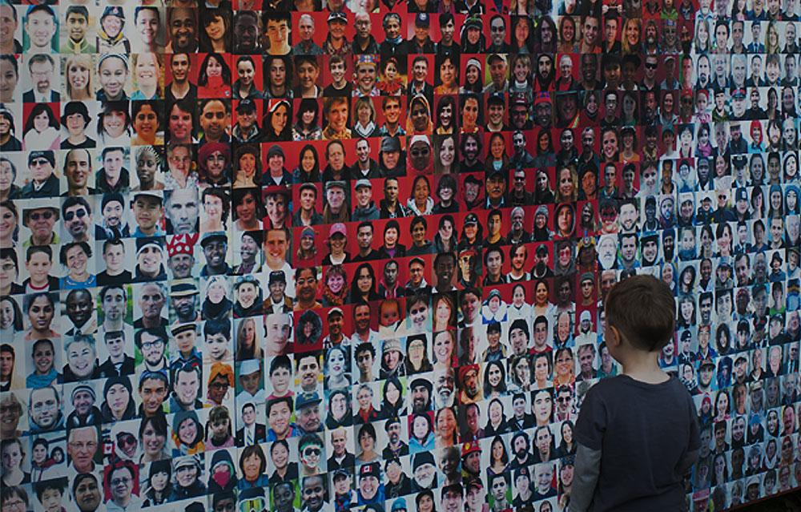
Pre-Arrival English
Looking at Multiculturalism And Canadian Traditions
Copyright © 2020 International House Pacific Group
Do not share or copy without permission

Slide 2
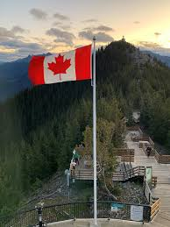
Warm-Up
What are some Canadian traditions that you have seen in the media?
Do you know about multiculturalism?
What do you want to learn about multiculturalism and Canadian traditions before you arrive in Canada?

Slide 3
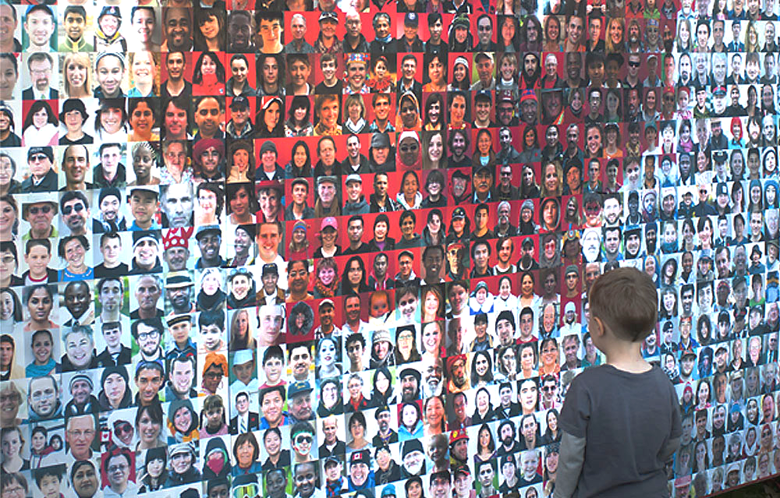
Multiculturalism
Many ethnic backgrounds/ heritage, cultures
Many types of lifestyles:
traditional families
single-parent families
same-sex couples
blended families as well
Gender roles are fluid
(e.g. stay-at-home dads)
Life in Canada

Slide 4
Culture & Traditions
So many things are in this category, including but not limited to:
Food
Eating/Table Etiquette
Clothing
Appearance
Greeting One Another
Hosting & Timing

Slide 5
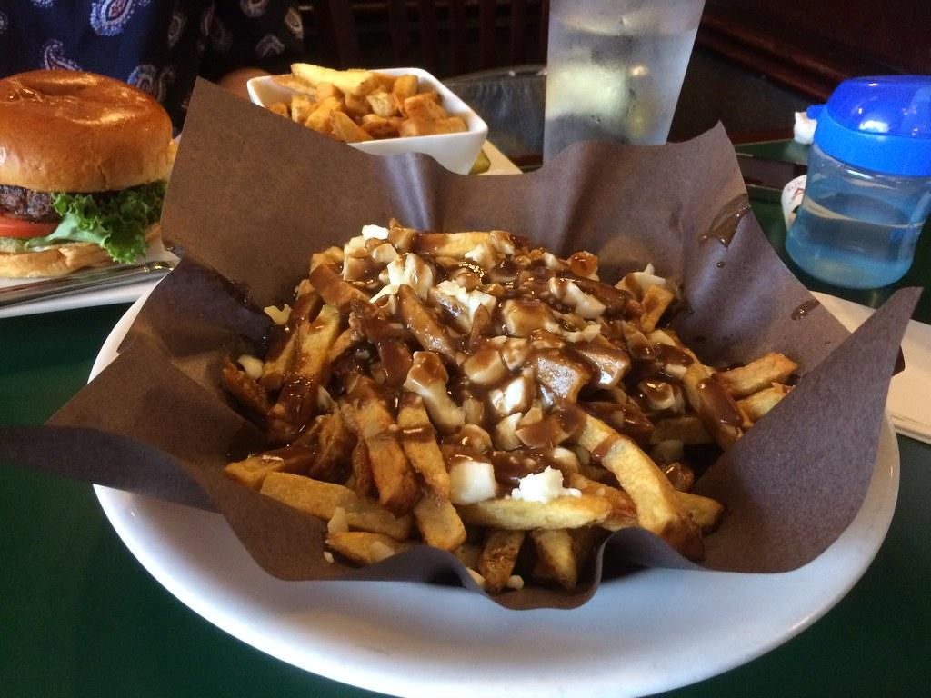
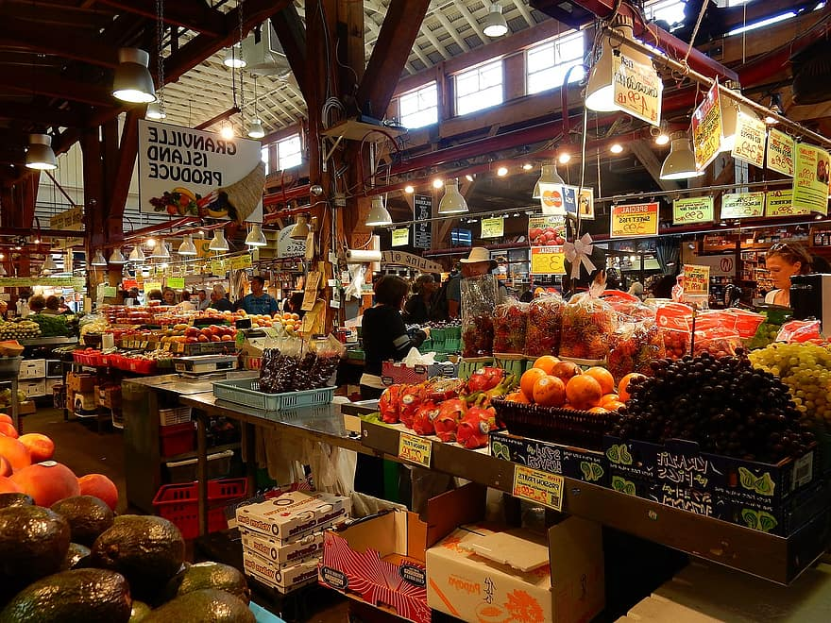
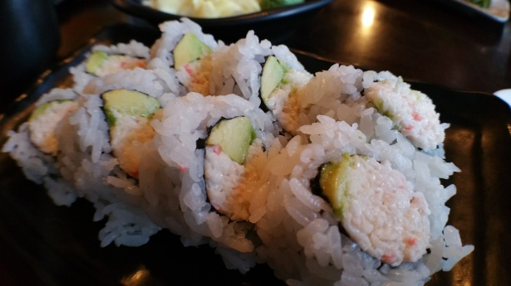
Food
Many different types of food
Portions are bigger than in other countries
Local farmers’ markets
Eating out at restaurants is common
Holidays revolve around food and friends
Vancouver is known for Asian influenced cuisine
Many vegetarian/vegan options at restaurants

Slide 6
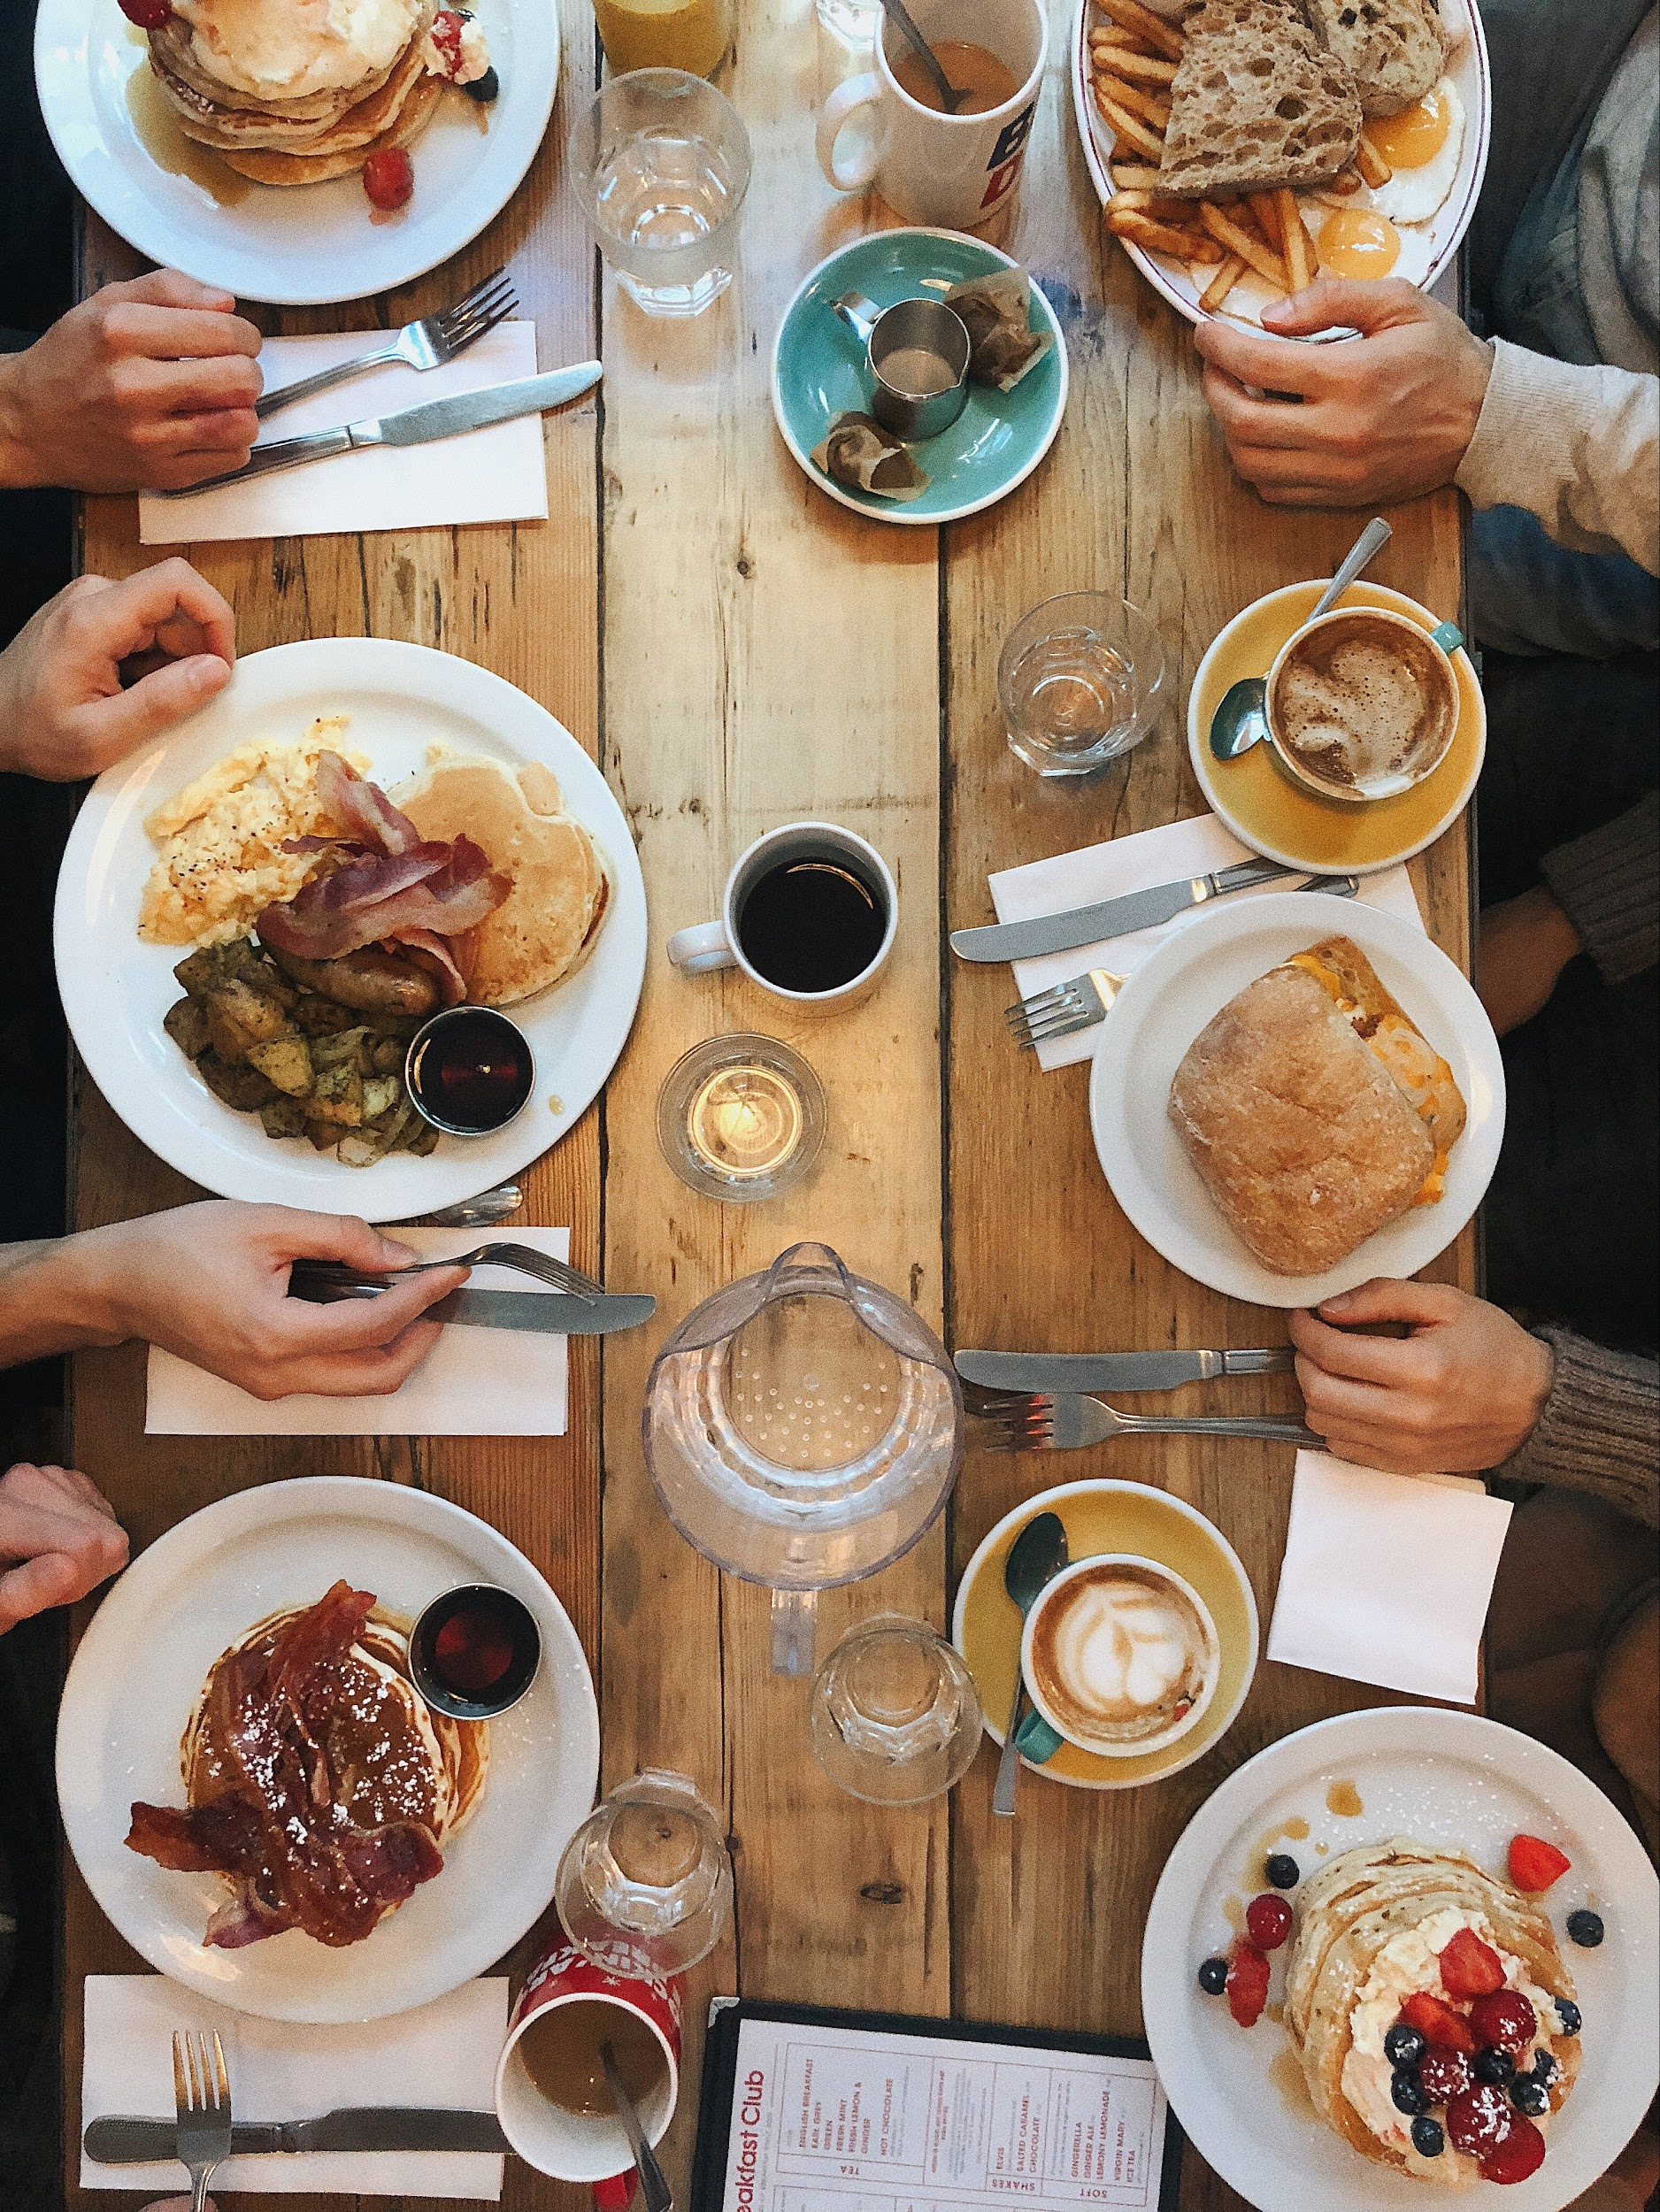
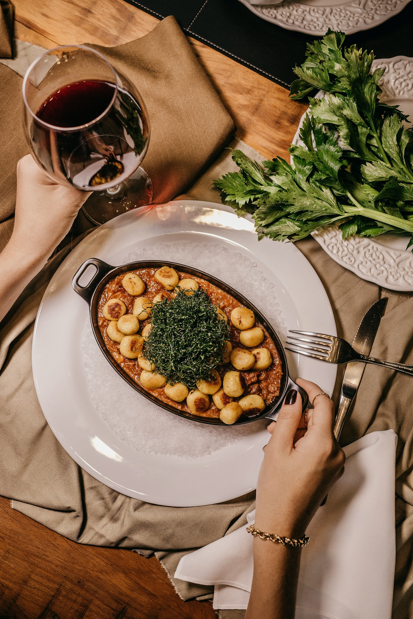
Eating/Table Etiquette
In Vancouver, most people can eat with chopsticks, fork and knife or, for some food, we eat with our hands
At dine-in restaurants, service is important:
Your server will check in with your table throughout your meal
It’s very rude not to tip
A polite wave is used to get their attention, not a call or a snap
It’s okay to share dishes with friends
You can also take uneaten food home in a to-go bag (‘doggie’ bag)

Slide 7
Tipping/Gratuity
How is tipping viewed in your culture?
What types of places do you give a tip in Canada?
What is a “good tip” here?

Slide 8
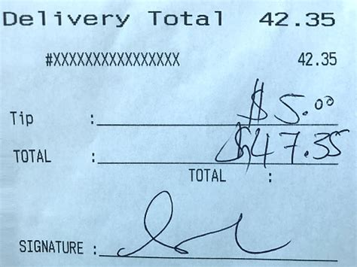
Tipping/Gratuity
What types of places do you give a tip in Canada?
Restaurants, salons (for services)
What is a “good tip” here?
15% = good service
18% = great service
20% = above & beyond!
When service is not good, explain to the server or manager
Photo credit: istockphotos.com

Slide 9
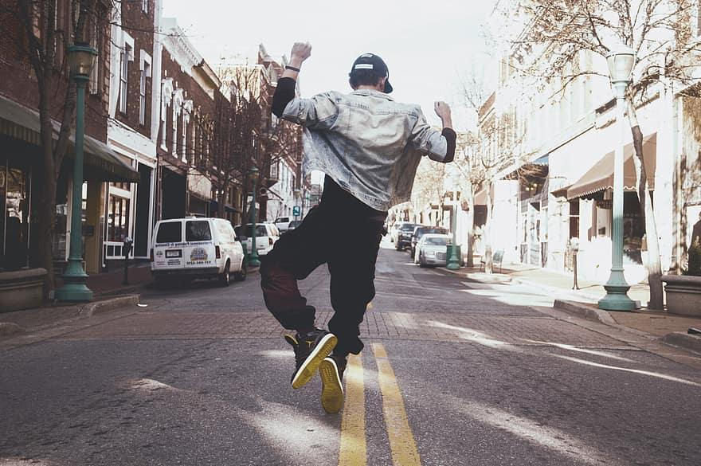
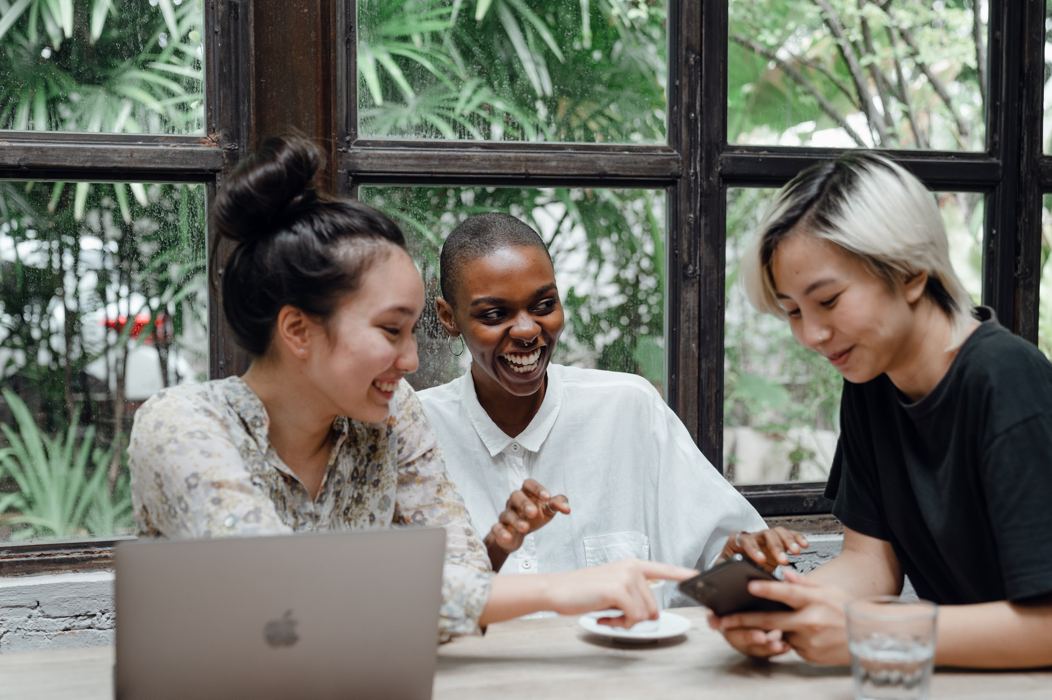
Clothing
In Canada, especially Vancouver, the style is very casual
Athleisure (Athletic leisure clothing) is very common at school
Smart casual is the most popular work attire
polo shirts, clean, dark jeans, comfortable shoes
sundresses(in the summer)
Short-sleeve blouses and cardigans, dark jeans

Slide 10
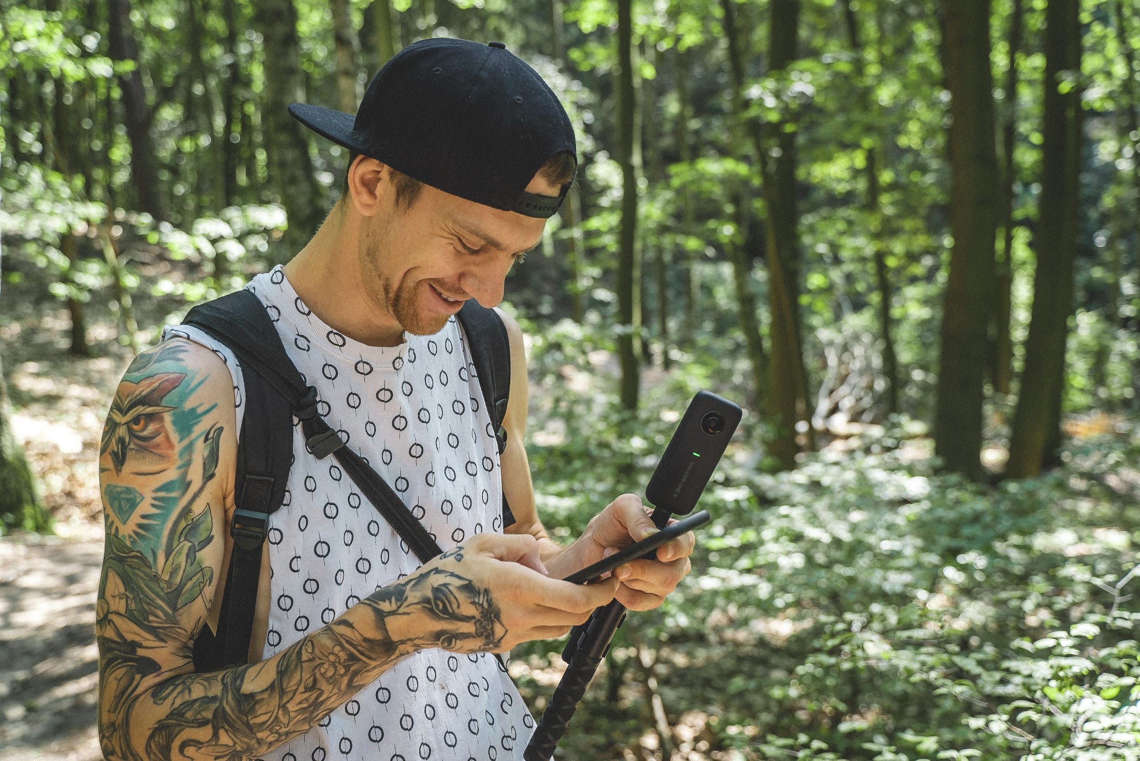
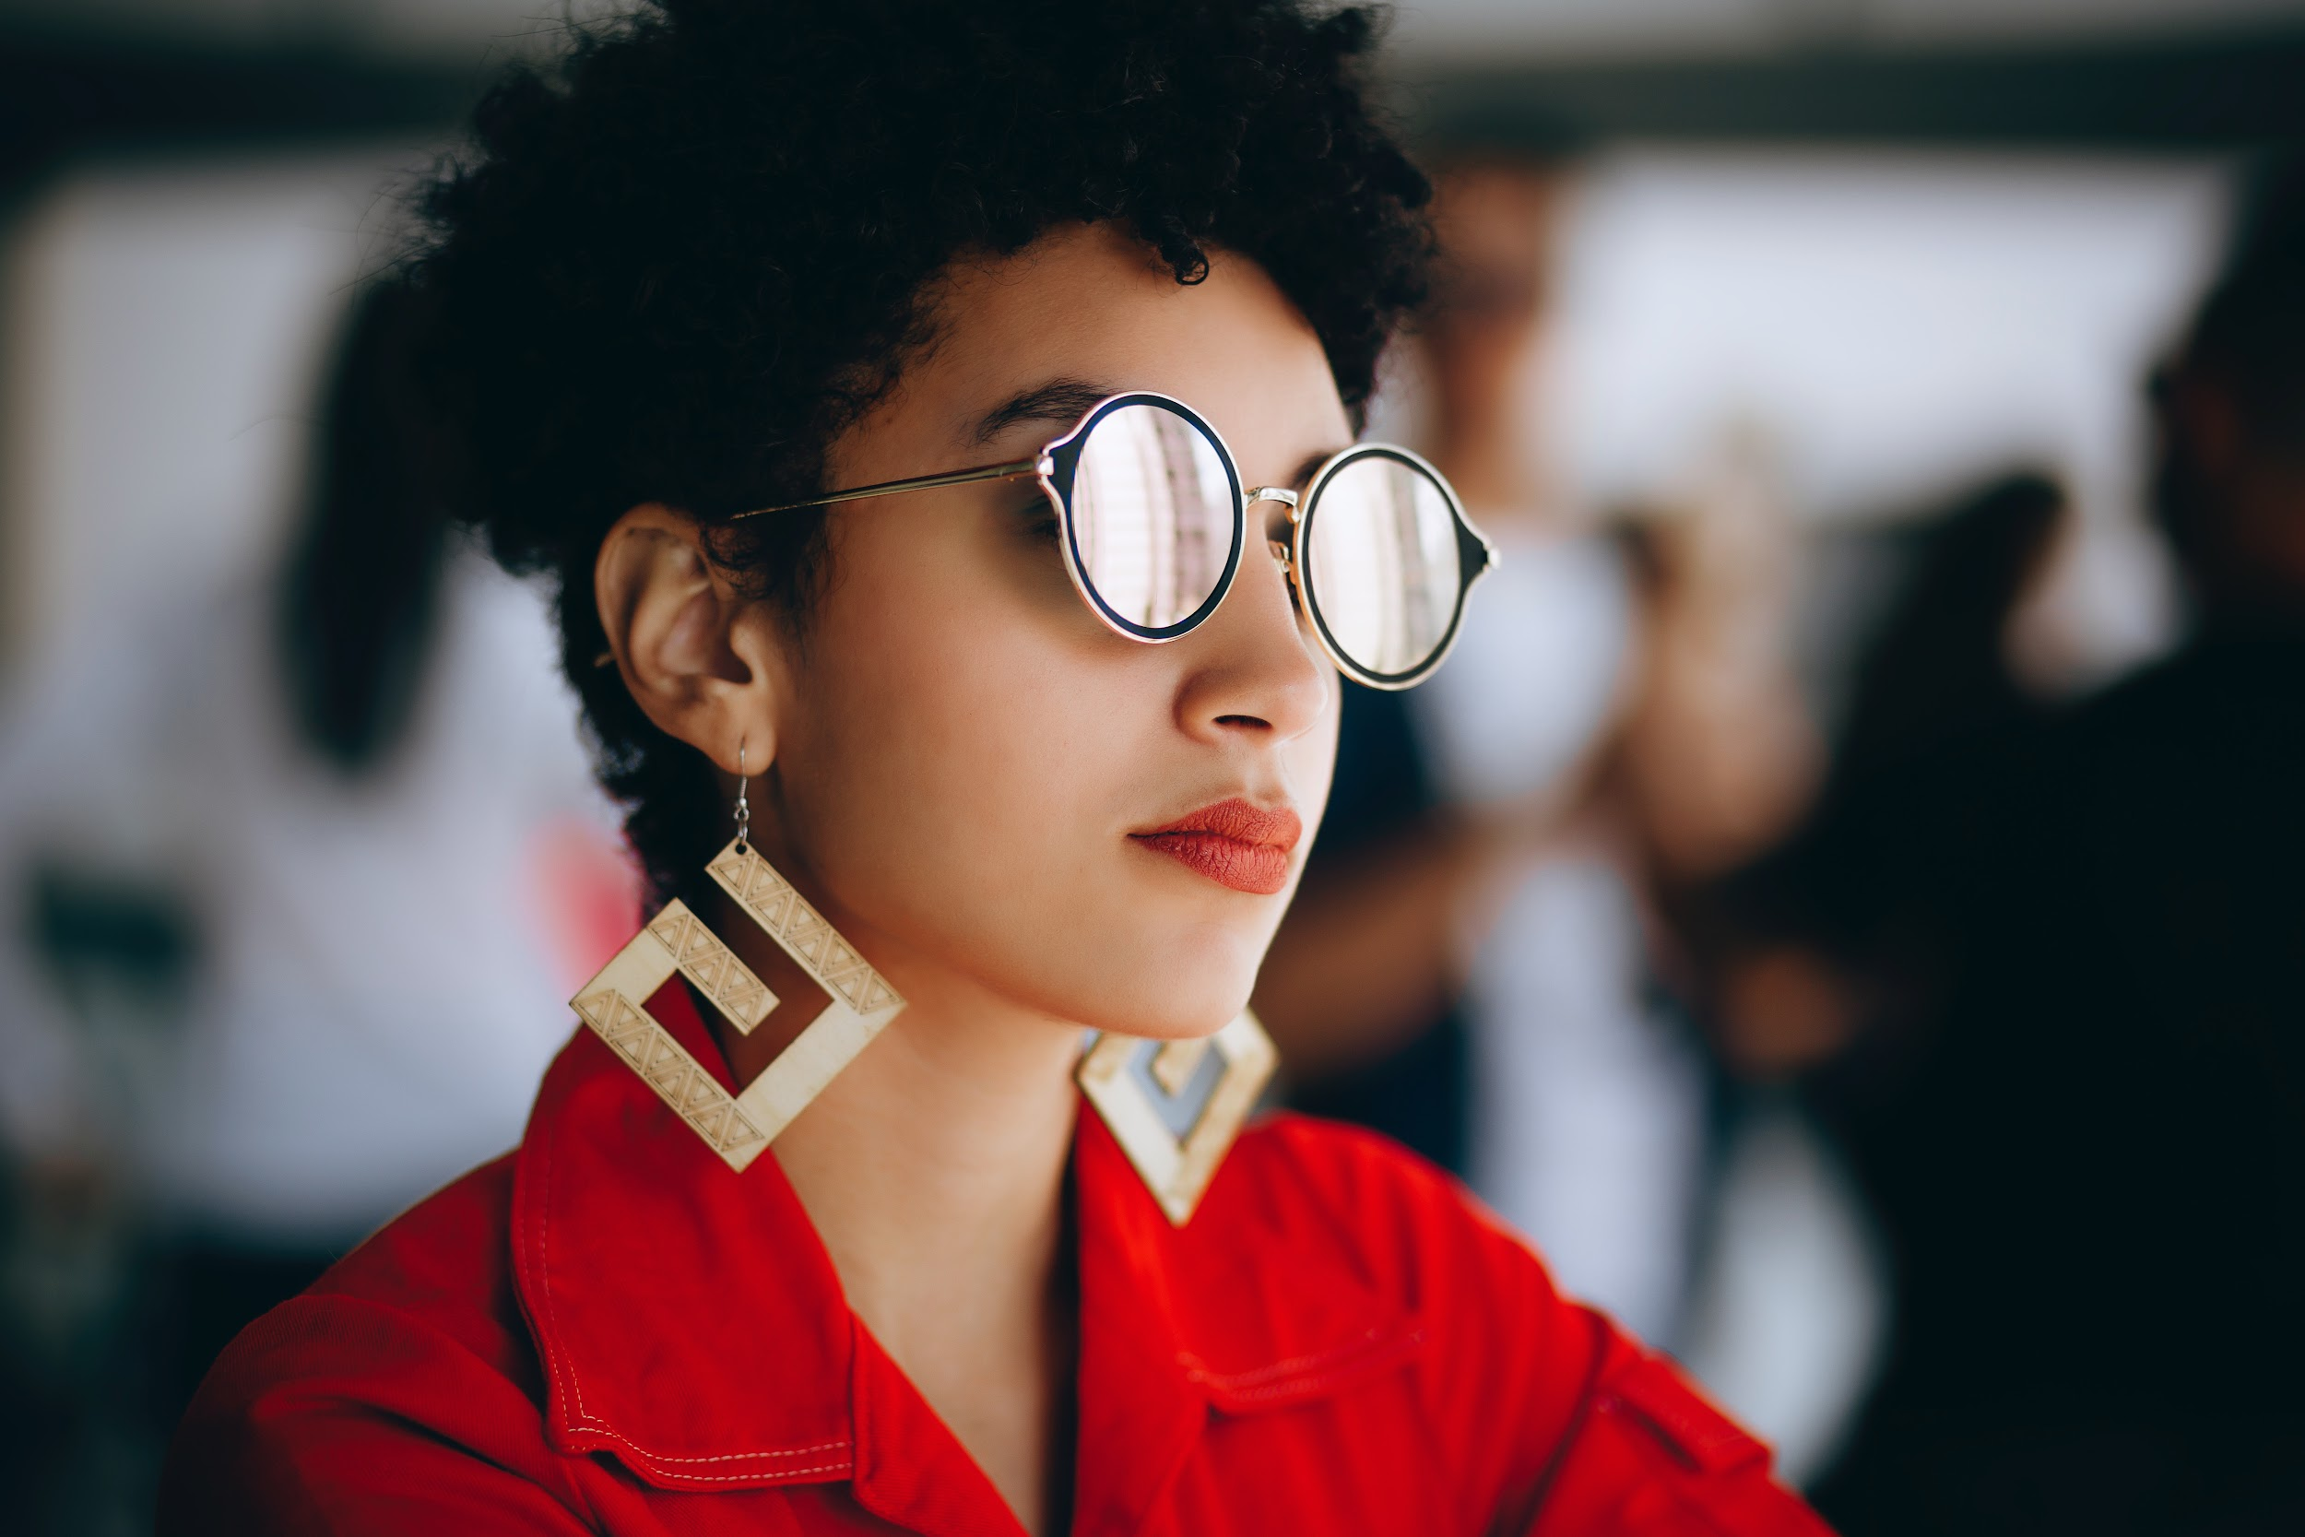
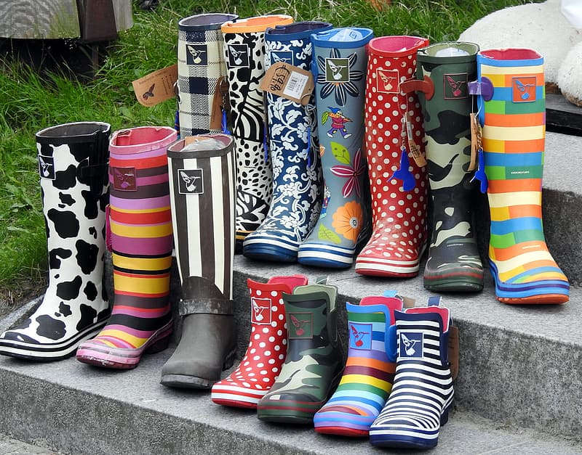
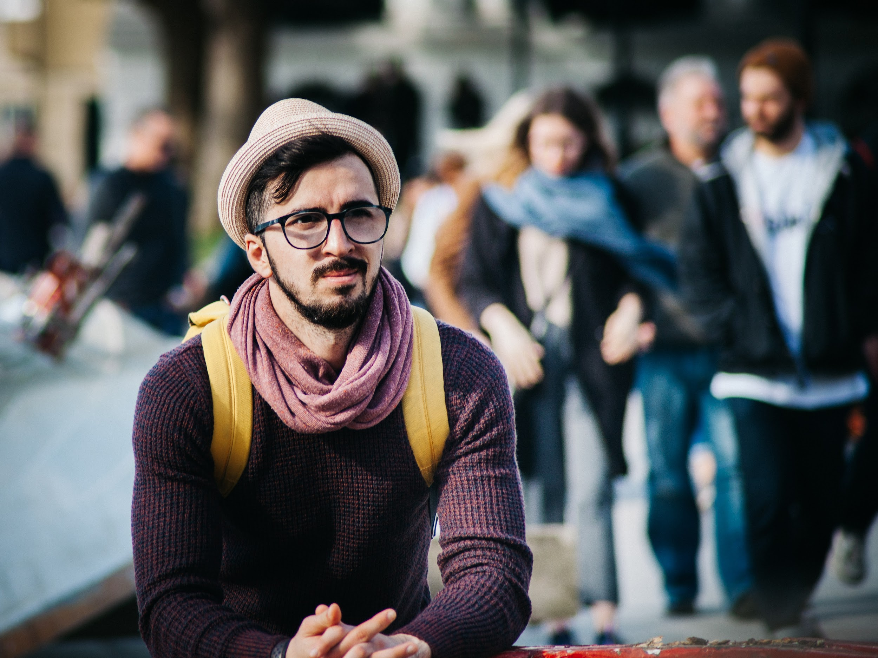
Appearance
It is very common for people to have tattoos and/or piercings
Variety of trends/styles
Hats are acceptable to wear indoors and outdoors
Rain boots (of all styles) are common during the winter season

Slide 11
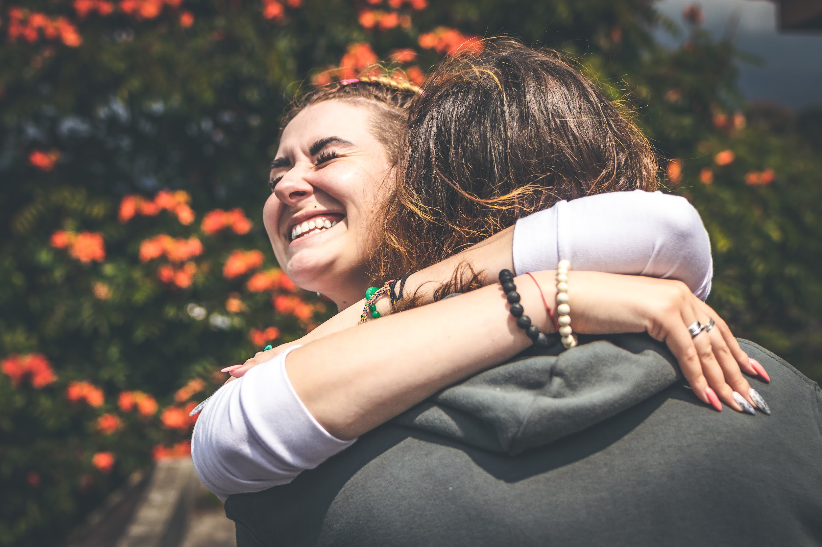
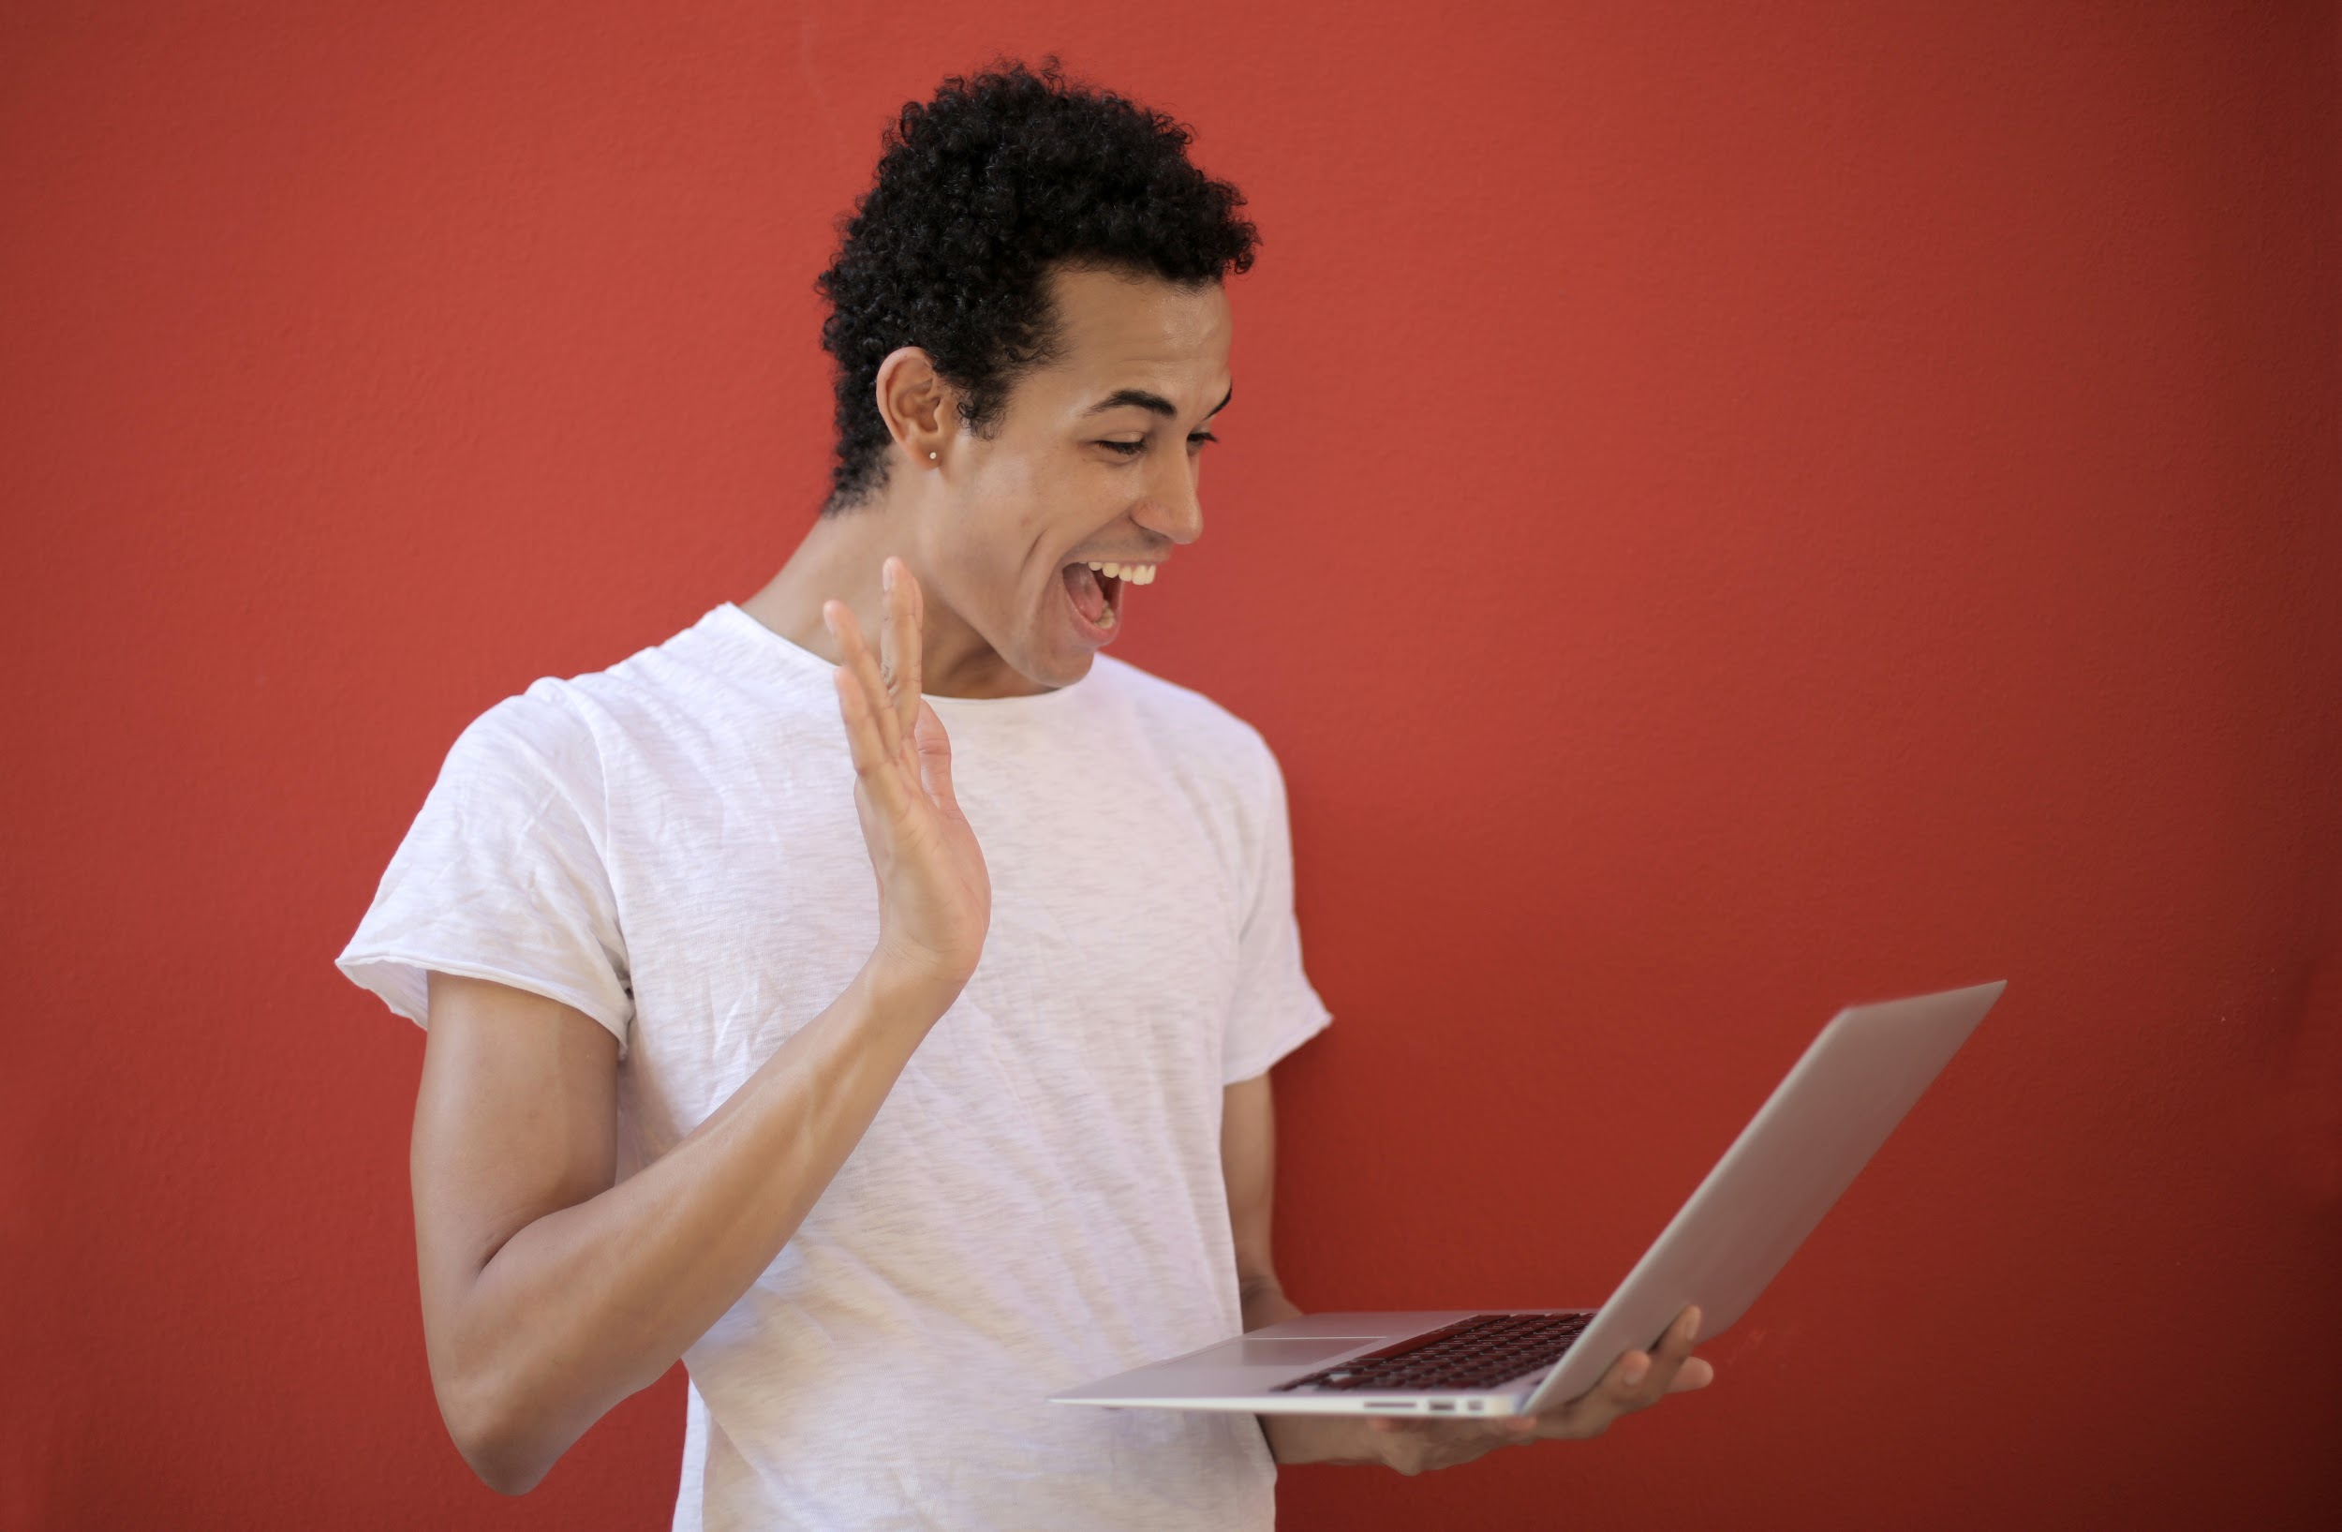
Greeting One Another
Business: Handshake
COVID: polite, short wave
Family and friends: Hugs
Friend of a friend: Hug, wave or nod and smile
Stranger: Handshake, wave or nod and smile
*even in business, greeting is fairly casual

Slide 12
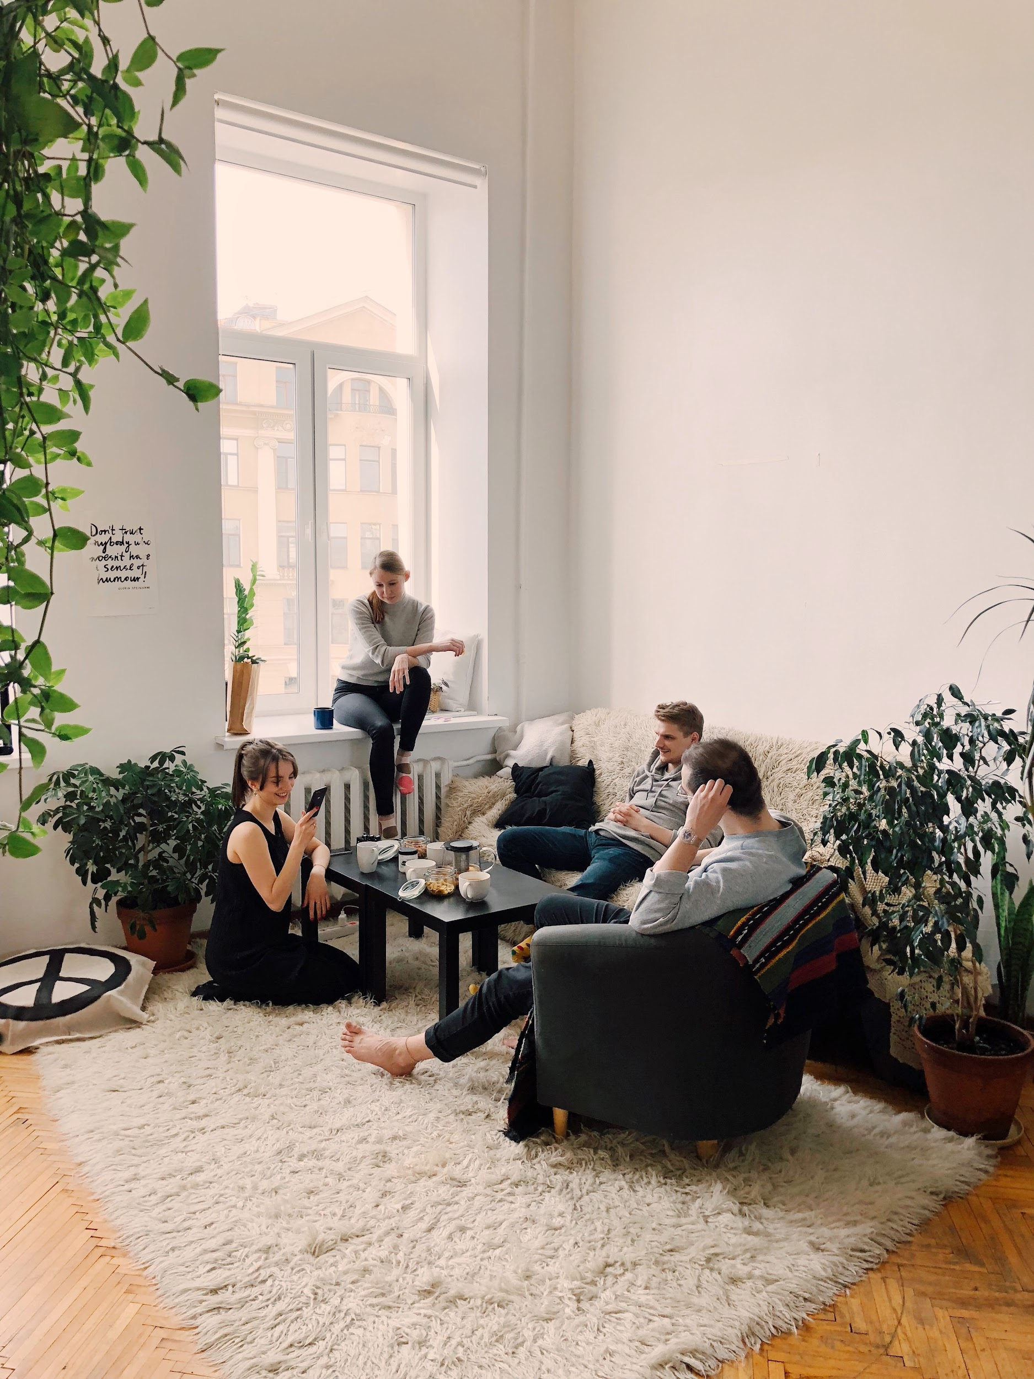
Hosting & Timing
It’s common in Canada to invite people to your home
When friends get together, it’s common to bring something to share (eg. wine, cookies, etc.)
Canadian are usually right on time or a few minutes late
When you are a guest, it’s usually better to be slightly late than too early

Slide 13
Functional Language
“What is your favorite type of cuisine?”
“I like (Mexican) but (Italian) is a close second.”
__________________________________
“How much should I tip?”
“The service was (above and beyond)! Maybe (20%)?”

Slide 14
Functional Language
“What time should we meet for dinner?”
“Hmm, let’s say (6pm)?.”
“Sounds good! Meet out front at 6?”
“See you then!”

Slide 15
Wrap-Up
What are some Canadian traditions you are most looking forward to?
Which ones are you most nervous for?
What information from this lesson surprised you to hear about?
Do you have any other questions about multiculturalism or other Canadian traditions?
Next Class: Canadian Holidays

