Slide 1
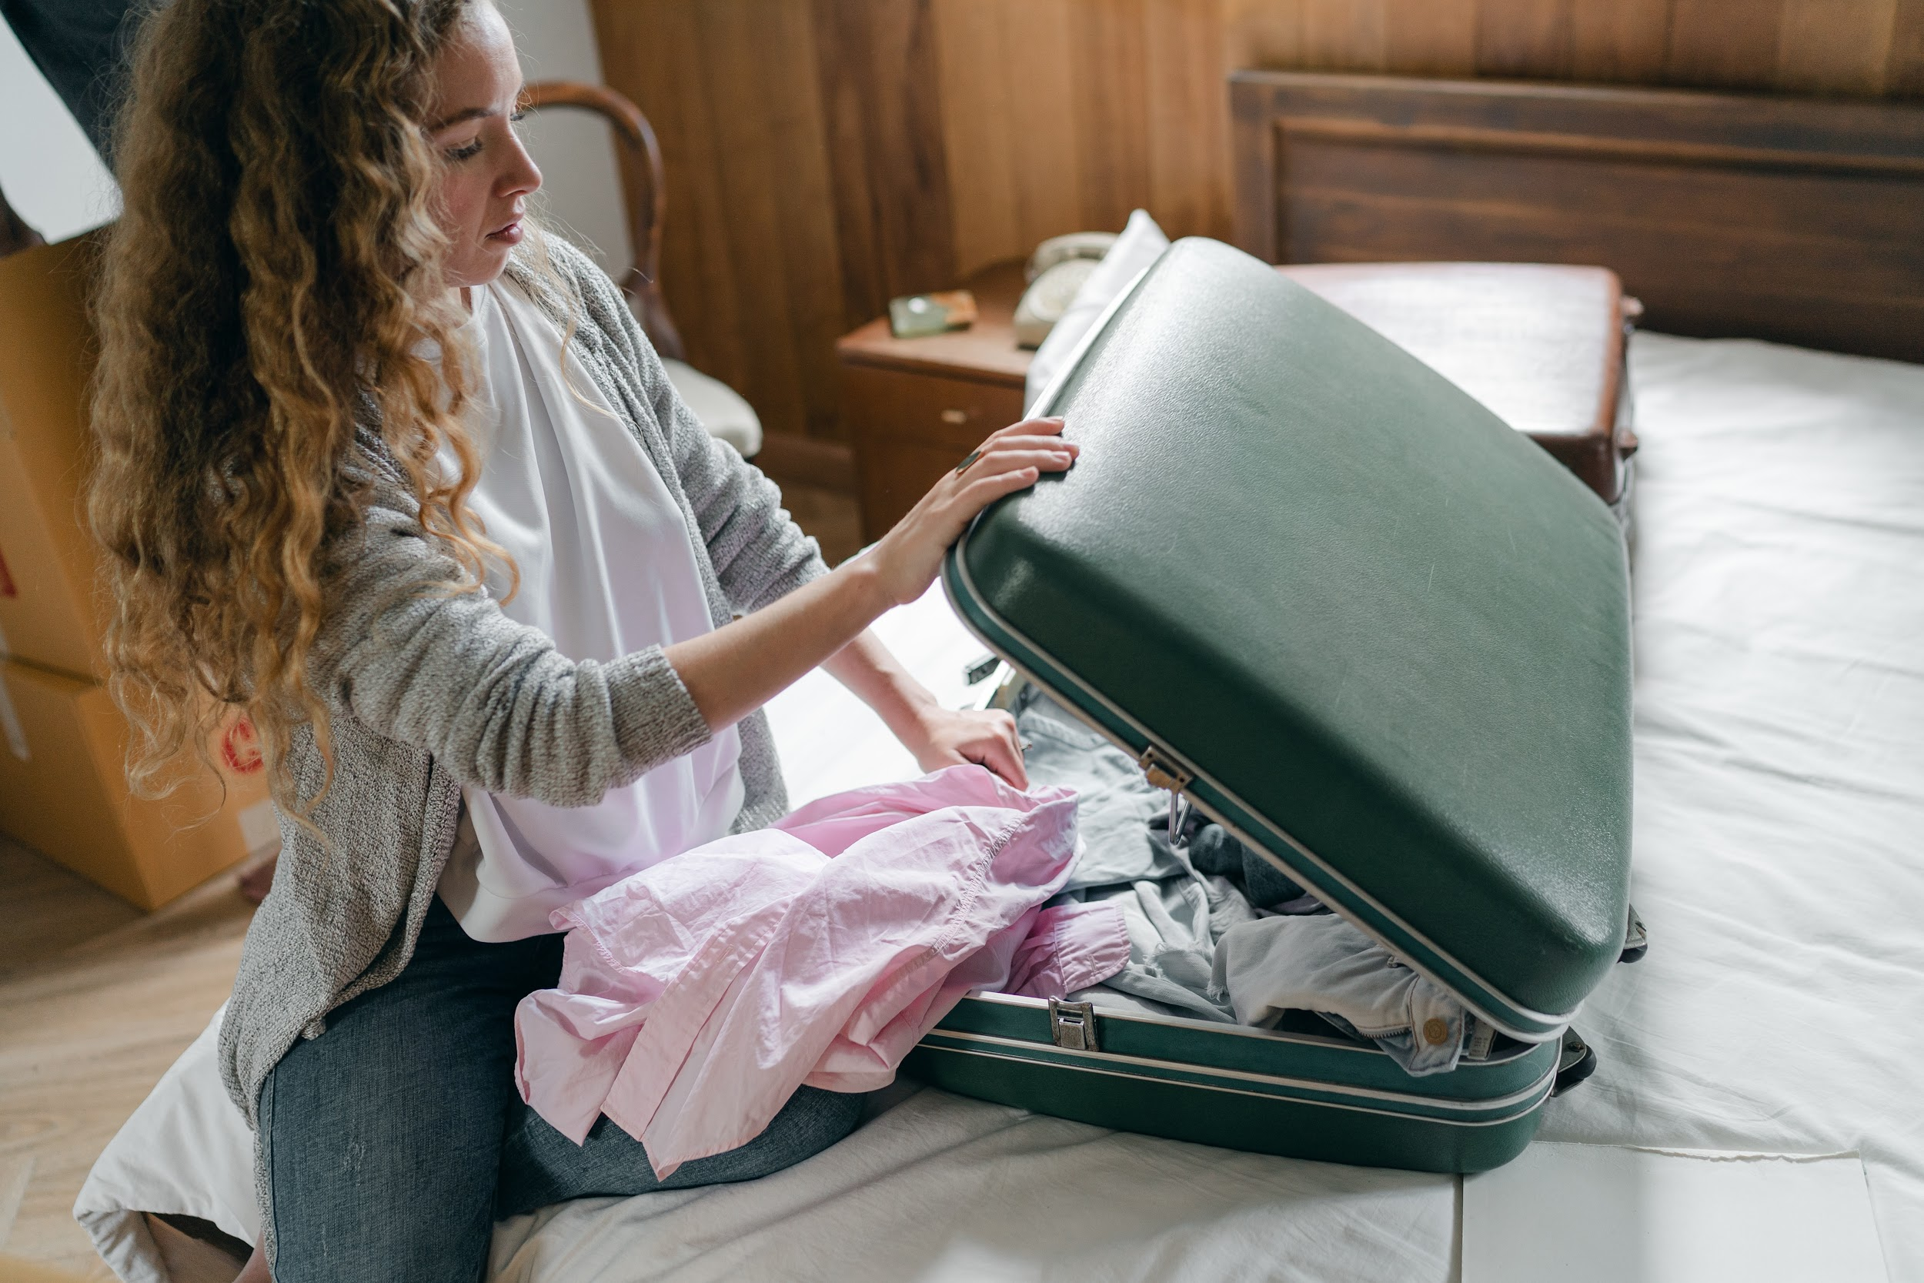
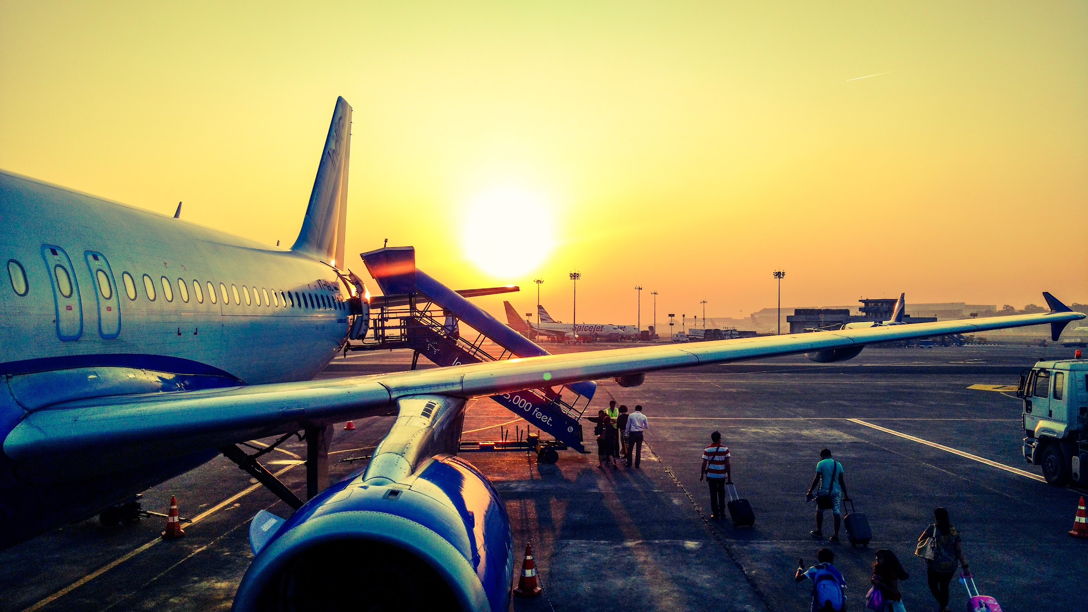
Pre-Arrival English
Must-See Sights in Vancouver
and Q&A
Copyright © 2020 International House Pacific Group
Do not share or copy without permission

Slide 2
Warm-Up
What are some “must-sees” in your country?
Do you have any in mind for Vancouver?

Slide 3
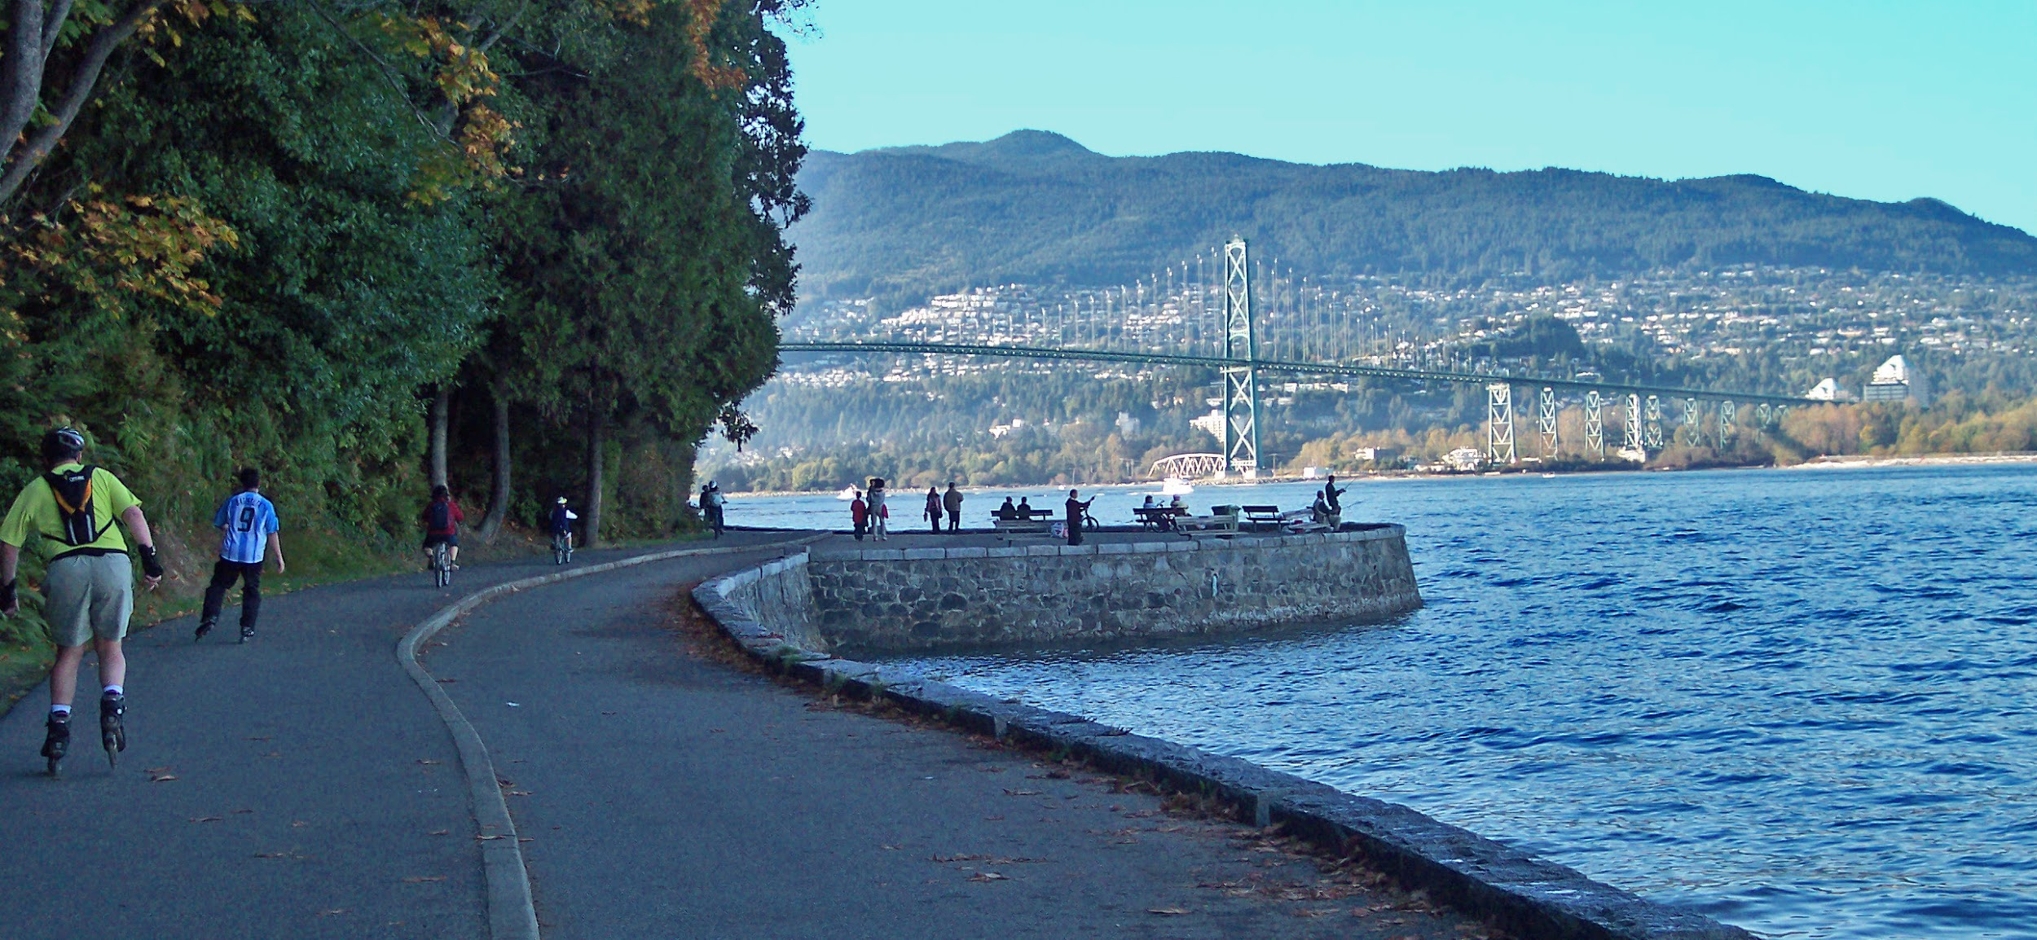
The Seawall
One of the most famous sights and beautiful areas loved by locals and tourists is the seawall.
Walking
Bicycling (biking)
Rollerblading
Lookout points
Enjoy spending a day at Stanley Park

Slide 4
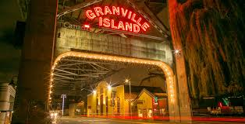
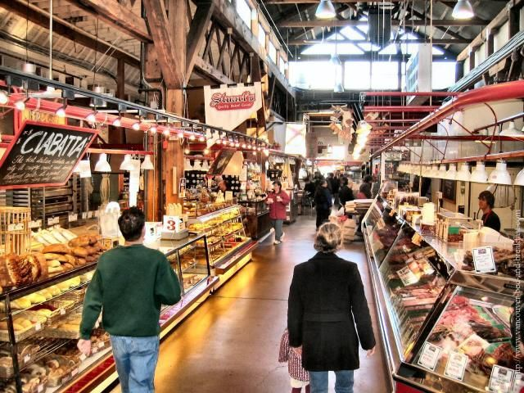
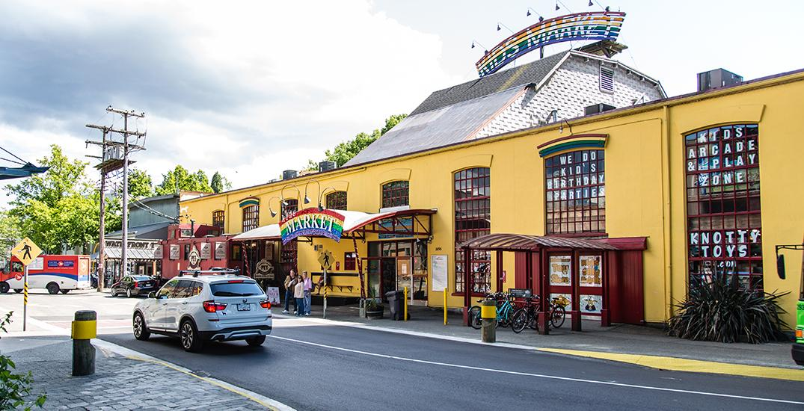
Granville Island
Granville Island markets boast the best of the local produce and savory delights. Also, check out the kid’s market. It’s for all ages.
Photo credit: Granville Island Website

Slide 5
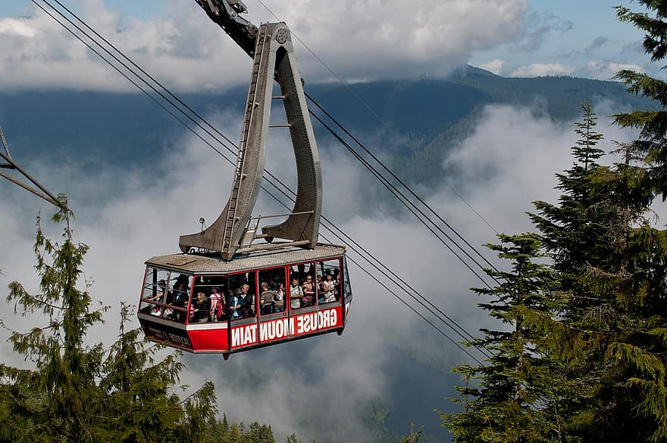
Grouse Mountain
Take the gondola up to the lookout atop
Grouse Grind!
Or hike the Grouse Grind in the summer. Definitely a bucket list item!

Slide 6
Now For Review
Let’s go over what we talked about in this course!

Slide 7
Course Outline
Class | Topic
1 | Arriving to Vancouver: From Airport to Accommodation
2 | Meeting Local People: Small Talk and Body Language
3 | Looking at Multiculturalism and Canadian Traditions
4 | Canadian Holidays
5 | The Neighborhoods of Vancouver
6 | How to Communicate When You Don’t Understand What People Are Saying
7 | Festivals and Events in Vancouver
8 | Grocery Stores and How to Look for Food
9 | The Best Restaurants and Popular Cuisine
What are good topics to discuss with people are just meet?
What are topics you should avoid?
What do you think of when you imagine multiculturalism?
Are you familiar when any Canadian holidays?
Would you buy food at the grocery store or a restaurant if you didn’t know what it was? Why or why not?
Which was your favorite class of these 9?

Slide 8
Course Outline
Where do you make new friends in your country?
Besides Vancouver, what do you want to see in British Columbia?
What Canadian slang have you heard in TV shows or movies?
Have you ever dealt with an emergency abroad? If so, how did you handle it?
How do you relax after school or work?
Which was your favorite class of these 9?
Class | Topic
10 | Making International Friends
11 | Weekend Trips from Vancouver
12 | Understanding the Different Regions of Canada
13 | Canadian Slang
14 | Emergency English
15 | Balancing School Work and Leisure Time
16 | Vancouver Nightlife
17 | Planning Your Abroad Experience from Start to Finish
18 | Must-See Sights in Vancouver and Q&A

Slide 9
Time for Questions
What questions did you think of for homework?

Slide 10
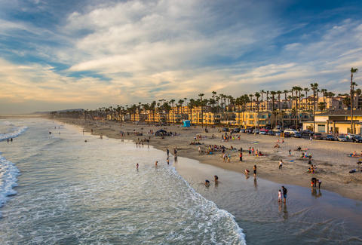
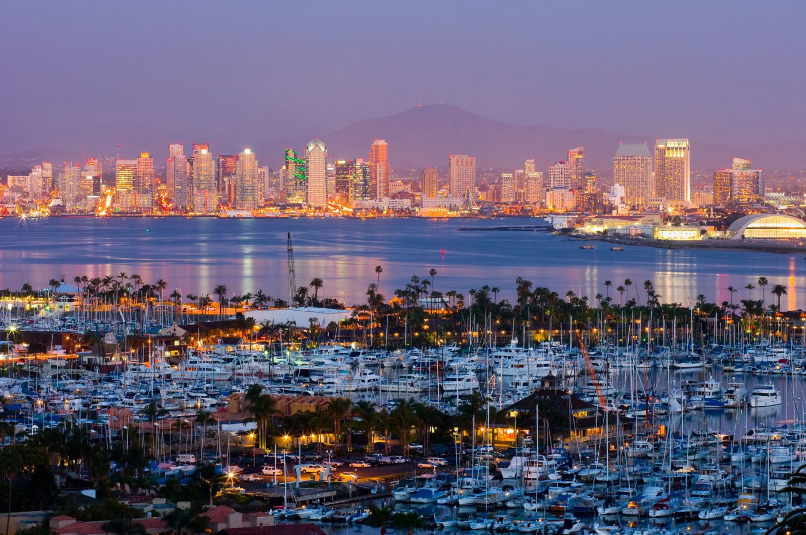
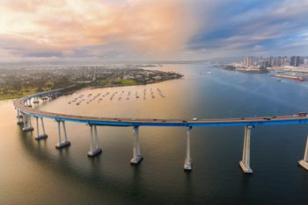
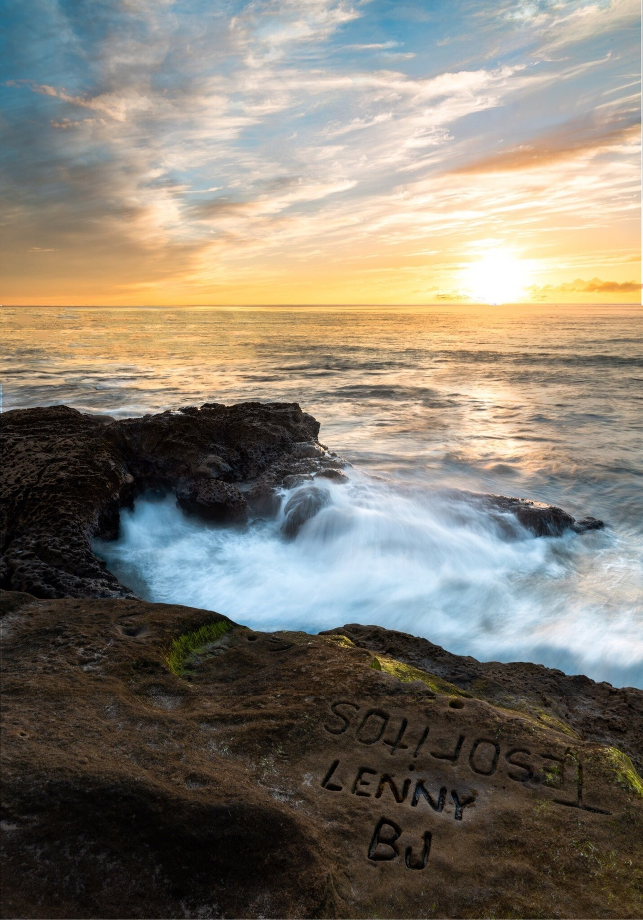
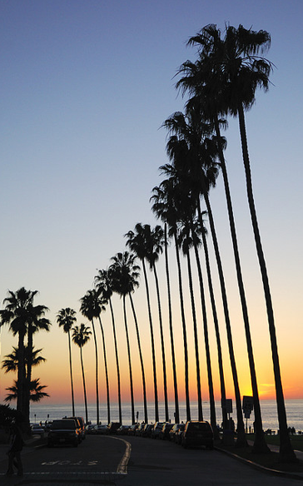
Thank you for joining!
Copyright © 2020 International House Pacific Group
Do not share or copy without permission

