Slide 1
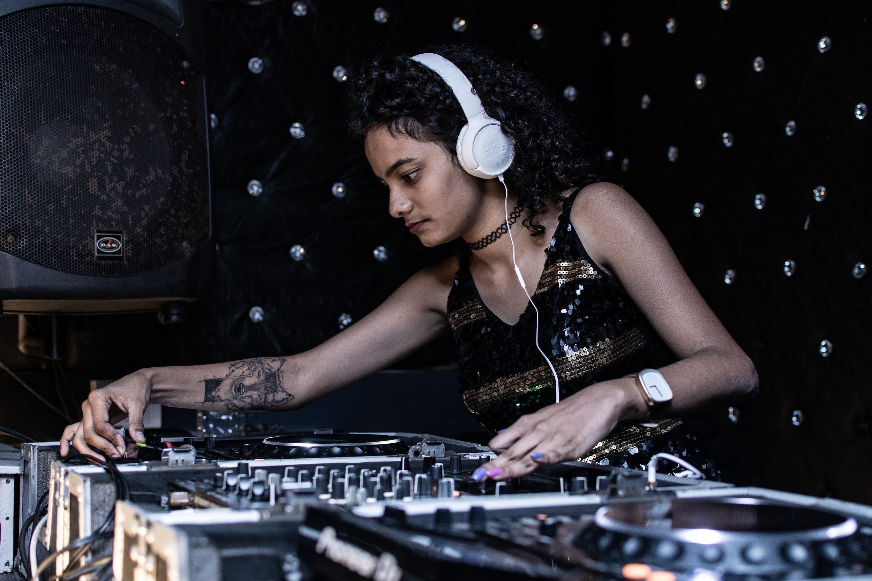
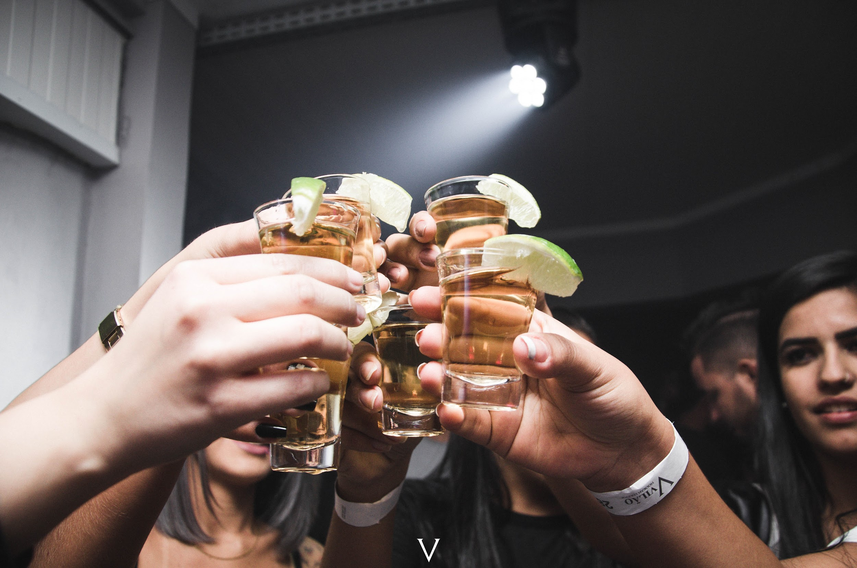
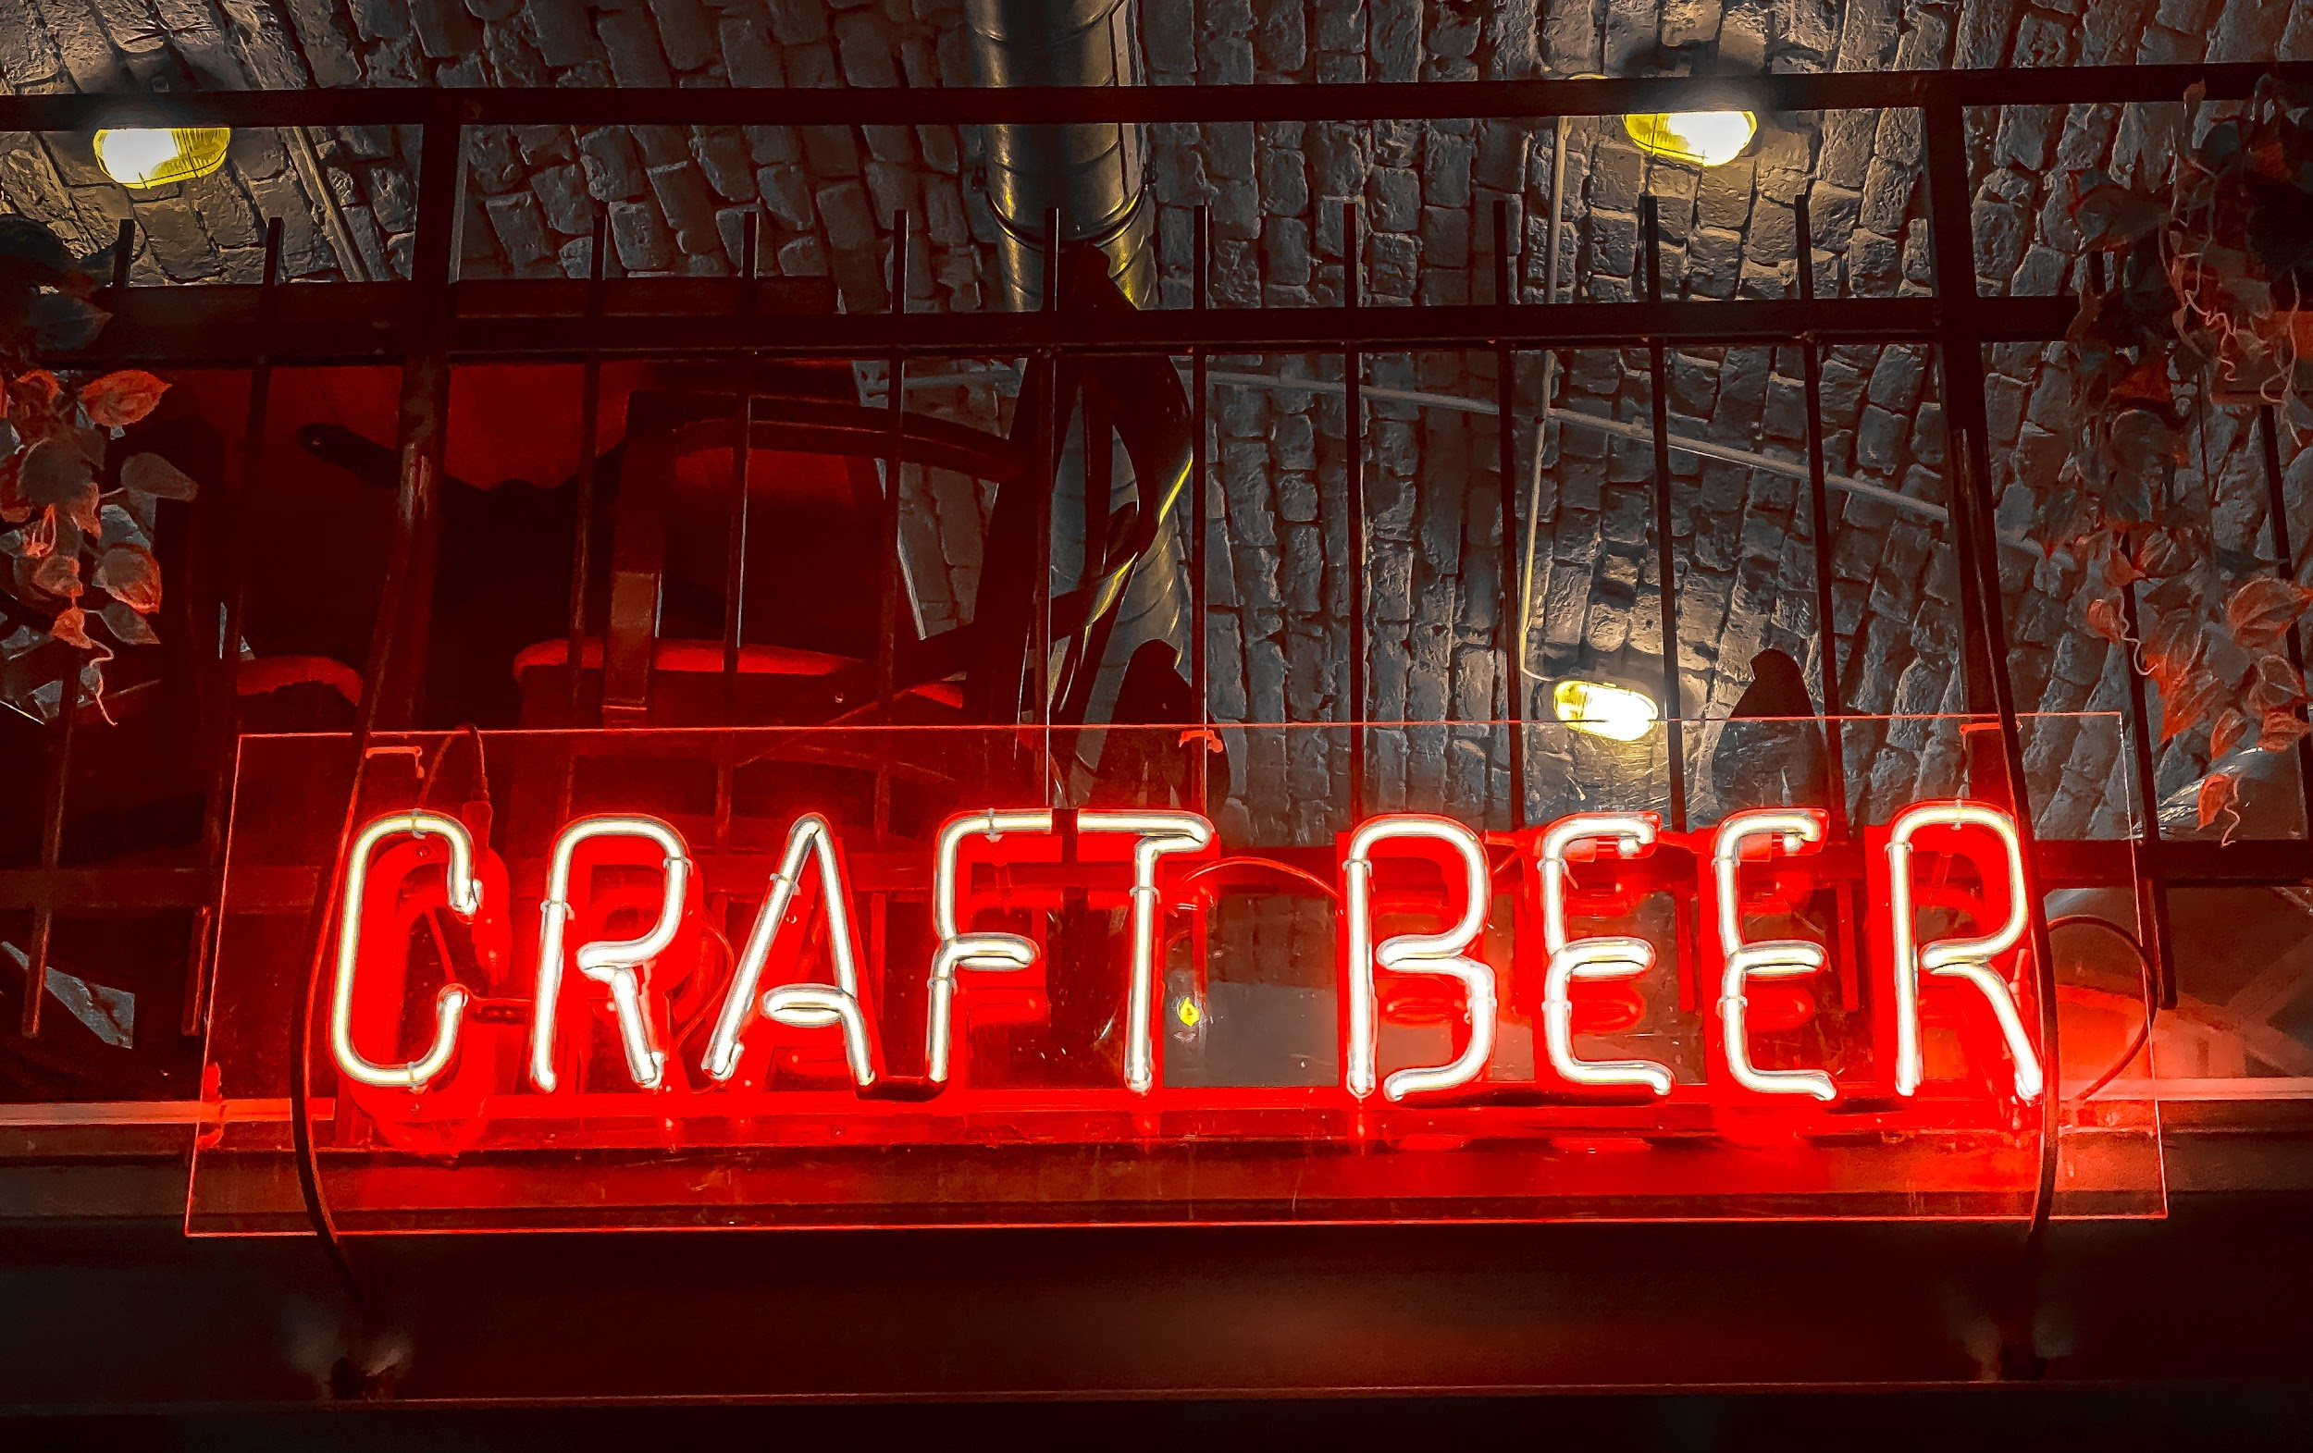
Pre-Arrival English
Vancouver Nightlife
Copyright © 2020 International House Pacific Group
Do not share or copy without permission

Slide 2
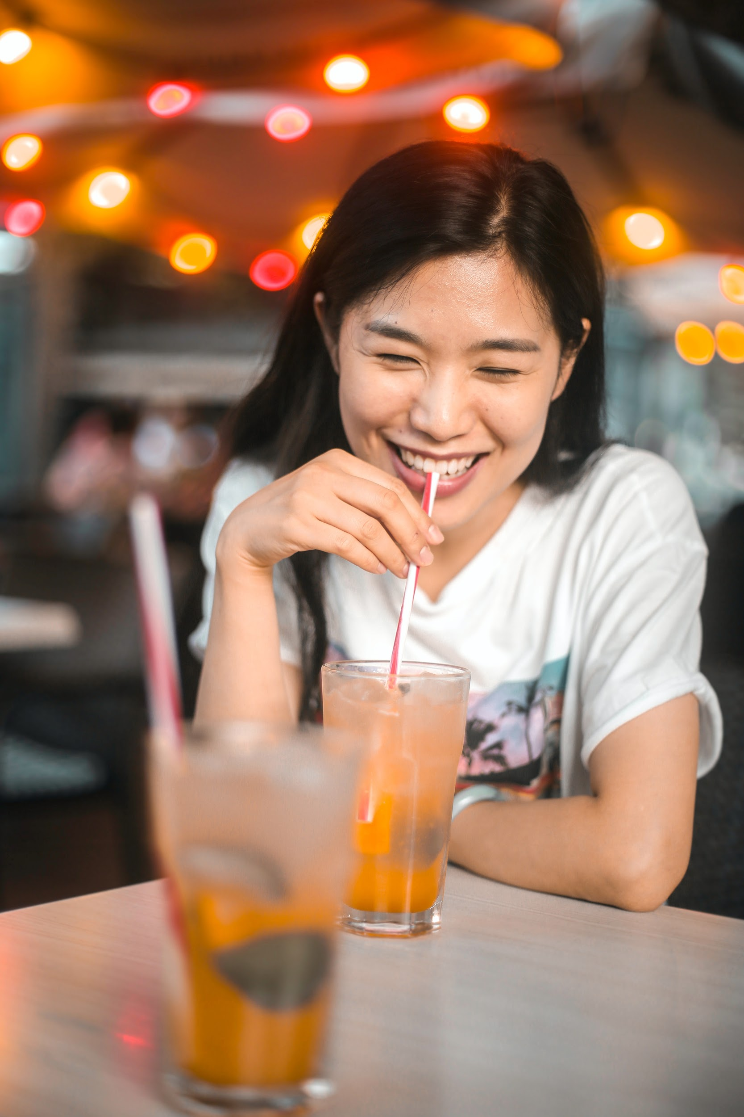
Warm-Up
Where do people go in your city for fun activities at night?
What is your favorite nightlife activity with friends?
How late are restaurants and dance clubs open in your city?

Slide 3
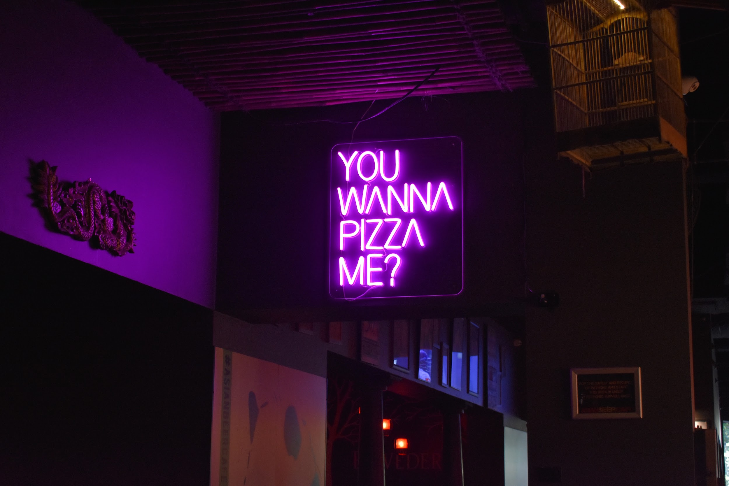
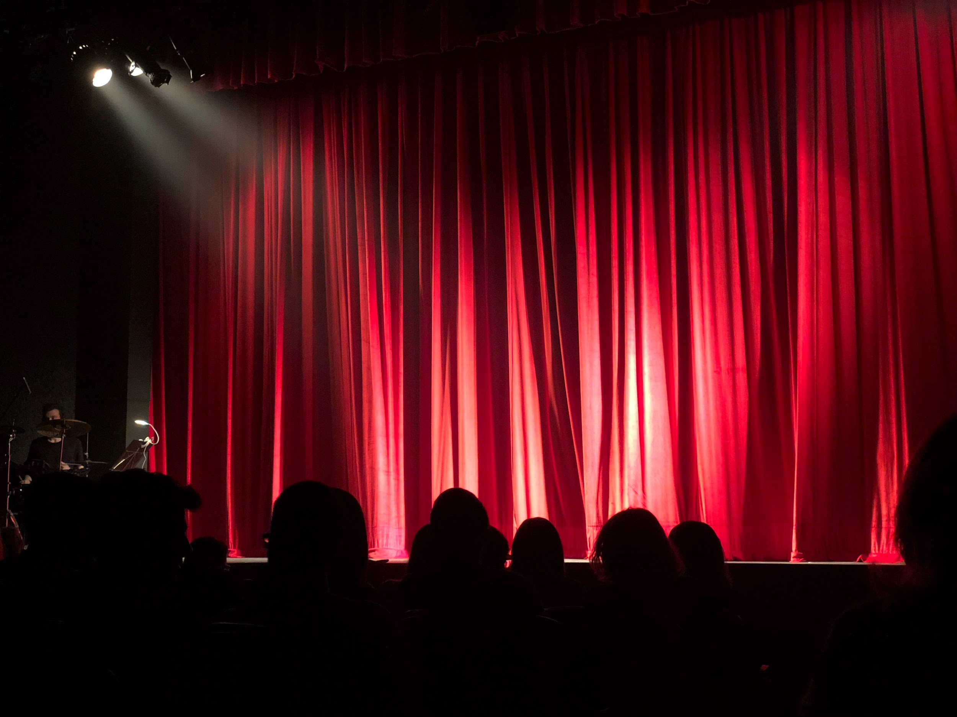
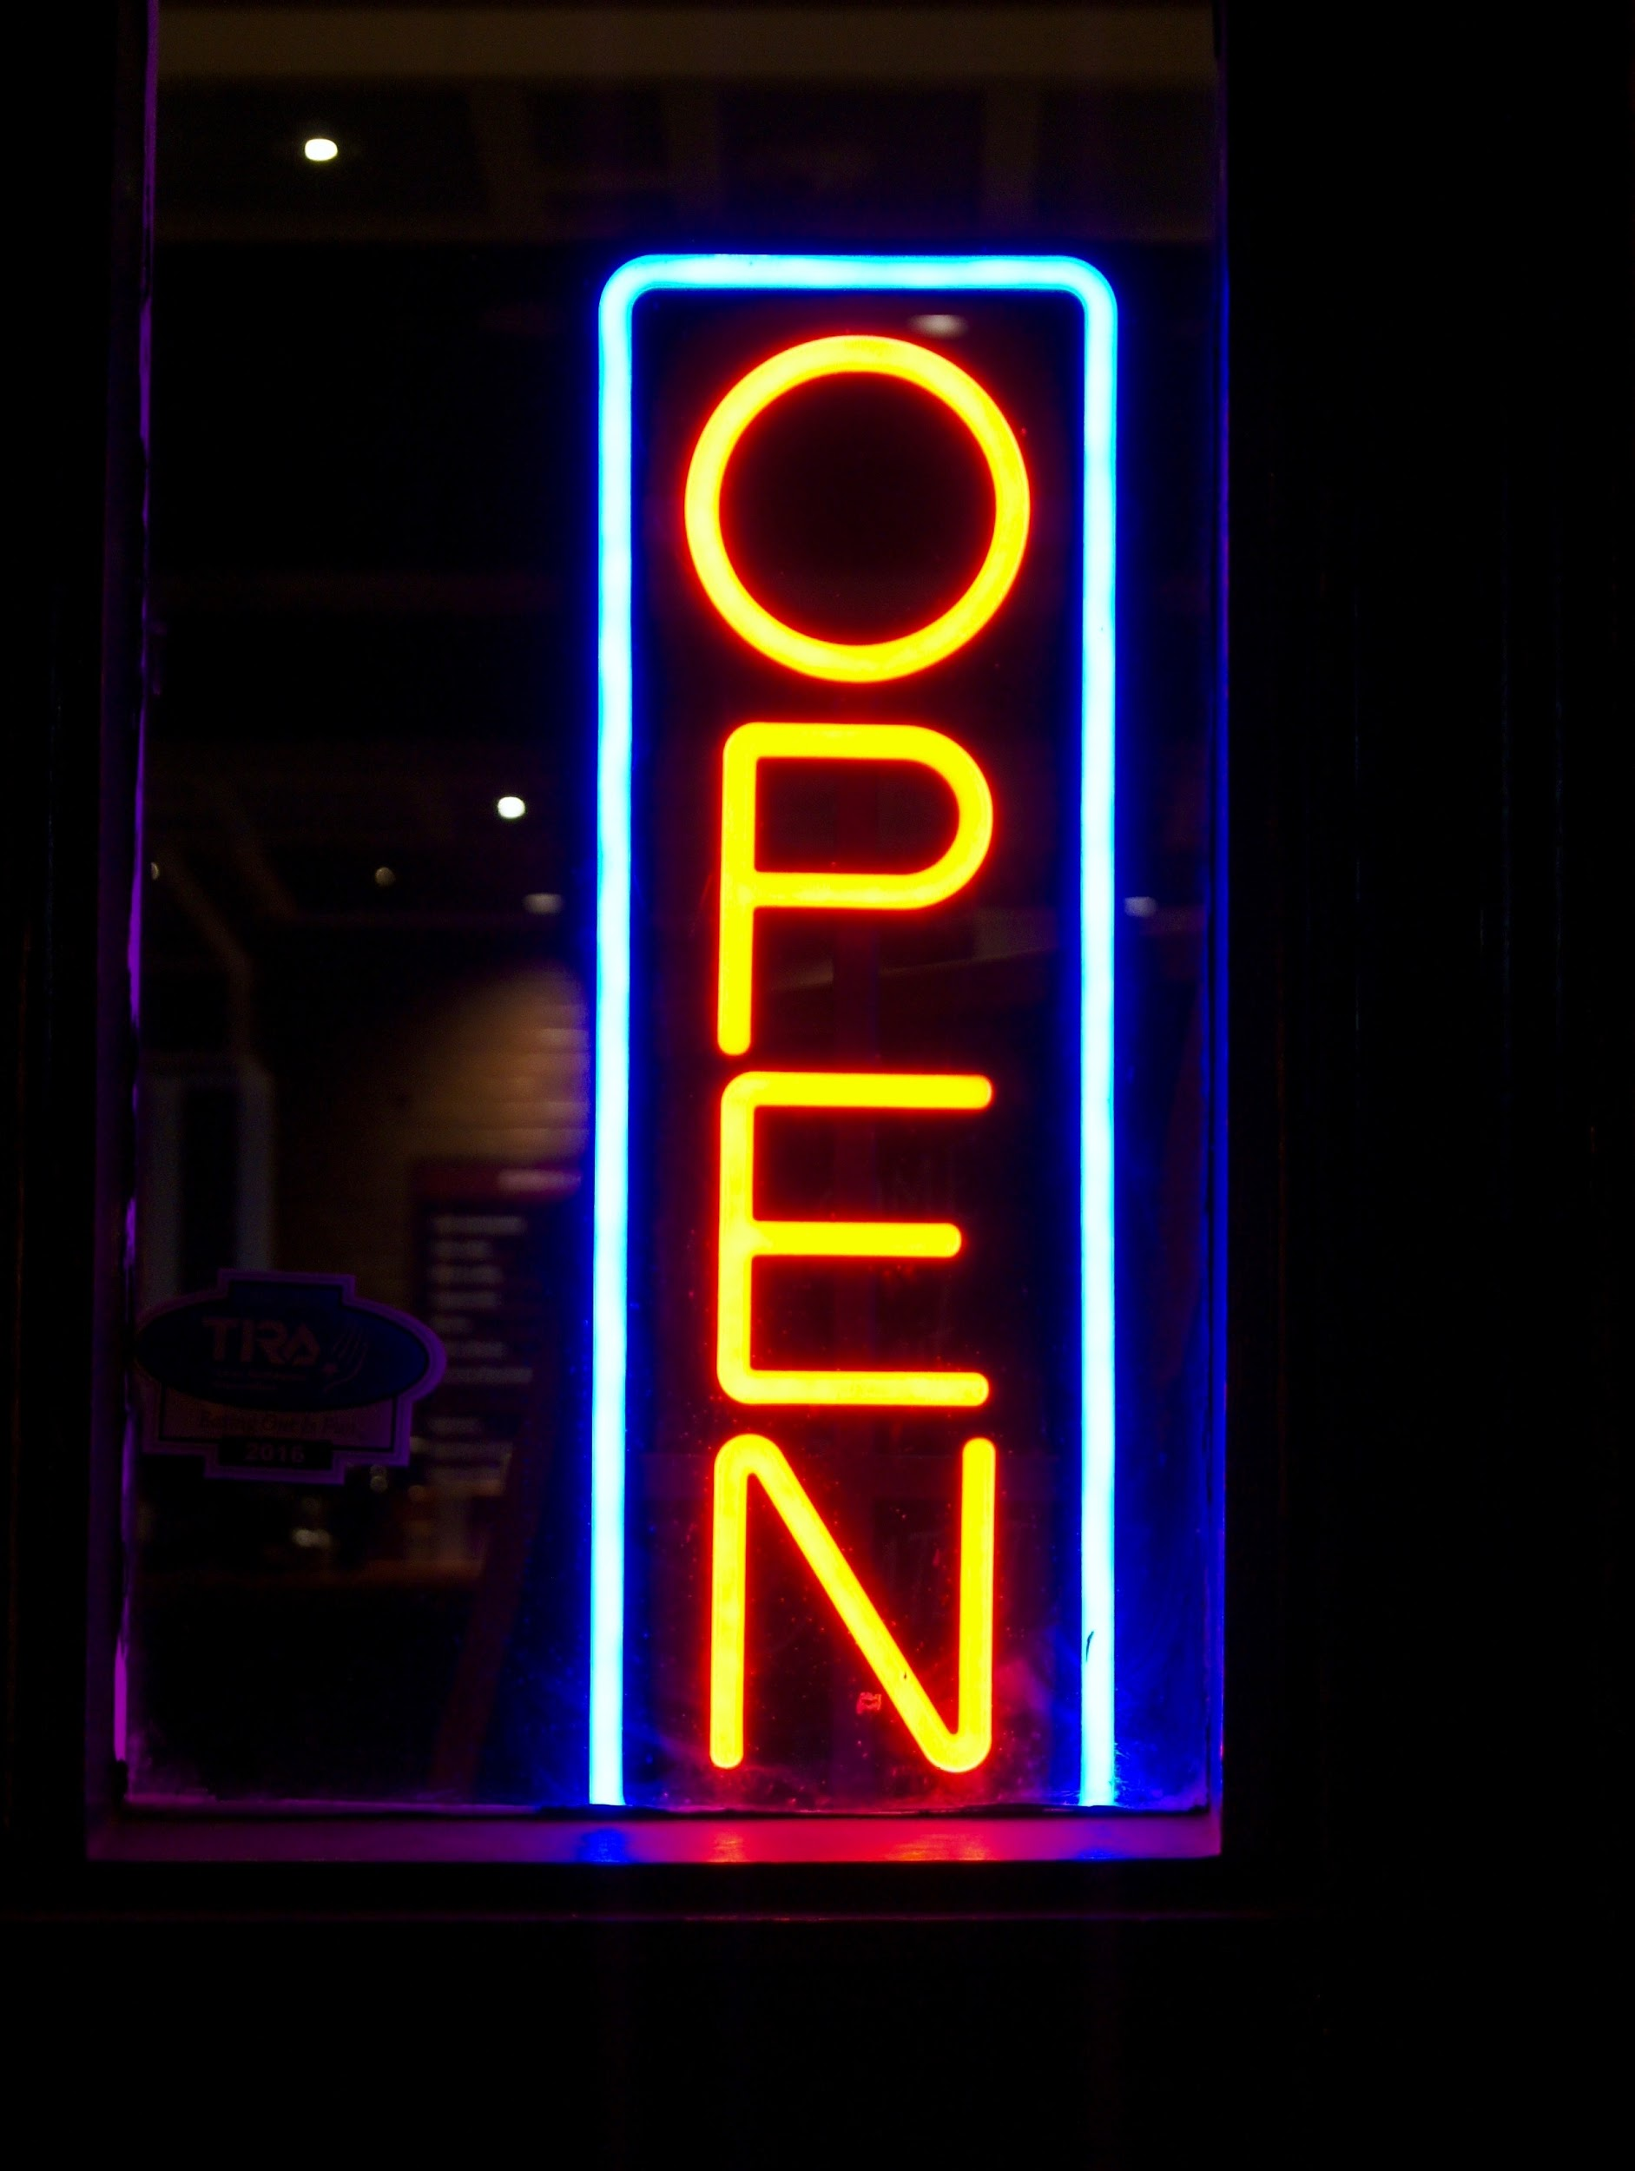
Nightlife in Vancouver
There are many things to do in Vancouver at night! Some popular activities are:
Food trucks
Craft breweries
Dinner experiences
Club Dancing
Live Performances
Comedy Shows

Slide 4
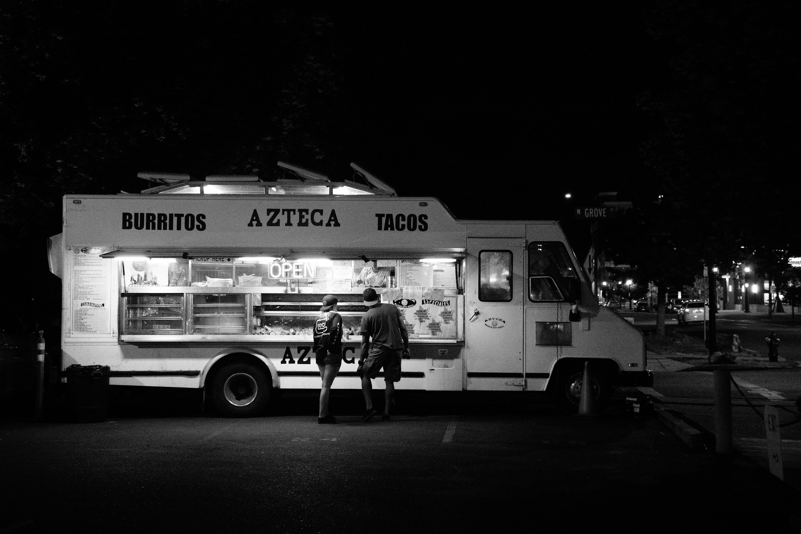
Food Trucks
Are food trucks popular in your country/city?
Many kinds of food
Quick and easy
Up-and-coming chefs
Great way to sample and share new food

Slide 5
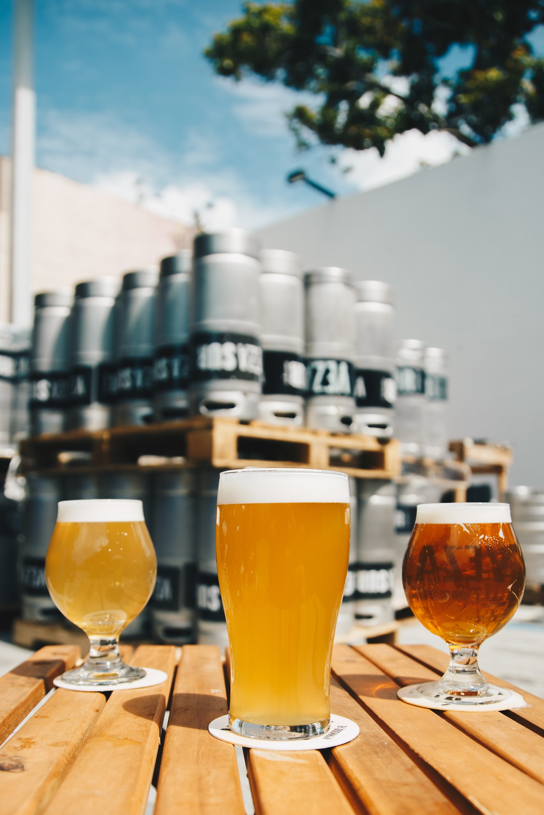
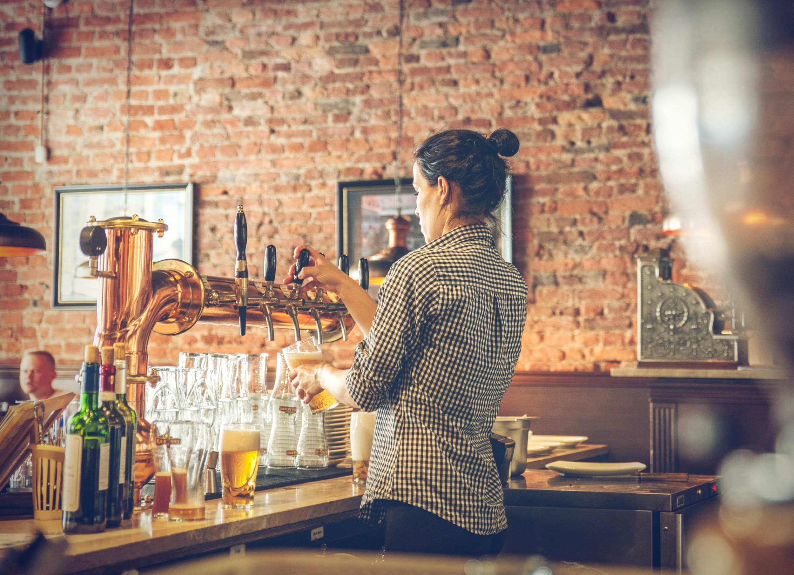
Craft Breweries
What does “craft” mean?
unique
“one of a kind”
made in small amounts
skill and care taken to make it

Slide 6
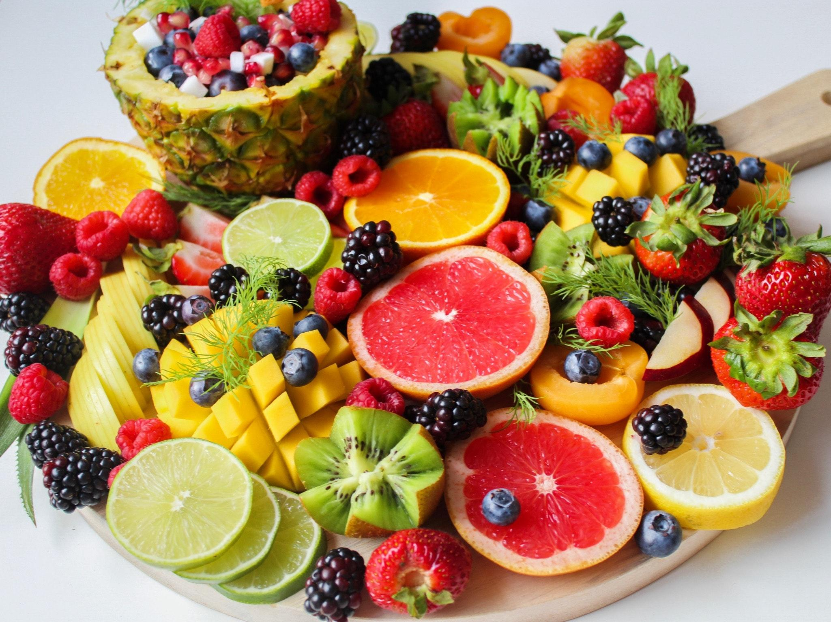
Craft Breweries
Over 150 breweries in San Diego
California has more breweries than any other state
MANY flavors: avocado and honey, banana split coconut, fruit and vanilla…
What flavor would you want try?

Slide 7
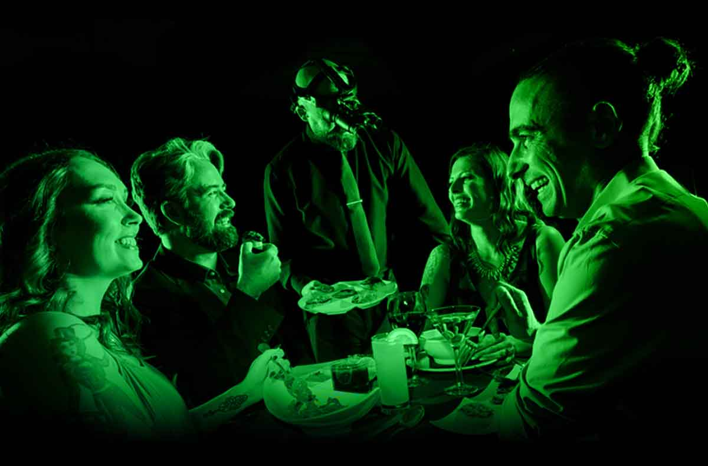
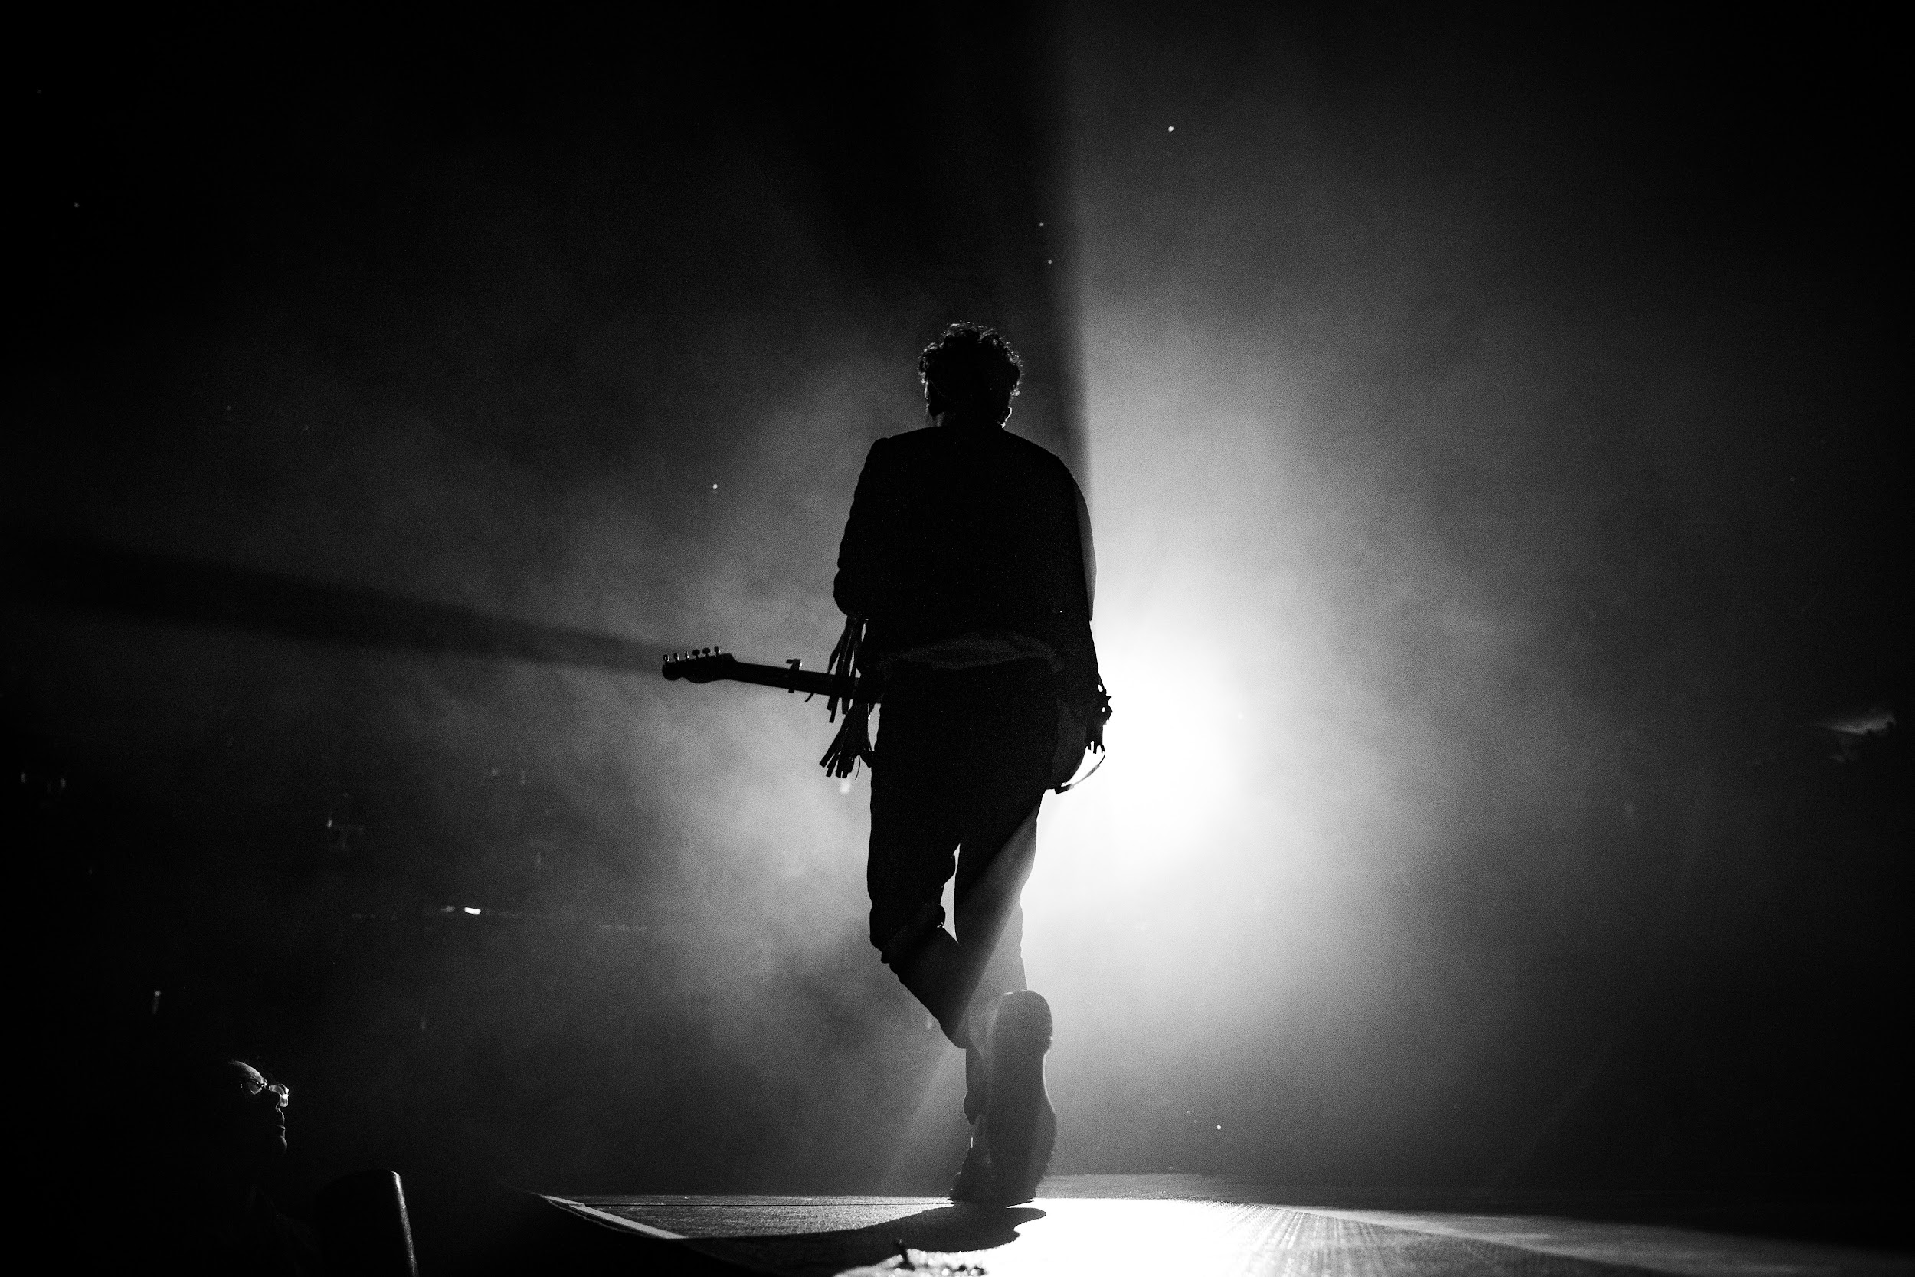
Dinner Experiences
In Canada, it is common to make dinner a fun time with experiences like…
Dinner in the Dark
Live Music
Theater Performances
Comedy Shows
Do you have similar experiences in your country?
Photo credit: Medieval Times
Copyright © 2020 International House Pacific Group
Do not share or copy without permission

Slide 8
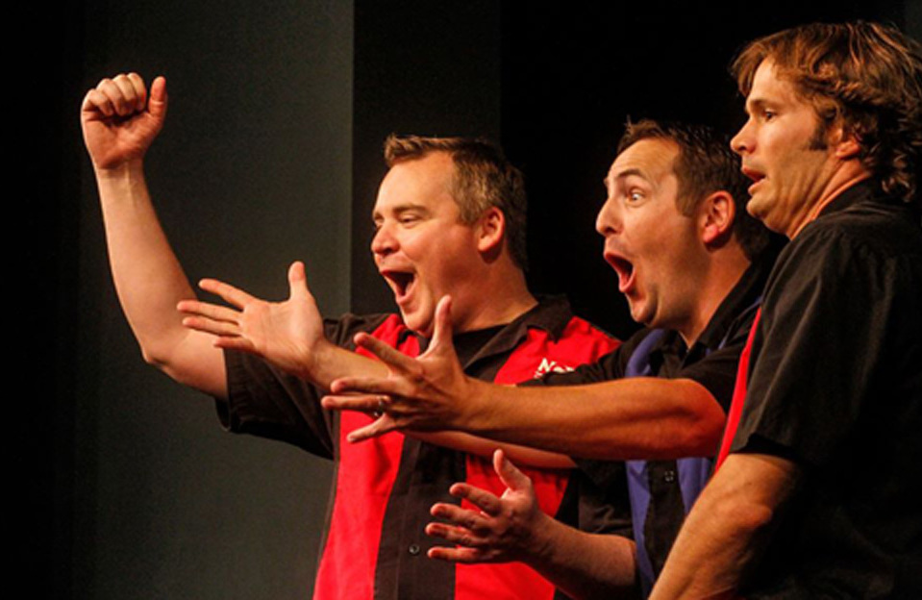
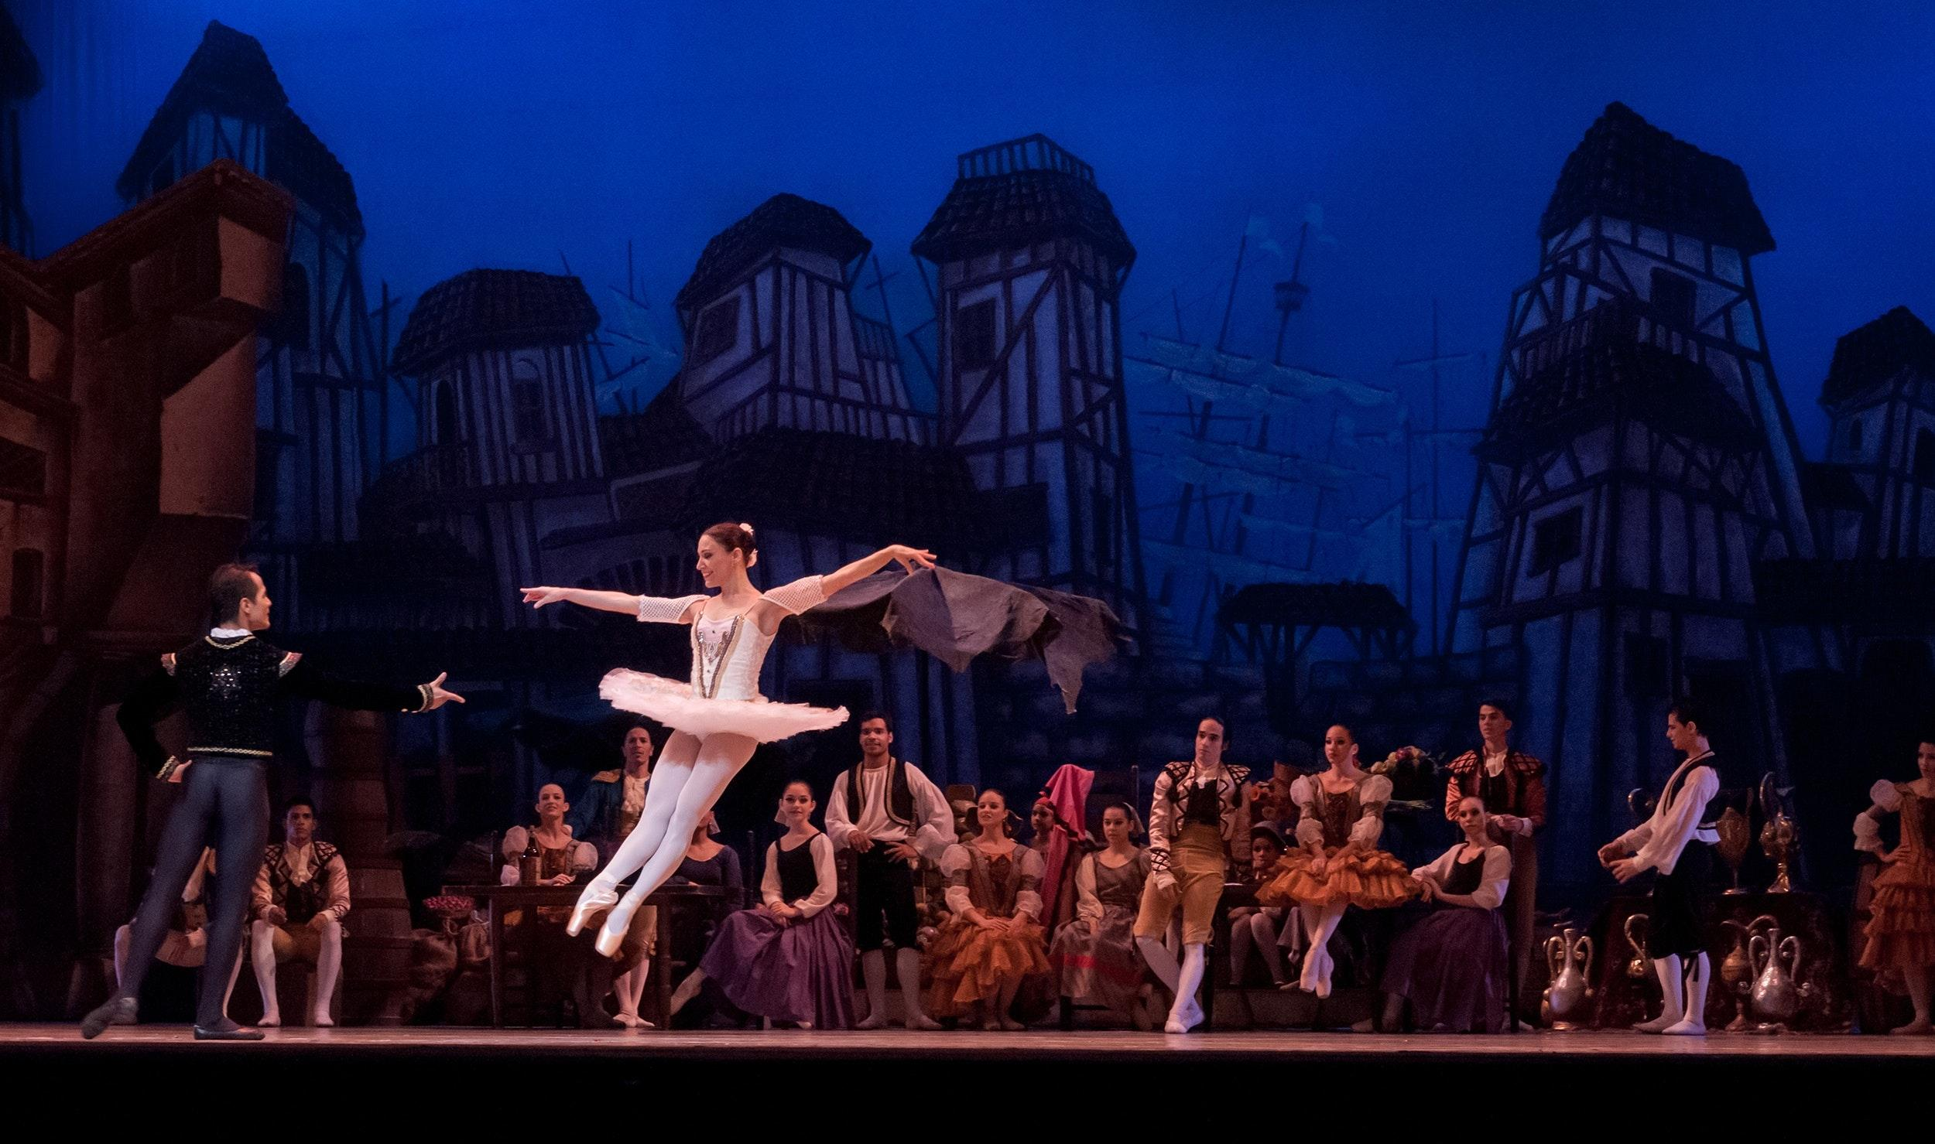
Live Performances
Photo credit: National Comedy Theater
What is “Improv”?
Is it popular in your country?
Do you enjoy live music?
If so, what kind?
- Jazz - Rock’n’Roll
- Classical - Gospel
Have you ever seen a Broadway “play”?
Which one would you like to see?
Beauty and the Beast
The Phantom of the Opera
The Lion King
....
Copyright © 2020 International House Pacific Group
Do not share or copy without permission

Slide 9
Wrap-Up
What part about Vancouver nightlife are you most excited for?
What things are similar to your country?
Which ones are different?
Next Class: Planning your Experience Abroad from Start to Finish

