Slide 1
Pre-Arrival English
Emergency English
Copyright © 2020 International House Pacific Group
Do not share or copy without permission

Slide 2
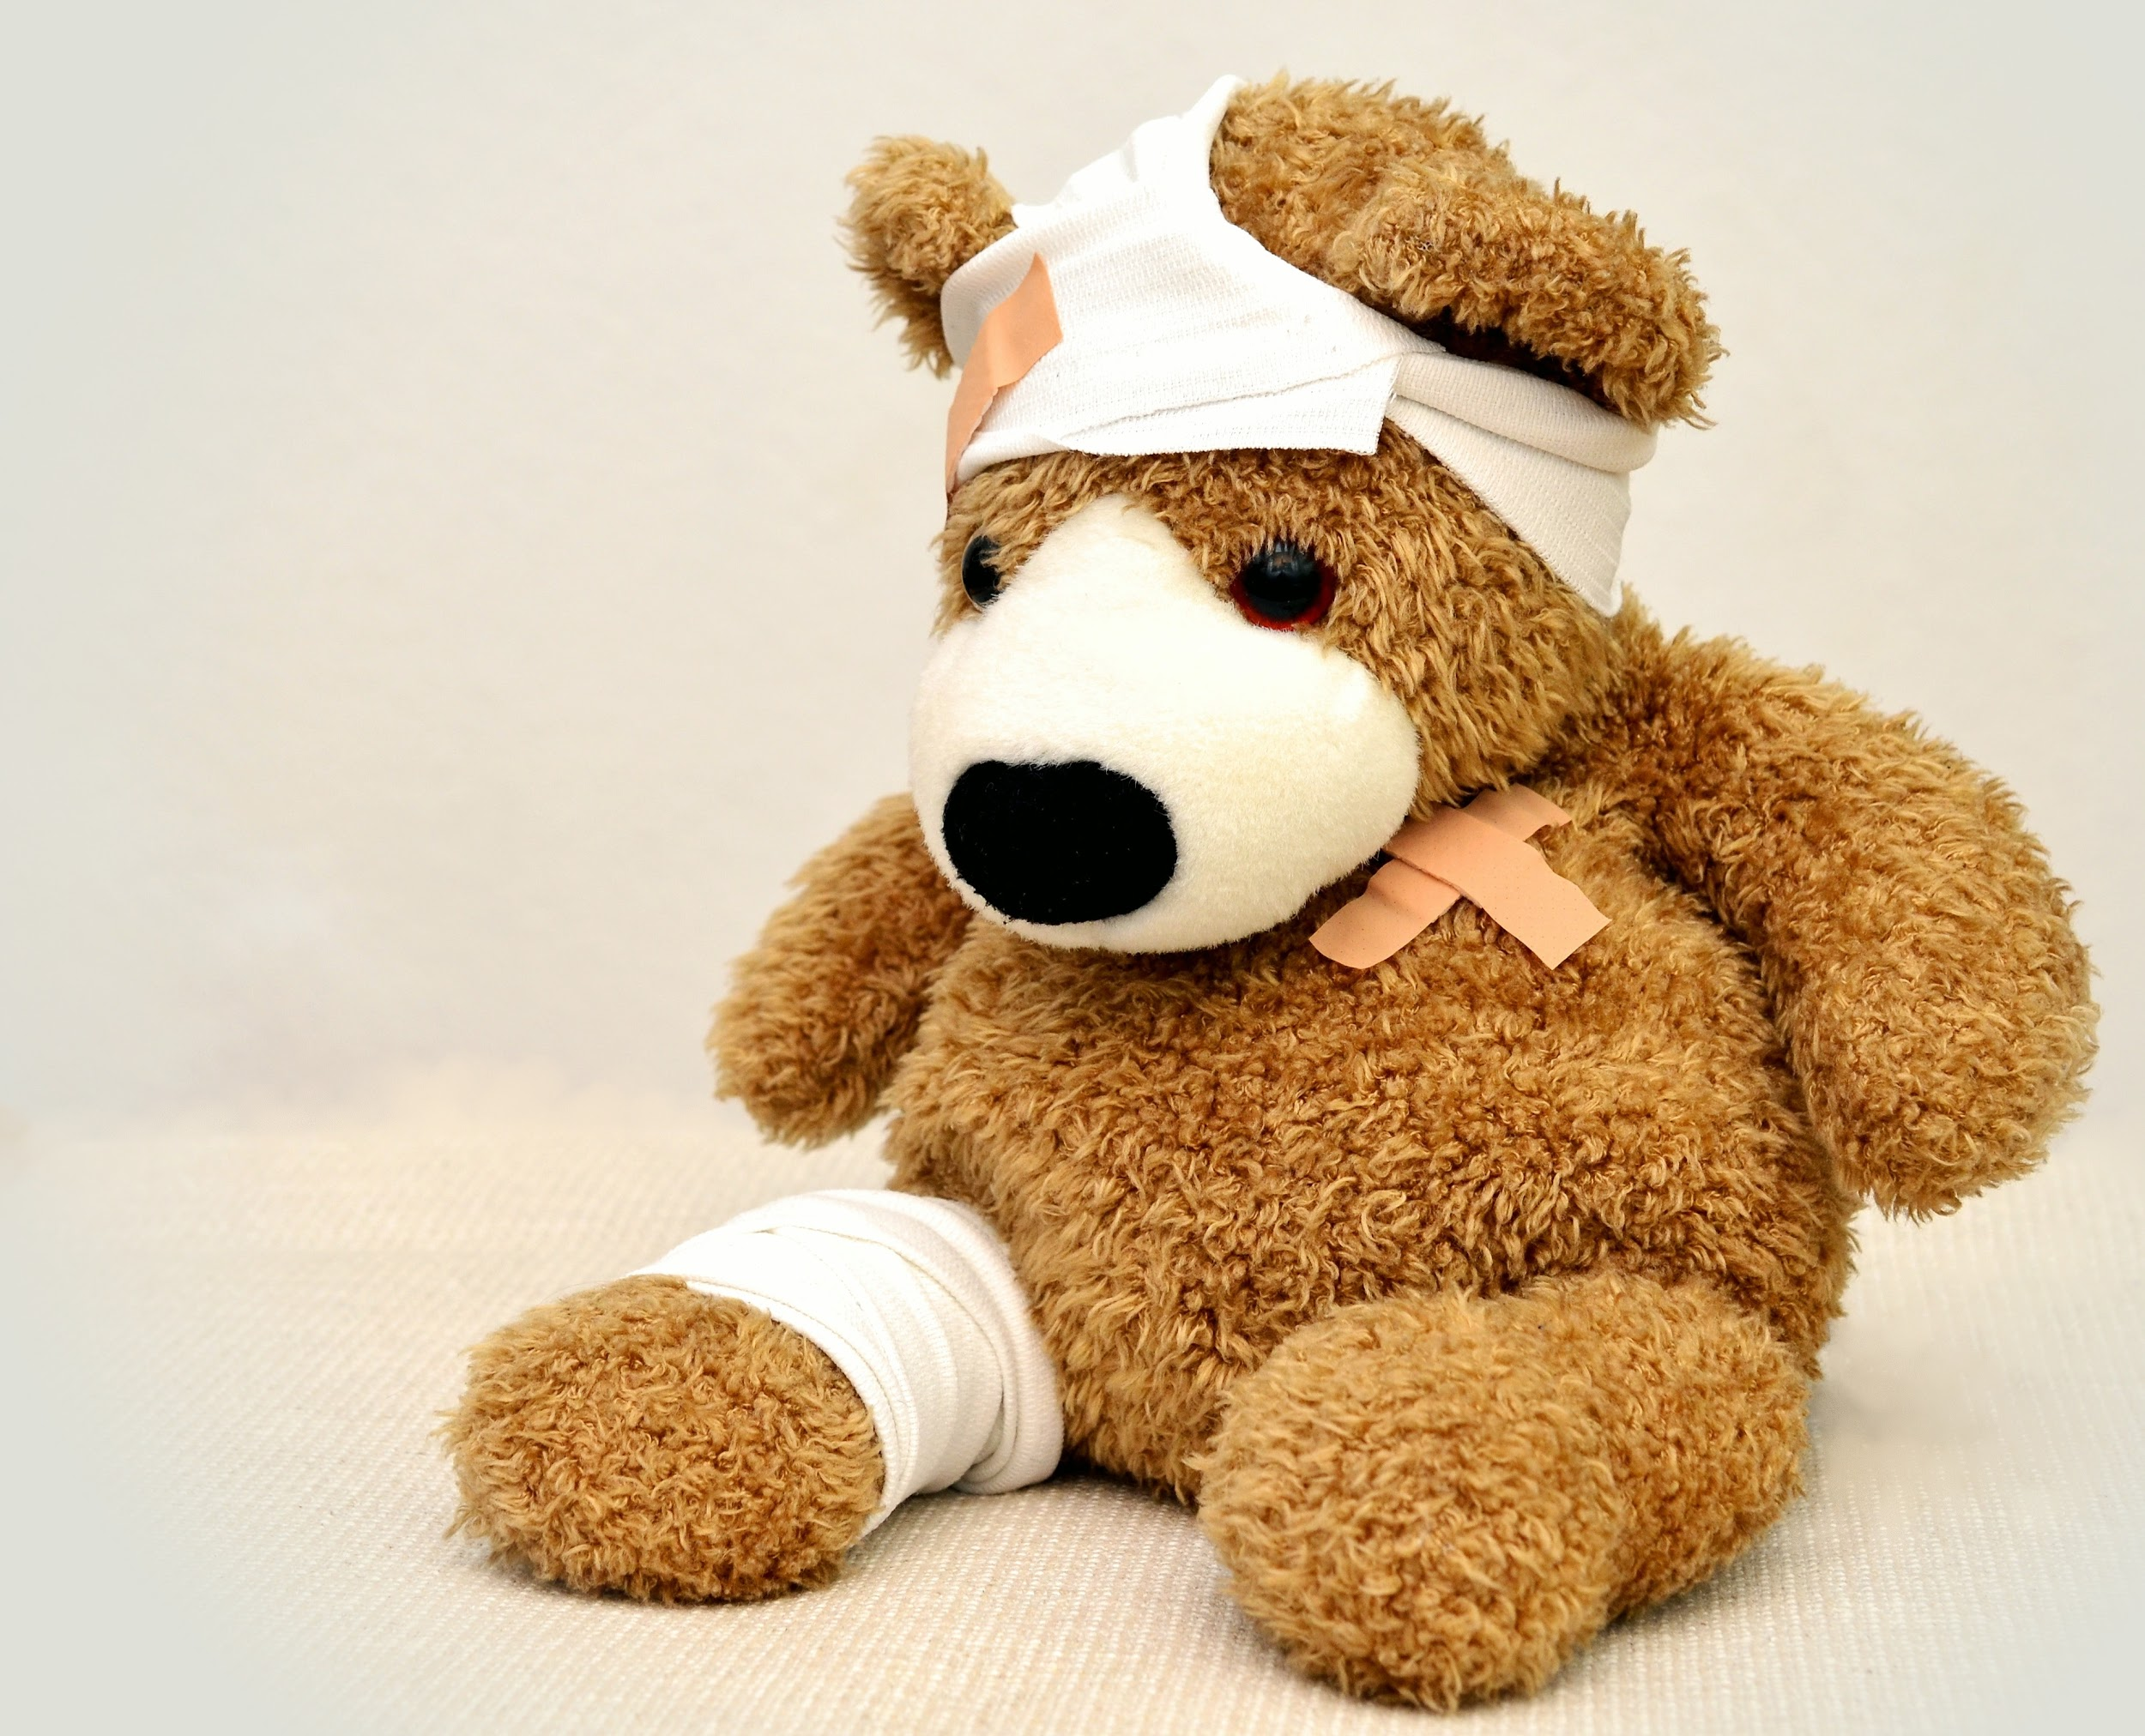
Warm-Up
What emergency situations do you practice at school?
What are some phrases you know in English for an emergency?
What is the phone number we call in Canada for the police / ambulance / firefighters?

Slide 3
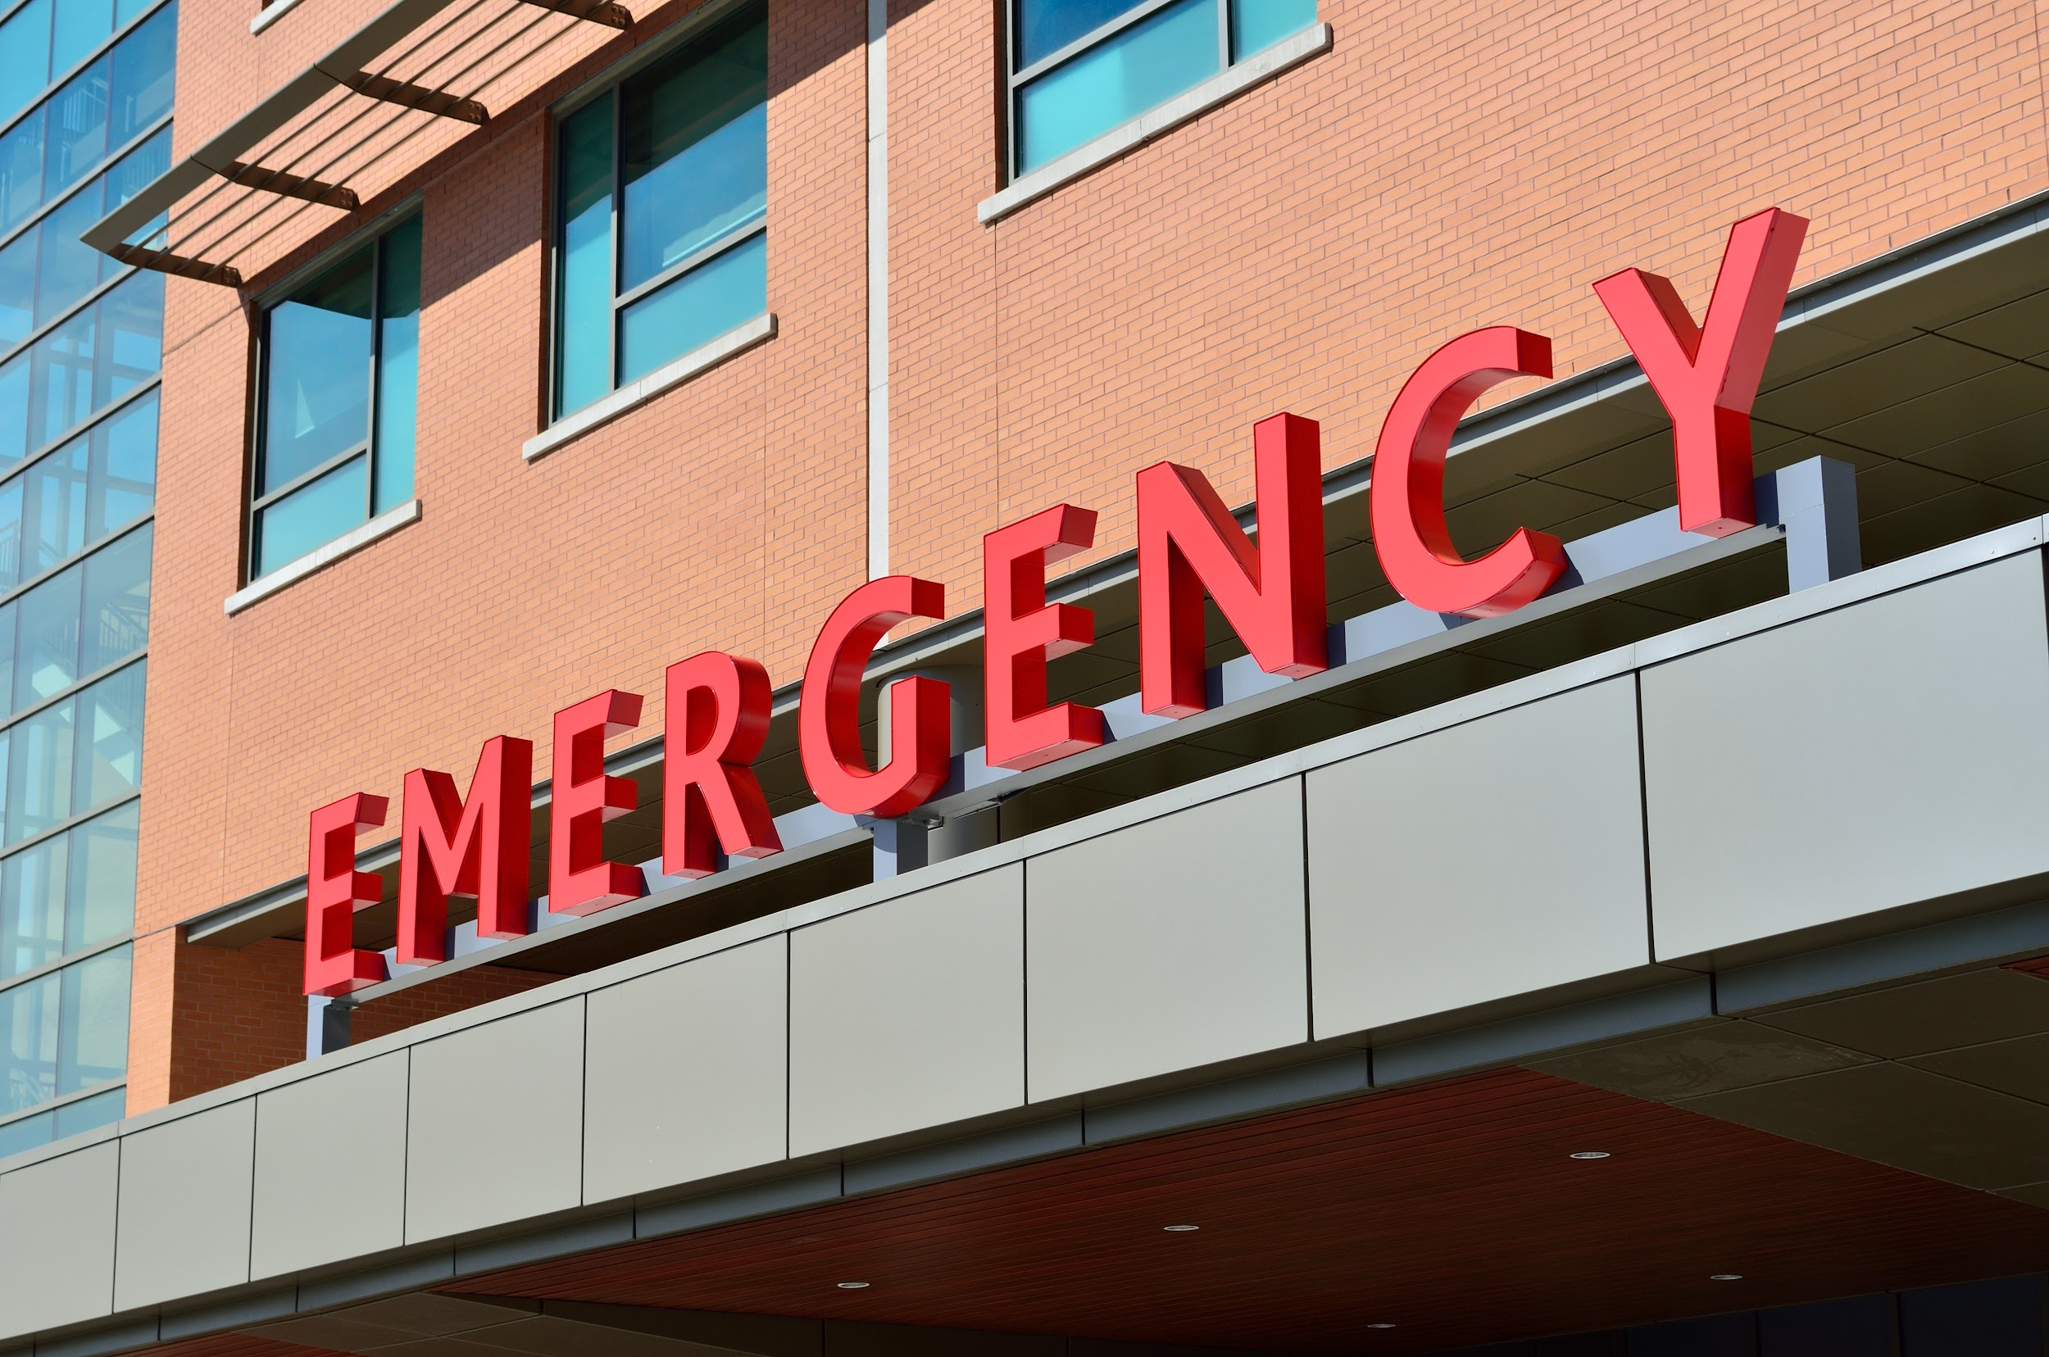
Useful Phrases
Excuse me!
Can you help me please?
Can someone call 911?
I need an ambulance/the police
Please hurry

Slide 4
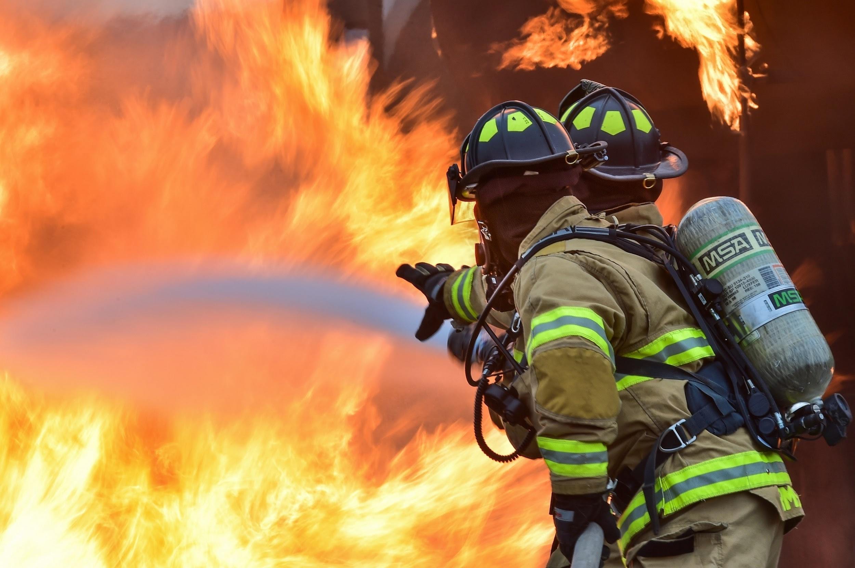
In Case of Fire
There’s a fire / The building’s on fire
Can you smell smoke?
I can smell burning
Where is the fire escape?

Slide 5
In Case of Crime
There’s been a robbery
I’ve been robbed
I’ve been hurt
I’ve been threatened
Please help me!

Slide 6
In Case of Medical Need
Please can someone help me?
I need a doctor.
This is a medical emergency.
Is there a doctor here?
Can someone call for an ambulance?
Does anyone know how to do CPR?

Slide 7
Other Emergencies
My stomach/chest/head/legs hurts
My head is throbbing
I have a nose bleed
I think I’ve broken my arm / leg
I need to see the dentist

Slide 8
Wrap-Up
What would you say/do in the case of a fire?
What would you say/do in the case of a robbery?
What would you say/do in the case of a medical emergency?
What would you say/do in the case of a tooth issue?
What would you say/do in the case of a stomach/headache?
Resource: https://www.myenglishlanguage.com/essential-vocabulary/emergencies/
Next class: Balancing School Work & Leisure Time

