Slide 1
Pre-Arrival English
Understanding the Different Regions
Of Canada
Copyright © 2020 International House Pacific Group
Do not share or copy without permission

Slide 2
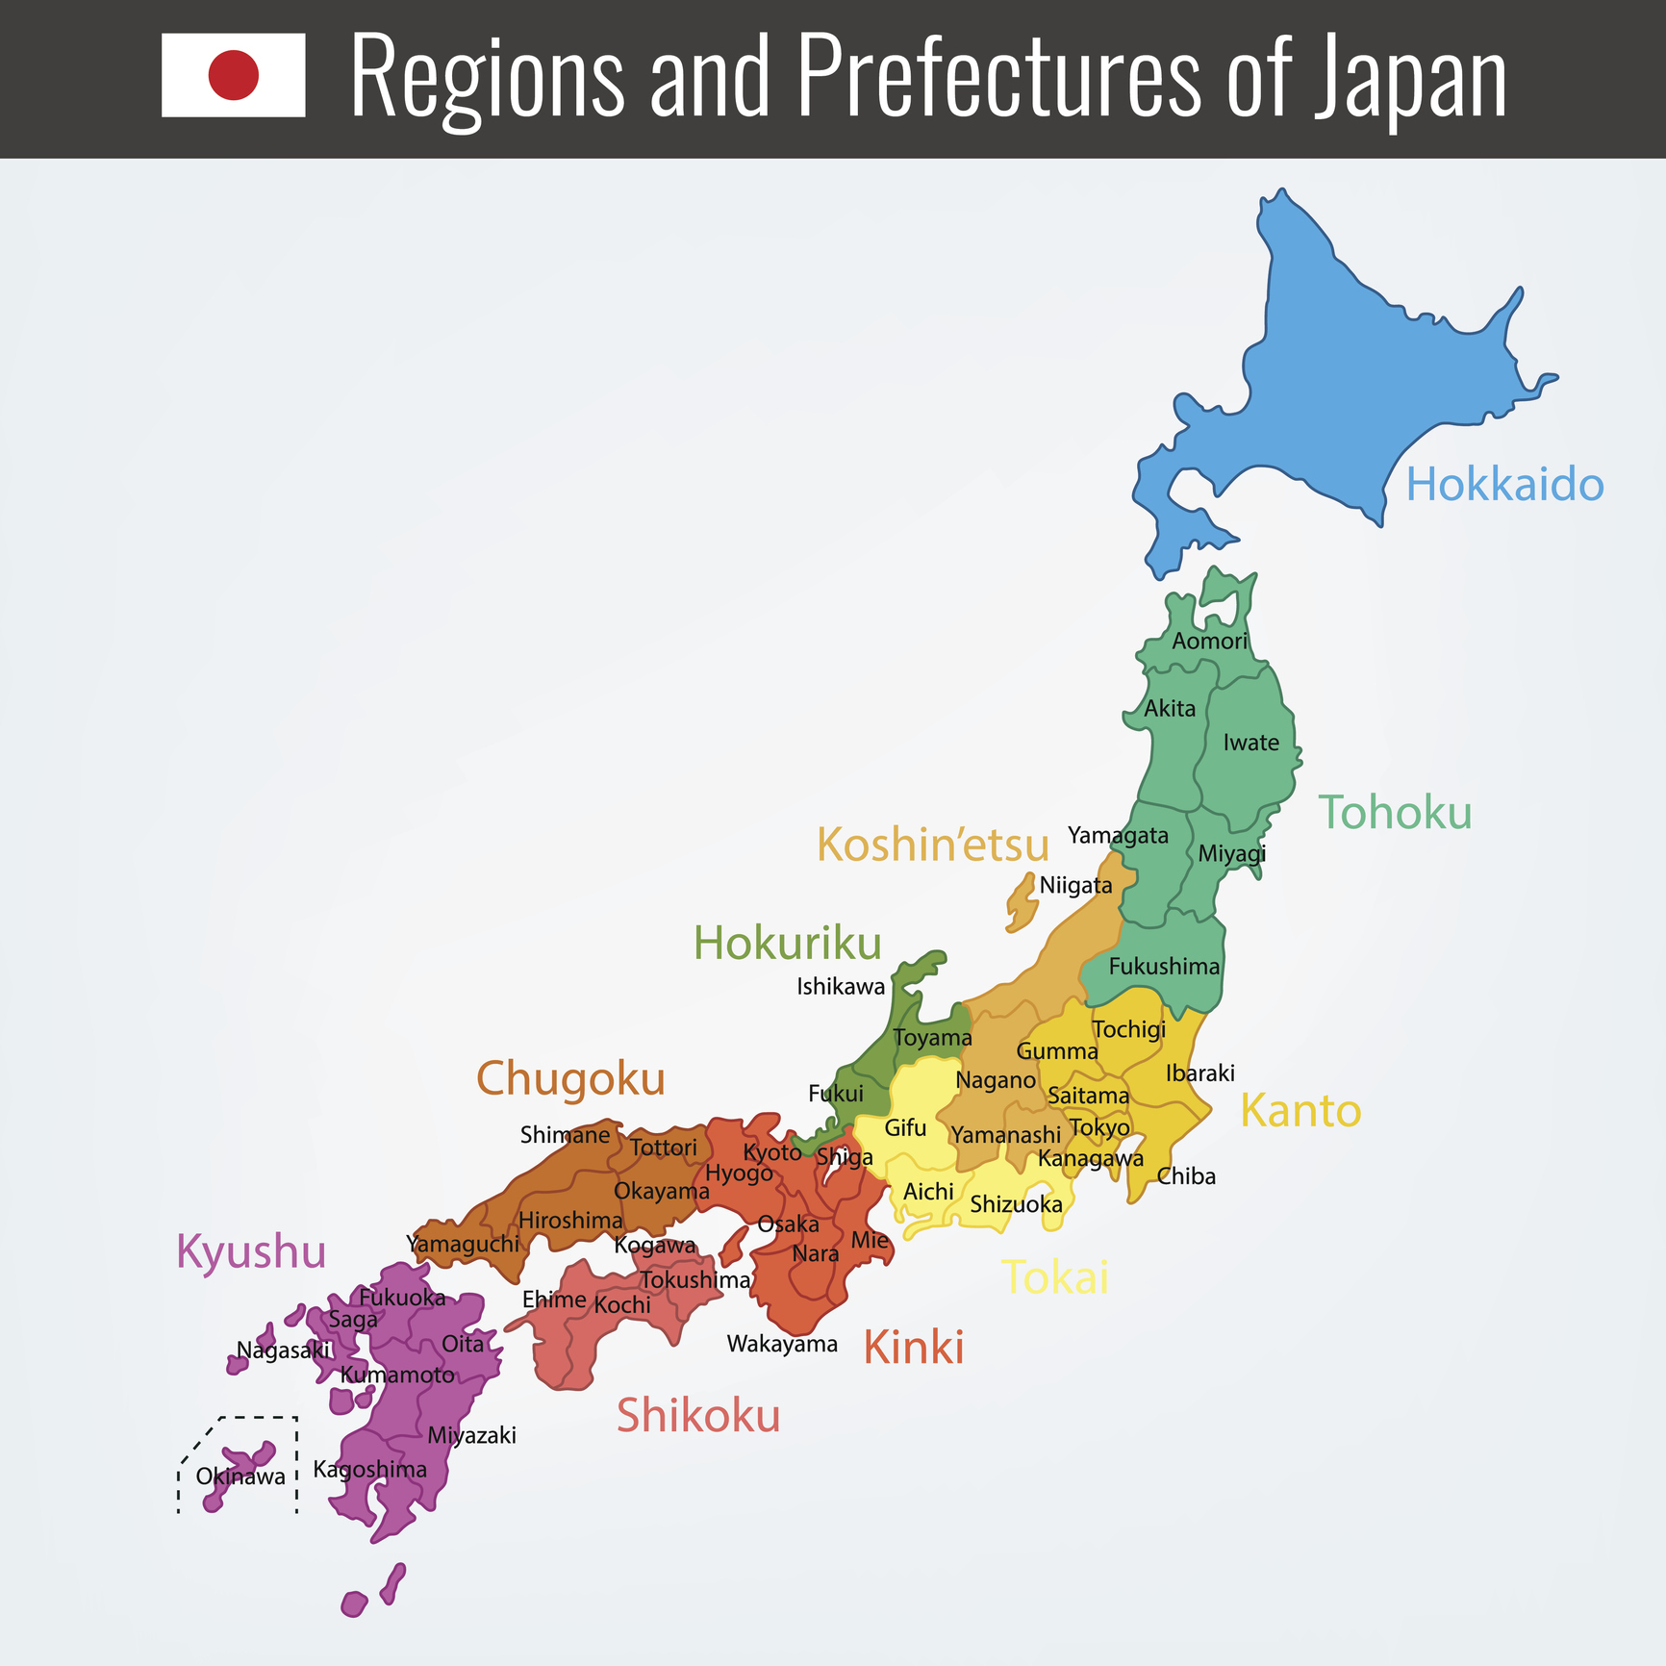
Warm-Up
What makes up a region?
History
Climate
Environment
Landforms
How many regions are in your country?
Photo credit: sapporo.co.uk

Slide 3
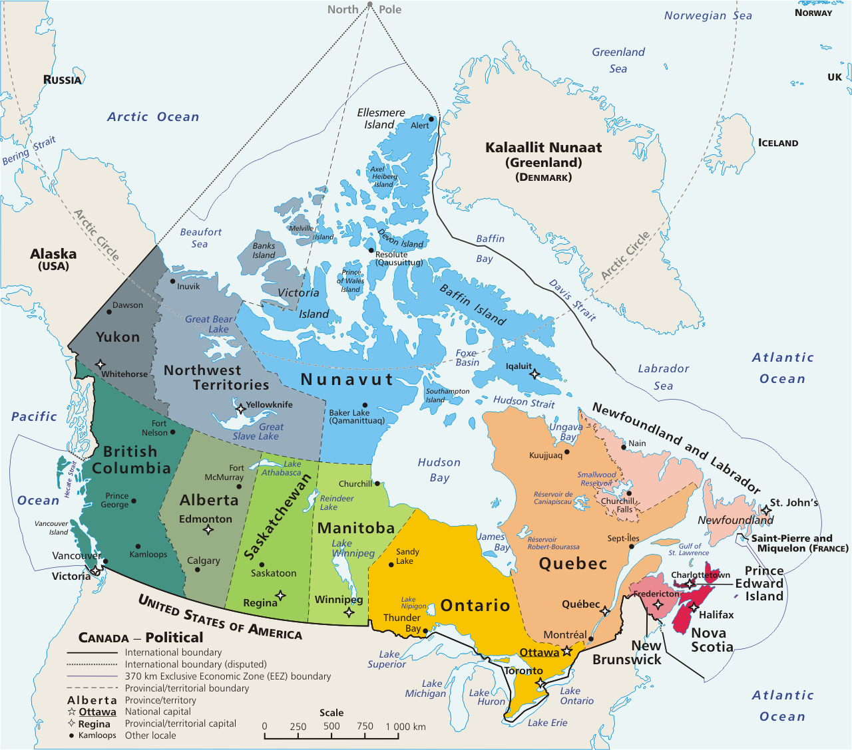
Canada
Provinces (10):
British Columbia
Alberta
Saskatchewan
Manitoba
Ontario
Quebec
Newfoundland
New Brunswick
Nova Scotia
PEI
Territories (3):
Yukon
Northwest Territories
Nunavut

Slide 4
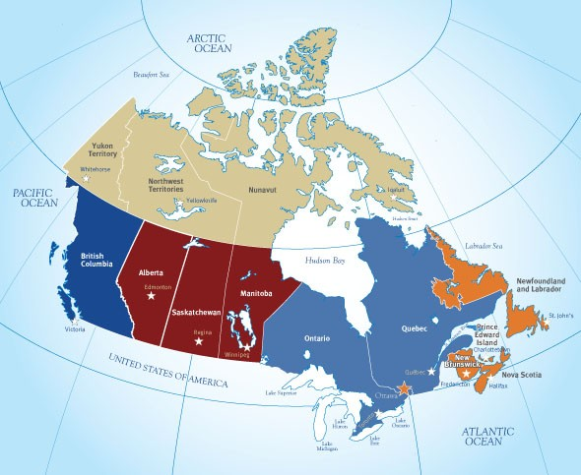
Canadian Regions
The West Coast
The Prairies
Central Canada
The Atlantic Region (the Maritimes)
The North

Slide 5
The West Coast
British Columbia
Known as Canada’s Pacific gateway
Known for temperate (mild) climate
Lots of parks: Approximately 600!
Lots to do: hiking, skiing/snowboarding, fishing
Lots to eat: nanaimo bars and beaver tails!
We even have vineyards (for making wine!)
Population
Approximately 4 million
Most populated city:
Vancouver (2.5 million)
British Columbia
https://www.canada.ca/en/immigration-refugees-citizenship/corporate/publications-manuals/discover-canada/read-online/canadas-regions.html
Notes:
British Columbia is known for its majestic mountains and as Canada’s Pacific gateway. The Port of Vancouver, Canada’s largest and busiest, handles billions of dollars in goods traded around the world. Warm airstreams from the Pacific Ocean give the B.C. coast a temperate climate.
British Columbia (B.C.), on the Pacific coast, is Canada’s western most province, with a population of four million. The Port of Vancouver is our gateway to the Asia-Pacific. About one-half of all the goods produced in B.C. are forestry products, including lumber, newsprint, and pulp and paper products—the most valuable forestry industry in Canada. B.C. is also known for mining, fishing, and the fruit orchards and wine industry of the Okanagan Valley. B.C. has the most extensive park system in Canada, with approximately 600 provincial parks. The province’s large Asian communities have made Chinese and Punjabi the most spoken languages in the cities after English. The capital, Victoria, is a tourist centre and headquarters of the navy’s Pacific fleet.

Slide 6
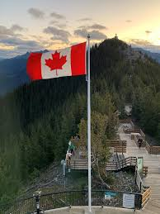
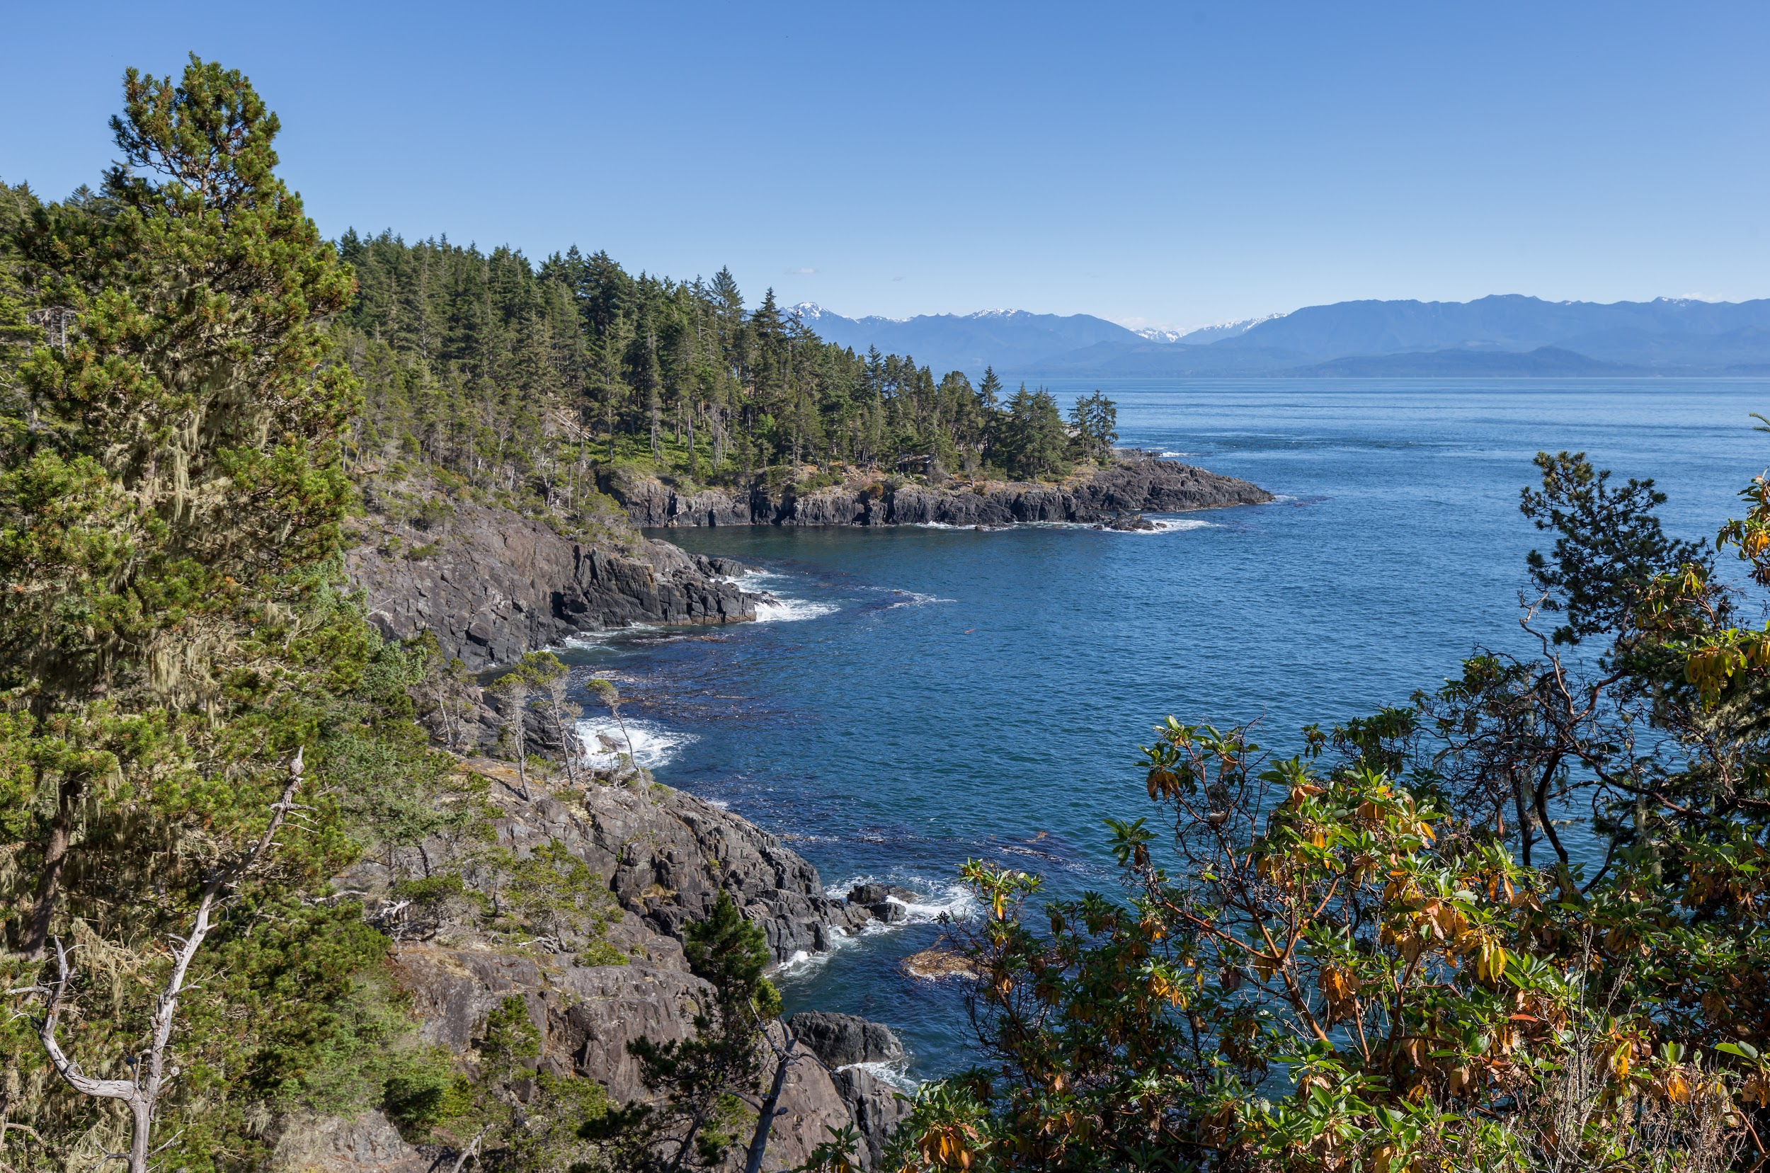
The West Coast

Slide 7
The Prairies
Alberta, Saskatchewan, Manitoba
Lots of sunshine and very little rain
Extreme temperatures: average of -15C in the winter and 25C in summer
The breadbasket of Canada and the most fertile farmland in the world
Famous for Banff National Park, and Lake Louise, both located in the Rocky Mountains
Alberta
Saskatchewan
Manitoba
Population:
Approximately 6 million
Most populated city:
Calgary (1.5 million)
https://www.canada.ca/en/immigration-refugees-citizenship/corporate/publications-manuals/discover-canada/read-online/canadas-regions.html

Slide 8
Central Canada
Ontario
Population:
Ontario
(more than 12 million)
Quebec
(9 million)
Most populated cities:
Toronto
Montreal
Quebec City
Over 50% of Canada’s population lives in Ontario and Quebec
Heartland of Canadian industries
Southern parts of Ontario and Quebec enjoy warm humid summers but cold winters
Home of maple syrup!
Quebec
Notes:
More than half the people in Canada live in cities and towns near the Great Lakes and the St. Lawrence River in southern Quebec and Ontario, known as Central Canada and the industrial and manufacturing heartland. Southern Ontario and Quebec have cold winters and warm humid summers. Together, Ontario and Quebec produce more than three-quarters of all Canadian manufactured goods.

Slide 9
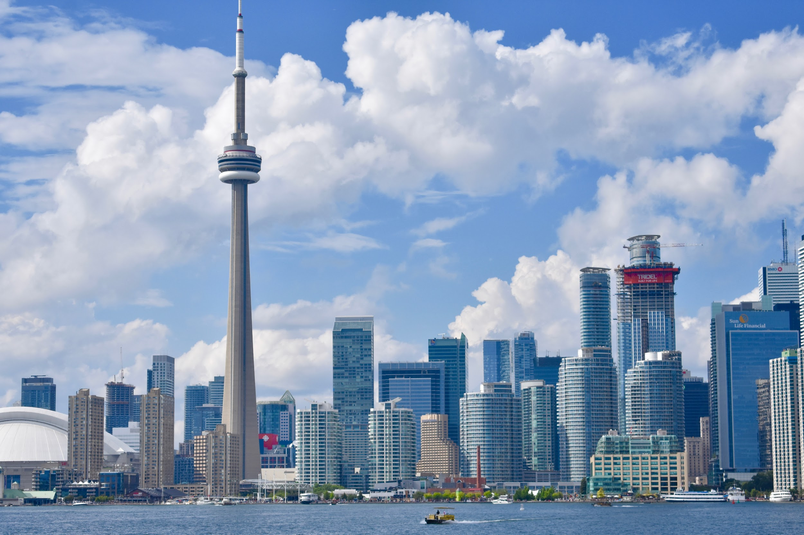
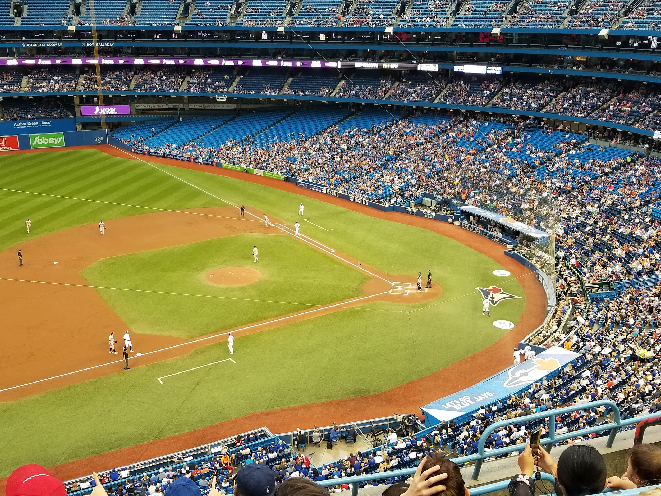
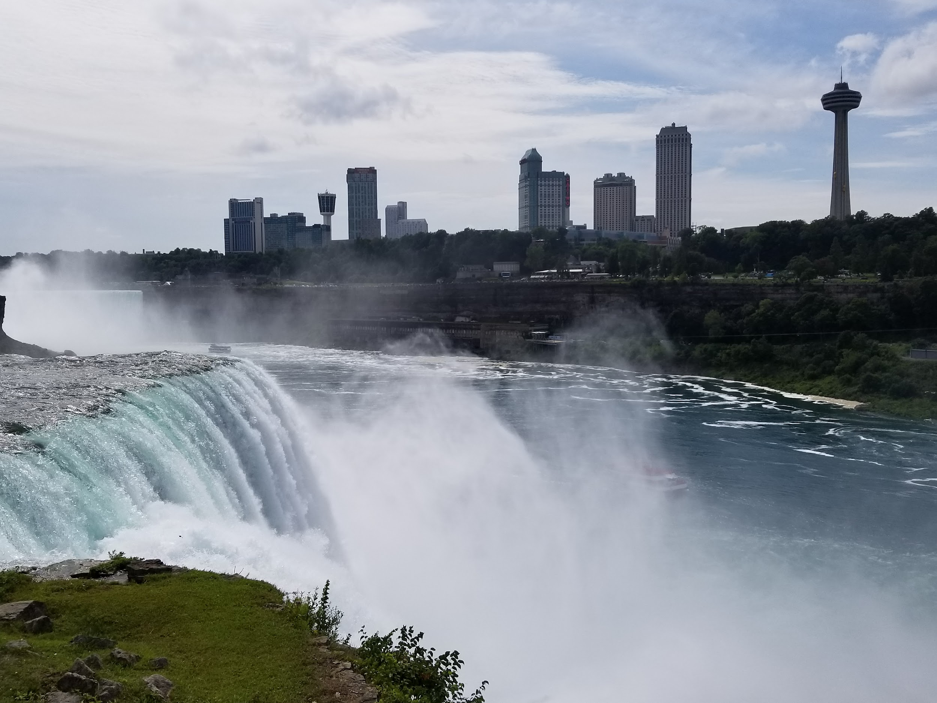
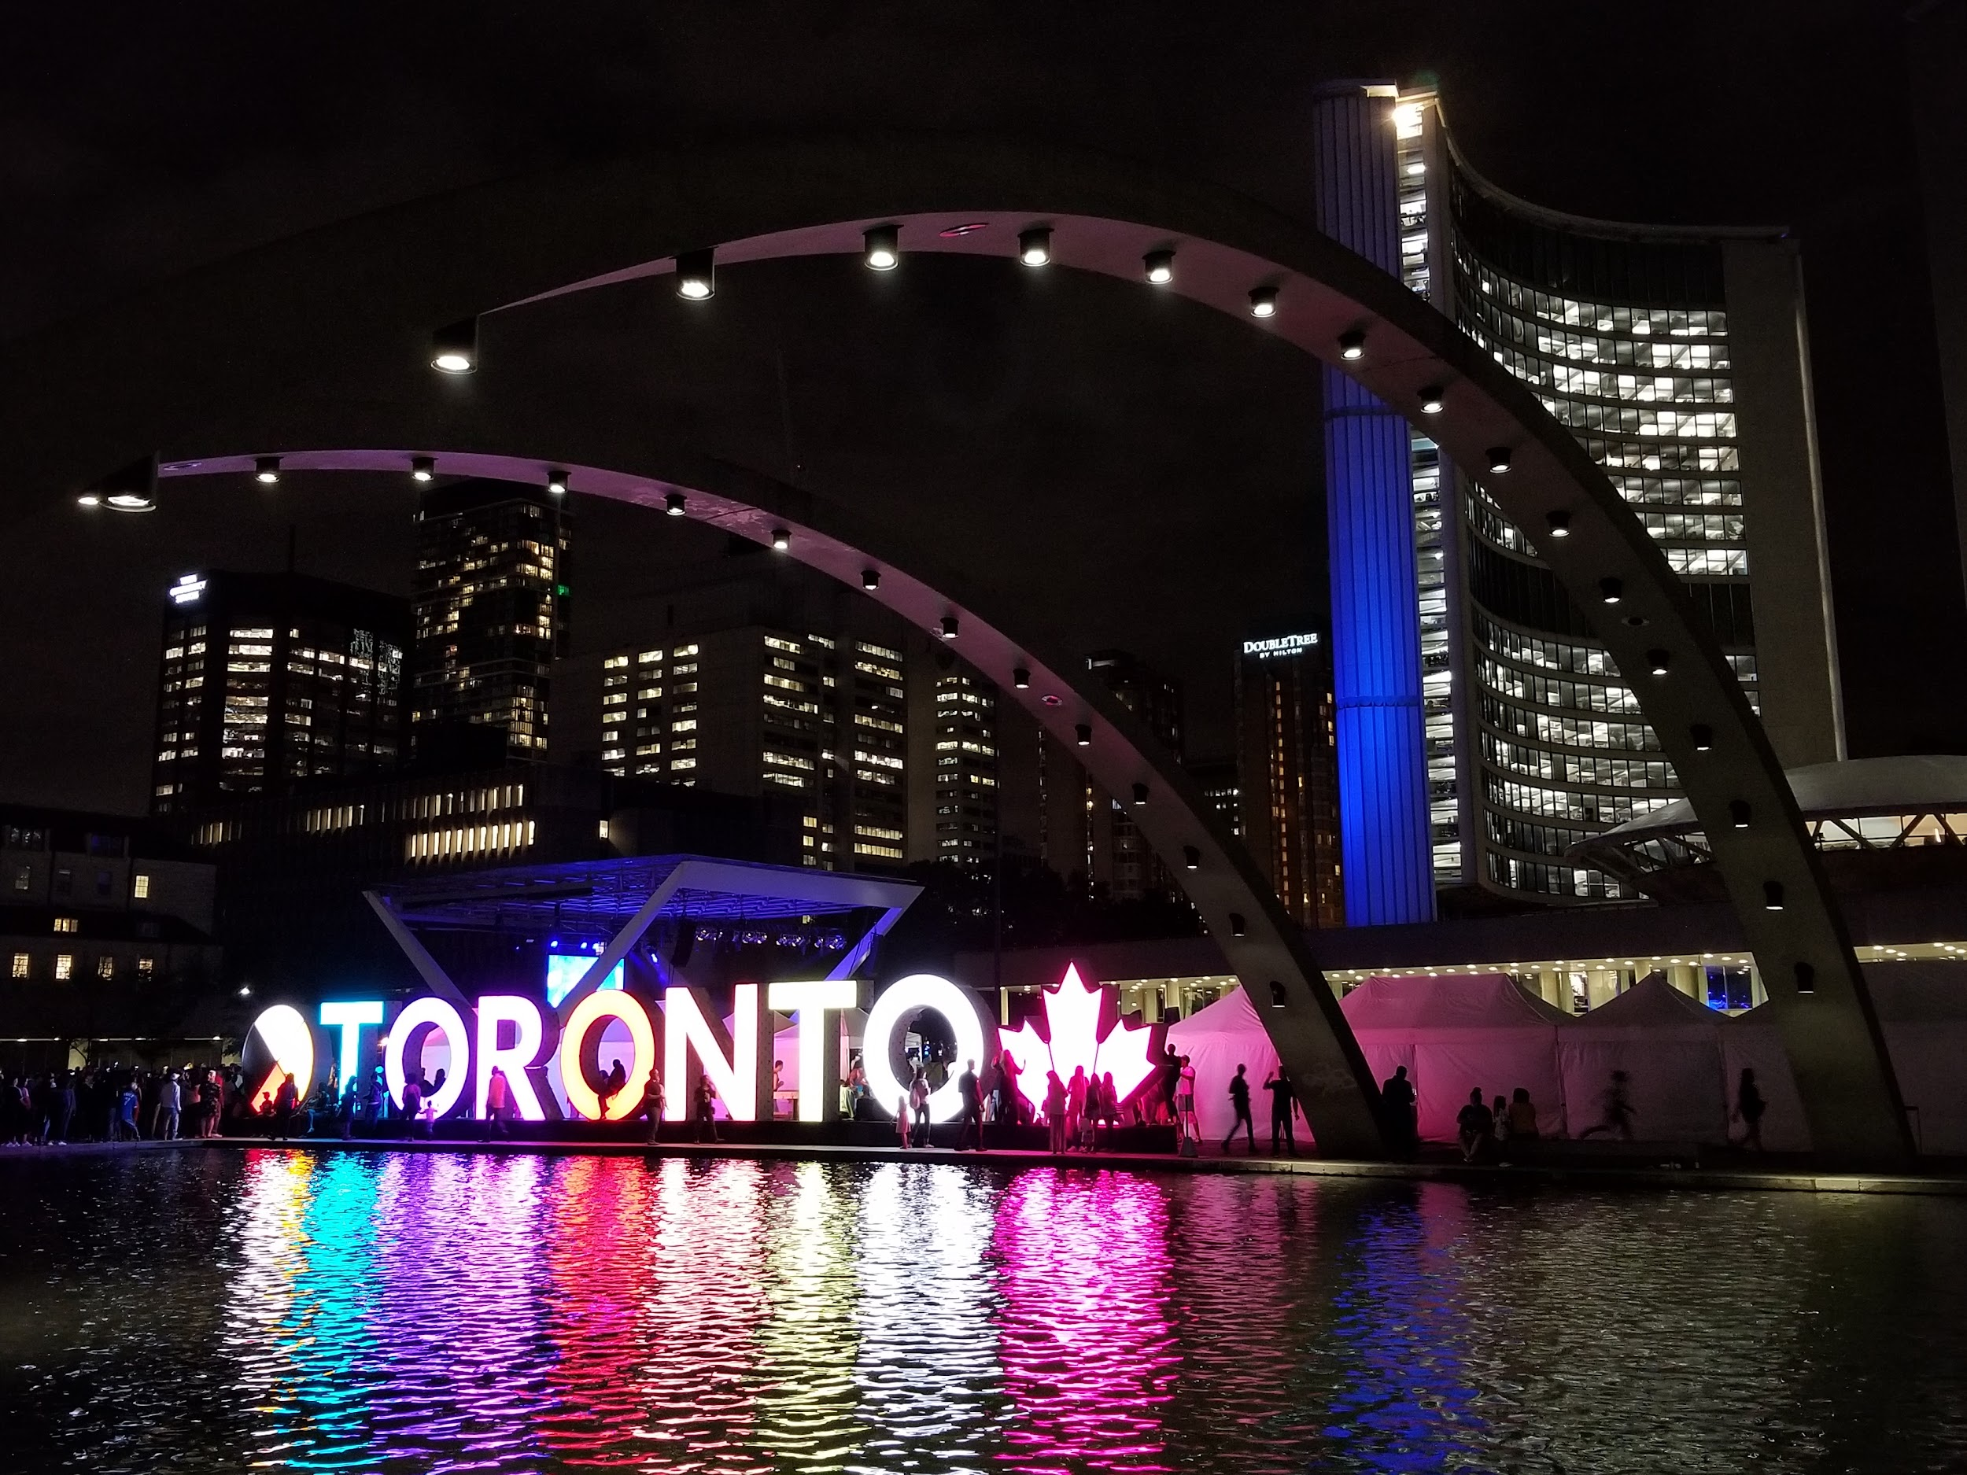
Toronto (T.O.)
the most populated city in Canada
Home to Toronto Blue Jays (MLB), Toronto Maple Leafs (NHL), Toronto Argonauts (CFL), Toronto Raptors (NBA) and Toronto FC
Famous sites: CN Tower, Niagara Falls

Slide 10
The Atlantic Regions
Also known as the Maritimes
Near where the Titanic sank!
Cold winters with lots of icebergs and cool humid summers
New Brunswick is the only official bilingual province: English and French
(also the two official languages of Canada)
New Brunswick
Nova Scotia
Newfoundland
Prince Edward Island
https://www.canada.ca/en/immigration-refugees-citizenship/corporate/publications-manuals/discover-canada/read-online/canadas-regions.html

Slide 11
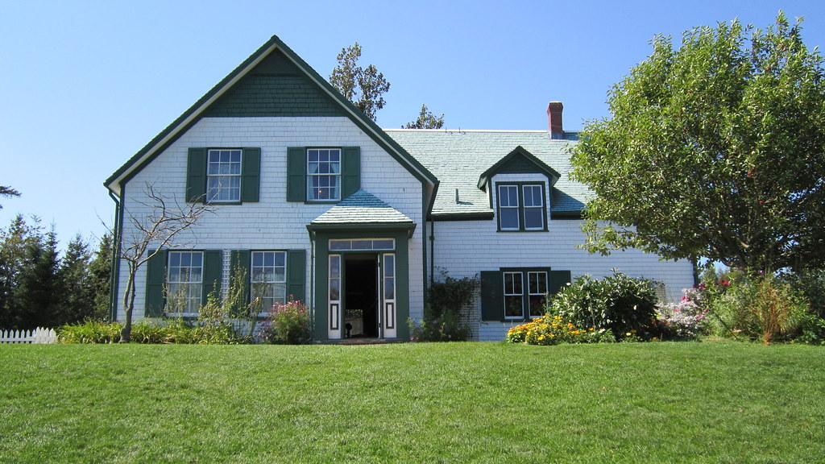
PEI: Anne of Green Gables
Written by Lucy Maud Montgomery in 1908, Anne of Green Gables is set on the tiny island of Prince Edward Island.
It tells of the story of a young orphan girl coming of age.
“Kindred spirits are not so scarce as I used to think. It's splendid to find out there are so many of them in the world.”
Lucy Maud Montgomery

Slide 12
The North
A lot of land, almost ⅓ of Canada, but very few people- only 100,000
Called “Land of the Midnight Sun” - During summer months, daylight can be almost 24 hours (average 14C)
In contrast, only 2-3 hours of daylight during winter (-25C average)
Famous site: The Northern Lights (Aurora Borealis)
Nunavut
The Northwest Territories
Yukon
https://www.canada.ca/en/immigration-refugees-citizenship/corporate/publications-manuals/discover-canada/read-online/canadas-regions.html
Notes:
The Northwest Territories, Nunavut and Yukon contain one-third of Canada’s land mass but have a population of only 100,000. There are gold, lead, copper, diamond and zinc mines. Oil and gas deposits are being developed. The North is often referred to as the “Land of the Midnight Sun” because at the height of summer, daylight can last up to 24 hours. In winter, the sun disappears and darkness sets in for three months. The Northern territories have long cold winters and short cool summers. Much of the North is made up of tundra, the vast rocky Arctic plain. Because of the cold Arctic climate, there are no trees on the tundra and the soil is permanently frozen. Some continue to earn a living by hunting, fishing and trapping. Inuit art is sold throughout Canada and around the world.

Slide 13
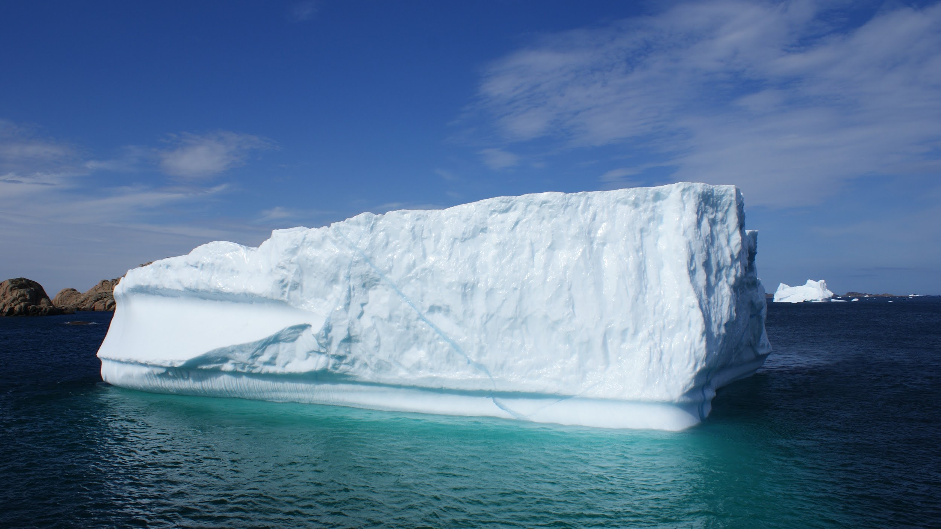
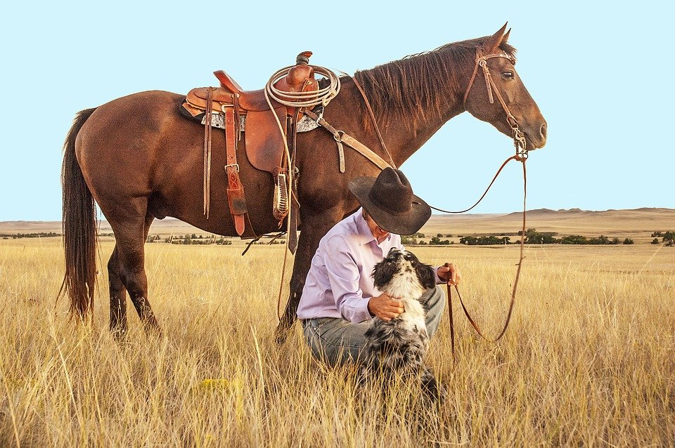
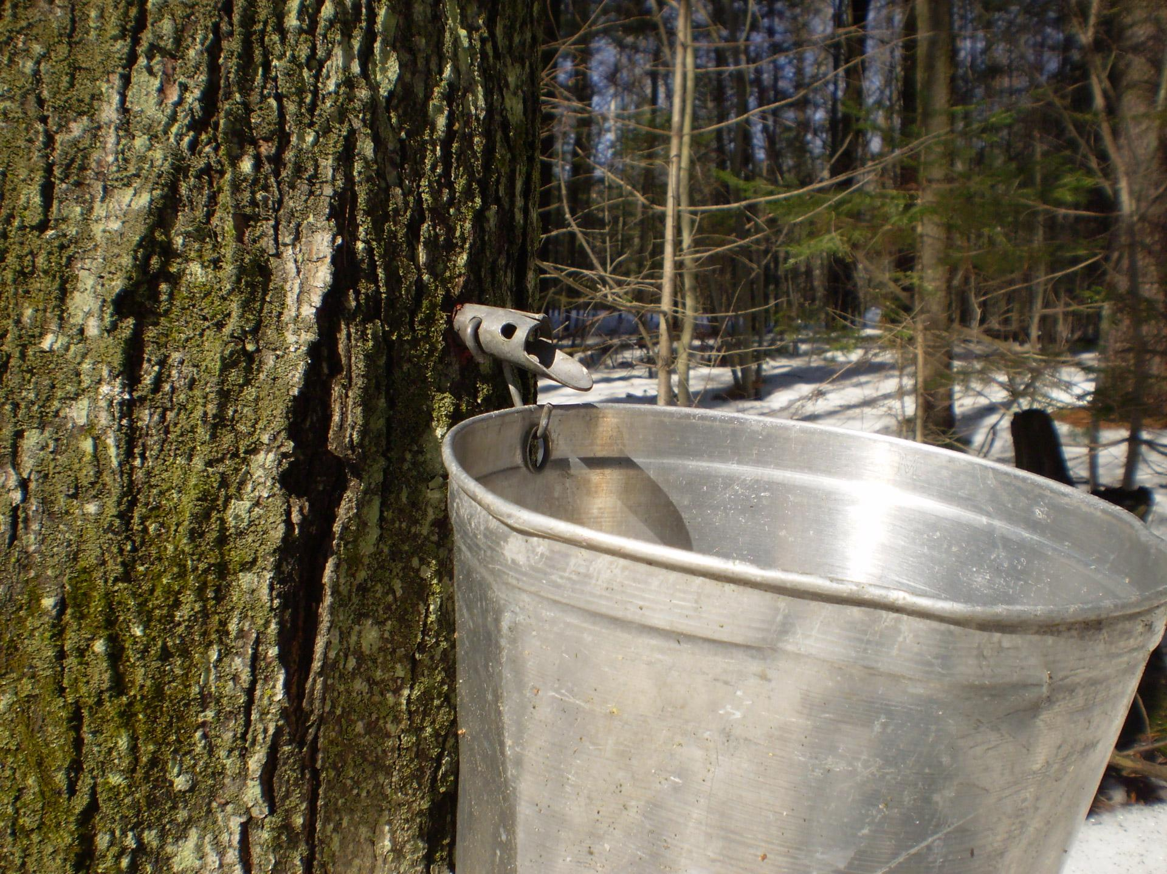
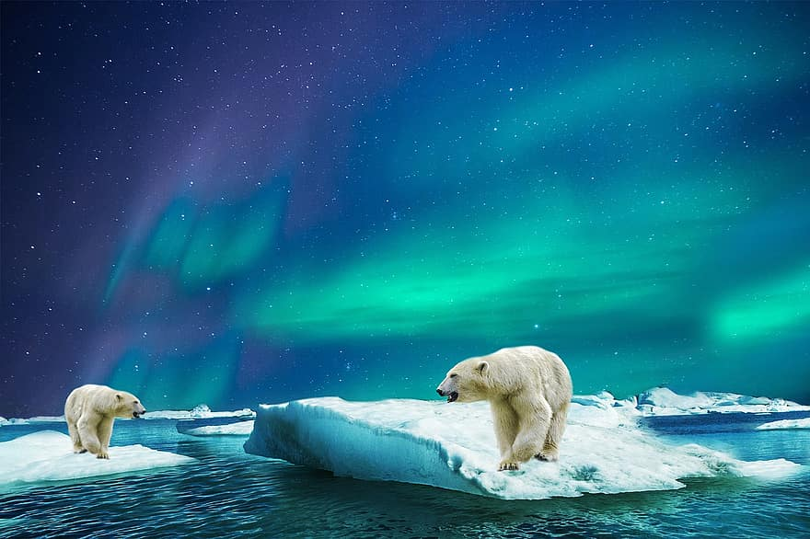
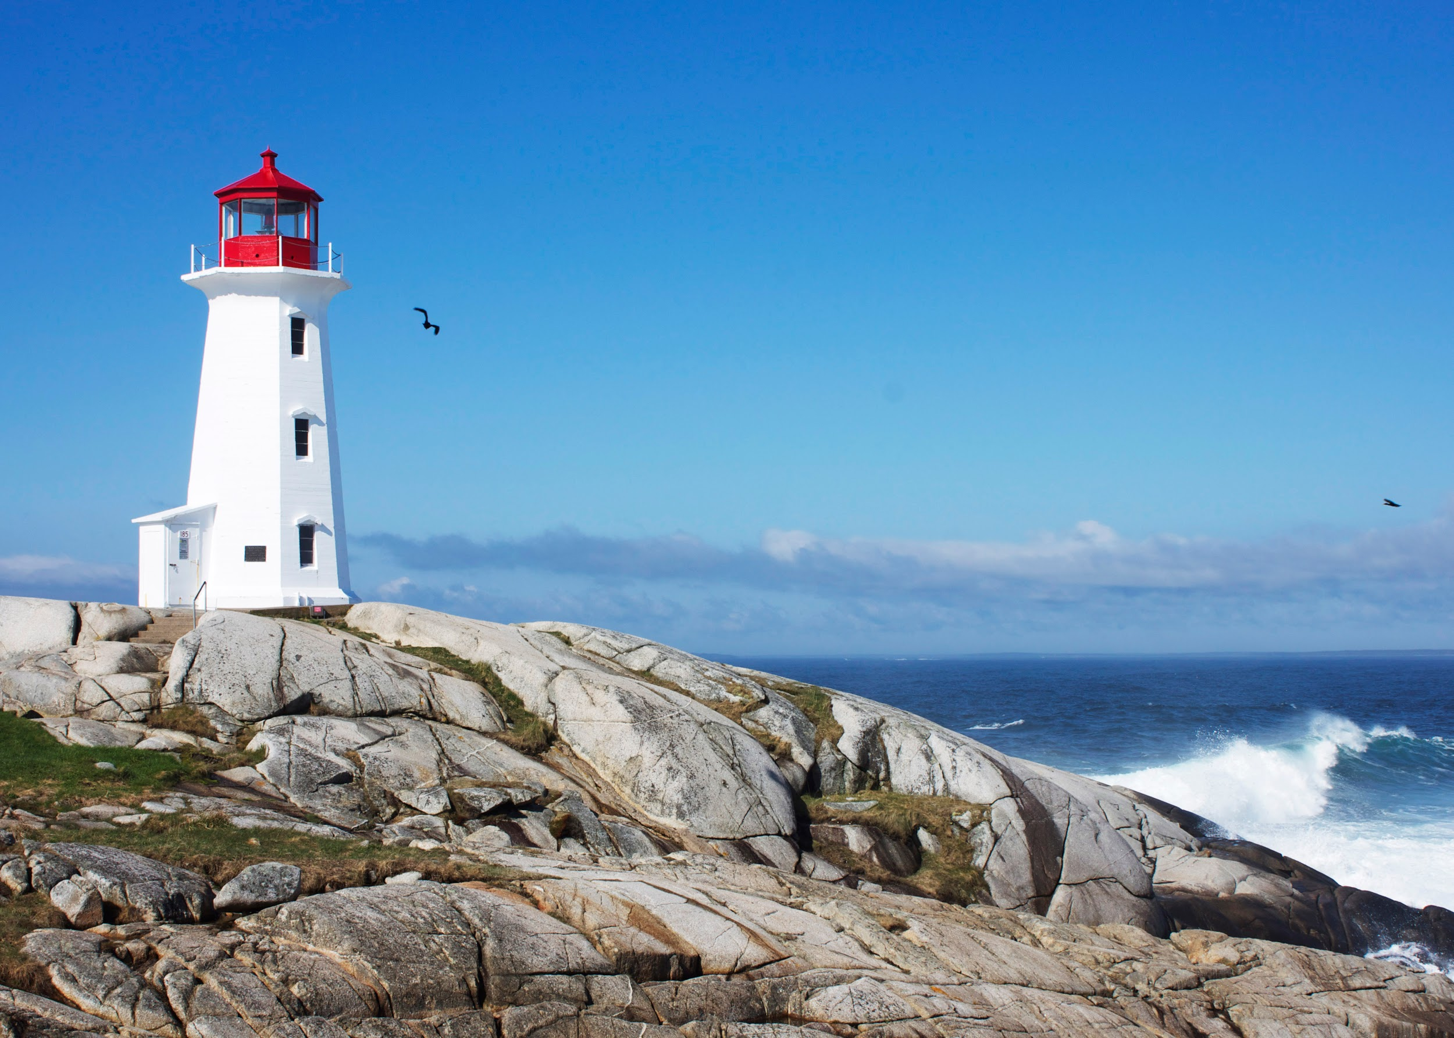
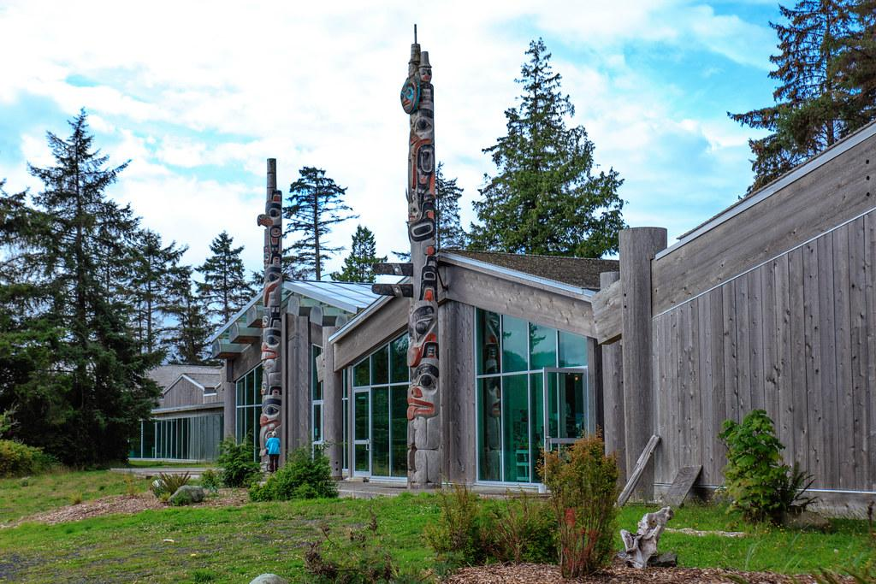
Where Would You Find It?
1
2
3
4
5
6
Next Class: Canadian Slang
Notes:
From top left to right: Maritimes, The Prairies, Central, West coast, Maritimes, North

Slide 14
Wrap-Up
Which region reminds you the most of home?
Which is the most different?
Which would you most/least like to visit and why?
Next Class: Canadian Slang

