Slide 1
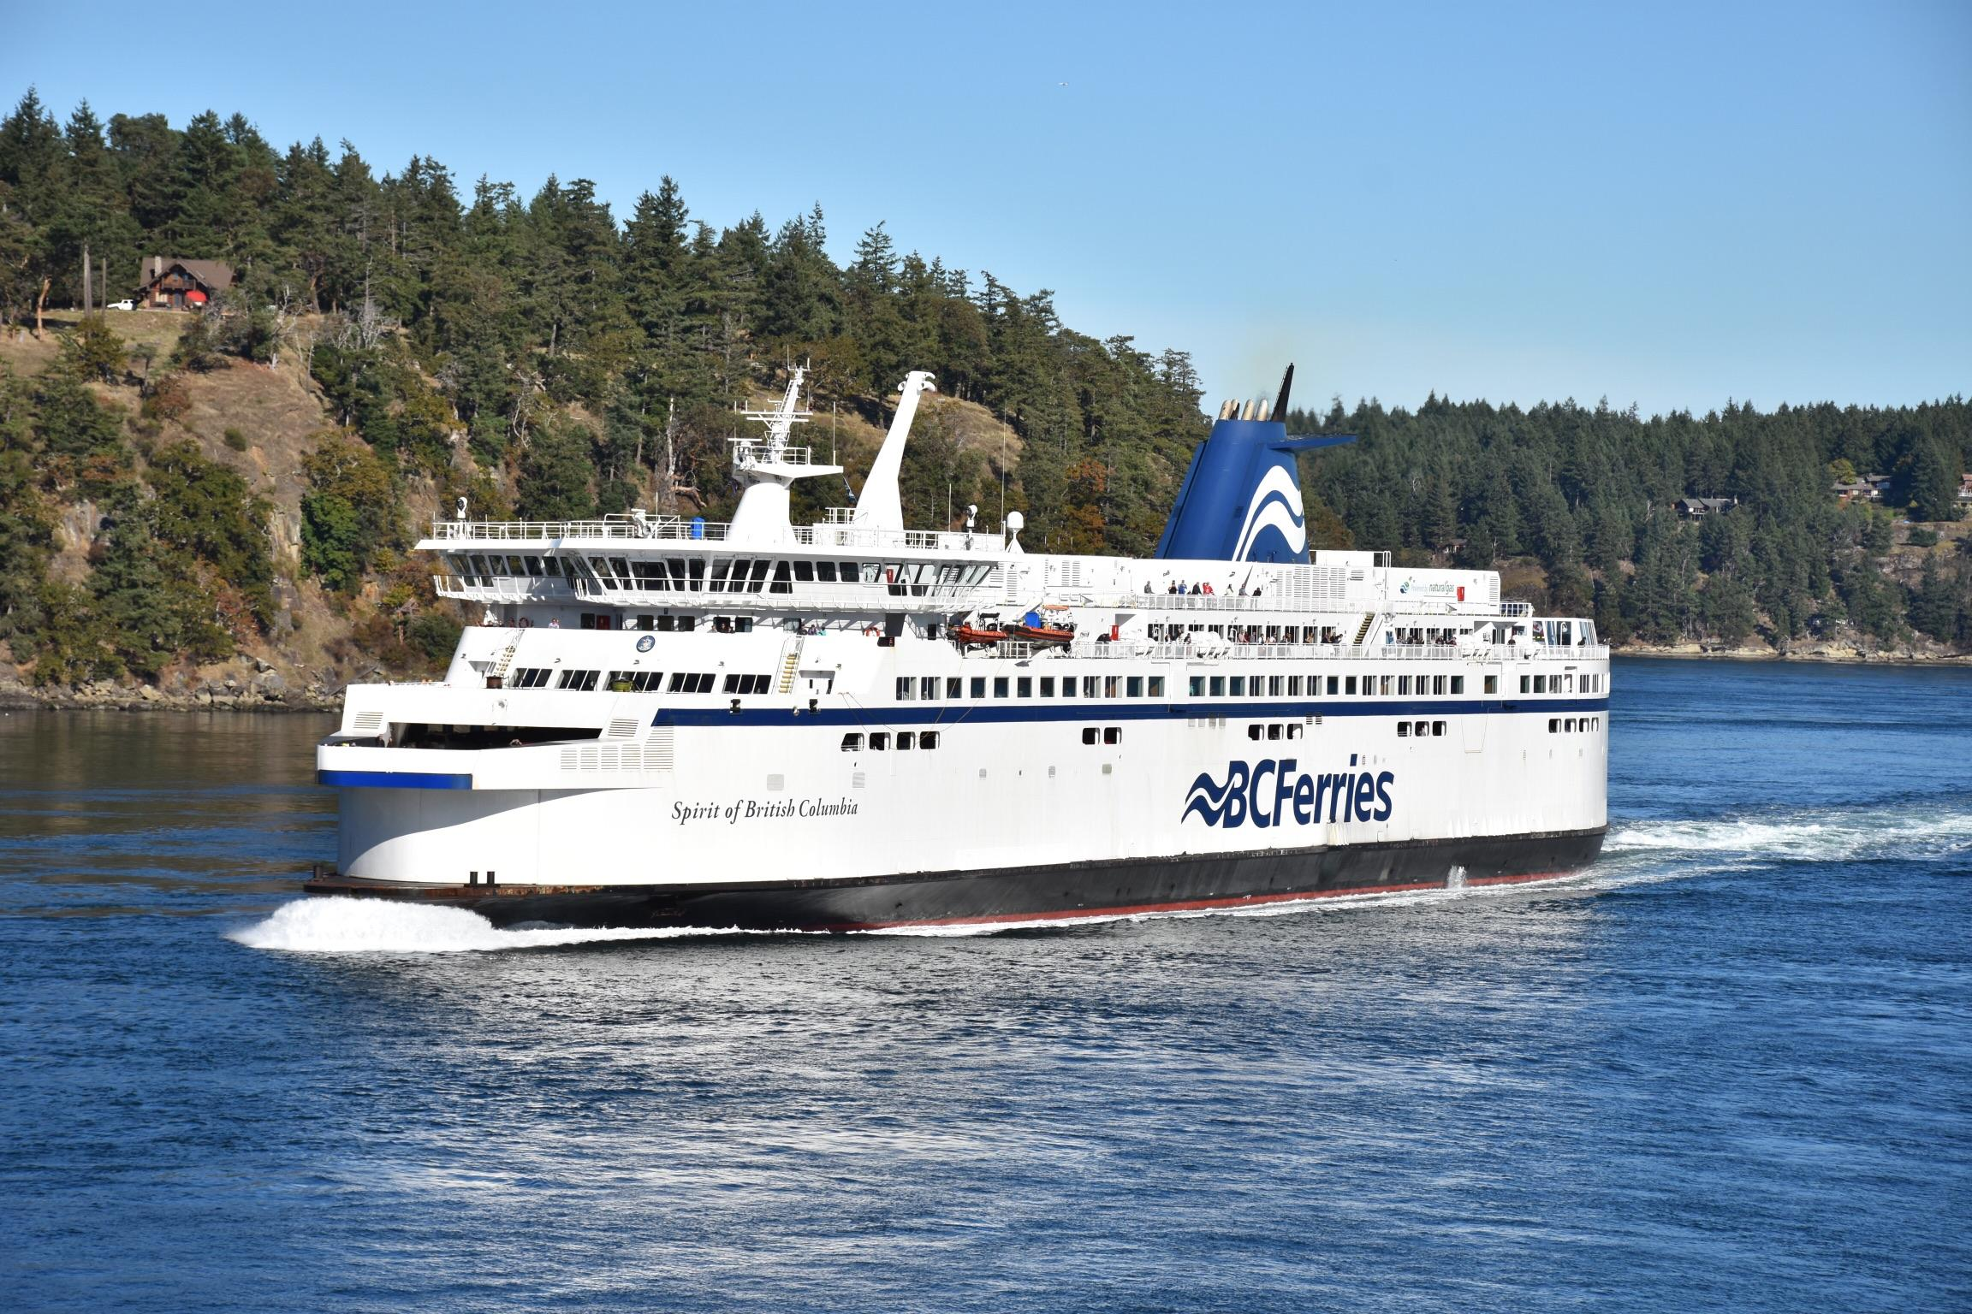
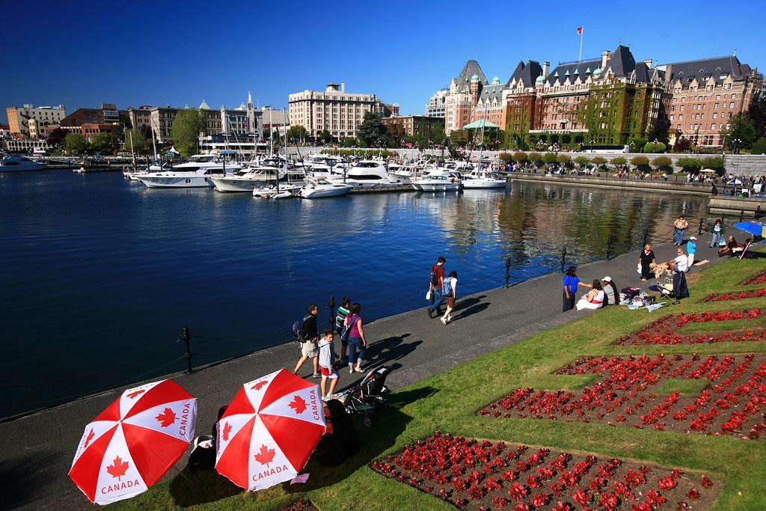
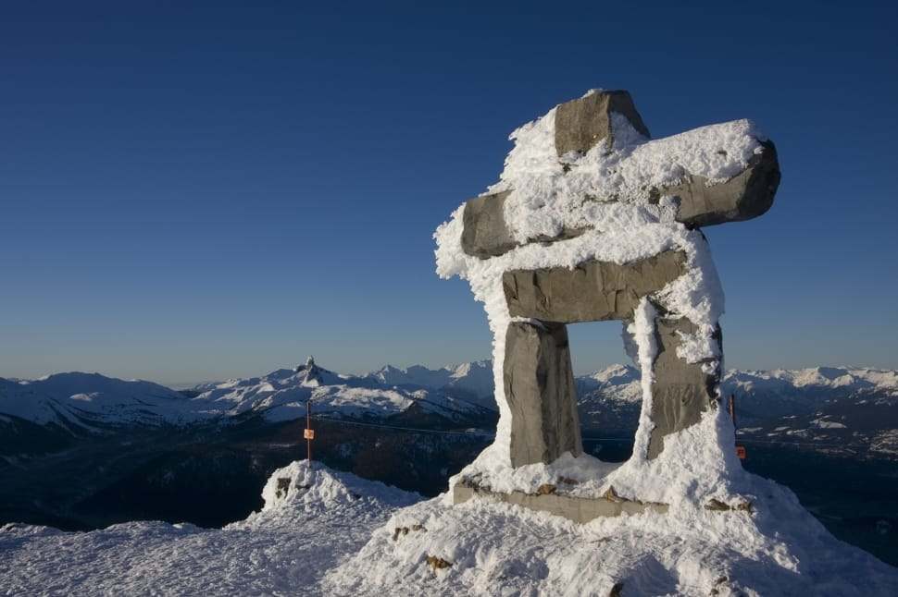
Pre-Arrival English
Weekend Trips
from Vancouver
Copyright © 2020 International House Pacific Group
Do not share or copy without permission

Slide 2
Warm-Up
What other cities or places have you heard about in Canada?
What about about them sounds interesting to you?
Where have you been in Canada?

Slide 3
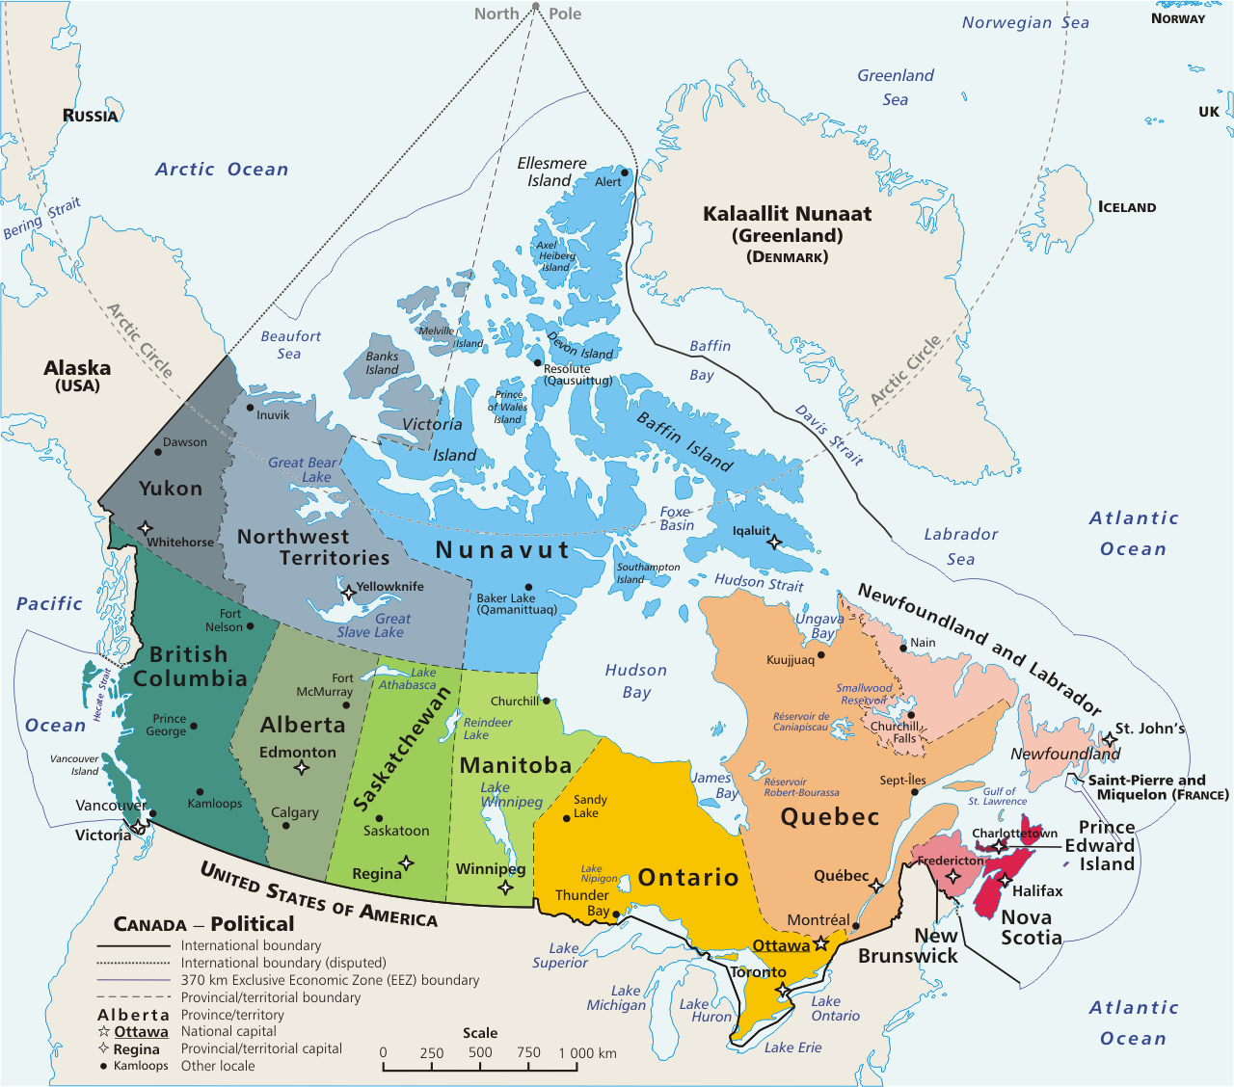
Geography
Let’s point out some cities!

Slide 4
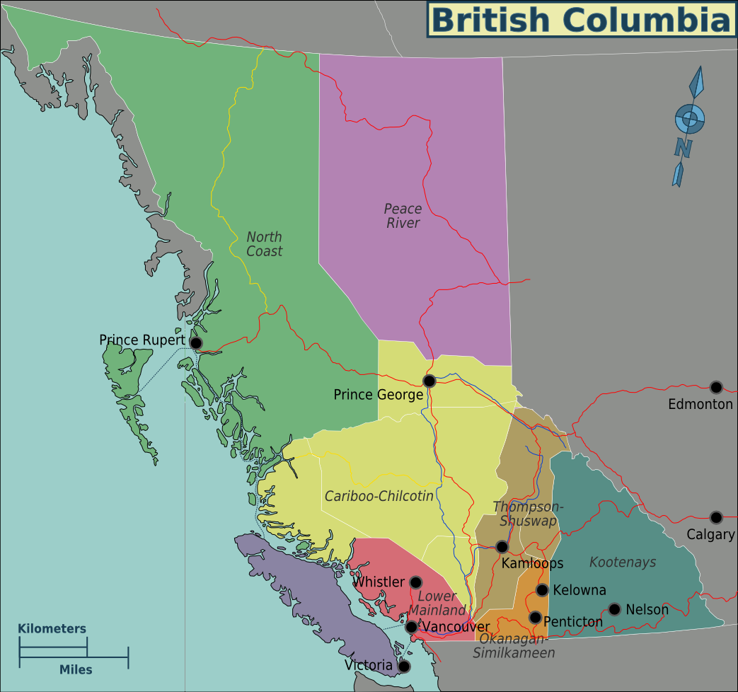
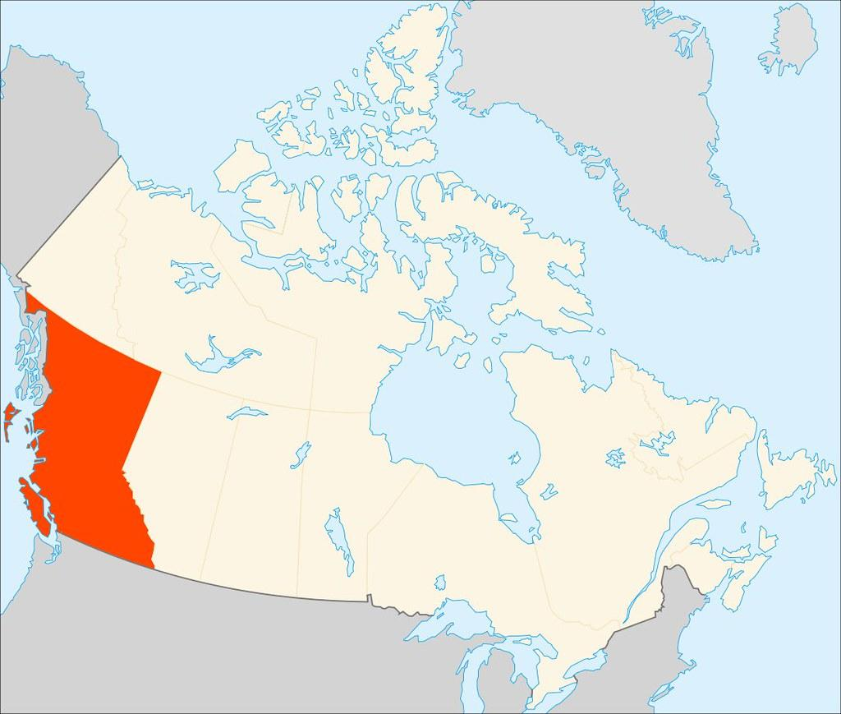
Geography
British Columbia
(The Pacific Coast)
Vancouver is located in the southwest corner of the province
Very close to the US Border
Driving across the province takes almost one whole day!
Driving north will take one week
Many different regions in British Columbia

Slide 5
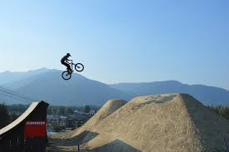
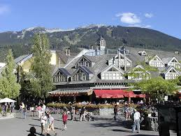
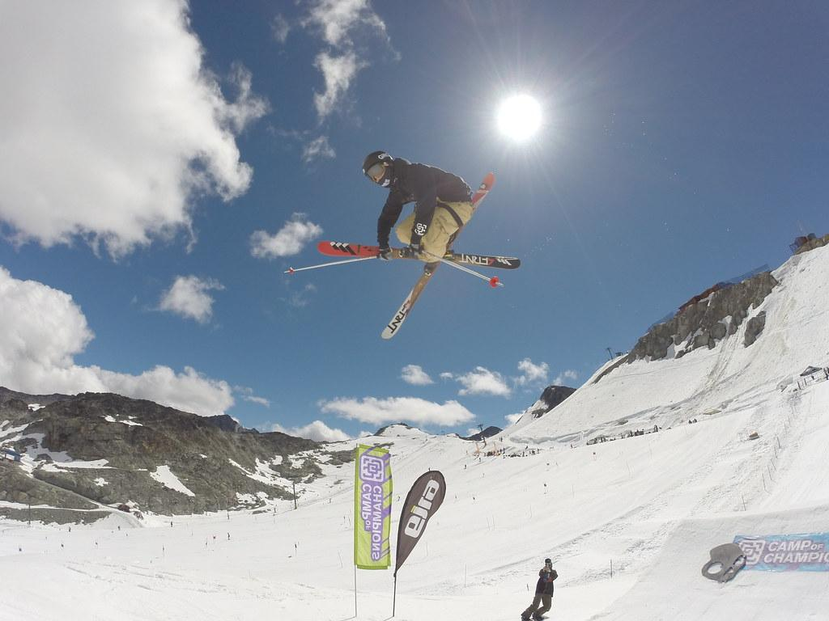
Whistler
2-3 hrs from Vancouver (by car/bus)
Site of the 2010 Winter Olympics
Great skiing/snowboarding mountain with fluffy snow
Peak-to-peak gondola
Great summer retreat
Camping
Mountain biking
Hiking
...what is the most similar place you know in your country?

Slide 6
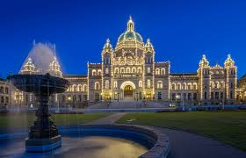
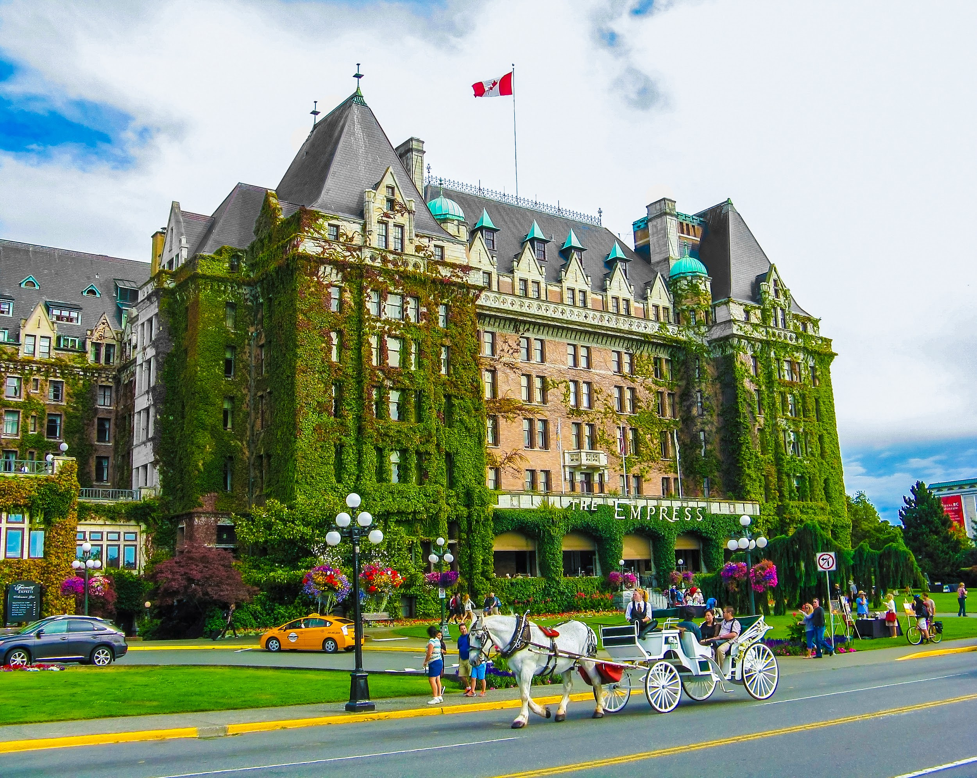
Victoria
~4 hour ferry ride from downtown Vancouver
The capital of British Columbia
Rich in History
Provincial Parliament
Butchart Gardens
High Tea at the Empress Hotel
...what is the most similar place you know in your country?

Slide 7
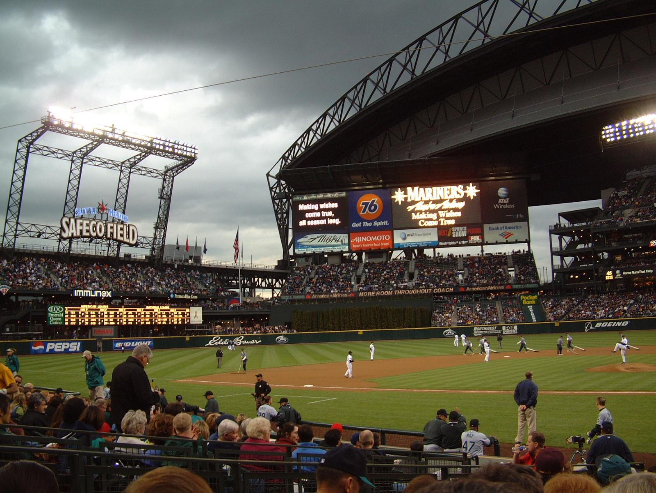
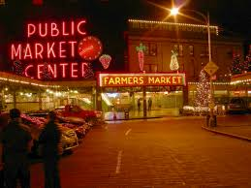
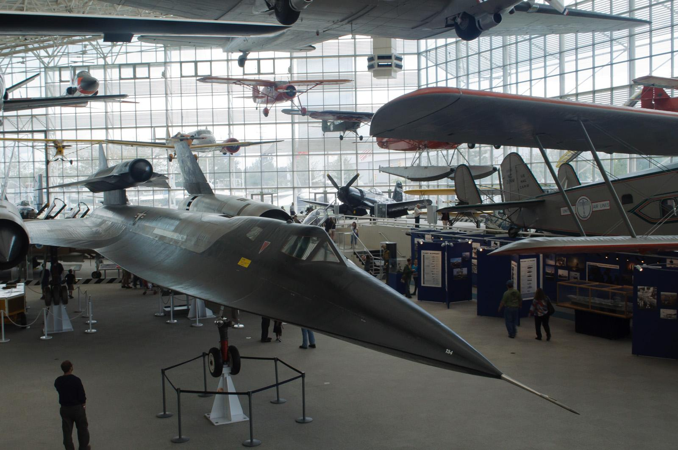
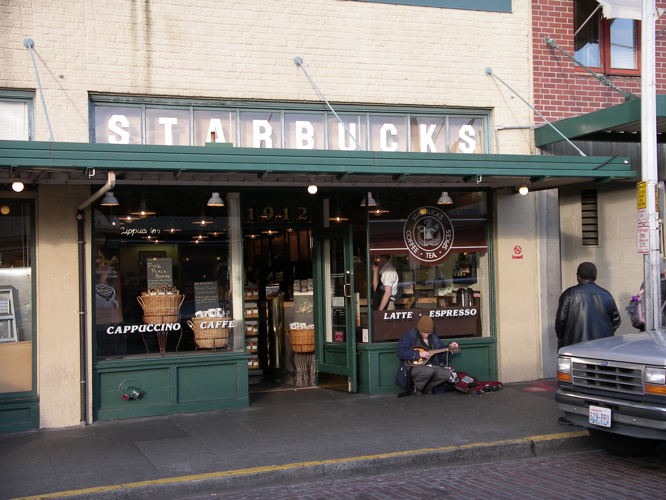
Seattle
2-4 hours from downtown Vancouver (by car/bus)
Pike Place Market
Visit the first ever Starbucks
Shopping Outlets
Safeco Field to watch the Seattle Mariners
Go to Boeing Field Tours
Check out the Museum of Flight
...what is the most similar place you know in your country?

Slide 8
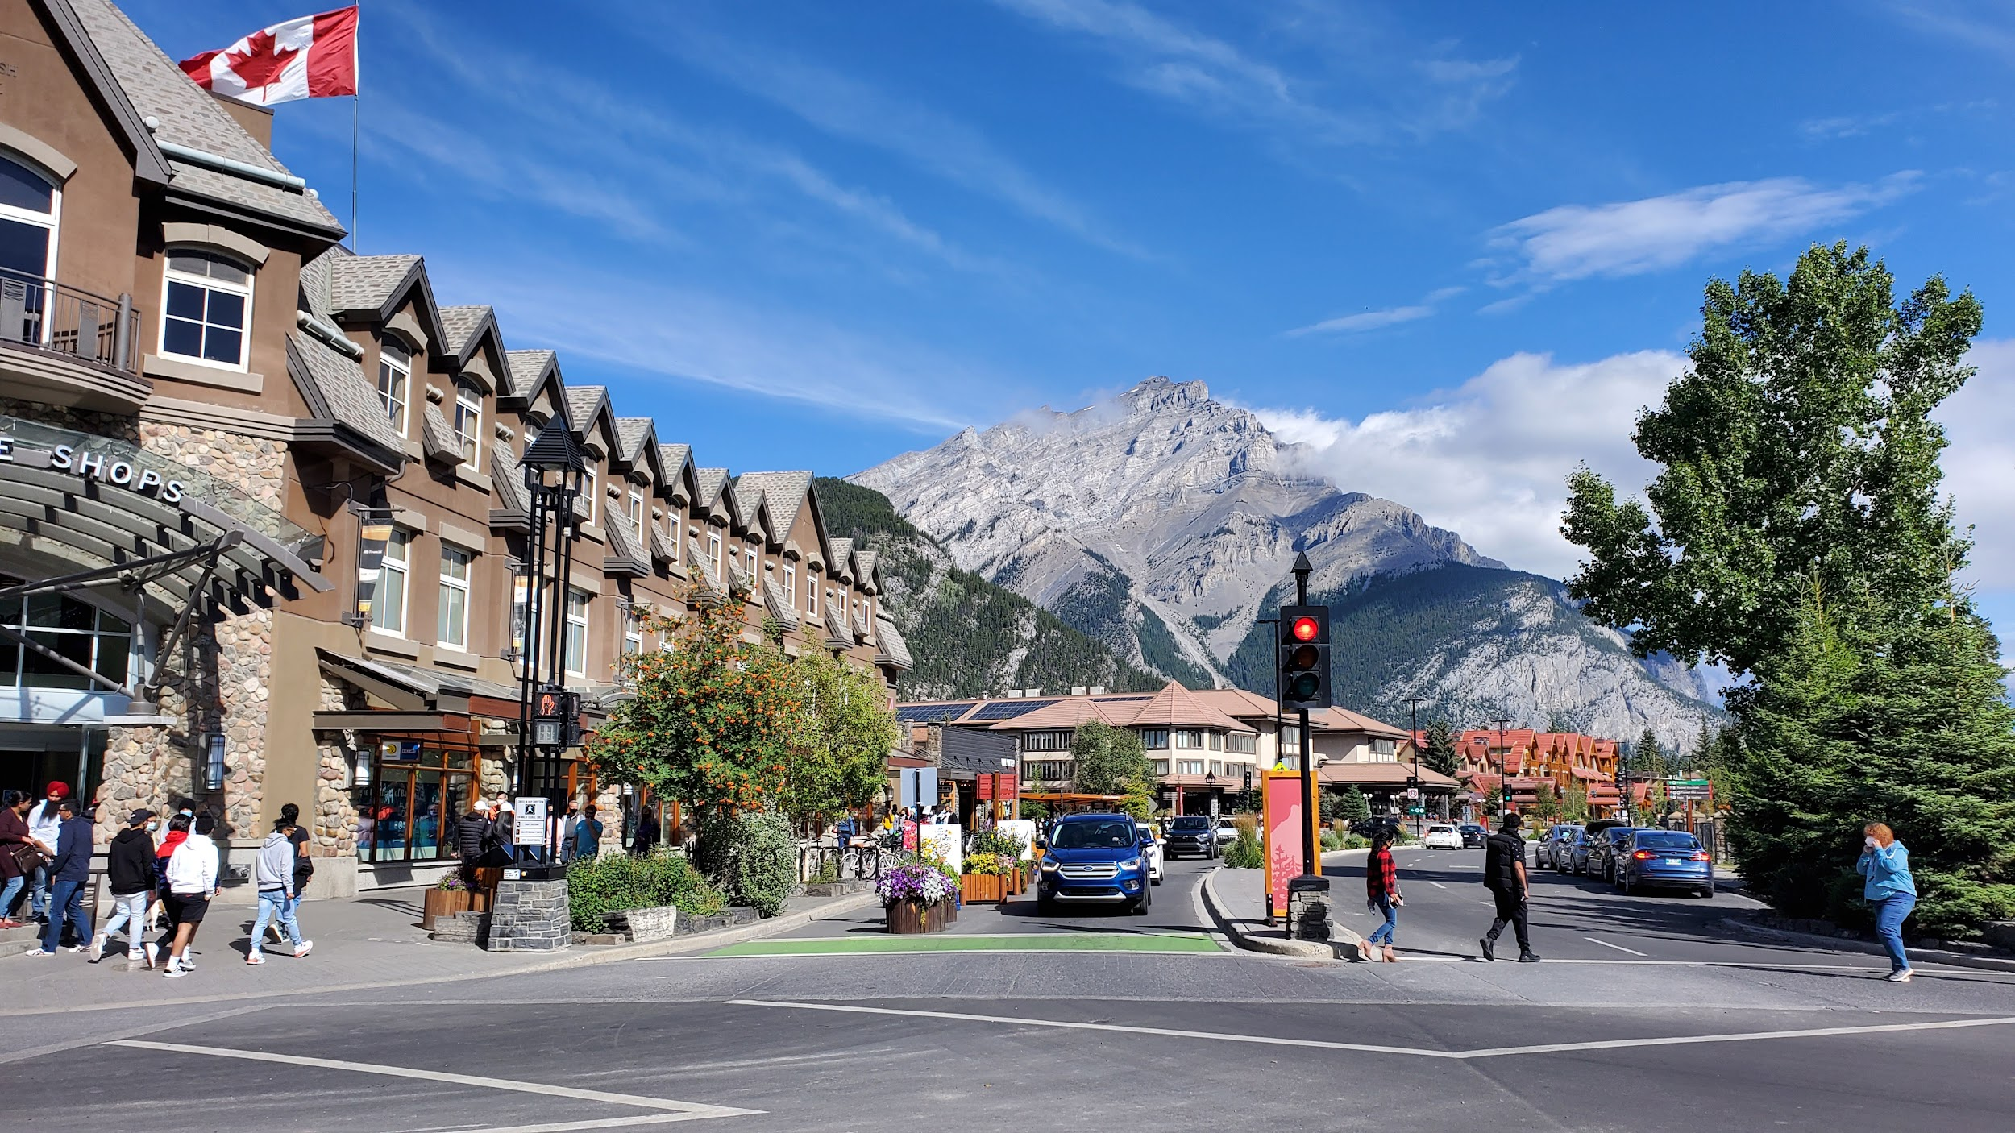
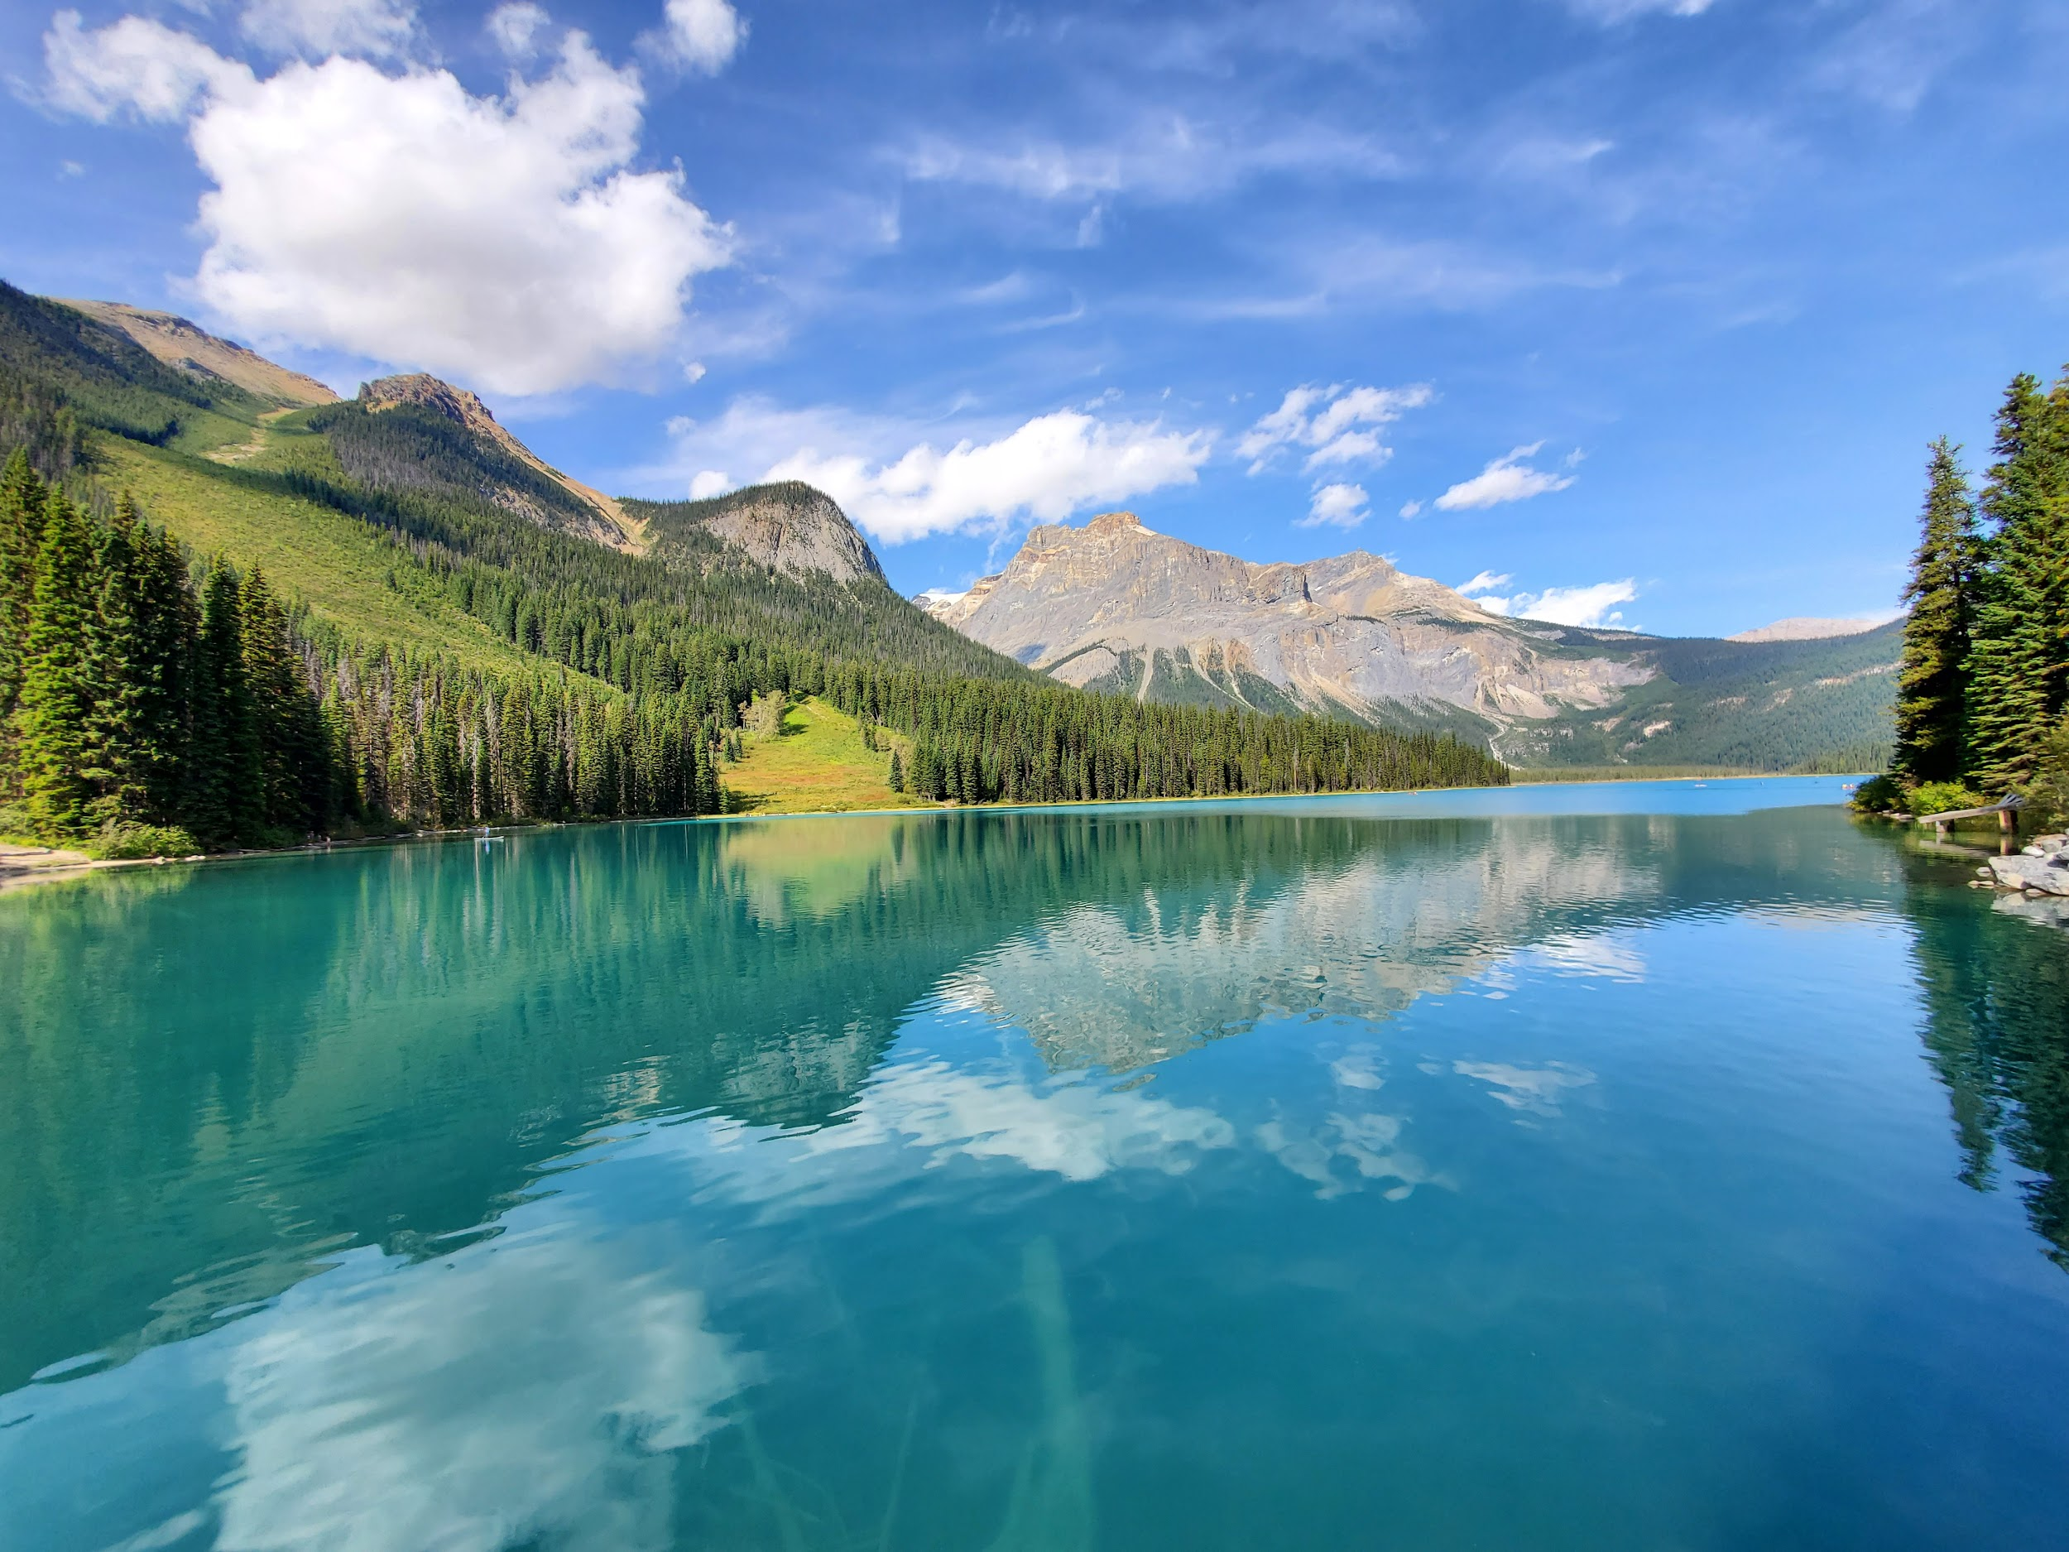
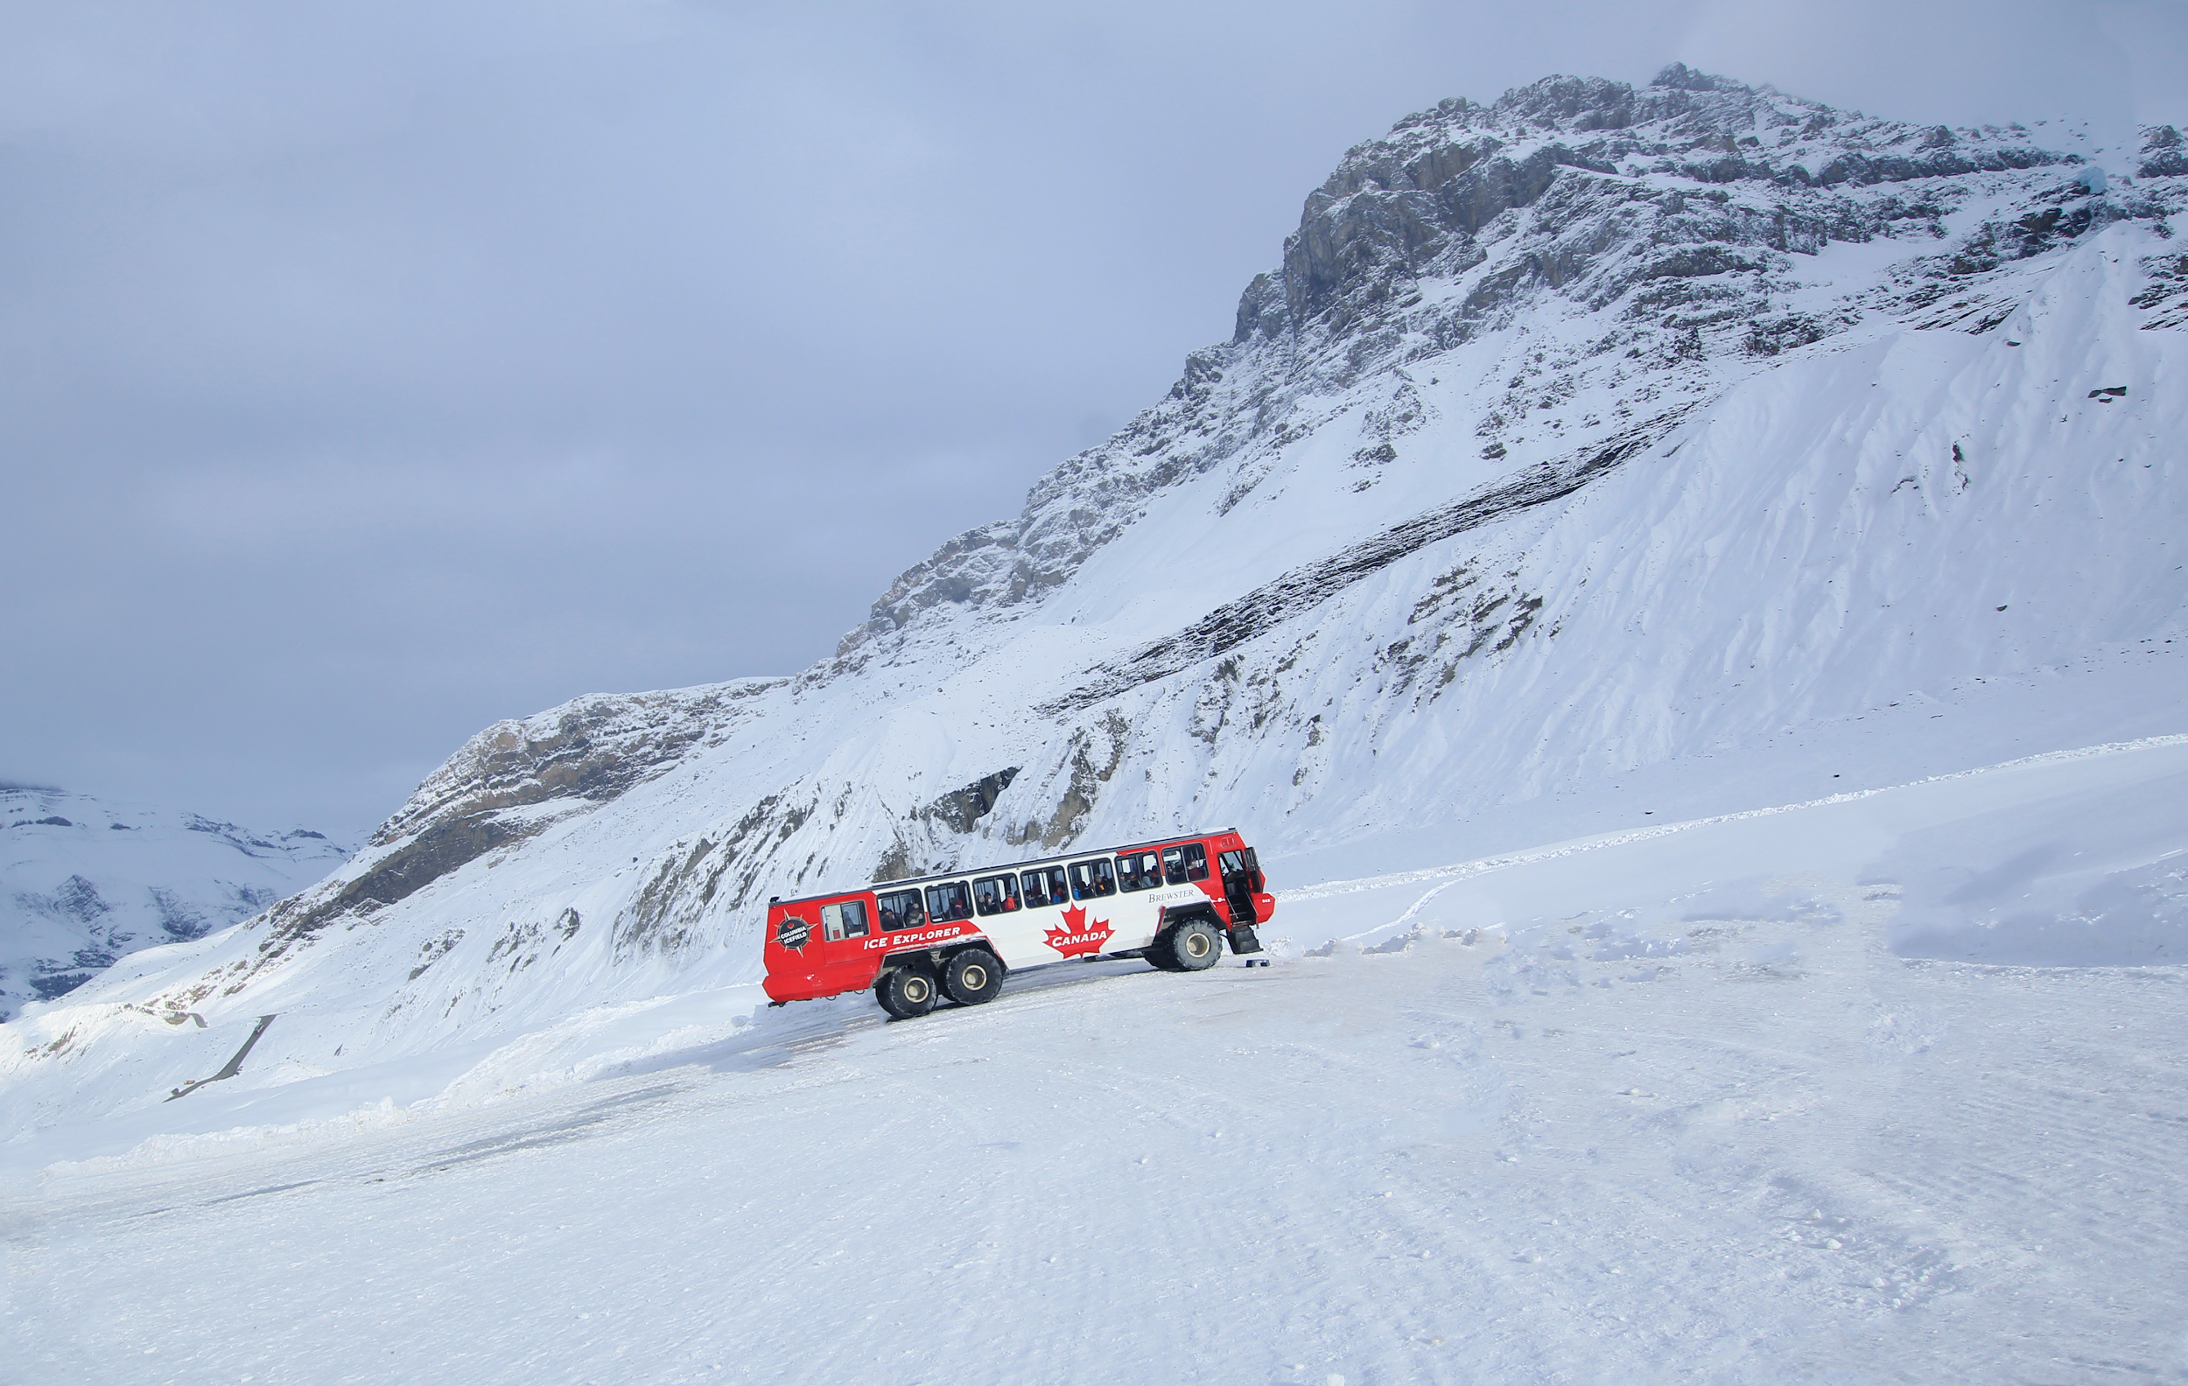
Banff, Alberta & Lake Louise
10 hours from Vancouver (by car/bus)
Located in the Rocky Mountains
Near Jasper National Park
Columbia Icefield
Great hiking trails
Lots of beautiful lakes and instagram-able moments!
...what is the most similar place you know in your country?
Copyright © 2020 International House Pacific Group
Do not share or copy without permission

Slide 9
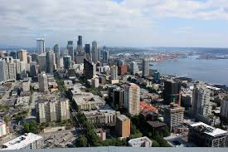
Wrap-Up
Where you go first and why?
Next Class: Understanding Different Regions of Canada

