Slide 1
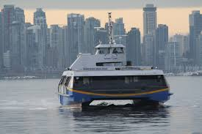
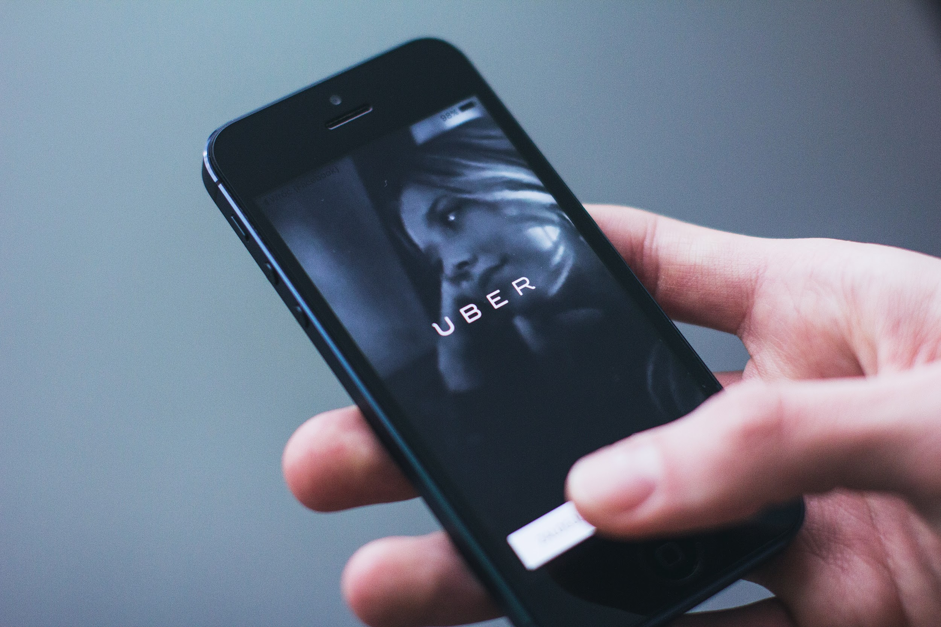
Pre-Arrival English
Making International Friends
Copyright © 2020 International House Pacific Group
Do not share or copy without permission

Slide 2
Warm-Up
Where did you make the best friends you have know?
Where can you meet friends besides school or work?
What kinds of things do you enjoy doing with your friends?

Slide 3
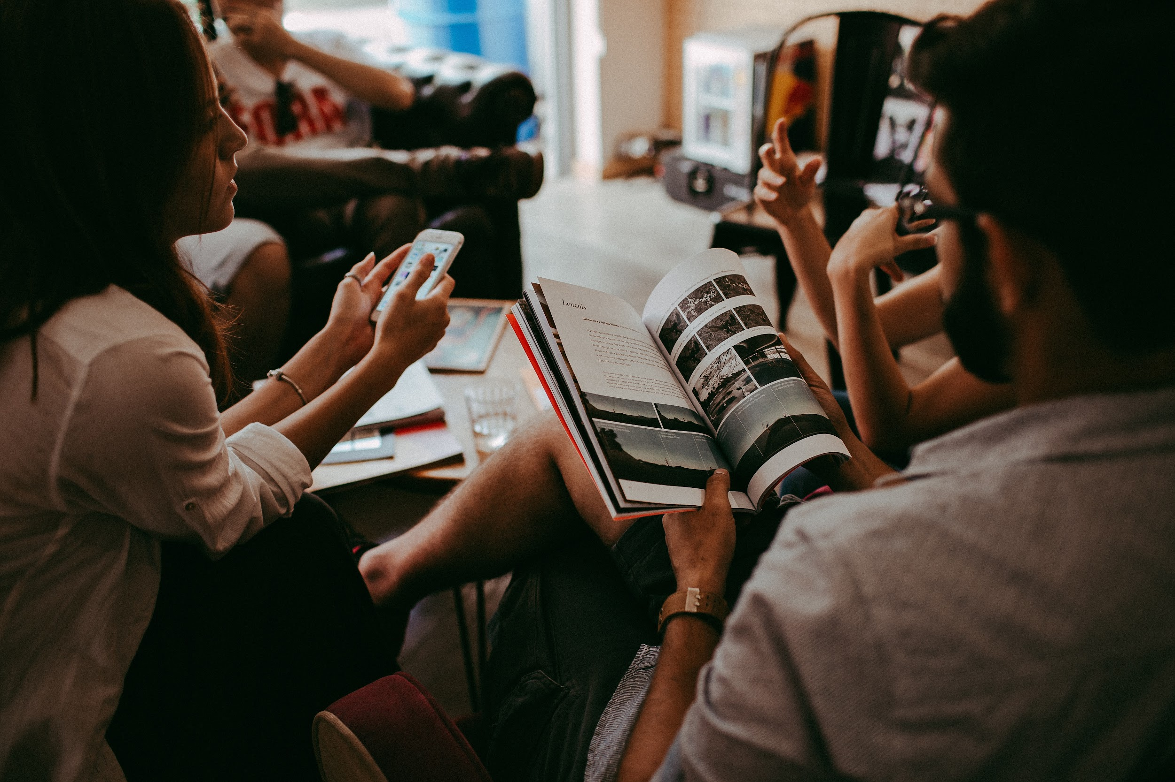
Do As the Locals Do
Join a…
Sports team
Book club
Cultural exchange group
Class at a gym
Group of people to go out to eat with from your host family or residence

Slide 4
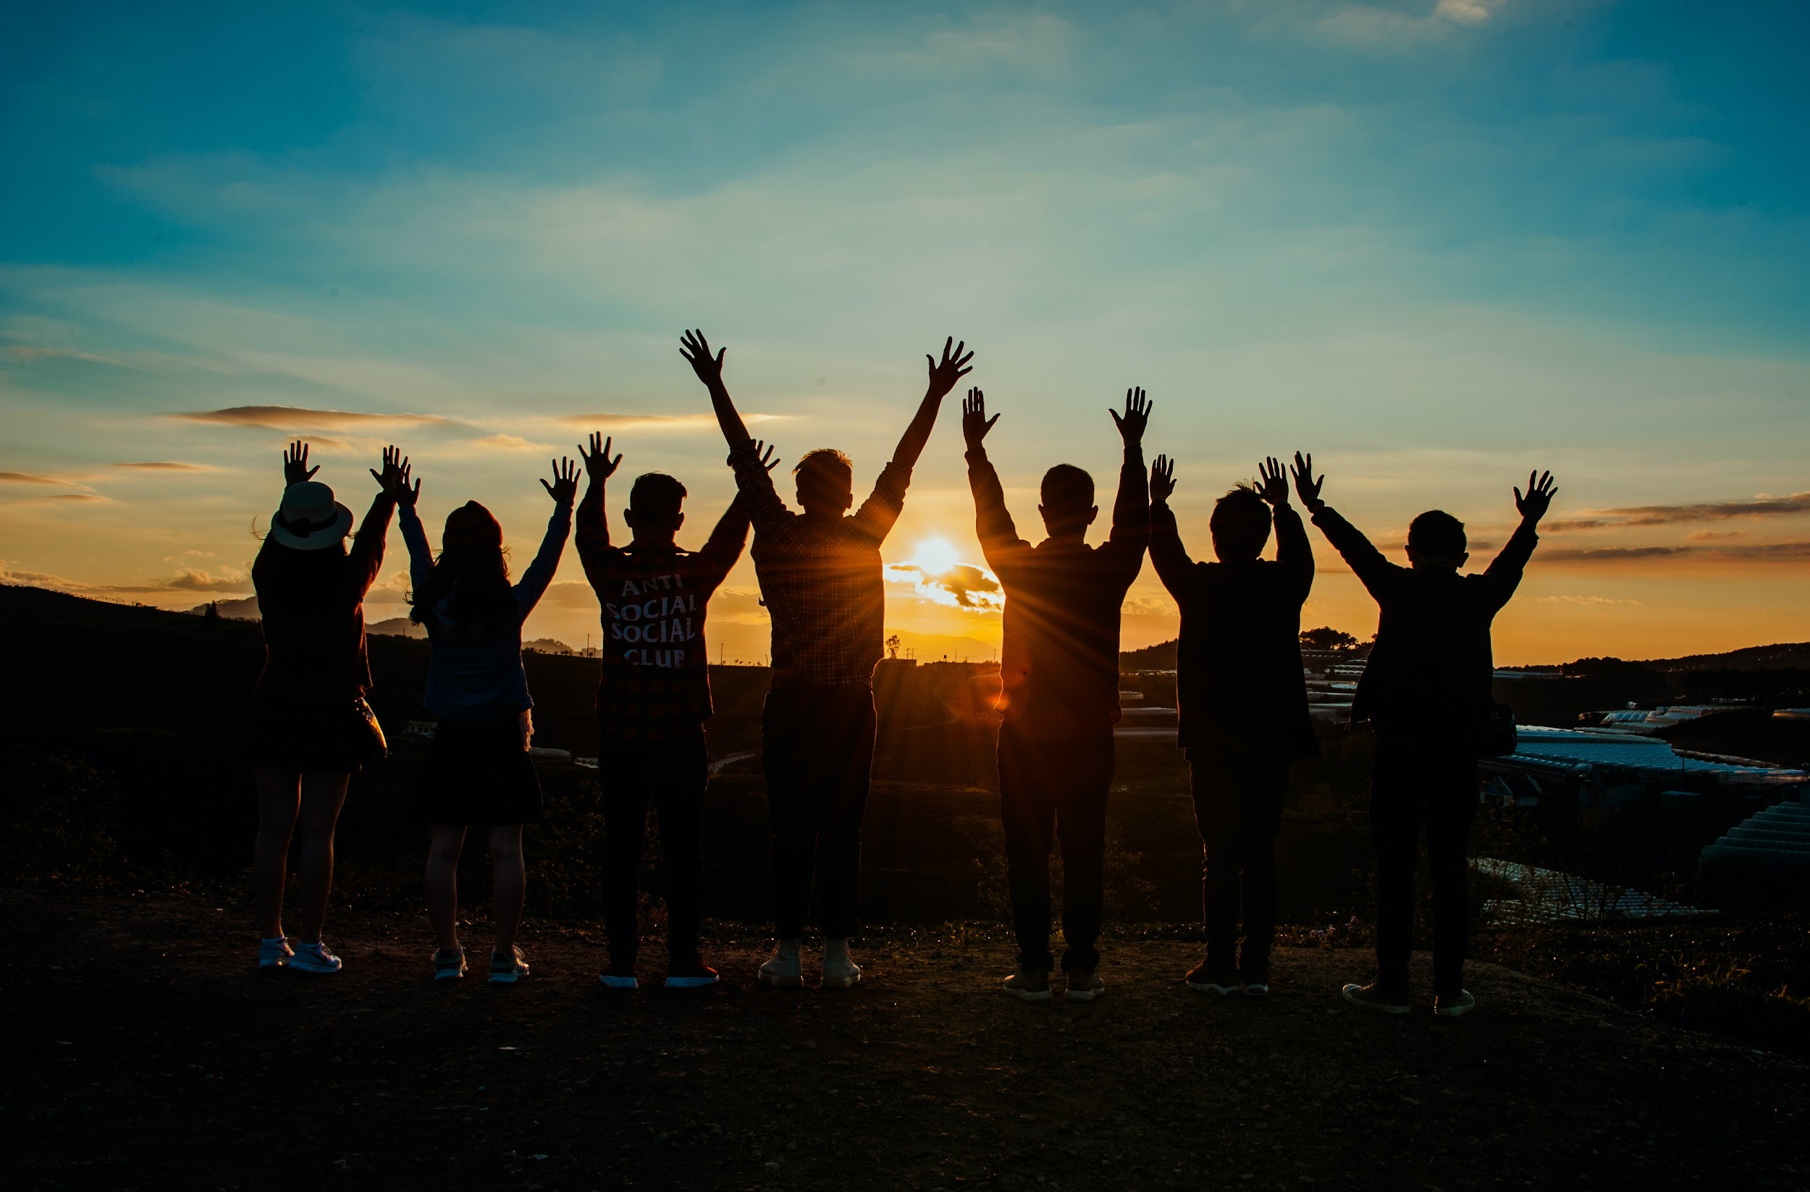
Where to Find These Groups
There are many meet-up websites and apps that can connect you to sports teams, book clubs and more!
Ask your host family or residence staff where their favorite places to go are. Recommendations are the best!
Join daily school activities to learn more about popular social places!

Slide 5
Asking for Gym Class Recommendations
Student: “Can you recommend a good gym to take classes at?”
Residence staff: “Let’s see, the closest one around here would probably be...24 Hour Fitness. They have tons of classes.”
Student: “Would you mind helping me call them?”
Residence staff: “Sure! I’ll have you talk to them but I’ll be here if you need any help.”

Slide 6
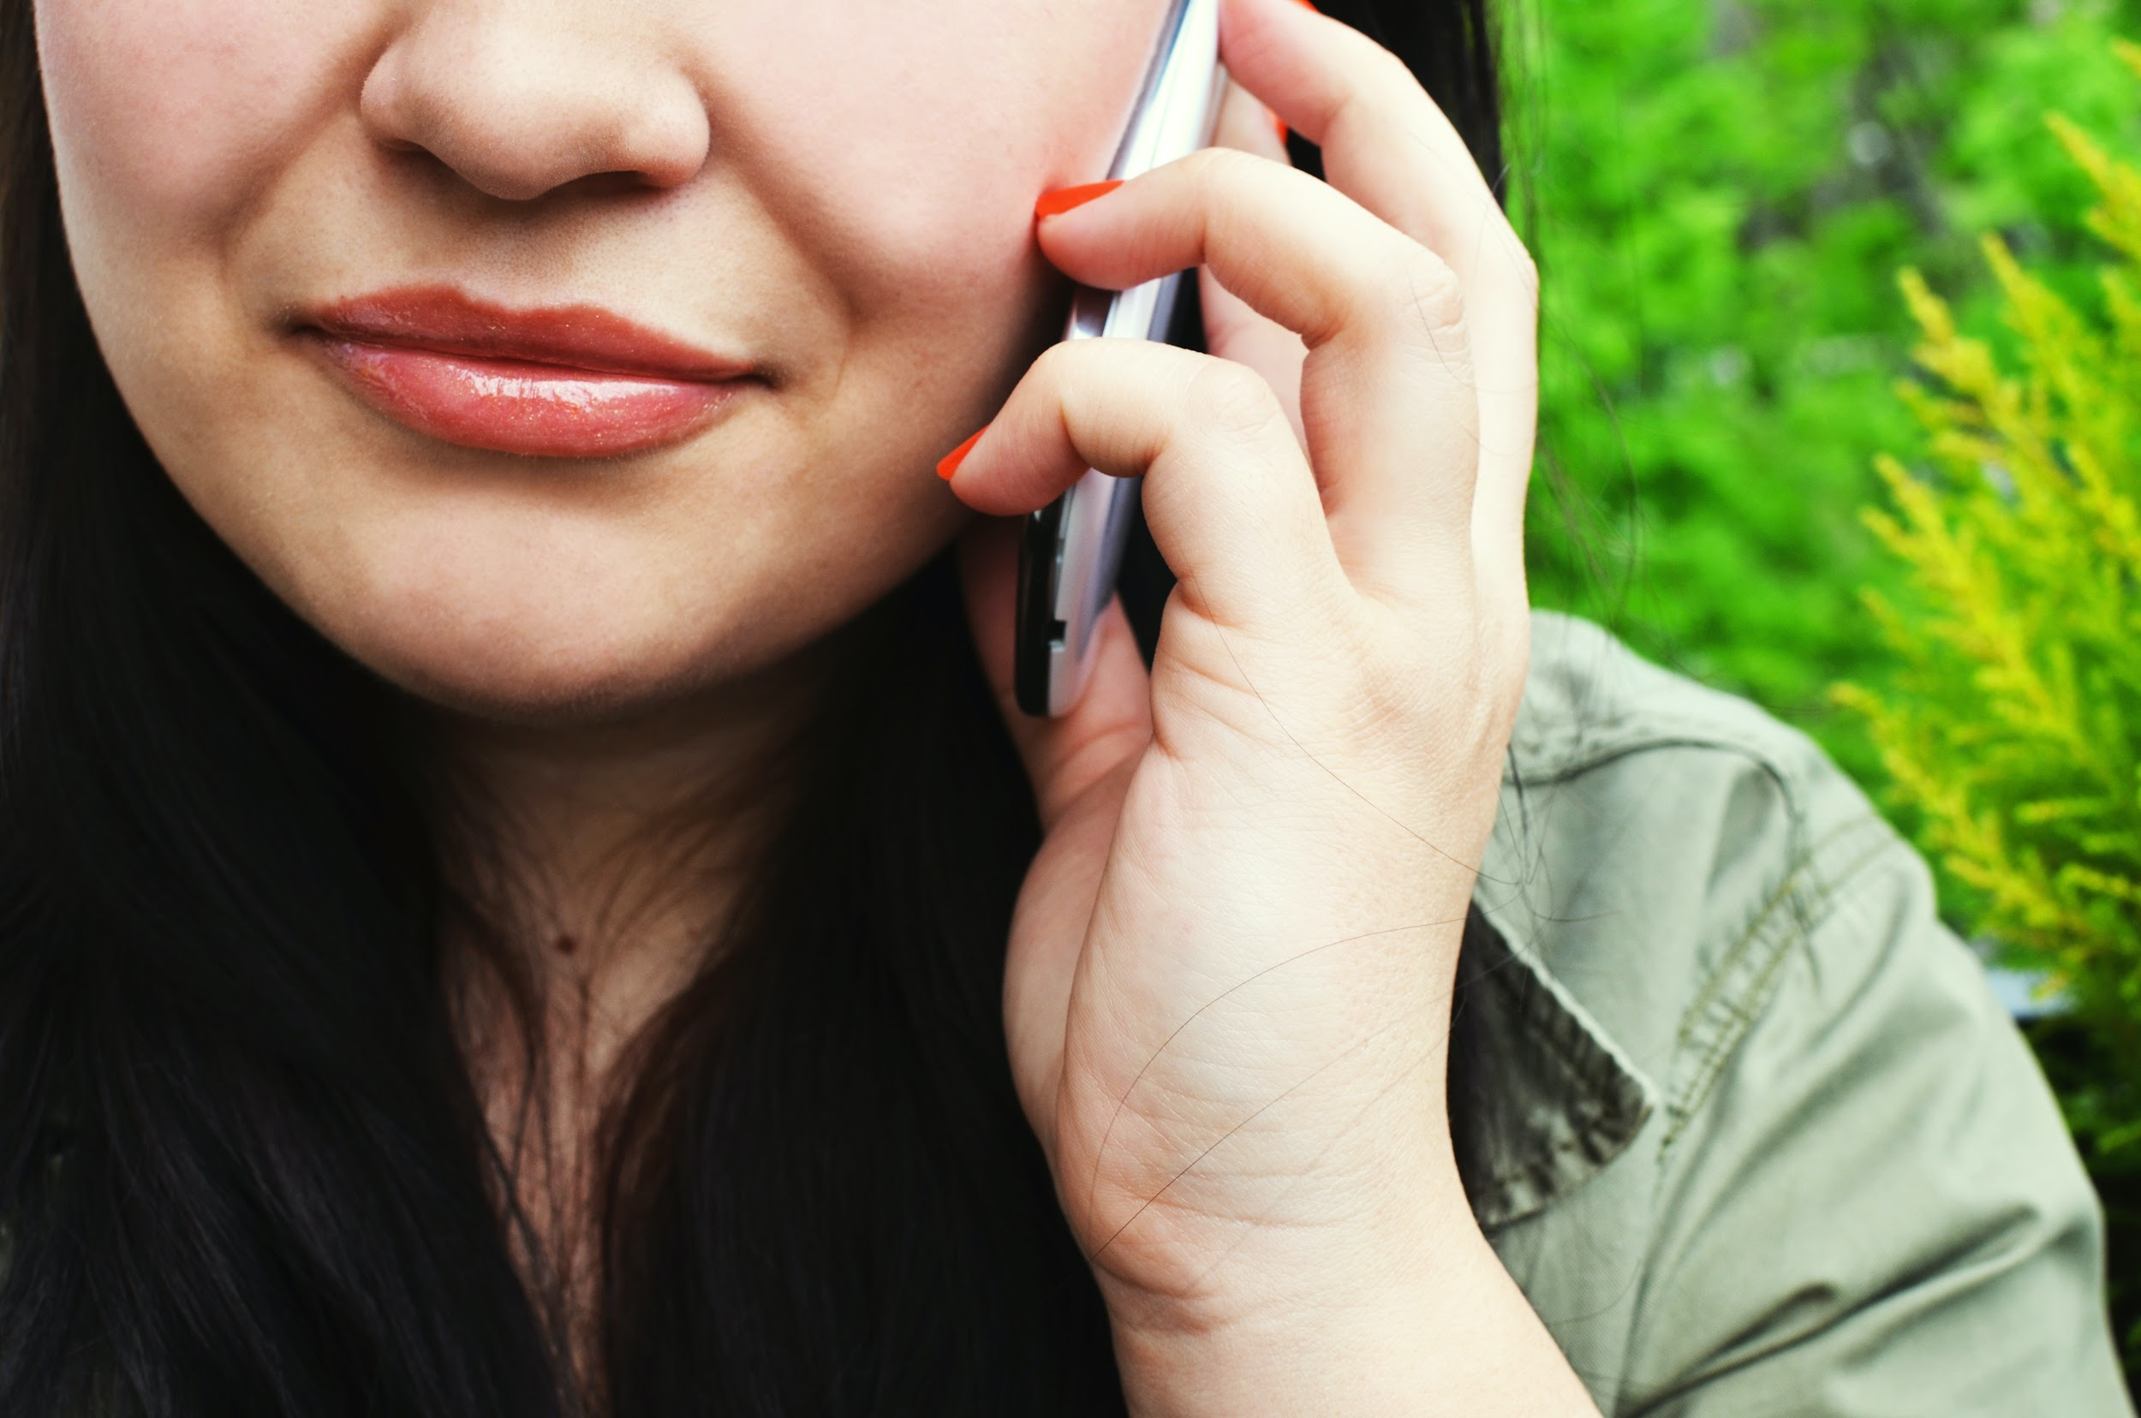
Calling
to Inquire
Staff: “24 Hour Fitness - this is Katie.”
Student: “Hi, I’m looking to take some fitness classes this week.”
Katie: “What kind of classes are you interested in?
Student: “Maybe yoga or dancing.”
Katie: “Sure, we have yoga every Tuesday, Thursday and Saturday and Zumba every Friday, Saturday and Sunday.”
Student: “How much would it be to try a class?”
Katie: “You can try three classes with our free week pass. If you can come down to the gym we can help you out.”

Slide 7
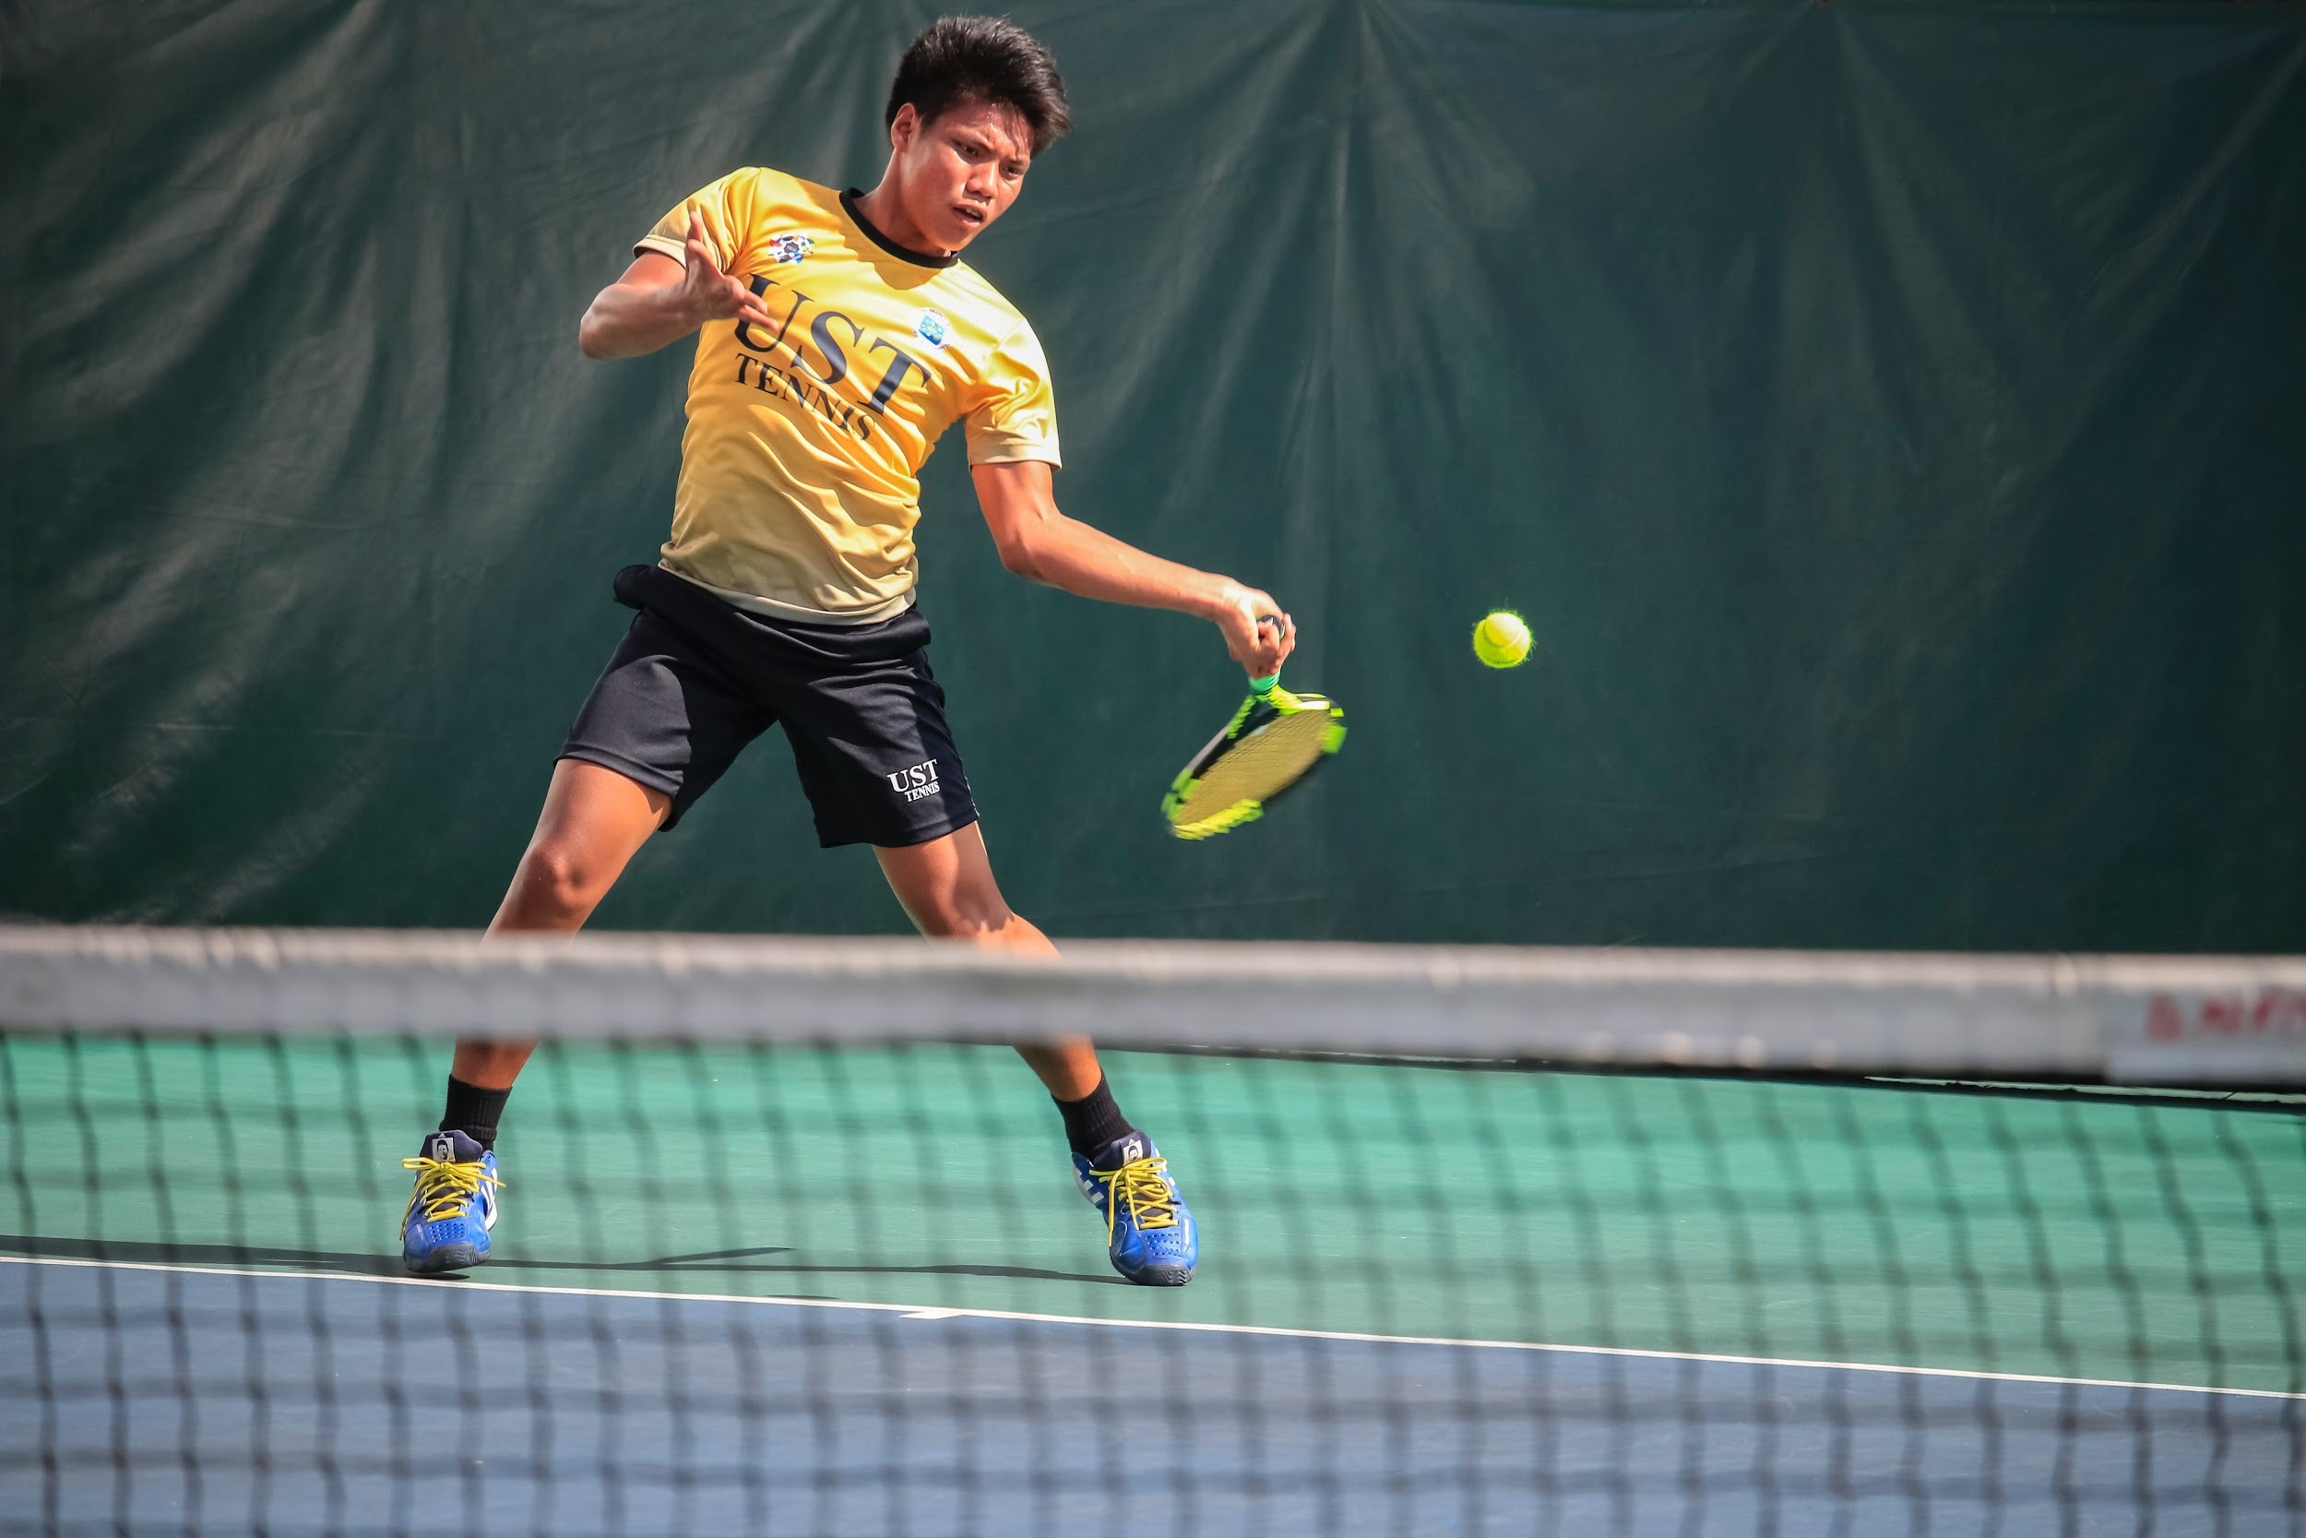
Further Practice
Which scenario would you like to try?
Sports team
Book club
Cultural exchange group
Group of people to go out to eat with from your host family or residence

Slide 8
Wrap-Up
How would you recommend meeting people in your country?
How are friends in Canada portrayed in TV shows and movies?
What are benefits of making local friends? What are the benefits of making international friends?
Next Class: Weekend Trips from Vancouver

